Slide 1
The Color Purple
By Alice Walker

Slide 2
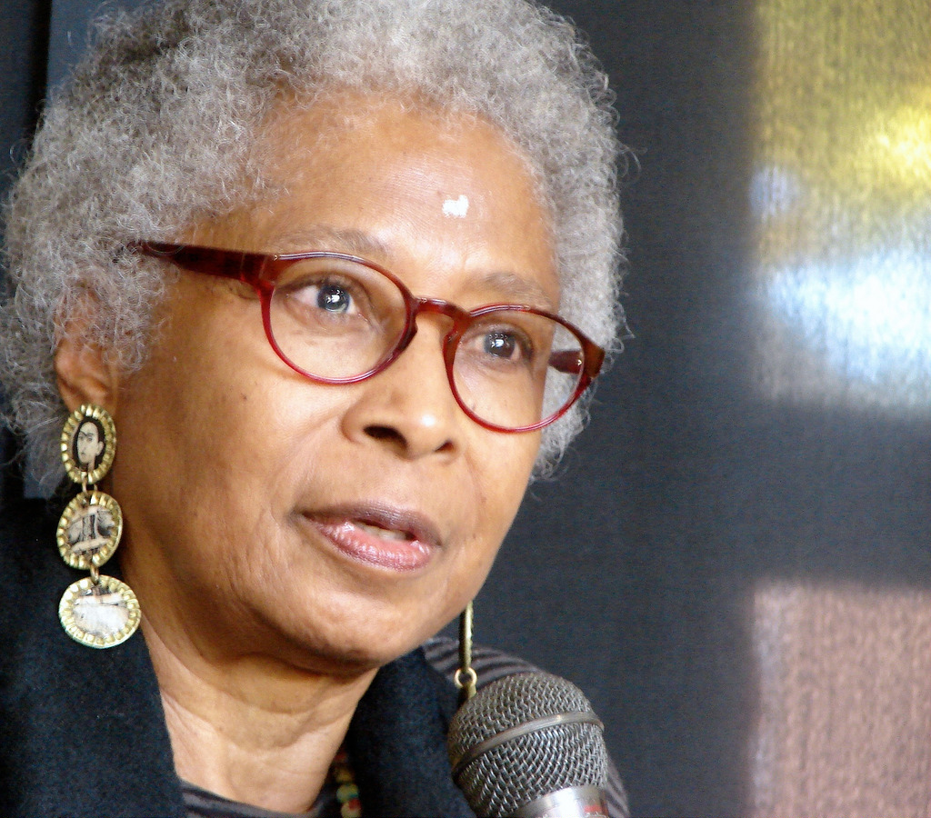
Alice Walker (1944- )
Born in Eatonton, Georgia
Writes fiction, poetry, and essays
Grew up poor, the daughter of sharecroppers
When she was 8 years old, she was shot in the eye by her brother. The injury caused her to withdraw and focus on reading and writing.
Became active in the Civil Rights Movement after college
Notes:
http://www.biography.com/people/alice-walker-9521939/videos/alice-walker-the-mysterious-wonder-of-life-11988547513 (2:16)
http://www.biography.com/people/alice-walker-9521939/videos/alice-walker-pursuing-civil-rights-11994179953 (1:44)

Slide 3
The Color Purple
Alice Walker on The Color Purple
Published in 1982
Takes place in the 1930s in rural Georgia
Won a Pulitzer Prize (first African American woman to win a Pulitzer Prize for fiction)
“Tells the story of a young, poor African-American woman named Celie and her struggle for empowerment in a world marked by sexism, racism and patriarchy.”
Alice Walker on the 30th Anniversary of the Book
Notes:
http://alicewalkersgarden.com/books/book-the-color-purple/ (2:59)
http://www.democracynow.org/2012/9/28/alice_walker_on_30th_anniv_of
“It is happening on your block” (16:30-24:46)

Slide 4
Womanism: “Womanist is to feminist as purple is to lavender.”
Walker developed the concept of Womanism in her collection of essays In Search of our Mothers’ Gardens: Womanist Prose (1983).
Womanism is a poetic synonym for black feminism
"I don't choose womanism because it is 'better' than feminism...Since womanism means black feminism, this would be a non-sensical distinction. I choose it because I prefer the sound, the feel, the fit of it; because I cherish the spirit of the women (like Sojourner) the word calls to mind, and because I share the old ethnic-American habit of offering society a new word when the old word it is using fails to describe behavior and change that only a new word can help it more fully see” (Walker).
“Womanism brings a racialized and often class-located experience to the gendered experience suggested by feminism. It also reflects a link with history that includes African cultural heritage, enslavement, women's culture, and a kinship with other women, especially women of color” (Steinem).
Notes:
Quotes from http://www.feminist.com/askamy/feminism/fem17.html

Slide 5
Epistolary Form
A novel comprised primarily of letters sent and received by its principle characters. This type of novel was particularly popular during the eighteenth century.
Why do you think Walker chose to write The Color Purple using letters?
Notes:
From https://owl.english.purdue.edu/owl/resource/575/1/

Slide 6
Some Themes…
Domestic Violence and Sexual Abuse
Voice
Racism and Sexism
Female Friendships (both sexual and platonic)
Find a passage in the book that deals with each of these themes. What happens? What is the message Walker conveys?

