Slide 1
Chimamanda Ngozi Adichie
1977-

Slide 2
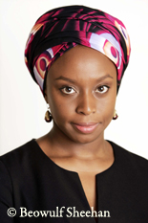
“I didn't ever consciously decide to pursue writing. I've been writing since I was old enough to spell, and just sitting down and writing made me feel incredibly fulfilled“ (Anya 2003).
Born in Nigeria in 1977
Moved to the United States at 19 years old
Scholarship at Drexel University in Philadelphia
Degree in communication and political science at Eastern Connecticut State University
Master's degree in creative writing at Johns Hopkins University
Fellowship at Princeton University
Master’s degree in African Studies from Yale University
Fellowship at the Radcliffe Institute for Advanced Study, Harvard University

Slide 3
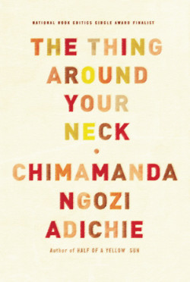
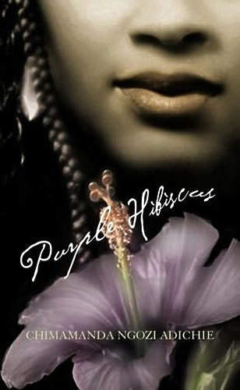
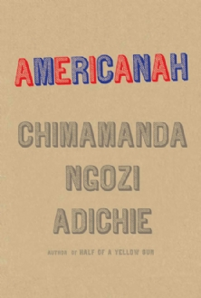
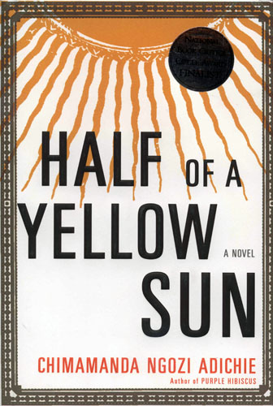
Her Work…
Poetry, plays, essays, short stories, and novels
Purple Hibiscus (novel, 2003)
Half of a Yellow Sun (novel, 2006)
The Thing around Your Neck (short stories, 2009)
Americanah (novel, 2013)
SO many awards!
Notes:
http://www.cerep.ulg.ac.be/adichie/cnaawards.html

Slide 4
Critics tend to categorize you as either a Nigerian author, a feminist or even an African-American writer. Do you feel that such generalizations might be reductive or do you see categorization as something positive in the sense that your being the “new voice of Nigerian literature”, for example, might inspire younger Nigerian writers to follow in your footsteps?
Generalizations are always reductive, I think, because they shrink you from a whole to a mere part. I am Nigerian, feminist, Black, Igbo, and more, but when I am categorized as one, it makes it almost impossible to be seen as all of the others, and I find this limiting.
I used to insist that I was simply a writer, that I rejected tags before ‘writer,’ especially tags based on race like ‘black’ or ‘African,’ because they are not value-free. They come with baggage. For example, a black writer who wrote about Africa would be placed on the ‘ethnic’ shelf in many bookstores in the US and UK, ‘ethnic’ in this sense subtly suggests not being quite on a par with ‘mainstream’ writing. A white writer, such as the Polish Ryszard Kapuscinski would not be on that ‘ethnic’ shelf. He would be considered ‘mainstream’ although he would be writing on the same subject as the black writer. The point is that it would be preferable if categorizations were based on the writing rather than on the writer.
Yet, we cannot deny that there are strong linkages based on race or gender or nationality. Being part of an under-represented group brings with it a sense of ‘we-ness’ which is why I feel an odd pride when an Igbo or an African or African-American or woman or Nigerian does well. I suppose categorization can be positive in this way. My being seen as a ‘Nigerian writer’ could motivate other Nigerian writers, in a way that my just being a ‘writer’ would not.
The more I think about just being a ‘writer,’ the more I realize that it is a position that is too easy to take. It would work only in a happily homogenized fantasy world. I cannot be just a ‘writer’ all the time; there are situations in which I will simply have to accept some tag before it. We all carry different labels and they come into play in what we write and in how we are read. The sad thing is that critics and sometimes readers do not hold all labels in equal significance.
I am less resentful of categorizations. I accept, sometimes even celebrate, them but I still feel much ambivalence about them. I am also wary of the baggage that comes with them and of having somebody else be prescriptive about them.
From http://www.cerep.ulg.ac.be/adichie/cnaintro.html

Slide 5
Americanah (2013)
“Americanah might be regarded as a generic hybrid, somewhere between the love story and the socio-political novel. It subtly explores the emotional consequences of geographical separation, and it offers a deft and humorous portrayal of two countries, the United States and Nigeria, which must each negotiate the social and cultural demons that they have inherited from their vastly different histories” (Tunca).
From http://www.cerep.ulg.ac.be/adichie/cnaintro.html
Race and Racism (and their shifting meanings depending on context)
Western beauty standards
Immigration
Great Britain, United States
Class
Access to wealth, power, education

Slide 6
Nigeria’s Colonial History and Civil war
Post World War II: Break up of the European colonial empires
1960: Nigerian Independence
1967-1970: military leaders of the Igbo people attempted to create the independent Republic of Biafra. Civil War breaks out.
Ethnic groups: Hausa and Fulani in the north, Yoruba in the south-west, and Igbo in the south-east.
Muslim and Christian divisions
1884: European powers met in Berlin to divide the interior of Africa into colonial possessions of European countries
1889-1914: English move into the land of the Igbo
1914: Northern and southern Nigeria united into a single British colony
1919-1935: European colonialism in Africa intensified

Slide 7
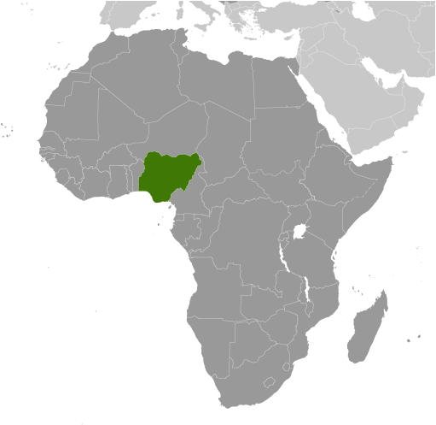
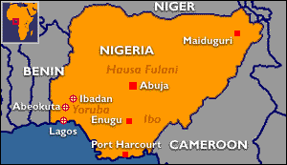

Slide 8
Post-Colonialism
A type of literary criticism/theory
“Looks at issues of power, economics, politics, religion, and culture and how these elements work in relation to colonial hegemony (western colonizers controlling the colonized).”
“Questions the role of the western literary canon and western history as dominant forms of knowledge making.”
“The terms "first-world," "second world," "third world" and "fourth world" nations are critiqued by post-colonial critics because they reinforce the dominant positions of western cultures populating first world status.”

Slide 9
Questions a Postcolonial critic might ask about a text
How does the literary text, explicitly or allegorically, represent various aspects of colonial oppression?
What does the text reveal about the problematics of post-colonial identity, including the relationship between personal and cultural identity and such issues as double consciousness and hybridity?
What person(s) or groups does the work identify as "other" or stranger? How are such persons/groups described and treated?
What does the text reveal about the politics and/or psychology of anti-colonialist resistance?
What does the text reveal about the operations of cultural difference - the ways in which race, religion, class, gender, sexual orientation, cultural beliefs, and customs combine to form individual identity - in shaping our perceptions of ourselves, others, and the world in which we live?
How does the text respond to or comment upon the characters, themes, or assumptions of a canonized (colonialist) work?
Are there meaningful similarities among the literatures of different post-colonial populations?
How does a literary text in the Western canon reinforce or undermine colonialist ideology through its representation of colonialization and/or its inappropriate silence about colonized peoples? (Tyson 378-379)
From https://owl.english.purdue.edu/owl/resource/722/10/

Slide 10
Find a partner
Even though colonial rule is over when Americanah takes place, how does Nigeria’s colonial history continue to influence the situations/limitations/worldviews/experiences of the characters in the novel?
Answer this question with a clear, arguable statement.
Find at least two specific quotes/passages from the novel to support your statement.

