Slide 1
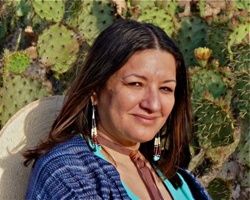
Sandra Cisneros
1954-

Slide 2
http://www.makers.com/sandra-cisneros
Born in Chicago, 1954
Grew up in ghetto neighborhoods in Chicago
Began writing poetry when she was 10 years old
Became a writer because she was “determined to fill a literary void . . . Trying to write the stories that haven’t been written”
The House on Mango Street won the 1985 Before Columbus Foundation’s American Book Award
Cisneros’ “emotionally rich subject is the Latino community, specifically the experience of growing up female in a male-dominated society; her work . . . might be as readily classified as prose poetry as prose fiction” (Joyce Carol Oates)

Slide 3
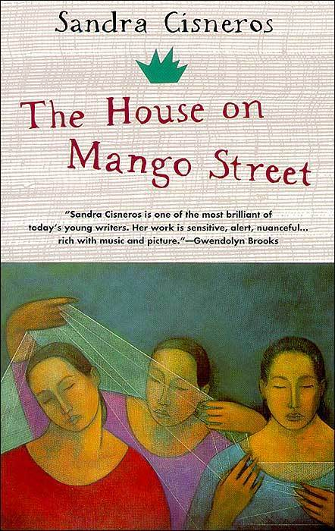
The House on Mango Street (1984)
A novel about a young girl growing up in the Latino section of Chicago
Told in a series of vignettes (short scenes or incidents)

Slide 4
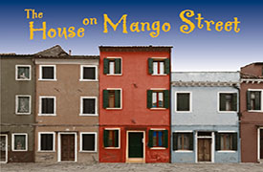
Prose Poetry
When the text appears to be prose but reads like poetry
While it lacks the line breaks associated with poetry, the prose poem maintains a poetic quality, often utilizing techniques common to poetry, such as fragmentation, compression, repetition, and rhyme.
“Only a house quiet as snow, a space for myself to go, clear as paper before the poem” (108).

Slide 5
Bildungsroman
A novel that recounts the development of an individual from childhood to maturity, to the point at which the protagonist recognizes her/his place in the world

Slide 6
The American Dream
“James Truslow Adams, in his book The Epic of America, which was written in 1931, stated that the American dream is ‘that dream of a land in which life should be better and richer and fuller for everyone, with opportunity for each according to ability or achievement.’”
“Some say, that the American Dream has become the pursuit of material prosperity - that people work more hours to get bigger cars, fancier homes, the fruits of prosperity for their families - but have less time to enjoy their prosperity. Others say that the American Dream is beyond the grasp of the working poor who must work two jobs to insure their family’s survival. Yet others look toward a new American Dream with less focus on financial gain and more emphasis on living a simple, fulfilling life.”
Excerpts from “What is the American Dream?” Library of Congress

Slide 7
Elements of Fiction
Plot
Character
Setting
Point of View
Style and Voice
Symbolism
Theme(s)

