Slide 1
Dorothy Allison
“Let me tell you a story”
1949-

Slide 2
Performance & Purpose
http://www.youtube.com/watch?v=vVDjWtyIiDs

Slide 3
Grew up in Greenville, South Carolina
Southern storyteller, writer
Bastard Out of Carolina (1992)
Part of the early feminist and LGBT movements (1970s and 80s)
Lives in Northern California with her partner and son

Slide 4
Two or Three Things I Know For Sure
Memoir
Originally a performance piece
Storytelling as a form of survival and way to understand difficult experiences

Slide 5
Truth?
Challenges our understanding of “truth”
“I'm a storyteller. I'll work to make you believe me. Throw in some real stuff, change a few details, add the certainty of outrage. I know the use of fiction in a world of hard truth, the way fiction can be a harder piece of truth” (3).
“I can tell you anything. All you have to believe is the truth” (94)

Slide 6
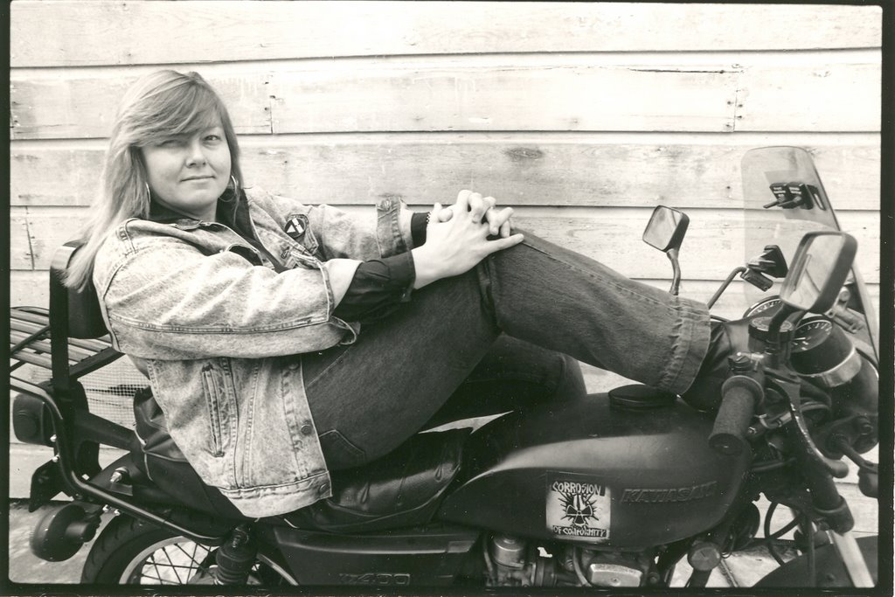
Intersections of Identity
Poor, white, rural southern family
Lesbian
Feminist
Survivor
Writer

Slide 7
Memoir
Narratives that “explore both what writers can remember and understand from their lives and also take readers with them on journeys into unknown territories where writers use the form to try to understand and make sense of unexamined experiences they have yet to comprehend fully” (2)
from New Directions in Teaching Memoir by Kirby and Kirby (2007)

Slide 8
Memoir, continued
Unlike autobiography, memoir is not the whole story of a life because memory is generally unreliable
Authors carefully choose details and shape them into a story
Unreliable narrator
“Memoir is unique as a genre because the writer must try to find the relationships between mind pictures and feelings, seeking to reconcile through story the details of what is remembered and what has been forgotten” (4).

Slide 9
Types of Memoir
Cross-Cultural
Writers use their unique cultural experiences to craft diverse accounts of their growing-up years in locations around the world
Personal Journeys
Writers chronicle personal journeys (both literal and metaphoric)
Multiple Memoirs
Single authors may write several memoirs of their life, looking at the events through different lenses

Slide 10
Types of Memoir, cont.
Blurred Genre
Writers blur the lines of genre distinction by including characteristic features of other genres in the memoir
Collections
Shorter life stories gathered together as a themed book

Slide 11
Trauma Memoir
Trauma:
Difficult to understand and remember
Impossible to explain
Necessary to try to explain it
A genre that came into existence in the 1990s
Often, “centres the life on what has been forgotten and only belatedly recovered” (Luckhurst 118)
Circles around a traumatic, shattering event

Slide 12
Two or Three Things as Trauma Memoir
Central traumatic event: abuse, rape, class limitations
About the difficulty of memory
Importance of telling the stories anyway
“Two or three things I know for sure, and one of them is what it means to have no loved version of your life but the one you make” (3).

Slide 13
Two or Three Things as Trauma Memoir
Silence versus speaking
“The tragedy of the men in my family was silence, a silence veiled by boasting and jokes. If you didn't look close you might miss the sharp glint of pain in their eyes, the restless angry way they gave themselves up to fate" (28).
"My mama never told me stories. She might repeat something someone had said at work that day, or something she had said. . . . But behind her blunt account of the day's conversation was a mystery: the rest of her life" (24).
“Two or three things I know, two or three things I know for sure, and one of them is that to go on living I have to tell stories, that stories are the one sure way I know to touch the heart and change the world” (72)

Slide 14
Post Traumatic Stress Disorder
Diagnostic and Statistical Manual of Mental Disorders (DSM-IV) describes PTSD as “the development of characteristic symptoms following exposure to an extreme traumatic stressor involving direct personal experience of an event that involves actual or threatened death or serious injury, or other threat to one's physical integrity; or witnessing an event that involves death, injury, or a threat to the physical integrity of another person; or learning about unexpected or violent death, serious harm, or threat of death or injury experienced by a family member or other close associate”

Slide 15
PTSD Characteristics
Intrusion: persistent reexperiencing of the traumatic event
Numbing/Avoidance: persistent avoidance of stimuli associated with the trauma and numbing of general responsiveness
Hyper-vigilance: persistent symptoms of increased arousal, nervousness, or sensitivity

Slide 16
Two or Three Things as Trauma Memoir
Does Allison and/or the text exhibit any PTSD symptoms?
Intrusion
Numbing/Avoidance
Hyper-Vigilance

