Slide 1
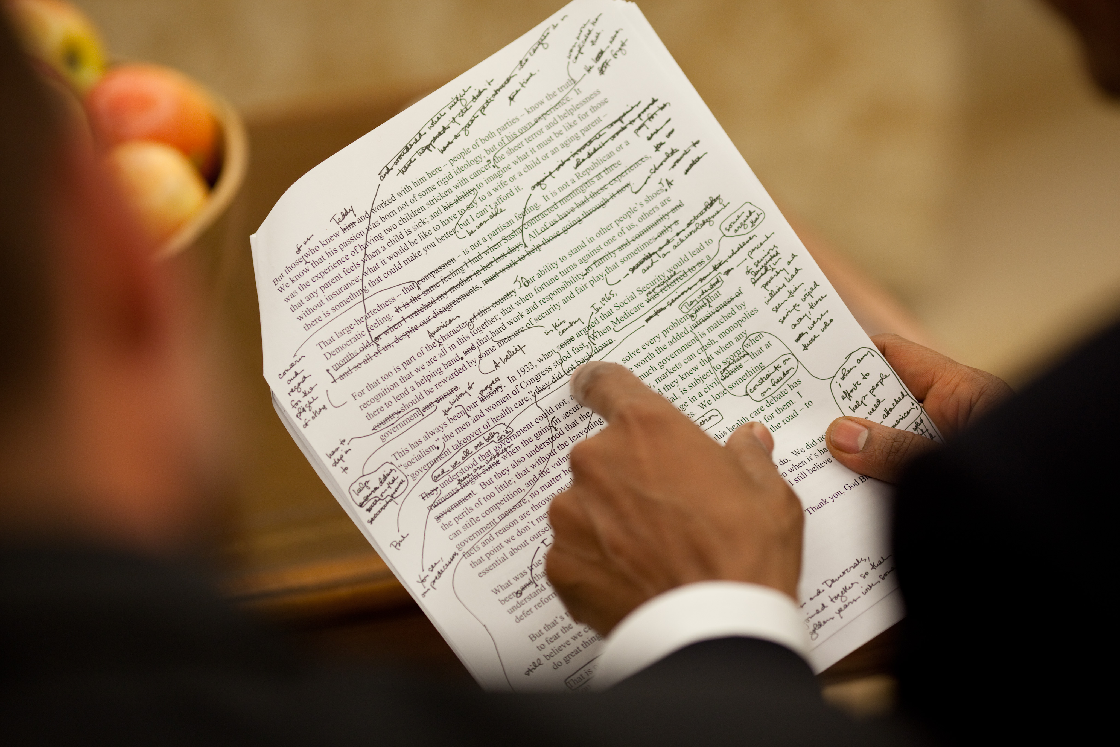
Reading for Meaning

Slide 2
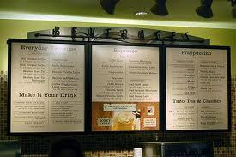
What do you read every day?
We get used to skimming the surface quickly for practical meaning

Slide 3
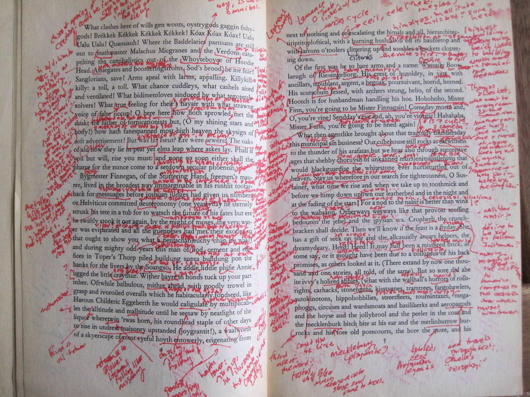
Academic Reading
We have to break our quick reading habits.
It requires effort and thought.
And it takes more time.

Slide 4
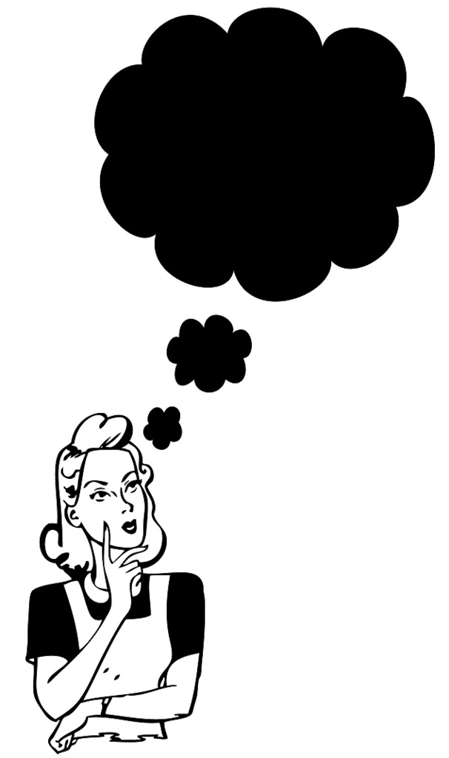
Step 1
Consider the title:
It should suggest a particular topic to you
Think about what you already know/feel about the topic
Think about what else you need to know in order to have an informed opinion about it
What do you think the author’s opinion is about this topic based on the wording of the title?

Slide 5
Step 2
Scan the entire passage with a pen in your hand (or find a way to annotate your digital text):
Circle any words you don’t understand
Star important things
Heart/check things you liked or didn’t like
Look up words
Reflect on what it is about

Slide 6
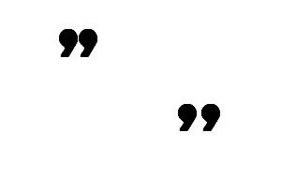
Step 3
Read it again:
Underline the main points
Mark phrases and sentences you might want to quote
Look up sentences and phrases you don’t understand

Slide 7
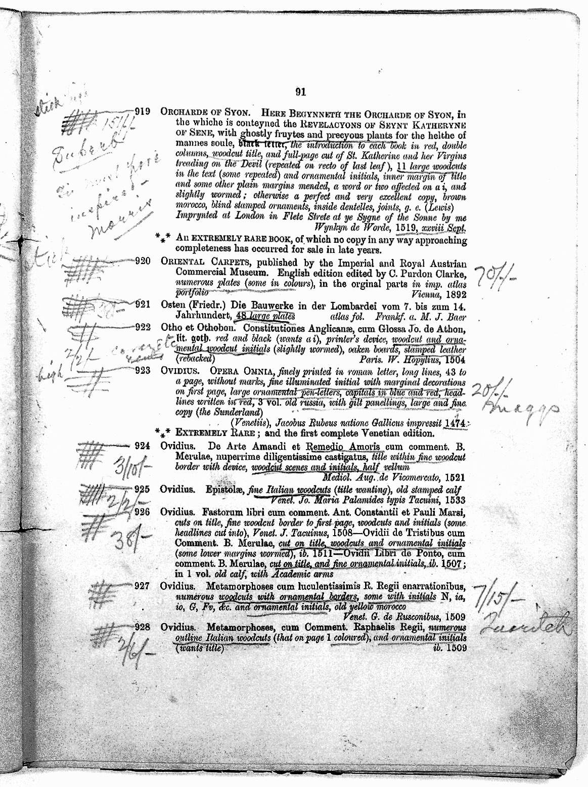
Step 4
Interpret and Respond:
In the margin on the one side of the essay, write the main idea of each paragraph
In the margin on the other side of the essay, write your thoughts, comments, questions, and connections

Slide 8
Step 5
At the top of the page:
Write down the author’s thesis (the biggest central idea or argument of the passage)
Write out 2-3 main points that the author uses to support that thesis

Slide 9
Step 6
Read it again!
Now that you have thought through the ideas and evidence presented, read the whole thing again to make sure it all makes sense

