Slide 1
Narrative Analysis
Using stories to understand and change our world

Slide 2
Tell a Story…
Are there myths, stories, fables, or tall tales that you were told as a child? Choose one and write down the story.
Find a partner and briefly tell your stories to each other
Discuss the following questions:
Where did it come from (family stories, religious texts, elders, movies, books, etc.)?
Are there lessons you draw from this story?
How does it impact your life today?

Slide 3
Dominant Culture
“As certain ideas, practices, and worldviews become normalized over time, they form a dominant culture that disproportionately represents powerful institutional interests and perpetuates the stories that validate their political agendas. These stories can become invisible as they are passed from generation to generation—carrying assumptions that become ‘conventional wisdom.’” (20)

Slide 4
Narrative Power Analysis
“A narrative power analysis recognizes that humans understand the world and our role in it through stories, and thus all power relations have a narrative dimension. Likewise, many stories are imbued with power. This could be the power to explain and justify the status quo or the power to make change imaginable and urgent.” (20)

Slide 5
Changing the Story
What is the story you would like to change? What are the beliefs and assumptions that people have that cause your problem to happen?
What are the story’s vulnerabilities? Limits? Contradictions? Lies? How can underlying assumptions or values be exposed?
Who is impacted by this problem? Who are the victims? Villains? Heroes?
Are there any particular images that you associate with the problem?

Slide 6
“We can't solve problems by using the same kind of thinking we used when we created them.” -Albert Einstein
Freewrite for 5 minutes about how you would like to change the problematic story you just wrote about. What assumptions would you like to change? What behaviors would you like to change? How should people think differently about this problem? What images would you use to change the way people think?

Slide 7
Point of Intervention: Assumptions
“Points of intervention are specific places in a system where an action can effectively interrupt and influence the narrative of that system and build momentum for change” (67).
“Assumptions are the unstated parts of the story that you have to believe in order to believe the story is true” (74).
“Point of assumption actions can take many forms: exposing hypocrisy or lies, reframing the issue, amplifying the voices of previously silenced characters in the story, or offering an alternative vision” (74).

Slide 8
Celebrity 10 year challenge
What assumptions are being made in the celebrity 10 year challenge?
What is the story being told?
Notes:
https://www.usatoday.com/story/news/2019/01/19/10-year-challenge-highlights-damage-climate-change-has-wrought/2618703002/

Slide 9
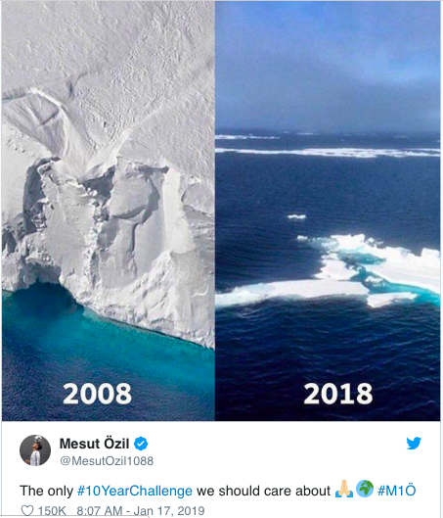
How does this meme change the story?
Does it…
Expose hypocrisy or lies?
Reframe the issue?
Amplify the voices of previously silenced characters in the story?
Offer an alternative vision?

