Slide 1
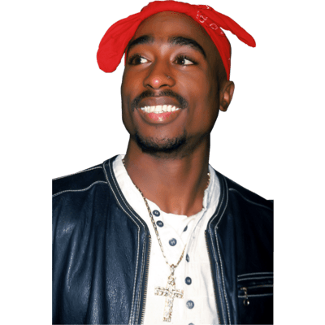
Narrative Analysis
”Tupac and my Non-Thug Life” by Jenee Desmond-Harris
Notes:
https://www.oxygen.com/snapped/blogs/what-happened-to-notorious-big-5-people-who-knew-him-speak-out-about-the-murder (1:00)

Slide 2
Narrative: Basic Features
What is the inciting incident?
Find the exposition at the beginning of the story. What do we learn about setting, characters, time period?
Look at the description of the photograph. Is it vivid?
What do you think is the climax of the story? Why?
What is the significance? What is the message Desmond-Harris is trying to communicate to readers?

Slide 3
Get out two types/colors of pens…
Color #1: Mark all of the instances in which Desmond-Harris includes direct quotes/dialogue
Color #2: Mark all of the instances in which Desmond-Harris summarizes dialogue
Find the speaker tags, mark them. Where are they located in relation to the quotation?
What does the dialogue DO? Does it tell you something about the speaker or her relationship with another person? Does it convey feelings or attitudes? Does it advance the narrative? Create a dominant impression?

Slide 4
Create some dialogue
Choose two characters from the photo who will play a role in your story
Write out a dialogue between characters that includes:
Direct quotes
Paraphrasing
Speaker tags

