Slide 1
THE ANIME QUIZ!
William Cantor
MTEC 1101
5/22/17

Slide 2
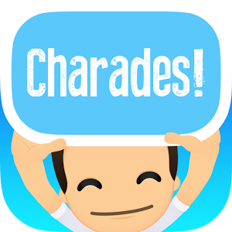
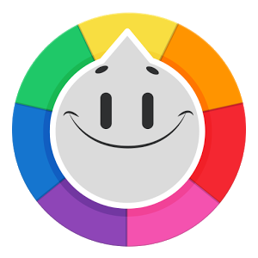
Precedents
1) Charades is a classic guessing game where players guess a word or phrase based on clues from gestures and such. *Link: http://www.charades-ideas.com
2) Guess that Anime character is a game where players look at a picture
of someone and guess who that character is. *Link: https://play.google.com/
store/apps/details?id=com.gibsonrlim.guessanimecharacter&hl=en
3) Trivia Crack is a game where you challenge your friends and other people
around the world to test your knowledge on anything. *Link: https://www.triviacrack.com/

Slide 3
Precedents
The Anime Quiz!
Anime Trivia
Trivia on different topics
Gestured based trivia
Trivia
Charades
Trivia on anime characters
Trivia Crack
Guess the Anime character

Slide 4
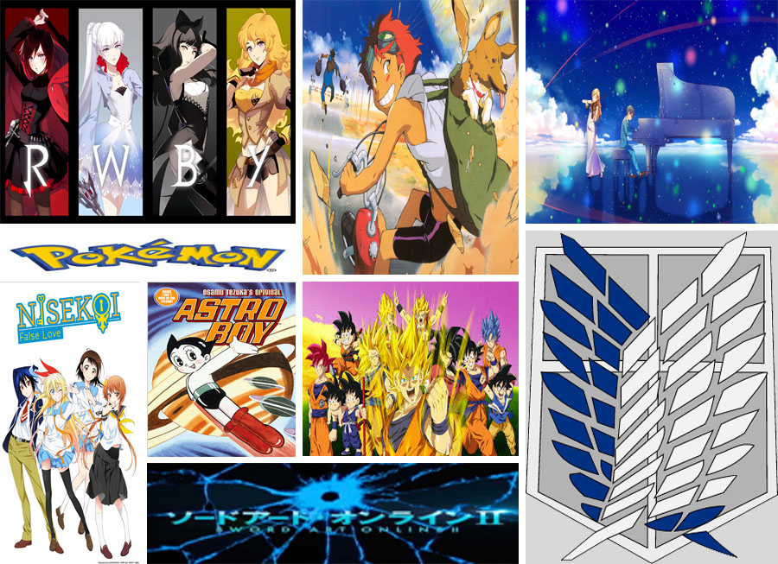
THE ANIME QUIZ!
This project is an anime based trivia game where it tests your knowledge of anime, and out of the choices listed, you try to guess which is the correct answer.

Slide 5
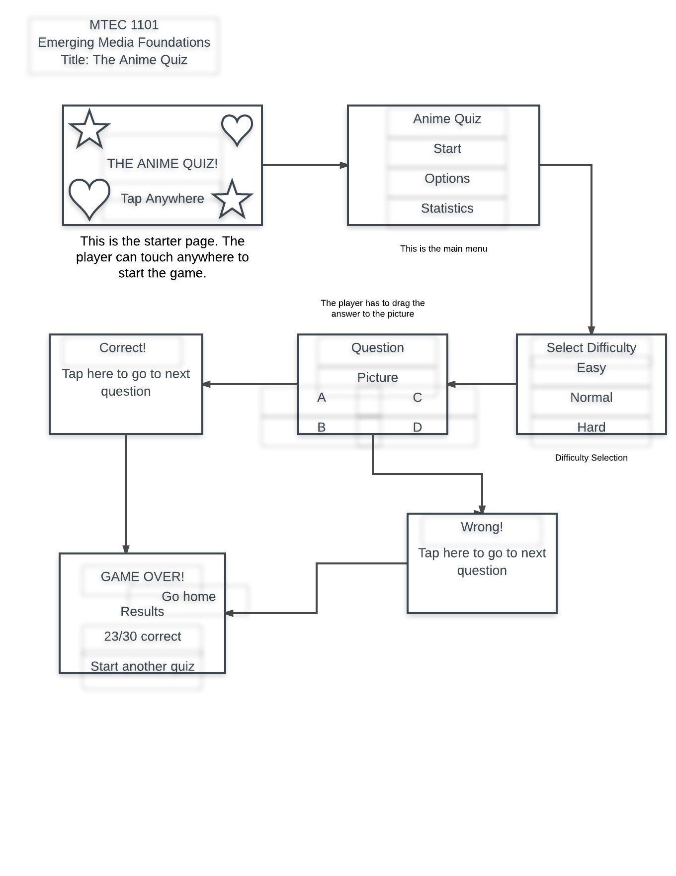

Slide 6
Project Features
All kind of anime from action to hentai
Online leaderboards to compare high scores
Multiple choice questions accompanied by opening music from different anime

Slide 7
Learning Experience
Challenges and Experience
1) Finding enough info on all anime to fit in the game
2) In doing this project, I learned more about different kinds of anime, especially really old ones,
as well as how to implement them into a game like this.
3) Doing this project has taught me the true importance of brainstorming. Learning how to
Organize my ideas and how to use them to develop this and other projects in general is my
biggest take away from this whole process.

Slide 8
Future Iterations
One change I would like to implement is to add more questions and challenges to my game.
Another change I would like to do would be to add different game modes to encourage more replayability.

