Slide 2
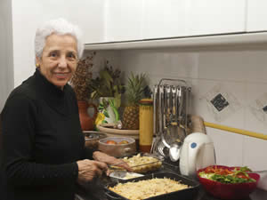
Notes:
Making the home environment safe for the elderly Modified Kitchen for the elderly Figure 4

Slide 3
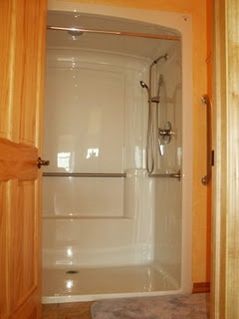
Modified Bathroom for the elderly

Slide 4
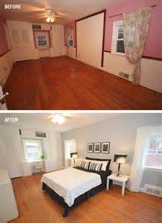
Modified bedroom and bedroom

Slide 5
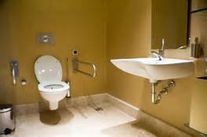
Modified Bathroom for the elderly

Slide 6
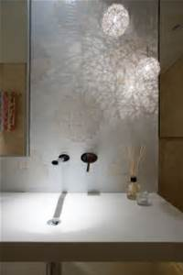
Modified Bathroom for showering

Slide 7
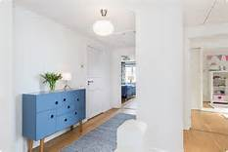
Safe Hallway with ample space

Slide 8
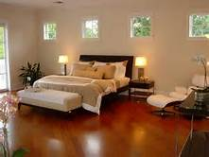
Modified bedroom for safety

Slide 9
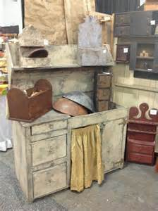
Modified kitchen Area

