Slide 1
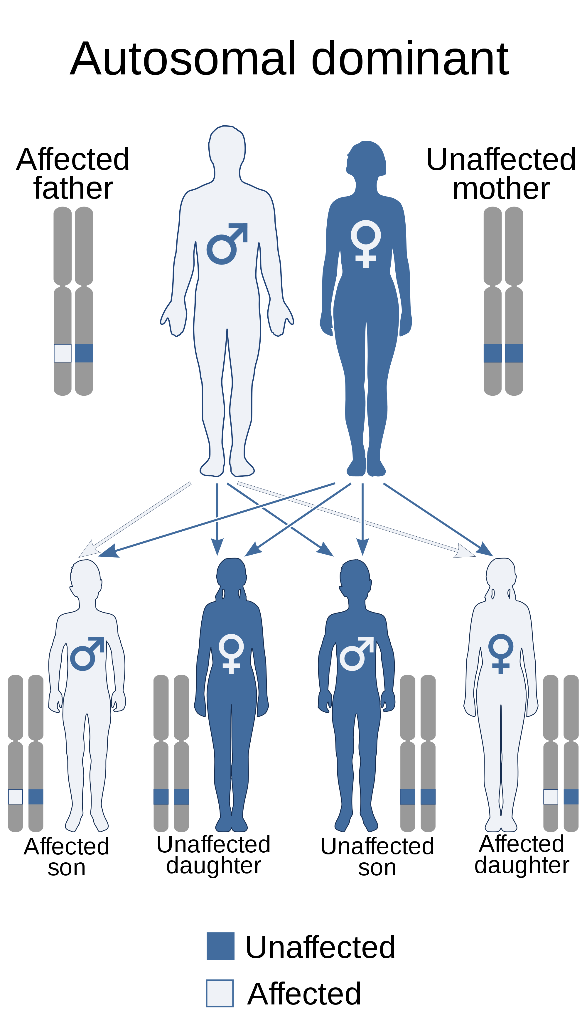
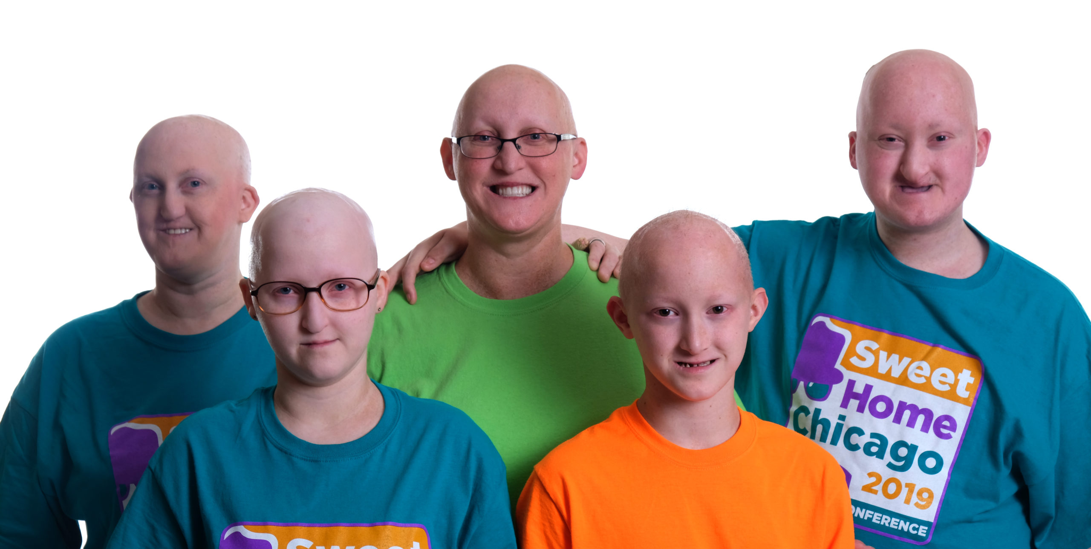
Ectodermal dysplasia
Genetic disorders
Caused by mutations in various genes

Slide 2
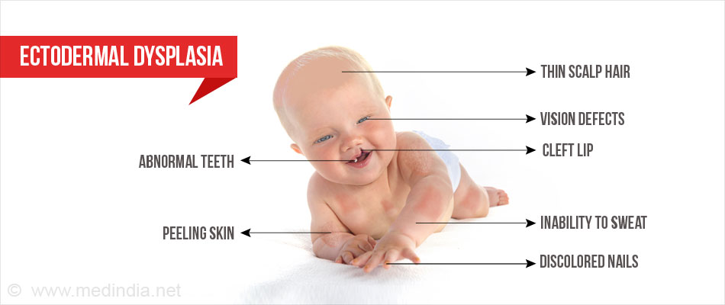
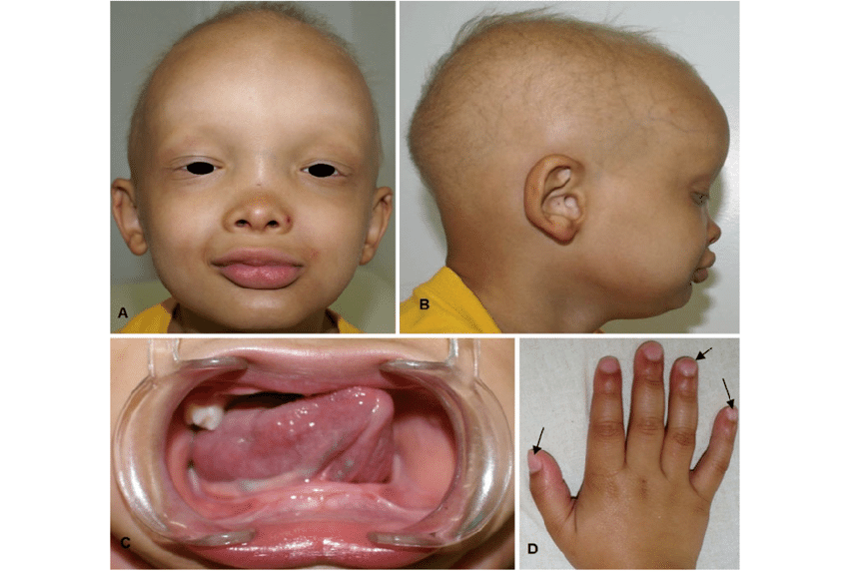
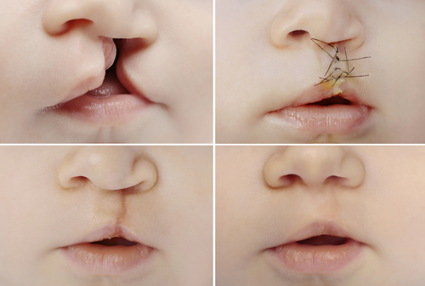
Abnormal nails.
Abnormal or missing teeth, or fewer than normal
Cleft lip.
Decreased skin color (pigment)
Large forehead.
Low nasal bridge.
Thin, sparse hair.

Slide 3
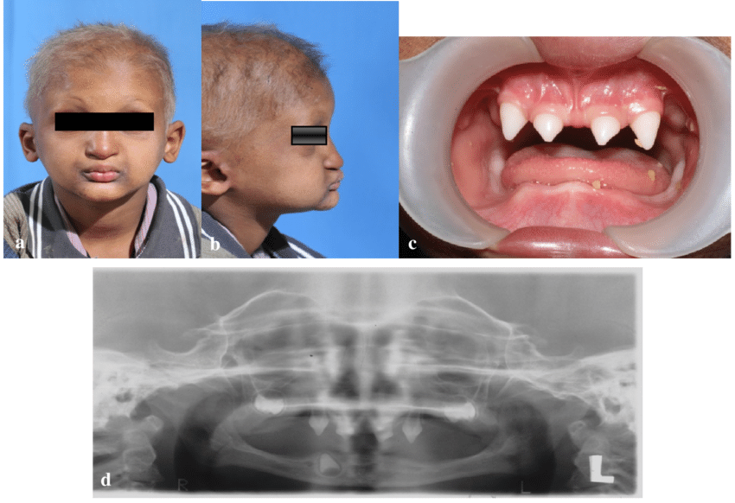

Slide 4
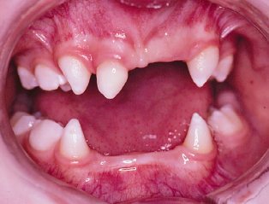
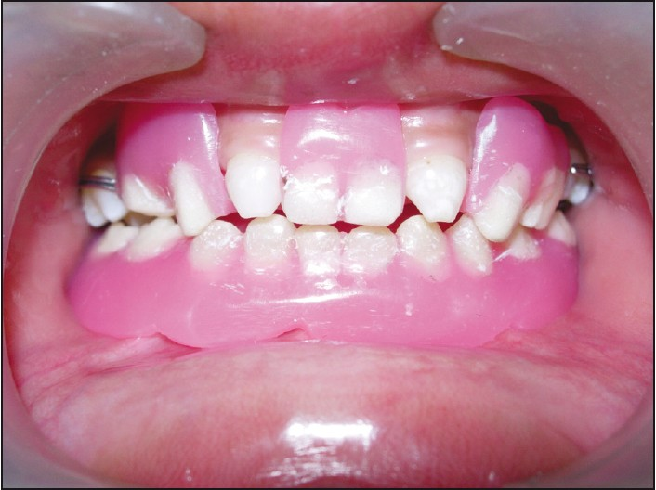
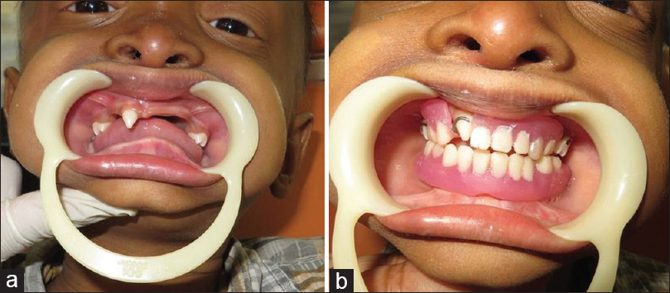
Ectodermal dysplasia
cannot be cured, but the symptoms can be treated or managed.
Treatment of ectodermal dysplasia may include special hair care formulas or wigs, removal of ear and nose concretions, and dental evaluations and treatment (restorations, dental implants, or dentures).

Slide 5
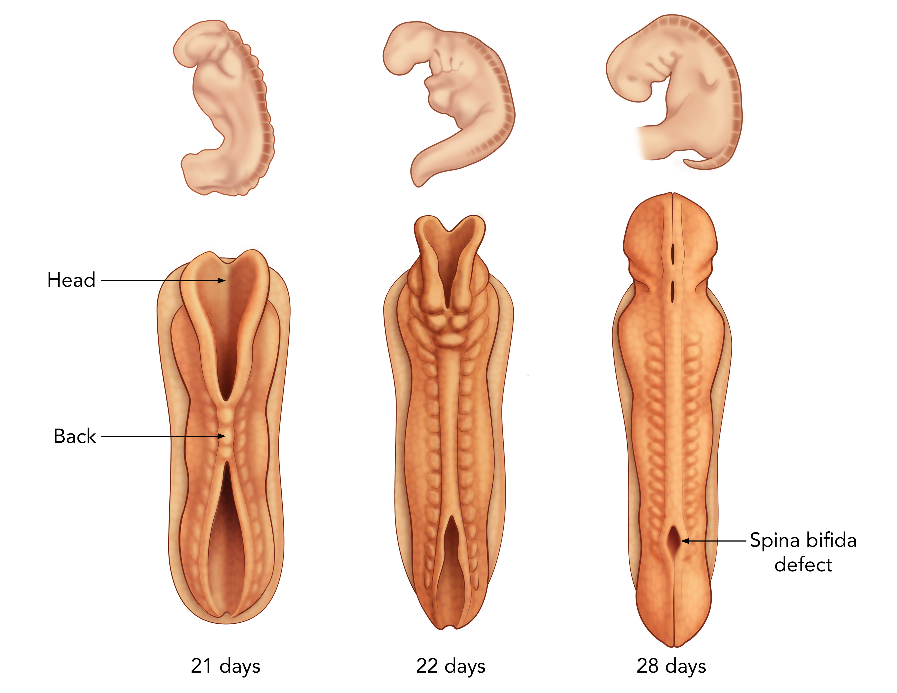
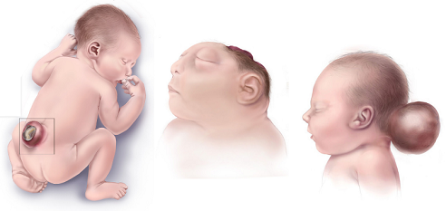
Neural tube defects
Neural tube defects are birth defects of the brain, spine, or spinal cord. They happen in the first month of pregnancy.
Spina Bifida

Slide 6
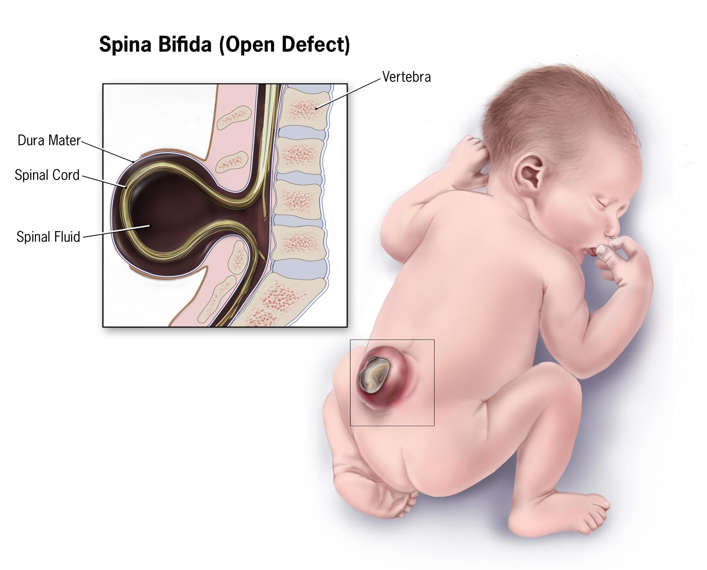
Neural tube defects - Spina Bifida
Spina Bifida- is the most common of a group of birth defects known as neural tube defects, which affect the central nervous system (brain and spinal cord). Spina bifida begins in the womb, when the tissues that fold to form the neural tube do not close or do not stay closed completely.
Caused by a combination of multiple genes and multiple environmental factors
folic acid deficiency
maternal insulin dependent diabetes,
maternal use of certain anticonvulsant medications

Slide 7
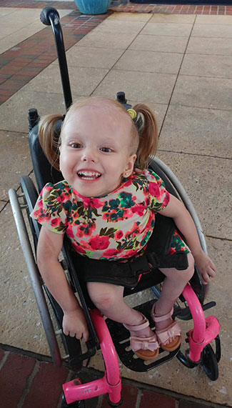
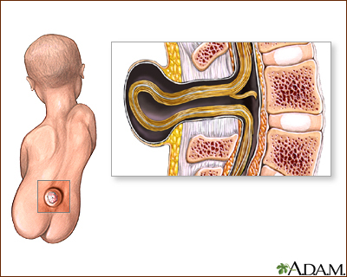
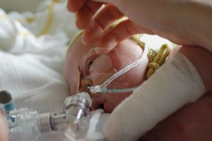
The symptoms:
weakness or paralysis in the legs.
urinary incontinence.
bowel incontinence.
a lack of sensation in the skin.
a build up of cerebrospinal fluid (CSF), leading to hydrocephalus
possibly brain damage.
Death

Slide 8
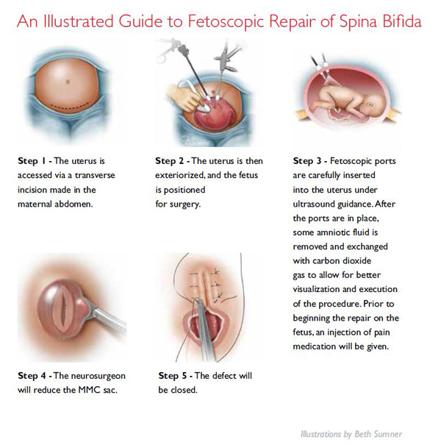
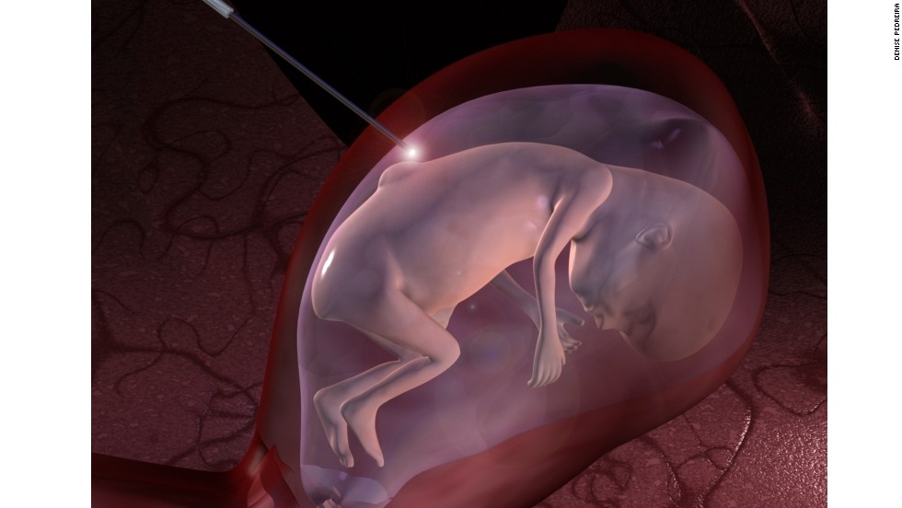
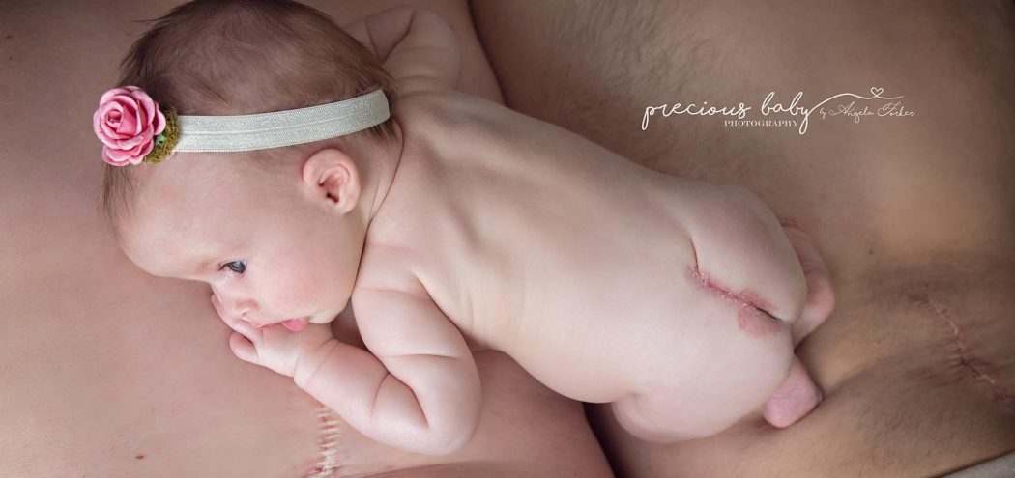
Neural tube defects are usually diagnosed before the infant is born, through lab or imaging tests.
Spina bifida surgery can be done in utero.
After recovery from surgery, babies may need long-term care to help treat any underlying conditions that result from their spina bifida. Those with paralysis may eventually need walking aids like leg braces, walkers, or a wheelchair.

Slide 9
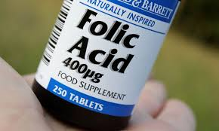
Spina bifida is best prevented by:
Getting enough Folic acid a B vitamin. It helps the body make healthy new cells, before and during pregnancy.
Risk of neural tube defects could be reduced by up to 70%.

