Slide 1
Can the Con-Ed substation in Vinegar Hill be removed, and what can replace it, and is it possible?
by Cesar Camacho, Jim, Jef, and Inkary

Slide 6
WHO/WHAT IS CON-ED?
The Con-Ed Corp operates one of the world’s largest energy delivery systems. Founded in 1823 as the New York Gas Light company, their electric, gas, and steam service now provides energy for over 10 million people who live in New York City and Westchester County.
This corporation also claims to have one of the cleanest and safest facilities in the world. They also claim to be one of the pioneers in “clean energy”.

Slide 7
Con Edison's Vinegar Hill Power Plant
Con Edison prides itself on environmental environment excellence. Con Edison believes in using renewable resources such as solar and wind power. It’s mission is to reduce carbon footprints and other harmful carbon compounds from the air. This Power Plant also provides energy to parts of Brooklyn and small portions of Manhattan

Slide 8
Con Edison’s Vinegar Hill Power Plant (con’t)
Con Edison established a strategy on dealing with this issue.
1) Integration of climate change and global warming principles.
2) Reducing greenhouse gas emissions.
3) Expanding energy efficiency programs.
4) Setting goals to reduce regional emission.
5) Advocating for legislation to reduce greenhouse gas emissions that is both proactive and balanced through economy wide integration.

Slide 9
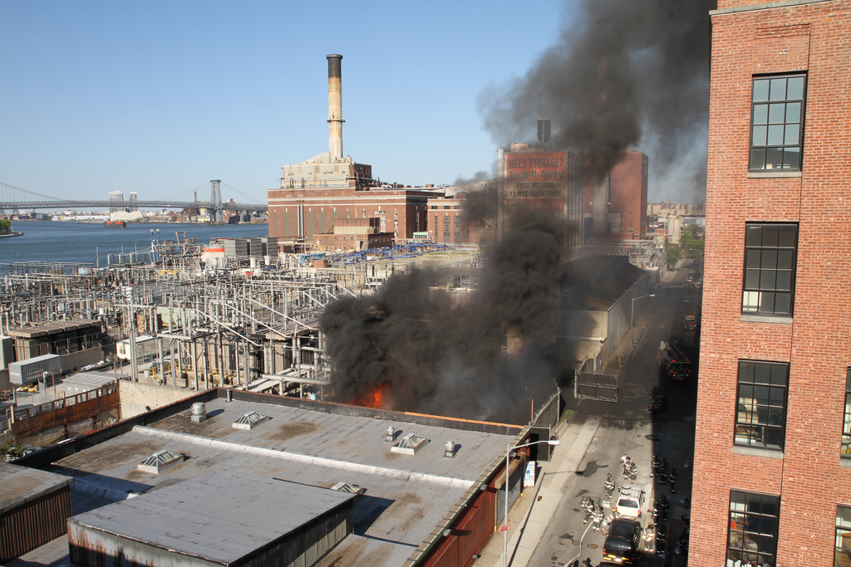
VINEGAR HILL UNDER SMOKE FROM ON OF THREE FIRES/EXPLOSIONS… Photo taken by Chris Frank 2012

Slide 10
Power Plant Fires and Leaks?
There have been 3 fires within two years in the Vinegar Hill Power Plant (2011-2013). This was due from small circuit breakers. The fire of 2012 released dangerous leaks of PCB due from leaks released from electrical transformers containing PCB, illegal or improper dumping of PCB and/or poorly maintained hazardous waste sites that contain PCB.

Slide 11
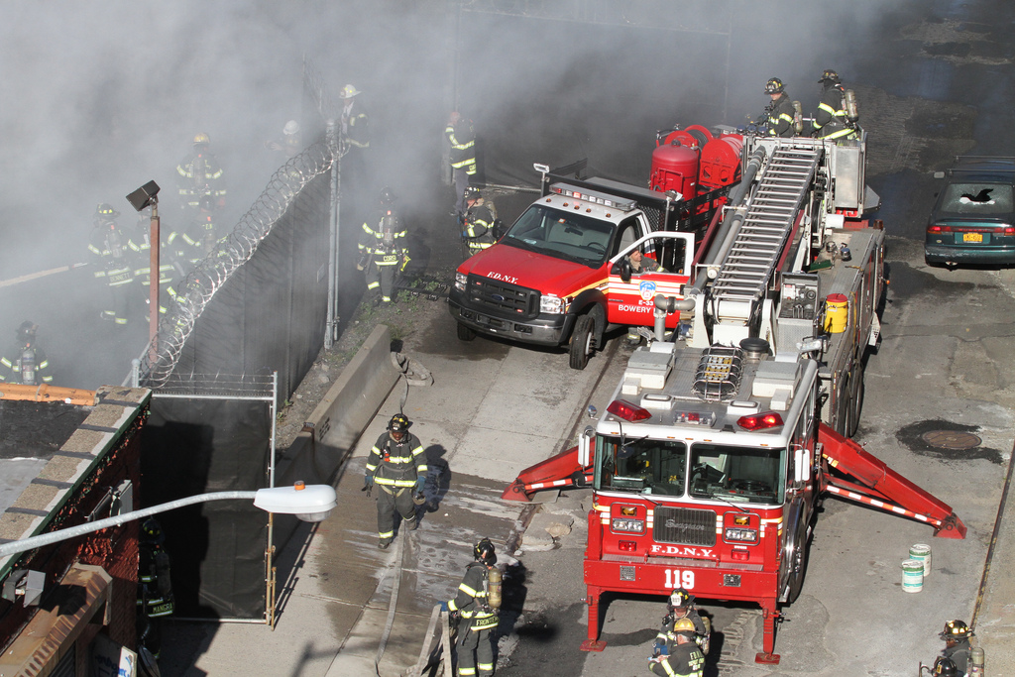

Slide 12
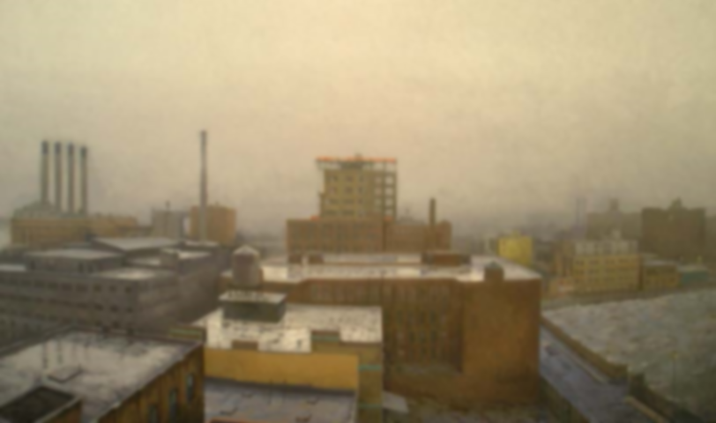
Photo taken by Nicholas Evans-Cato in 2006

Slide 13
Con Ed sub-station
The con edison sub-station, although inactive, has managed to catch on fire within three years
These Incidents have nearby residents concerned about their well being regarding the toxins released into the air
Fires have occurred and caused chaos in 2011,2012, and 2013

Slide 14
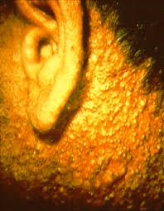

Slide 15
VHNA vs. Con Edison
After the explosion at the sub-station in 2012, a meeting was held by the Vinegar Hill Neighborhood Association and Con Edison
During this meeting, residents expressed their concerns regarding as to why the station had been catching on fire/exploding.
Also, the equipment that had caused the explosion at the time dates back to 1981
A physician from Columbia University’s Department of Environmental Health came to raise awareness of PCB poisoning and how it could be caused by what was burned at the plant.

Slide 16
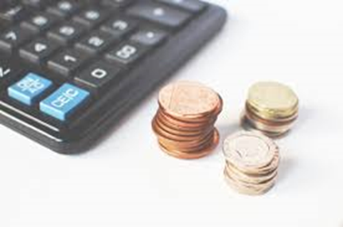
Finances Behind the vinegar Hill Substation
According to https://www.smartgrowthamerica.org/app/legacy/documents/true-costs.pdf, the typical cost to maintain a non-productive factory/substation is 49.6 million for 20 years, thus Con-Ed is paying around 2.48 million/year for the maintenance of the Vinegar Hill Substation!!!
However, this number does not include the removal costs of the four other smoke stacks and the operations required to comply to NY state issued permits and environmental concerns.

Slide 17
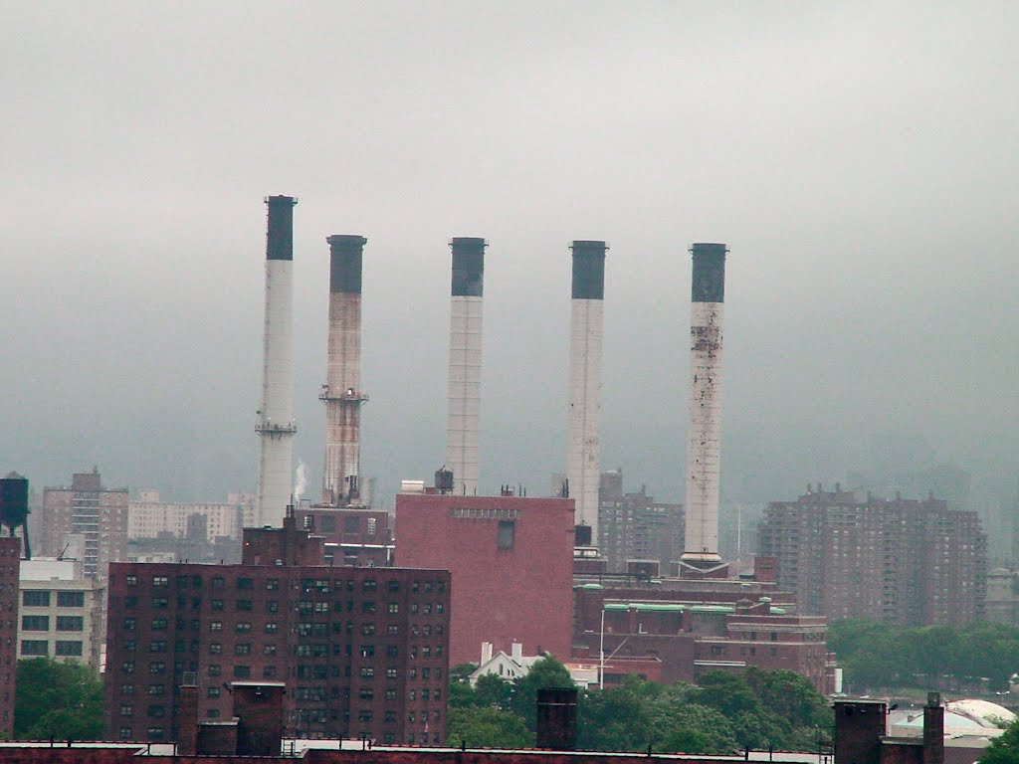

Slide 18
Hall of Science or Power Plant?
Con Edison sponsors the Hall of Science in Queens. If the Power Plant could be replace by another Hall of Science could benefit Vinegar HIll. Benefits such as, bringing more people to visit Vinegar Hill, bring profits to fix unused areas in Vinegar Hill, get rid of the Power Plant which won’t prevent guest from looking over the beautiful waterfront view and most importantly, stops the random fires happening around the community. It also won’t bring any crime if a Hall of Science was built in Vinegar Hill.

Slide 19
Possibility of a park
Con Edison has given 3.4 acres of its property to the Brooklyn Bridge Park
Con Edison has stated that they don’t plan on shutting down the sub-station anytime soon during the meeting that was held
Politicians want to turn the land con Edison owns into residential buildings while the community wants a park along the waterfront

Slide 20
Possible “Merger Institutions” for NY + Con-Ed to work on
Hall of Science Up to $10,000 (as of now)
Park
Up to $45,000
Museums
Intrepid
Westchester’s children museum
September 11th museum→ provides electricity at a discounted rate, along with monetary donation
Museum of Natural History→ provides electricity at a discounted rate, along with monetary donation

Slide 21
Benefits for Said Institutions
Estimates show that the New York metropolitan region’s life sciences industry could double in terms of jobs and economic output over the next decade if the right investments are made by the private and public sectors. The study found that for every $1.00 of National Institutes of Health (NIH) funding that Massachusetts received in federal fiscal year 2015, its life sciences industry attracted $1.32 of venture capital. In comparison, New York State’s life sciences industry secured only $0.06 of venture capital for every $1.00 of NIH grants, well below the national average of $0.48.

Slide 22
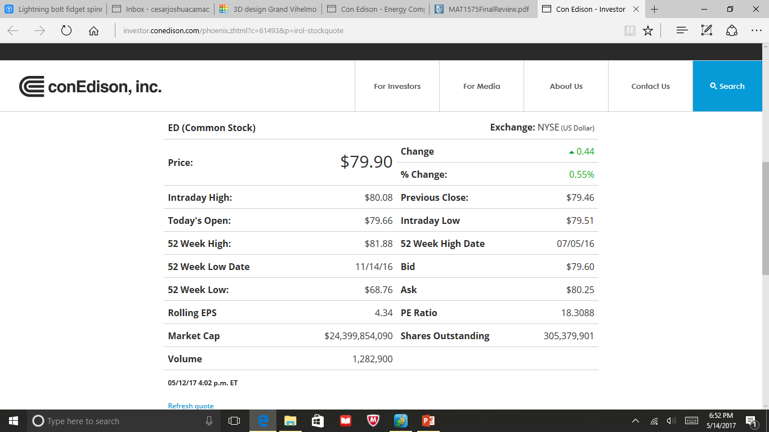

Slide 24
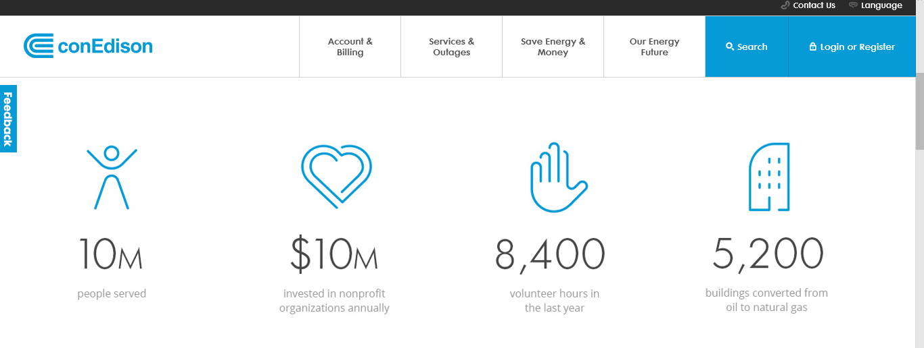
What Does Con-Ed Already Do For It’s Community?
AS OF 2017

Slide 26
SOURCES USED FOR THE FINANCIAL SECTION
http://www.scenichudson.org/aboutus/pressroom/071708
http://www.queenscouncilarts.org/funders/
https://www.smartgrowthamerica.org/app/legacy/documents/true-costs.pdf
http://nasdaqomx.mobular.net/nasdaqomx/7/3504/5003/
http://investor.conedison.com/phoenix.zhtml?c=61493&p=irol-stockquote
https://www.coned.com/en/community-affairs/partnerships/conedison-grants-volunteerism

Slide 27
SOURCES USED FOR the “Possibilities” section
"Could Vinegar Hill ConEd Plant Be Repurposed as Part of Brooklyn Bridge Park?"Dumbo NYC. N.p., 15 July 2013. Web. 13 May 2017. http://dumbonyc.com/blog/2011/08/15/could-vinegar-hill-coned-plant-be-repurposed-as-part-of-brooklyn-bridge-park/
"Vinegar Hill Neighborhood Association with Con Edison Meeting Minutes." Dumbo NYC. N.p., 31 May 2012. Web. 13 May 2017. http://dumbonyc.com/blog/2012/05/31/vinegar-hill-neighborhood-association-with-con-edison-meeting-minutes/
Upadhye, Janet. "Latest Con Ed Fire Adds to Locals' Growing Concerns About 89 John St. Plant." DNAinfo New York. N.p., 10 June 2013. Web. 17 May 2017. https://www.dnainfo.com/new-york/20130610/dumbo/latest-con-ed-fire-adds-locals-growing-concerns-about-89-john-st-plant

Slide 28
Sources for Con-Ed’s current effects on its community
http://brooklynbridgeparents.com/important-update-about-conedison-power-plant-in-vinegar-hill/
https://www.epa.gov/pcbs/learn-about-polychlorinated-biphenyls-pcbs
https://www.trulia.com/for_sale/40.717636807991,40.736272158467,-73.861413163298,-73.832316559904_xy/111th%20St_street/15_zm/#map-crime
https://www.trulia.com/NY/Brooklyn,5264,Vinegar_Hill/#map-crime

