Slide 1
Cuyana “Chic Minimalist Essentials”
Valerie Waldron
BUF 4246: Future Fashion & Textiles
Dr. Nazanin Munroe
Summer 2023

Slide 2
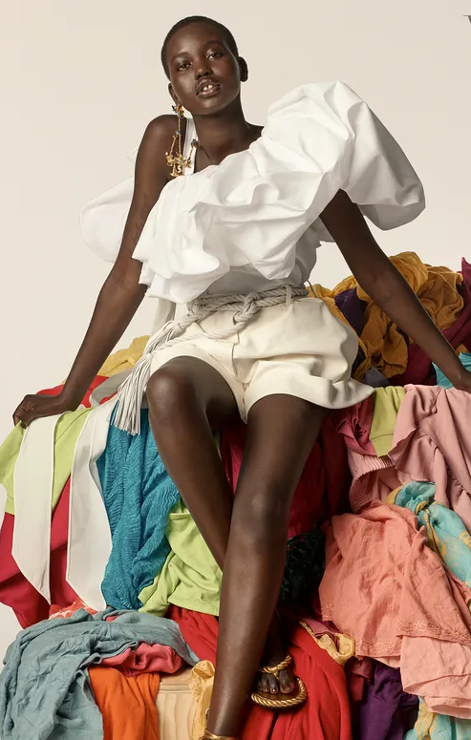
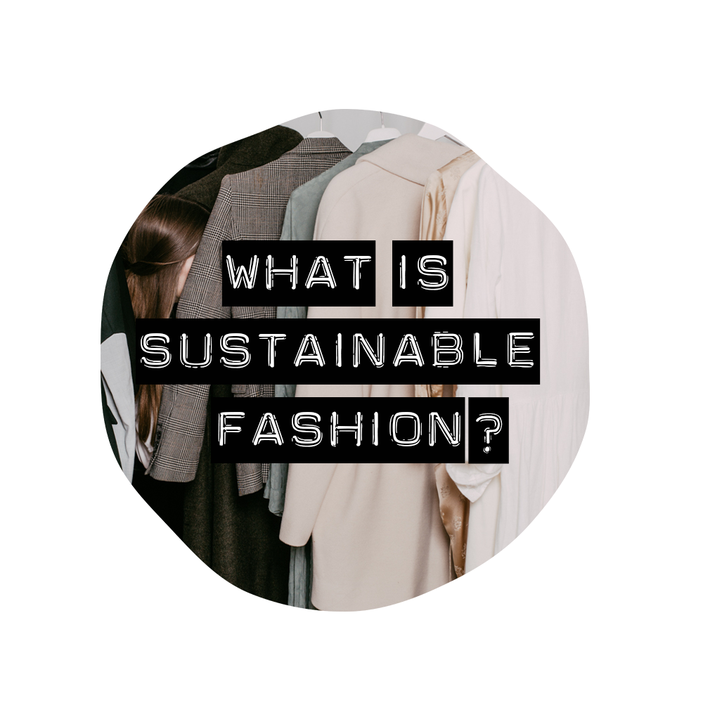
Main Problems in the Industry; Why is there a need for sustainability?
One of the most surprising problems many people wouldn’t relate to producing textiles it’s its problematic overuse of water and water pollution because of it’s dyeing and finishing products.
Making a single cotton t-shirt would take about 2,700 liters of water, which is enough to meet someone’s drinking needs for 2.5 years (society, 2022).
Textile waste in Landfills is one of the leading issues In the fashion industry.
Europeans use about 26 kilos of textiles and discard about 11 kilos a year. Used clothes are exported outside of the EU but mostly (87%) are incinerated or landfilled (society, 2022).
Sustainability is crucial because it would help reduce generational waste by addressing consumer shopping patterns. If brands become more sustainable by manufacturing premium apparel and from long – lasting materials. (Emeritus, 2023).

Slide 3
Cuyana “ Chic Minimalist Essentials”
Cuyana is a women-led company that was founded by a woman named Karla Gallardo ten years ago she’s passionate about the continuous fight towards true sustainability within the fashion industry and who’s built a positive rapport amongst her customers. (Robert, 2022)
The company’s headquarters is stationed in San Francisco, California 291 Geary St, and currently has one office location.
Cuyana has geared to keep its brand’s mission statement by offering fewer products/collections at a time, luxury quality, and sustainability (Robert, 2022).
The way that Cuyana gives back to the community is by partnering up with a non-profit organization (H.E.A.R.T) which donates apparel and accessories to their mission. They partner up with ThredUp by donating pre-loved Cuyana pieces to individuals in need. (Cuyana, 2023).
Cuyana is eager on executing ”The Fewer, Better Wardrobe” very graciously which is a smart system that is easy to style and gives the consumer more time to focus on what they love (Cuyana, 2023).

Slide 4
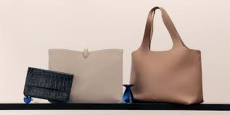
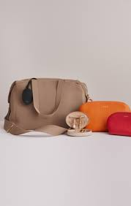
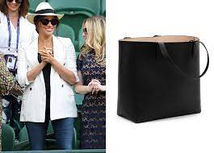
Cuyana: Where is the apparel made, by whom, and how (man or machine)?
Cuyana’s Co-Founder Karla Gallardo’s way of enrolling people into her brand is by providing authentic craftsmanship from Italian handmade products into their minimalist consumer’s hands (Cuyana, 2023).
Cuyana’s leather bags/ clothing apparel is keen to base its foundation on keeping its brand heritage focused which is derived into and executed by Cuyana’s suppliers, factories, and mills who are apart of their extended family (Cuyana, 2023).

Slide 5
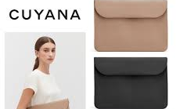
Sustainability: Is the product eco-friendly? Is it made by hand or machine?
Sustainability is one of Guyana’s leading mission statements; they make sure that every step it takes within its brand is adhered to and its integrity by providing its consumers with the highest eco-friendly product they could get (Robert, 2022).
Cuyana’s company ethically outsourced most of its materials to be made to adhere to its hand-made eco-friendly artisans (Cuyana, 2023).

Slide 6
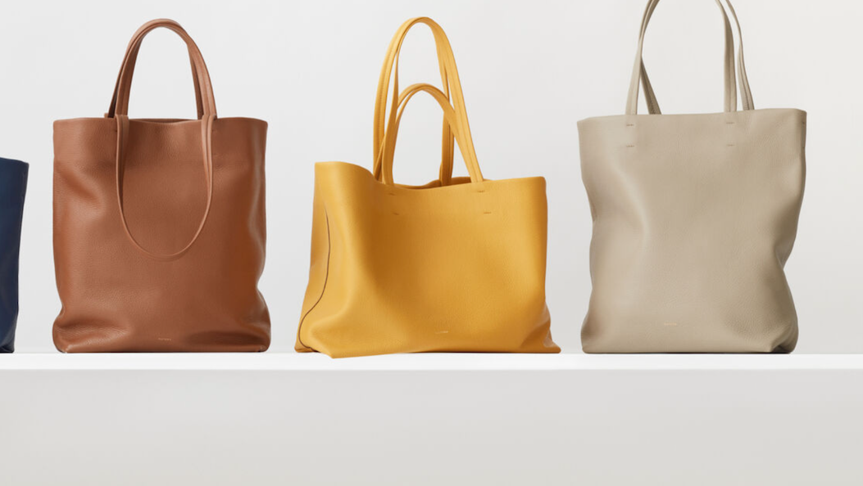
Is it sustainable from a business/financial perspective?
Cuyana shows integrity within the business/ financial perspective by making sure that what they advertise to its customers is always honest and true to its brand (Robert, 2023).
Gallardo stayed true to what her company was going to be and how financially ’Cuyana’ was going to face; being an immigrant and a woman of color she realized that she may have to work harder than a person who doesn’t fit that demographic (Robert, 2022).
Cuyana is a sustainable brand from a Business/Financial perspective because she didn’t want her heritage to be the label that defined her success it was for a business that worked, a brand that people loved, and a team that worked well together (Robert, 2023).
Cuyana has upscaled over the years by providing luxury within its consistency and merging it with sustainability.
i.e Products and their Price Ranges with their Bags: Classic Easy Tote $248, Oversized Double Loop Bag $348 and Linen Wrap Skirt $148

Slide 7
Market Demographic: Who is buying it?
Cuyana targets women who are of typically between the ages of 30 to 45 years old. Who ideally has a Bachelor’s degree or above (Window’s Wear, 2019).
Household Earners who make between $100,000 and $400,000, someone who's educated, travels a lot and lives in an urban area. (Window’s Wear, 2019).
People who are typically shopping at Cuyana like the design of the product which appeals to fit a wide array of its demographic (Stevenson, 2018).

Slide 8
References
(S&D, D. B. (2023, June 5). The impact of textile production and waste on the environment: News: European parliament. The impact of textile production and waste on the environment | News | European Parliament. https://www.europarl.europa.eu/news/en/headlines/society/20201208STO93327/the-impact-of-textile-production-and-waste-on-the-environment-infographic
About us - Cuyana . About Us. (n.d.). https://www.cuyana.com/about-us.html
Editors, O. (2023, June 5). 35 sustainable clothing brands betting against Fast Fashion. The Good Trade. https://www.thegoodtrade.com/features/fair-trade-clothing/
Kumar, A. (2023a, February 15). Why sustainable fashion matters: Learn the benefits & trends. Emeritus Online Courses. https://emeritus.org/blog/sustainability-sustainable-fashion/#:~:text=Reduced%20Carbon%20Dioxide%20and%20Greenhouse,carbon%20footprint%20of%20these%20brands.
Kumar, A. (2023b, February 15). Why sustainable fashion matters: Learn the benefits & trends. Emeritus Online Courses. https://emeritus.org/blog/sustainability-sustainable-fashion/#:~:text=Reduced%20Carbon%20Dioxide%20and%20Greenhouse,carbon%20footprint%20of%20these%20brands.
Robert, Y. (2022, November 8). 3 lessons Karla Gallardo, CEO of Cuyana, learned as a Latin American founder. Forbes. https://www.forbes.com/sites/yolarobert1/2022/10/20/3-lessons-karla-gallardo-ceo-of-cuyana-learned-as-a-latin-american-founder/?sh=48546e8d2642
Stevenson, S. (2018, November 20). How to build a brand for average women-and literal royalty. Slate Magazine. https://slate.com/business/2018/11/cuyana-ceo-karla-gallardo-who-runs-that-transcript.html
WindowsWear. (2019, February 22). Interview: Cuyana founders on taking a fewer, better approach to DTC Apparel – PSFK. WindowsWear. https://www.windowswear.com/interview-cuyana-founders-on-taking-a-fewer-better-approach-to-dtc-apparel-psfk/

