Slide 1
Lymphadenopathy
vladlen berlin

Slide 2
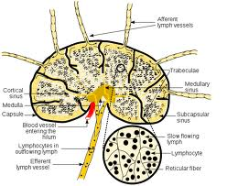
Lymphadenopathy
The lymph nodes are part of the Immune System. They help your body fight infection.
Lymphadenopathy is a general term for pathology in the lymph nodes.
An increase in size and change in consistency of the lymphoid tissue is a sign of Lymphadenopathy.

Slide 3
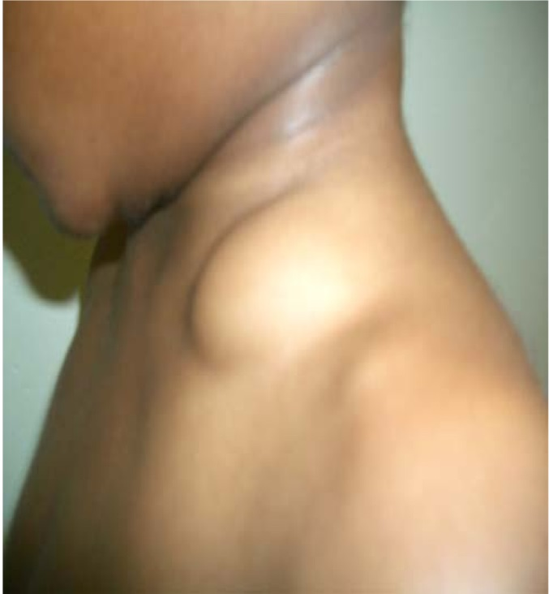
Etiology
Infectious disease (viral/bacterial)
Local Odontogenic
Immune System disorders
Cancer(neoplasms)

Slide 4
Lymphadenopathy occurs when the lymph nodes respond during an active disease process, such as cancer or infection in a specific region.

Slide 5
Impact on the patient
Normally lymph nodes cannot be seen on palpated during an extraoral examination of a healthy patient.
Lymphadenopathy allows the node to be easily noted during an extraoral examination.
Changes in consistency from firm to bony hard allow the lymph node to be palpated.
Palpation may be painful.
Lymph nodes can become fixed and attached to the surrounding tissue.
Finally Lymphadenopathy plays a role of indicating that the patient has a developmental disturbance/abnormality..

Slide 6
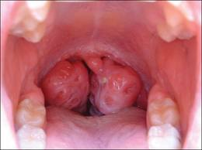
Lymphadenopathy can also occur in the intraoral tonsillar tissue.
Tissue enlargement can be inspected during intraoral examination.
When intraoral tonsils are palpated they are tender.
A big concern to the patient is airway obstruction , which could further lead to infection of tonsillar tissue.

Slide 7
Role of the dental team
Dental Professionals must have a clear understanding of the head and neck including the oral cavity.
Identify any abnormalities and pathologies.
May potentially save a patient’s life by encouraging them to seek proper treatment.
Findings should be recorded in the patient record and appropriate referrals should be made when
Lymph nodes are palpable.
Enlargement or infection of intraoral tonsillar tissue is observed.

