Slide 1
a step-by-step guide to submitting to Academic Works: student posters
Prof. Monica Berger NYCCT Library May 2, 2018

Slide 2
Get ready to submit
find your poster
Check in with your mentor about sharing your poster in Academic Works

Slide 3
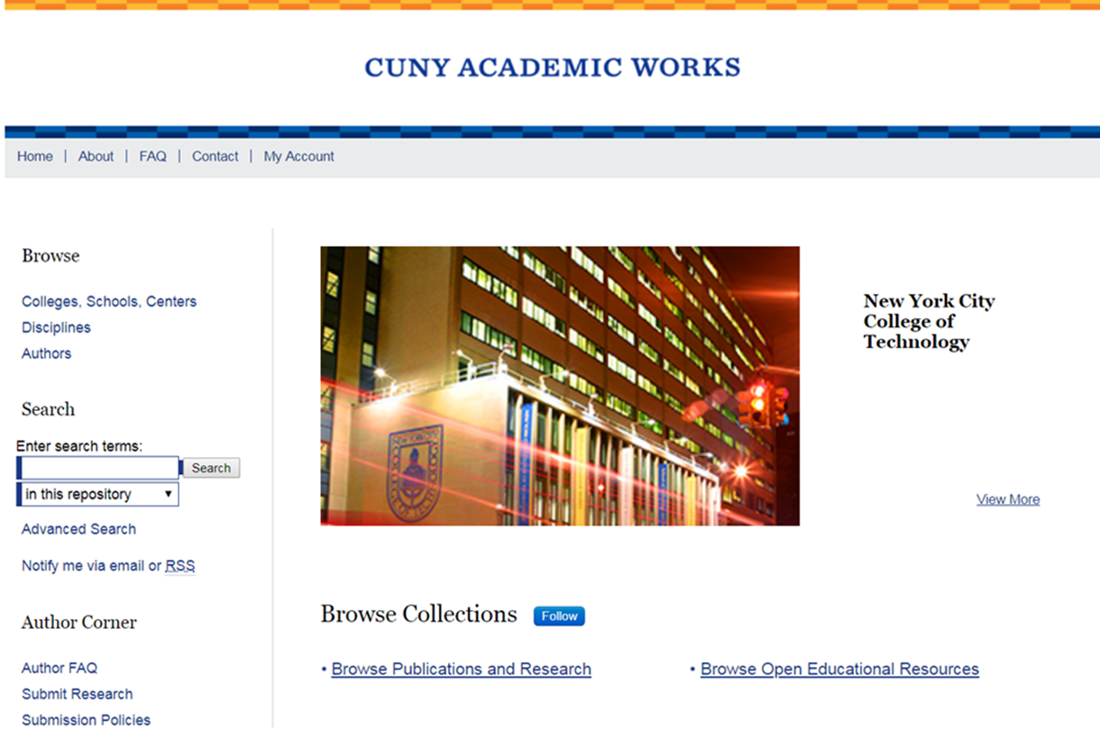
Step 1 Go to CUNY Academic Works https://academicworks.cuny.edu/

Slide 4
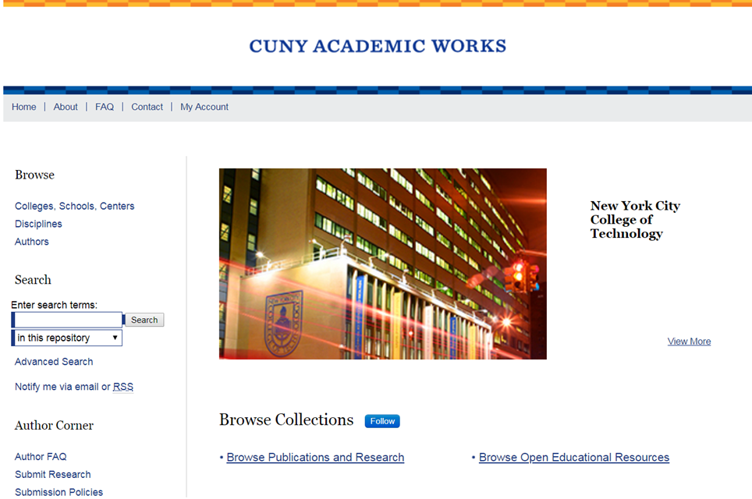
Step 2 Under AUTHOR CORNER, select SUBMIT RESEARCH

Slide 5
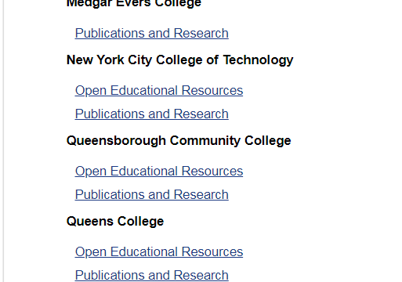
Step 3 Browse to NYCCT and select PUBLICATIONS AND RESEARCH for scholarship and OER for OER

Slide 6
Step 4 create new account: use your City Tech email

Slide 7
Step 5 fill out the form: title. Use standard capitalization

Slide 8
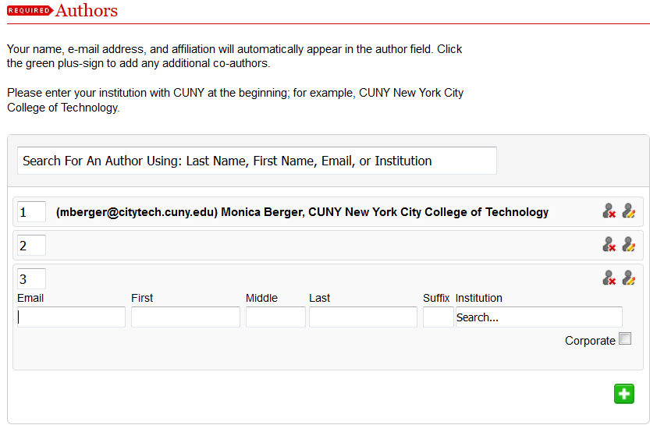
Step 6 fill out the form: authors. If you have a co-author, asking their permission to add to Academic Works is a courtesy but not a requirement. Click the green button to add an author

Slide 9
Step 7 affiliations at CUNY. Click on NYCCT to expand and then select your major and, if different, the department of your mentor. Add to the right hand box

Slide 10
Step 8 document type. Select POSTER from the dropdown menu

Slide 11
Step 9 publication date: the year is required

Slide 12
Step 10 embargo period: not needed for posters

Slide 13
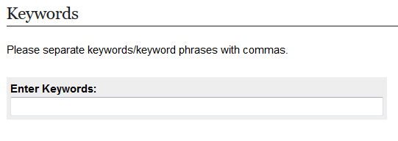
Step 11 keywords: copy and paste from your article (OPTIONAL)

Slide 14
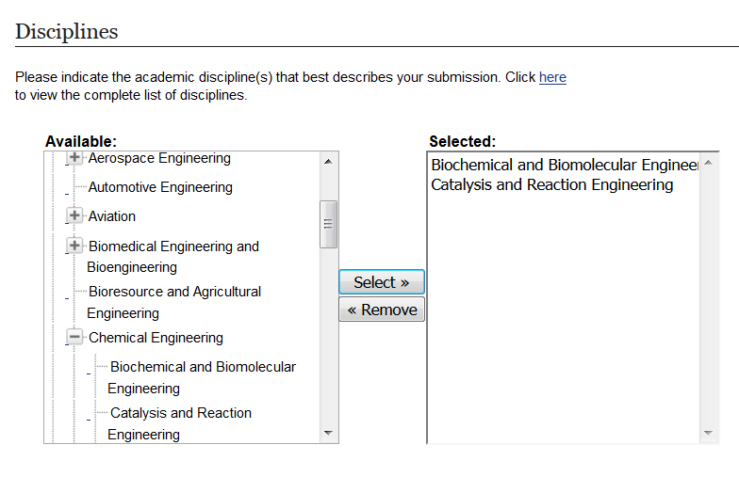
Step 12 disciplines. Add as many as appropriate (OPTIONAL)

Slide 15
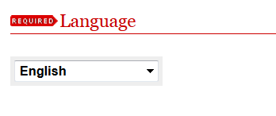
Step 13 language. Select from the dropdown menu

Slide 16
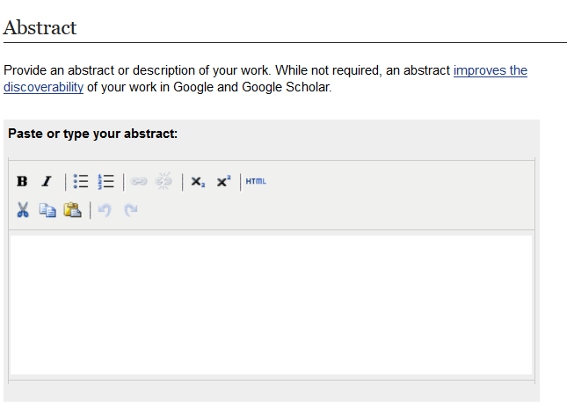
Step 14 abstract. Copy and paste your abstract. Helps boost your article in Google Scholar (OPTIONAL)

Slide 17
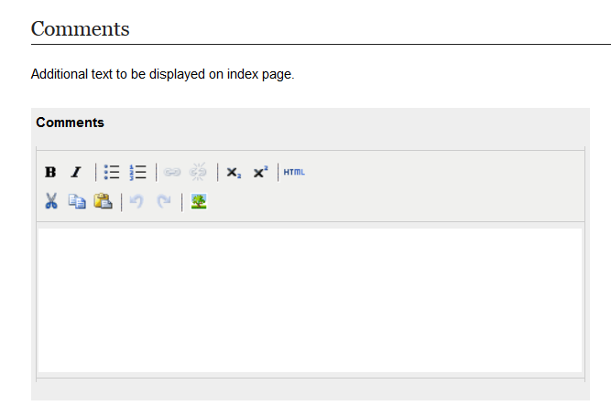
Step 15 comments. Add a note so we know your work is part of the poster session as follows below
This poster was presented as the 28th Semi-Annual Honors and Undergraduate Research Scholars Poster Presentation at New York City College of Technology, May 2, 2018.

Slide 18
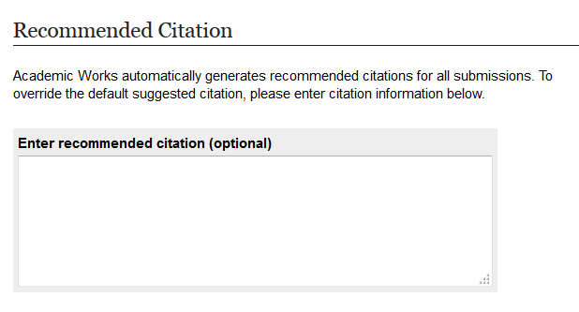
Step 16 citation. (OPTIONAL)

Slide 19
Step 18 upload your poster as a PPT or PDF

Slide 20
Step 19 additional files: upload supplemental material including images, handouts, etc. (OPTIONAL)

Slide 21
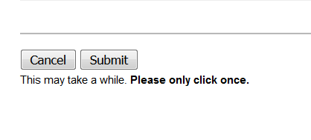
Step 20 SUBMIT. Now your submission will go to an administrator for approval. If no changes are needed, it will go live after a brief delay

Slide 22
That’s it. Hurrah!
Need help? Call Prof. Monica Berger at 260-5488 or mberger@citytech.cuny.edu

