Slide 1
Macro & Microdontia
Dens in Dente
By Ugiloy Hamrayeva

Slide 2
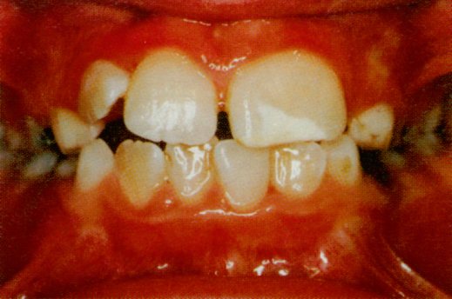
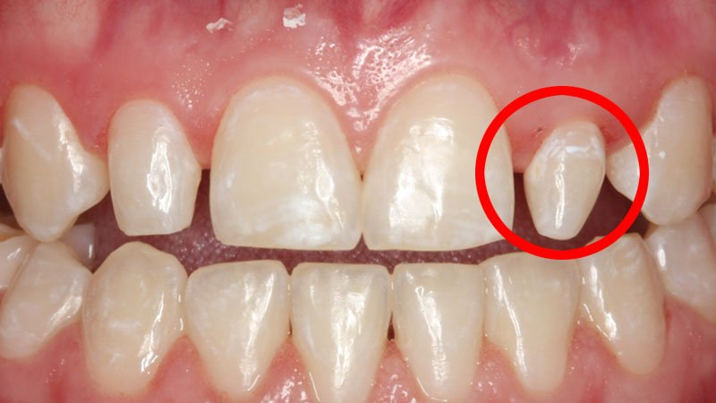
A single tooth or multiple teeth (partial) or an entire dentition (complete) to be larger or smaller than usual.
Abnormally large teeth result in macrodontia abnormally small teeth result in microdontia

Slide 3
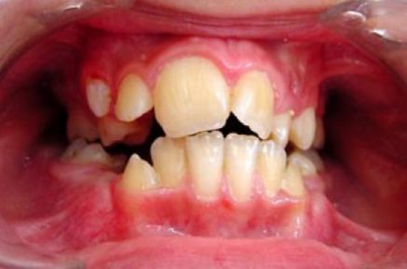
Etiology of Macrodontia:
- splitting of the enamel organ
- fusion of two adjacent tooth germs
-childhood hyperpituitarism (gigantism)
-Inuit people from North America

Slide 4
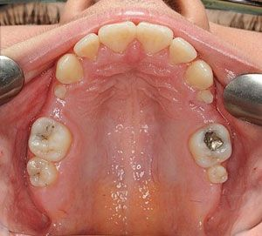
Etiology of Microdontia
Large set of jaws
-Hereditary factors
Hypopituitarism
-Down syndrome.

Slide 5

Role of the Hygenist
Our role is to explain that there are teeth that are commonly affected by microdontia, which are the permanent maxillary lateral incisor and permanent third molar (which are known as peg molar)
Also to be aware that this condition can lead to esthetic and spacing complications, and explain that it can be corrected by full restorative crowns on partial microdontic teeth (lateral incisor) and/or possibly extraction (third molar).

Slide 6
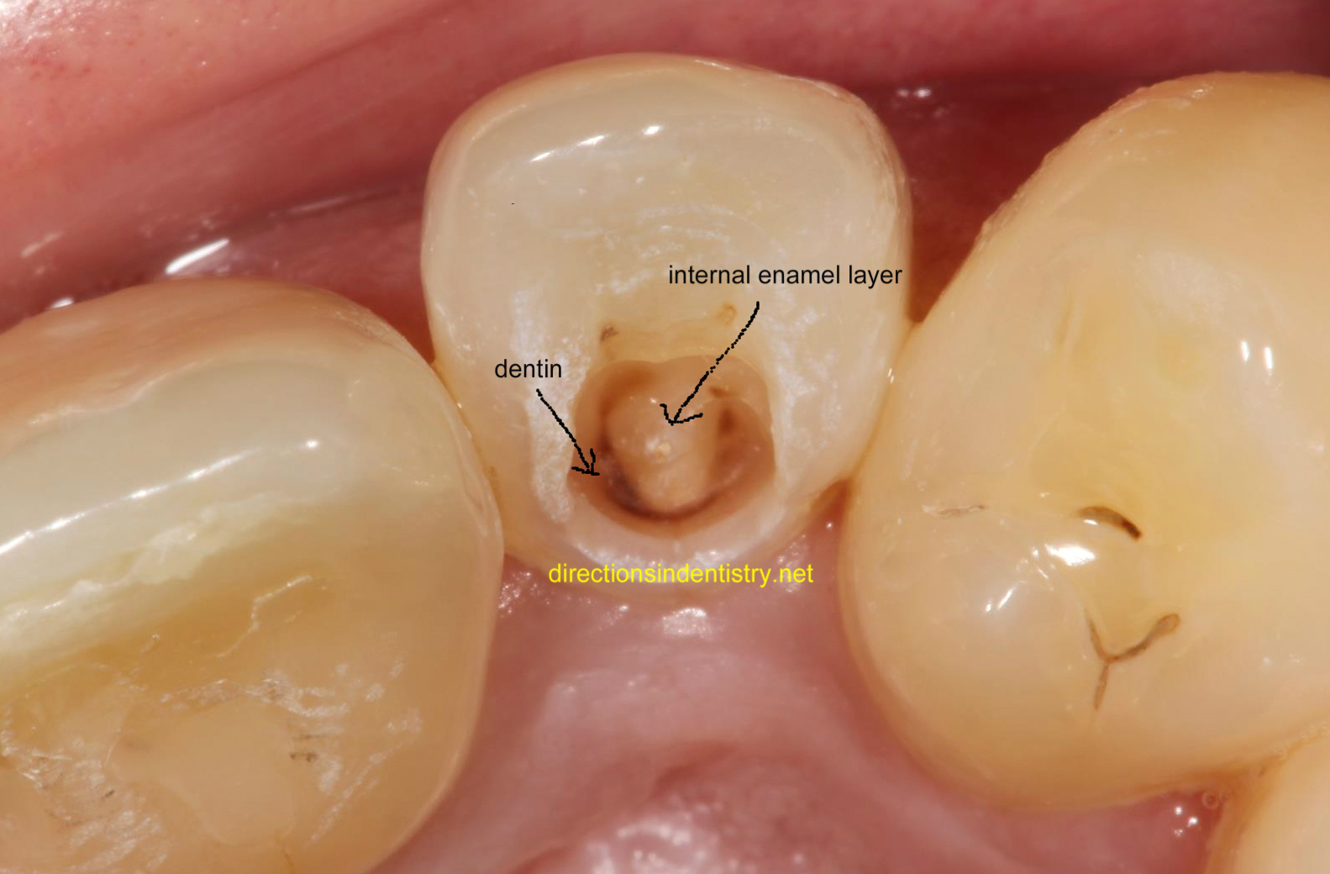
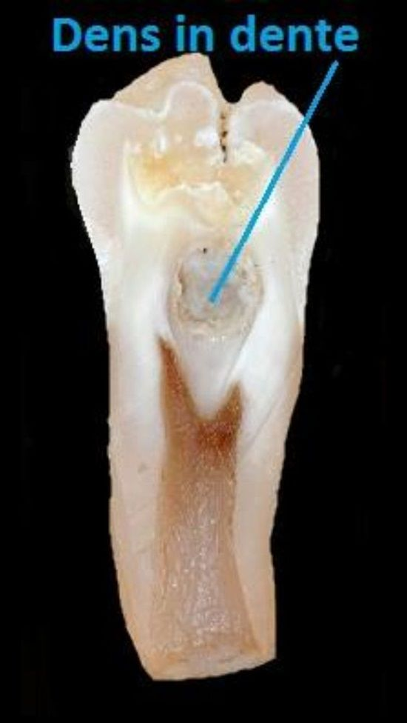
Dens in dente results from an infolding of the dental papilla during tooth development. Affected teeth show a deep infolding of enamel and dentine starting from the tip of the cusps and which may extend deep into the root.

Slide 7
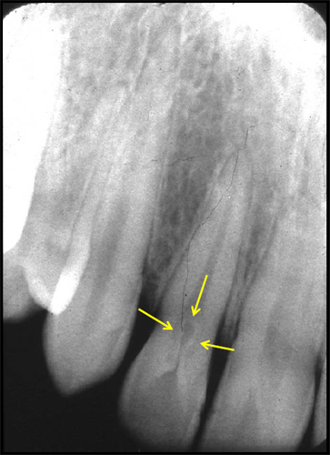
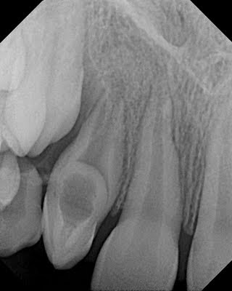
Etiology: Hereditory
Affected tooth Maxillary Lateral Incisors

Slide 8
Role of the Hygenists
Recognize the condition, explain it to the patient (tooth within tooth)
Consult with the dentist, who can either do root canal therapy or reimplantation of the affected tooth.

Slide 9

Thank You for Your Attention

