Slide 1
Fluoride For All!
Introducing A Fluoride Oral Rinse Program to Third Graders in Massapequa, NY

Slide 2
Welcome!
Thank you for joining us tonight! Let’s start with some questions…
Notes:
TAYA-Raise your hand… Who knows what fluoride is? Does anyone know whether we live in a fluoridated or non-fluoridated water community? Does everyone here want their child to experience fewer cavities and have great oral health?
Have any of your kids missed school bc of a dentist appt
ARE THERE MORE QS WE SHOULD ASK

Slide 3
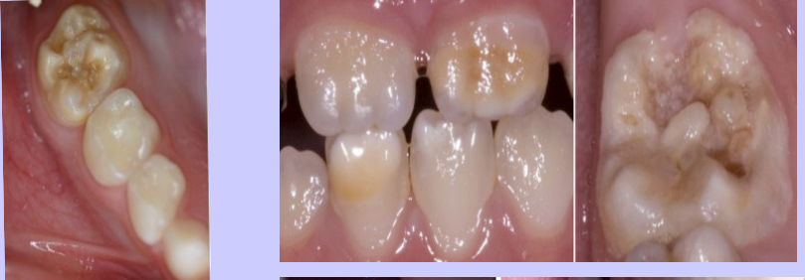
Early Childhood Caries (ECC)
A severe, rapidly progressing form of tooth decay in infants and young children
High occurrence during adolescence and pre-teen years
Notes:
TAYA-Early childhood caries (ECC) can impact around 60 to 90% of children around the world.
Teeth are most prone to caries after eruption from ages 2-5 for baby teeth and early teenage years for permanent teeth.
Children with ECC have the potential to be underweight and can demonstrate failure to thrive

Slide 4
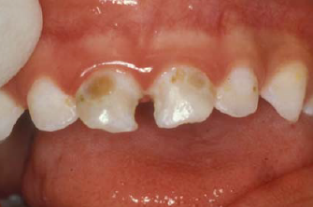
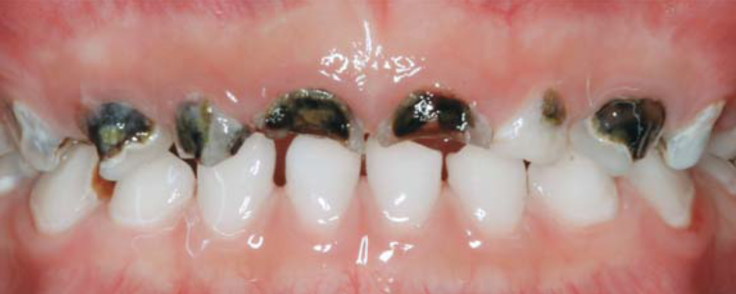
Early Childhood Caries (ECC)
It is irreversible!
Notes:
TAYA-As we mentioned, dental caries is one of the most prevalent oral cavity diseases that affects people of all ages, and ECC effects young children. It is an irreversible disease characterized by demineralization of the inorganic portion of the enamel or dentin.
IT AFFECTS DA TOP TEEEF

Slide 5
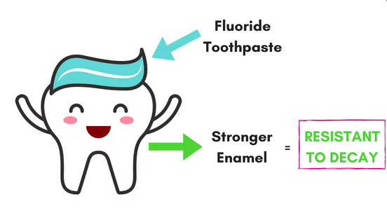
What Preventive Measures Can We Take?
Let’s help our children achieve optimum oral care
We want fewer cavities! How does this happen…?
This includes the addition of FLUORIDE into their oral health routines
Notes:
EMILY-As parents, I’m sure some of your children have already experienced cavities, and we know this is not desirable for so many reasons. What can we do to help prevent more cavities from occurring and help your child receive the best oral health?

Slide 6
But…There is No Fluoride in Our Water Supply!
Massapequa, NY is a non-fluoridated community.
You may be wondering…
What is a non-fluoridated community?
Why is this relevant to me?
Why is this relevant to my child?
If fluoride is good but it is not in our water supply, how do our children obtain its benefits?
Notes:
EMILY-A non fluoridated community is an area that does not have added fluoride into the community water system. Although almost all water contain fluoride, since fluoride is a mineral existed in the natural and release from rocks into soil, water, and air.
This is relevant to you because dental visits is one of the reasons students lose school hours. It is also expensive and time consuming for you.
How do our children get fluoride then? HINT LISTEN TO THE NEXT SLIDE TO FIND OUT :)

Slide 7
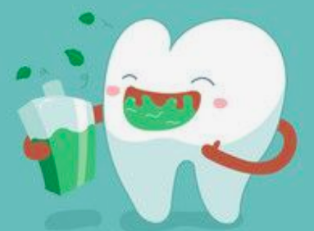
Fluoride Rinse!
Oral rinse with the addition of fluoride is:
Safe and beneficial for your child’s oral health
Cost effective
Non-toxic
Has a lack of adverse effects
These rinses do not:
Alter salivary flow alter taste (only transient effect)
Alter dental restorations
Notes:
EMILY -
Fluoride is the most effective method of decay prevention.
The concentration of fluoride in oral rinse is safe and beneficial for your child’s oral health. It helps to prevent demineralization and to enhance remineralization in a number of ways. The rate at which an acid solution dissolves tooth enamel is decreased by fluoride.

Slide 8
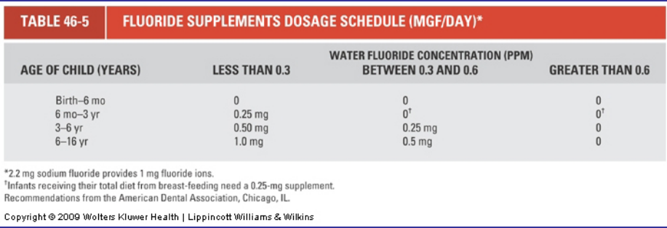
Recommended Fluoride Supplement Intake in a Non-Fluoridated Community
FLUORIDE CHART
Notes:
CHRISTINA- 3rd graders are normally 8-9 years old so they fit into in the last portion of the table. [read off the last part of the table]
The fluoride concentration is allowed to be up to 4.5 times the optimal amount of 0.7ppm to compensate for fewer number of days in the school year. Because Massapequa, the city that we will be doing our program at is a non-fluoridated community, it is important for us to have the students get as much fluoride as possible while they are in school and hopefully help them develop habits that they can attain while they are at home.

Slide 9
Fluoride Rinse Program
We will be using a rinse containing 0.2% sodium fluoride
One time per week
Swish for 60 seconds
Dentist oversees the entire program
Volunteers will be diligently trained from start to finish
Notes:
CHRISTINA-
Using mouthrinse one times per week is all it takes to help prevent cavities from occurring in your child. By having them do fluoride rinse, it will compensate for the times that they are not in school and they can do the rinse at home. The rinse is easy to do and very affordable. This will help promote remineralization.

Slide 10
Why Third Graders?
Third graders are at an ideal age to begin forming meaningful oral health habits!
Help them learn how to form a healthy routine
Improve their oral health for the long haul!
Notes:
CHRISTINA-
Third graders are old enough to understand that they should not swallow the mouthrinse which can possibly cause fluoride overdose like fluorosis. This is also an ideal age where they are still young so we can teach them about the importance of fluoride so that they can hopefully develop a healthy habit with the fluoride mouthrinse.

Slide 11
How Will the Oral Rinse Program Work?
1. Each student will receive one cup containing the rinse and one napkin
2. When instructed, students will empty the entire contents of the cup into their mouth
3. Students will be instructed to forcefully strain the rinse between their teeth with their lips tightly closed (volunteers will listen for the sound of swishing)
4. Students will continuously be reminded that the rinse should not be swallowed
5. The rinsing will be timed for exactly 60 seconds
6. After 60 seconds, the students will be directed to to carefully expel the rinse back into their cup and wipe their mouths with the napkin provided
7. Students will be instructed to gently insert the napkin into their cup to absorb the liquid and dispose of the cup by gently placing it in a trash can with a plastic liner.
Notes:
HUANAN- ( Christina–distribute materials out—cups, Listerine, napkins, trash )
1. Each student will receive one cup containing the rinse and one napkin
2. When instructed, students will empty the entire contents of the cup into their mouth
3. Students will be instructed to swish the solution in their mouths with the lips tightly closed and teeth together (volunteers will listen for the sound of swishing)
4. Students will continuously be reminded that the rinse should not be swallowed (but should be swished between the teeth)
5. The rinsing will be timed for exactly 60 seconds
6. After 60 seconds, the students will be directed to empty the fluoride solution back into the cup and wipe their mouths with the napkin.
7. Students will be instructed to put the napkin into the cup to absorb the liquid and dispose of the cup in a trash can.
( Faculties are encouraged to rinse with the students. The fluoride rinse helps their teeth, too. Tell the children that they will know they are doing a good job if they can hear themselves swishing. They should sound like a classroom full of washing machines.

Slide 12
Let’s Try All Together!
Notes:
HUANAN - Distrubute supplies out now, follow steps that are written out on previous slide
Let’s Try All Together! DO TIMER ON PHONE–1min
1. Each student will receive one cup containing the rinse and one napkin
2. When instructed, students will empty the entire contents of the cup into their mouth
3. Students will be instructed to swish the solution in their mouths with the lips tightly closed and teeth together (volunteers will listen for the sound of swishing)
4. Students will continuously be reminded that the rinse should not be swallowed (but should be vigorously swished between the teeth)
5. The rinsing will be timed for exactly 60 seconds
6. After 60 seconds, the students will be directed to empty the fluoride solution back into the cup and wipe their mouths with the napkin.
7. Students will be instructed to put the napkin into the cup to absorb the liquid and dispose of the cup in a trash can.

Slide 13
Emergency Protocols
Faculty will not store fluoride mouth rinse in their classroom unless it is under lock and key.
Faculty are able to store cups and napkins in a cabinet in the classroom.
If a student accidentally swallows their portion of the weekly mouthrinse solution, this amount is not harmful.
If a student has adverse reaction after accidentally swallowing the rinse, faculty will stay calm, and will have the student drink milk, and induce vomiting if needed.
Notes:
HUANAN
The school-based fluoride mouth rinse program is designed to be safe and effective. If a child swallows their portion of the weekly mouth rinse solution, no adverse reaction will occur.
We will be taking every precaution to make sure your children are 100% safe
To avoid any accident, Faculty will store the supply of fluoride in a locked and secure place.
Faculty are able to store cups and napkins in a cabinet in the classroom.
If a student has an adverse reaction after accidentally swallowing the rinse, faculty will stay calm, and will have the student drink 1-2 glasses of milk, and induce vomiting if needed
( If the condition gets worse, take the child immediately to the nearest hospital emergency room.)

Slide 14
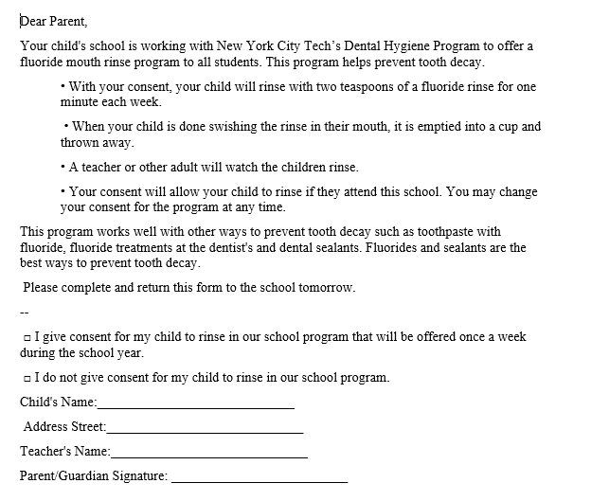
(2) mL
Notes:
Joanna - Copy of Permission Slip
Obtaining signed parental consent is a critical component to successfully proceed with a school-based rinse program.
Child participation is dependent upon this. Once you fill them out we will keep them securely stored on file.
You can change your mind adn withdraw consent at any time.

Slide 15
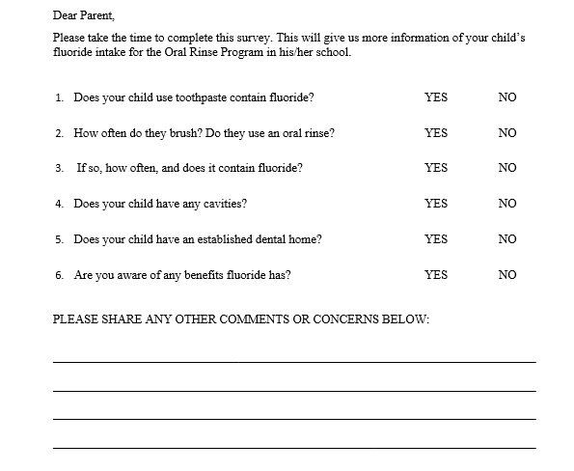
Notes:
Joanna -
Parent Questionaire We wanted to include this survey for a few reasons - to enable you to start thinking more about your childs oral health in different ways and to get a better sense of our school populations oral health. Feel free to share as much or nothing in the space provided.

Slide 16
Tips
Avoid eating or drinking dairy and calcium-fortified products in the following hour (milk, yogurt, cheese, and juice).
Children will be advised to not rinse, eat, or drink for 30 minutes.
Notes:
Dan - Avoid eating dairy because these products will bind with fluoride, and prevent its fully absorption.
Children will not rinse, eat, or drink for 30 minutes so that the fluoride has the appropriate time to absorb into the enamel.
We will be continuously monitoring the children to make sure this does not occur.

Slide 17
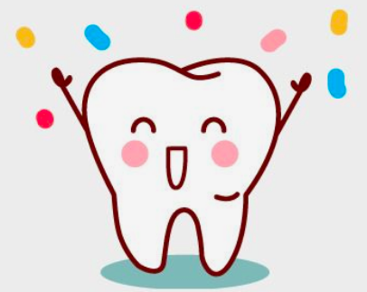
Outcomes and Goals for Students
Reduce cavities!
Fewer dentist visits!
Fewer missed school days!
Less expenses for parents!
Improve oral care and therefore quality of life!
Notes:
Dan-
Our main goal is to reduce the risk of caries in third graders by introducing them to a 0.2% sodium fluoride rinse once per week. There is no downside.
This program helps improve the dental health of your child, but please be aware it will not take the place of regular dental checkups and proper oral care at home.

Slide 18
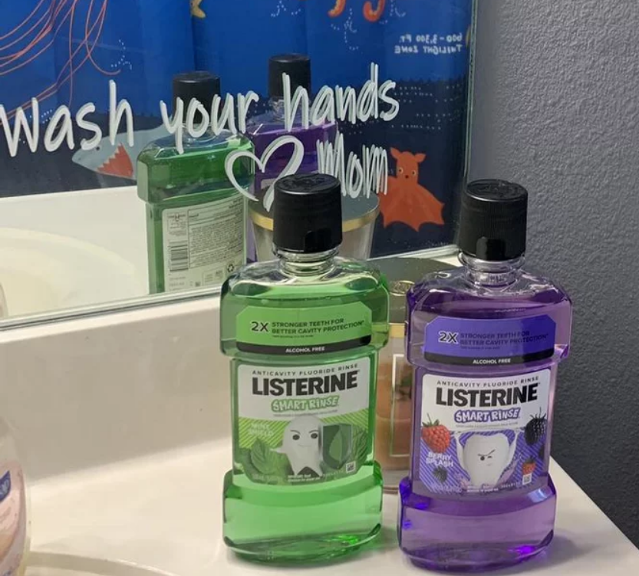
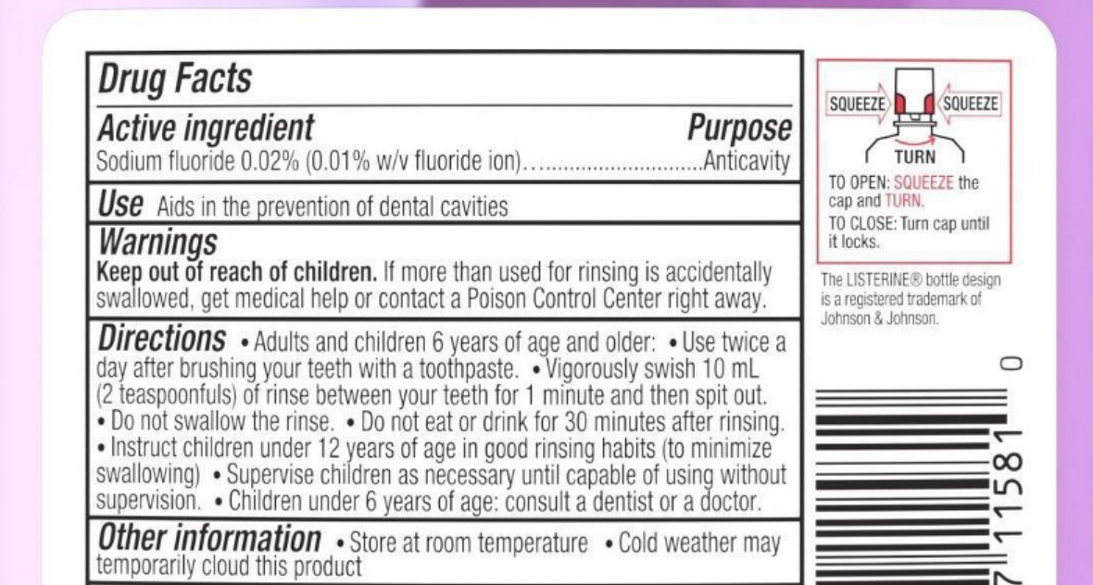
Alternative/At-Home Options
Notes:
Dan - Alternative option includes uses 0.02% sodium fluoride rinse twice daily after brushing
How to use mouthrinse
1.Pour 10 milliliters (2 teaspoons) of LISTERINE fluoride rinse into a cup.
2.Empty the cup into your mouth. Don’t dilute the solution with water.
3.Swish for a full 60 seconds (try counting to 60 in your head or using a stopwatch). Don’t worry if you can’t get to 60 seconds the first time – it gets easier each time you try.
4.During rinsing, gargle in your mouth.
5.Spit the solution out in the sink.

Slide 19
Questions?
Notes:
Dan -

