Slide 1
Exostoses
Taeyoung Lee
DEN 1114 Histology & Embryology OL 20

Slide 2
Exostoses
Exostoses are defined as benign growths of bone extending outwards from the surface of a bone.
A less than common variation present usually on the facial surface at the alveolar process of the maxillary arch is exostoses.
They may be single or multiple lesions and unilateral or bilateral raised hard areas located in the premolar to molar region covered by oral mucosa.

Slide 3
The specific cause of exostoses is uncertain, although they likely are related to both genetic factors. It most likely starts to develop from young age, when the bone grows.

Slide 4
In oral, we have mandibular torus and palatine torus.

Slide 5
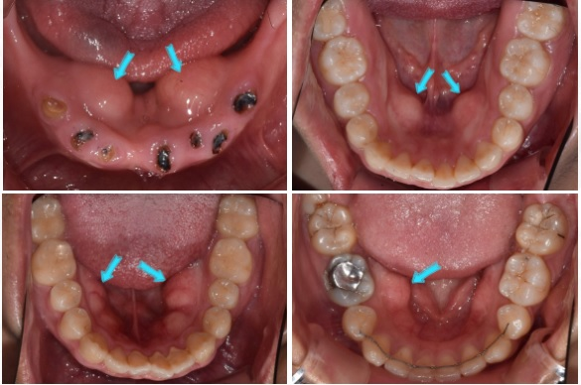
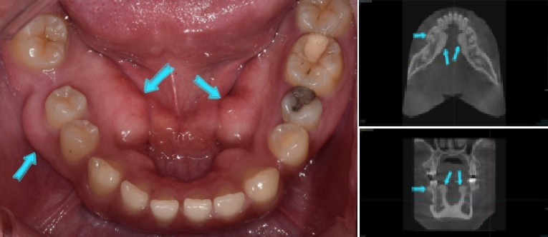
Mandibular torus

Slide 6
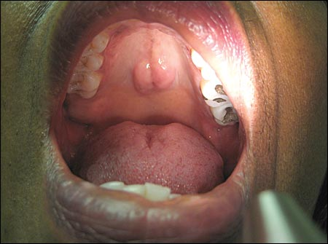
Palatine torus

Slide 7
Development of torus does not impact the patient much since it does not relate to the patient’s health.
However, if the bone gets bigger and bigger, and reaches point when the patient is hard to take care, like,
foods keep stuck near the torus
Hard to brush teeth, and mouth
Bothering when speaking
if you are an elder, and need to equip denture
You should be suggested to remove it by the dentist.

Slide 8
The dental team should pay more attention if the torus is getting bigger and if it is being hygiene correctly by the patient.
If the patient is not under a good condition to take care of it, then the team should warn the patient, or it should be removed before it causes complication such as inflammation.

Slide 9
Mucocele, Ranula
Taeyoung Lee
DEN 1114 Histology & Embryology OL 20

Slide 10
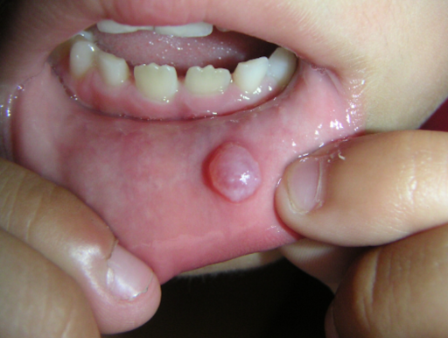
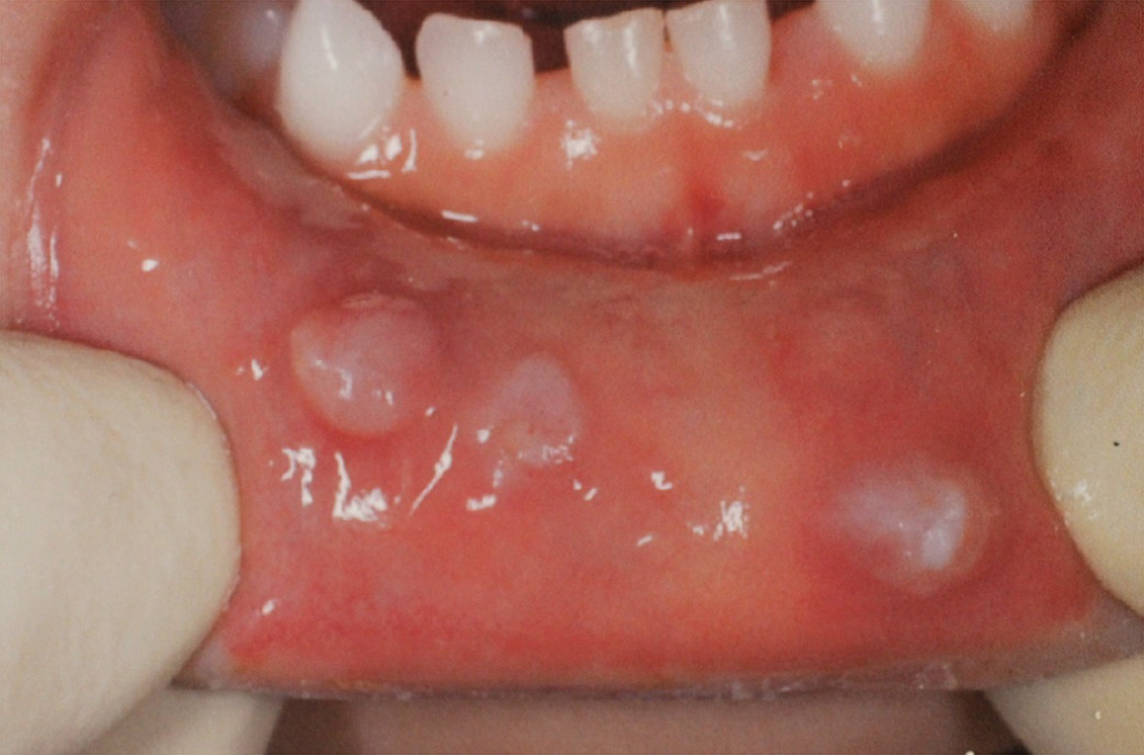
mucocele is a benign, mucus-containing cystic lesion of the minor salivary gland.

Slide 11
You can get mucocele if a tiny tube (duct) that moves saliva gets damaged or blocked. This most often happens if you repeatedly bite or suck on your lower lip or cheek.

Slide 12
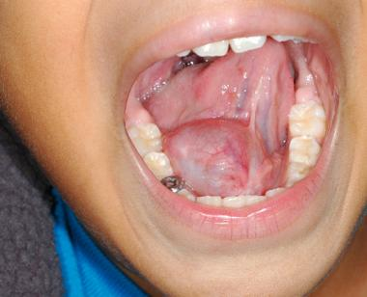
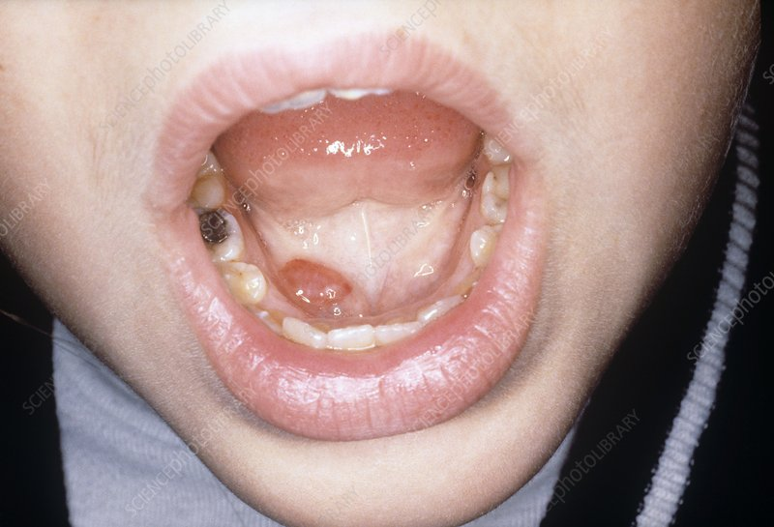
Ranula is a fluid cyst that forms in the mouth under the tongue. it is filled with saliva that has leaked out of a damaged salivary gland.

Slide 13
like mucocele, ranula causes and develops when saliva leaks out of the injured or damaged gland and forms a bubble of fluid in the tissue around the gland

Slide 14
Both, mucocele and ranula, are harmless cyst In your mouth, and it often goes away without treatment.
But sometimes it gets bigger, and it might impact the patient as it’s easy to repeatedly bite and gets popped. Then it might lead other complications.

Slide 15
The dental team should look close to see if the patient is doing well in oral hygiene, and if it’s getting too big to be treated.

Slide 16
Thank you for listening !

