Slide 1
Set Design For CUNY Around the World
By: Tristen Weber
Faculty Advisor: Jen Varbalow

Slide 2
Introduction
CUNY Around the World is a multicultural show presented in the Voorhees Theatre led by the leading members from the Stagecraft Club. The show itself will compromise many different performances from different countries. Participants/performers are only recruited within the CUNY schools.
For my culmination project, the main objective was to plan/execute a complete set design for CUNY Around the World by creating scenic elements and performing a trial load-in/out before the upcoming show. Deliverables also include paint elevations, a groundplan and a section view of the theatre.

Slide 3
Calendar/Process
October to February – Research/Order Materials
March – Drafting
April – Scenic Build/Painting
May – Trial Load-In & Load Out

Slide 4
Budget
Materials/Cost
128” Canvas, 10.5 oz., Natural NFR 9 Yds - $228.00 (Originally)
Canvas Drop Cloth (6’ x 9’ – Pack of 2) - $22.99
1 Quart Benjamin Moore Regal Select Interior Athens Blue 797 - $29.99
1 Quart Benjamin Moore Regal Select Interior Peppermint 2033-20 - $29.99
1 Quart Benjamin Moore Regal Select Interior Bold Yellow 336 - $29.99
2 Gallons Benjamin Moore Regal Select Interior Black HC-190 - $145.98
1 Gallon Benjamin Moore Regal Select Ultra White CC-10 - $79.99
2 Gallons Benjamin Moore Regal Select Sandalwood 273 - $ 145.98
4 8 oz. Fluid of Rosco Flamex PA - $97.00
1 Gallon Minwax Polycrilic Satin Crystal Clear Water-Based Polyurethane - $69.99

Slide 5
Scenic Elements
Because you’re dealing with multiple performances on stage, much floor space is needed.
The main visuals are the performers, the scenery serves secondary for this project. Minimal scenic elements serves best for this project.
Scenic elements include:
2 4x8 stock Flats fully painted and flameproofed (From Room V-102)
Large Duck Cloth NFR (Floor) Canvas painted and flameproofed
Two 6’ black curtain hung near Catwalk 1
Two 15’ black curtain hung on the traveler track upstage.

Slide 6
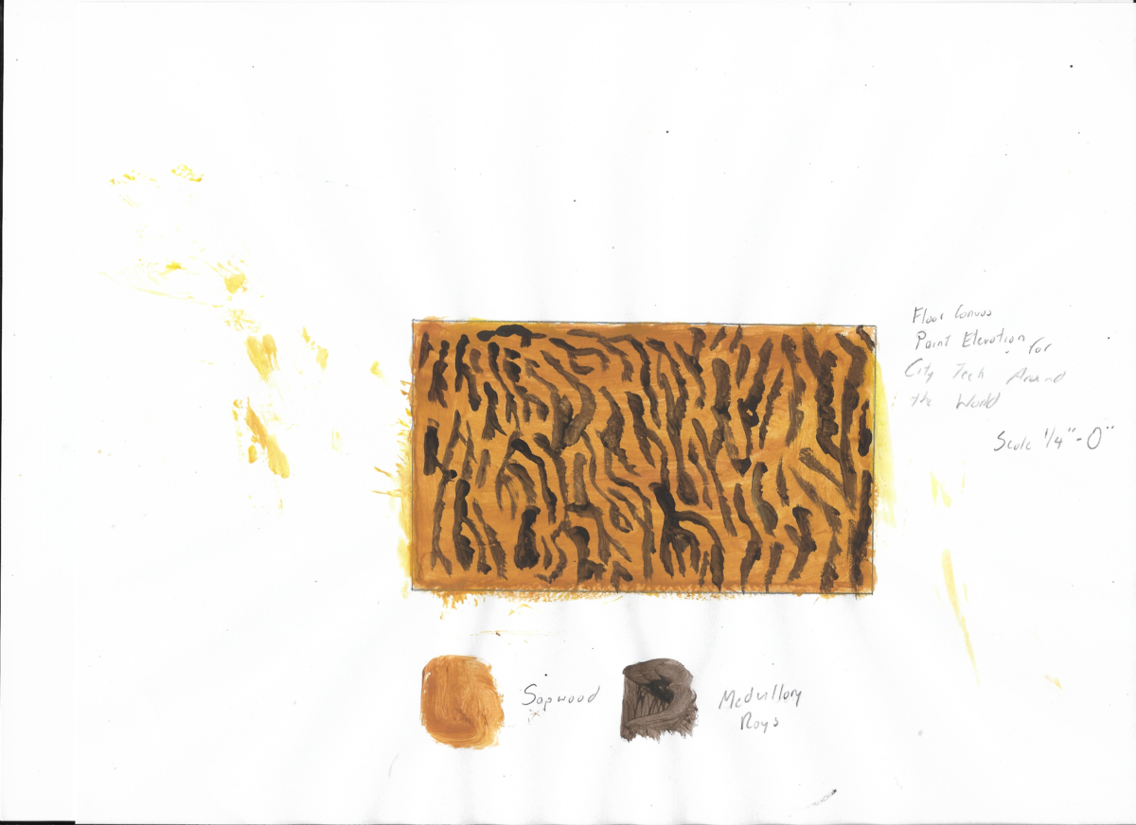
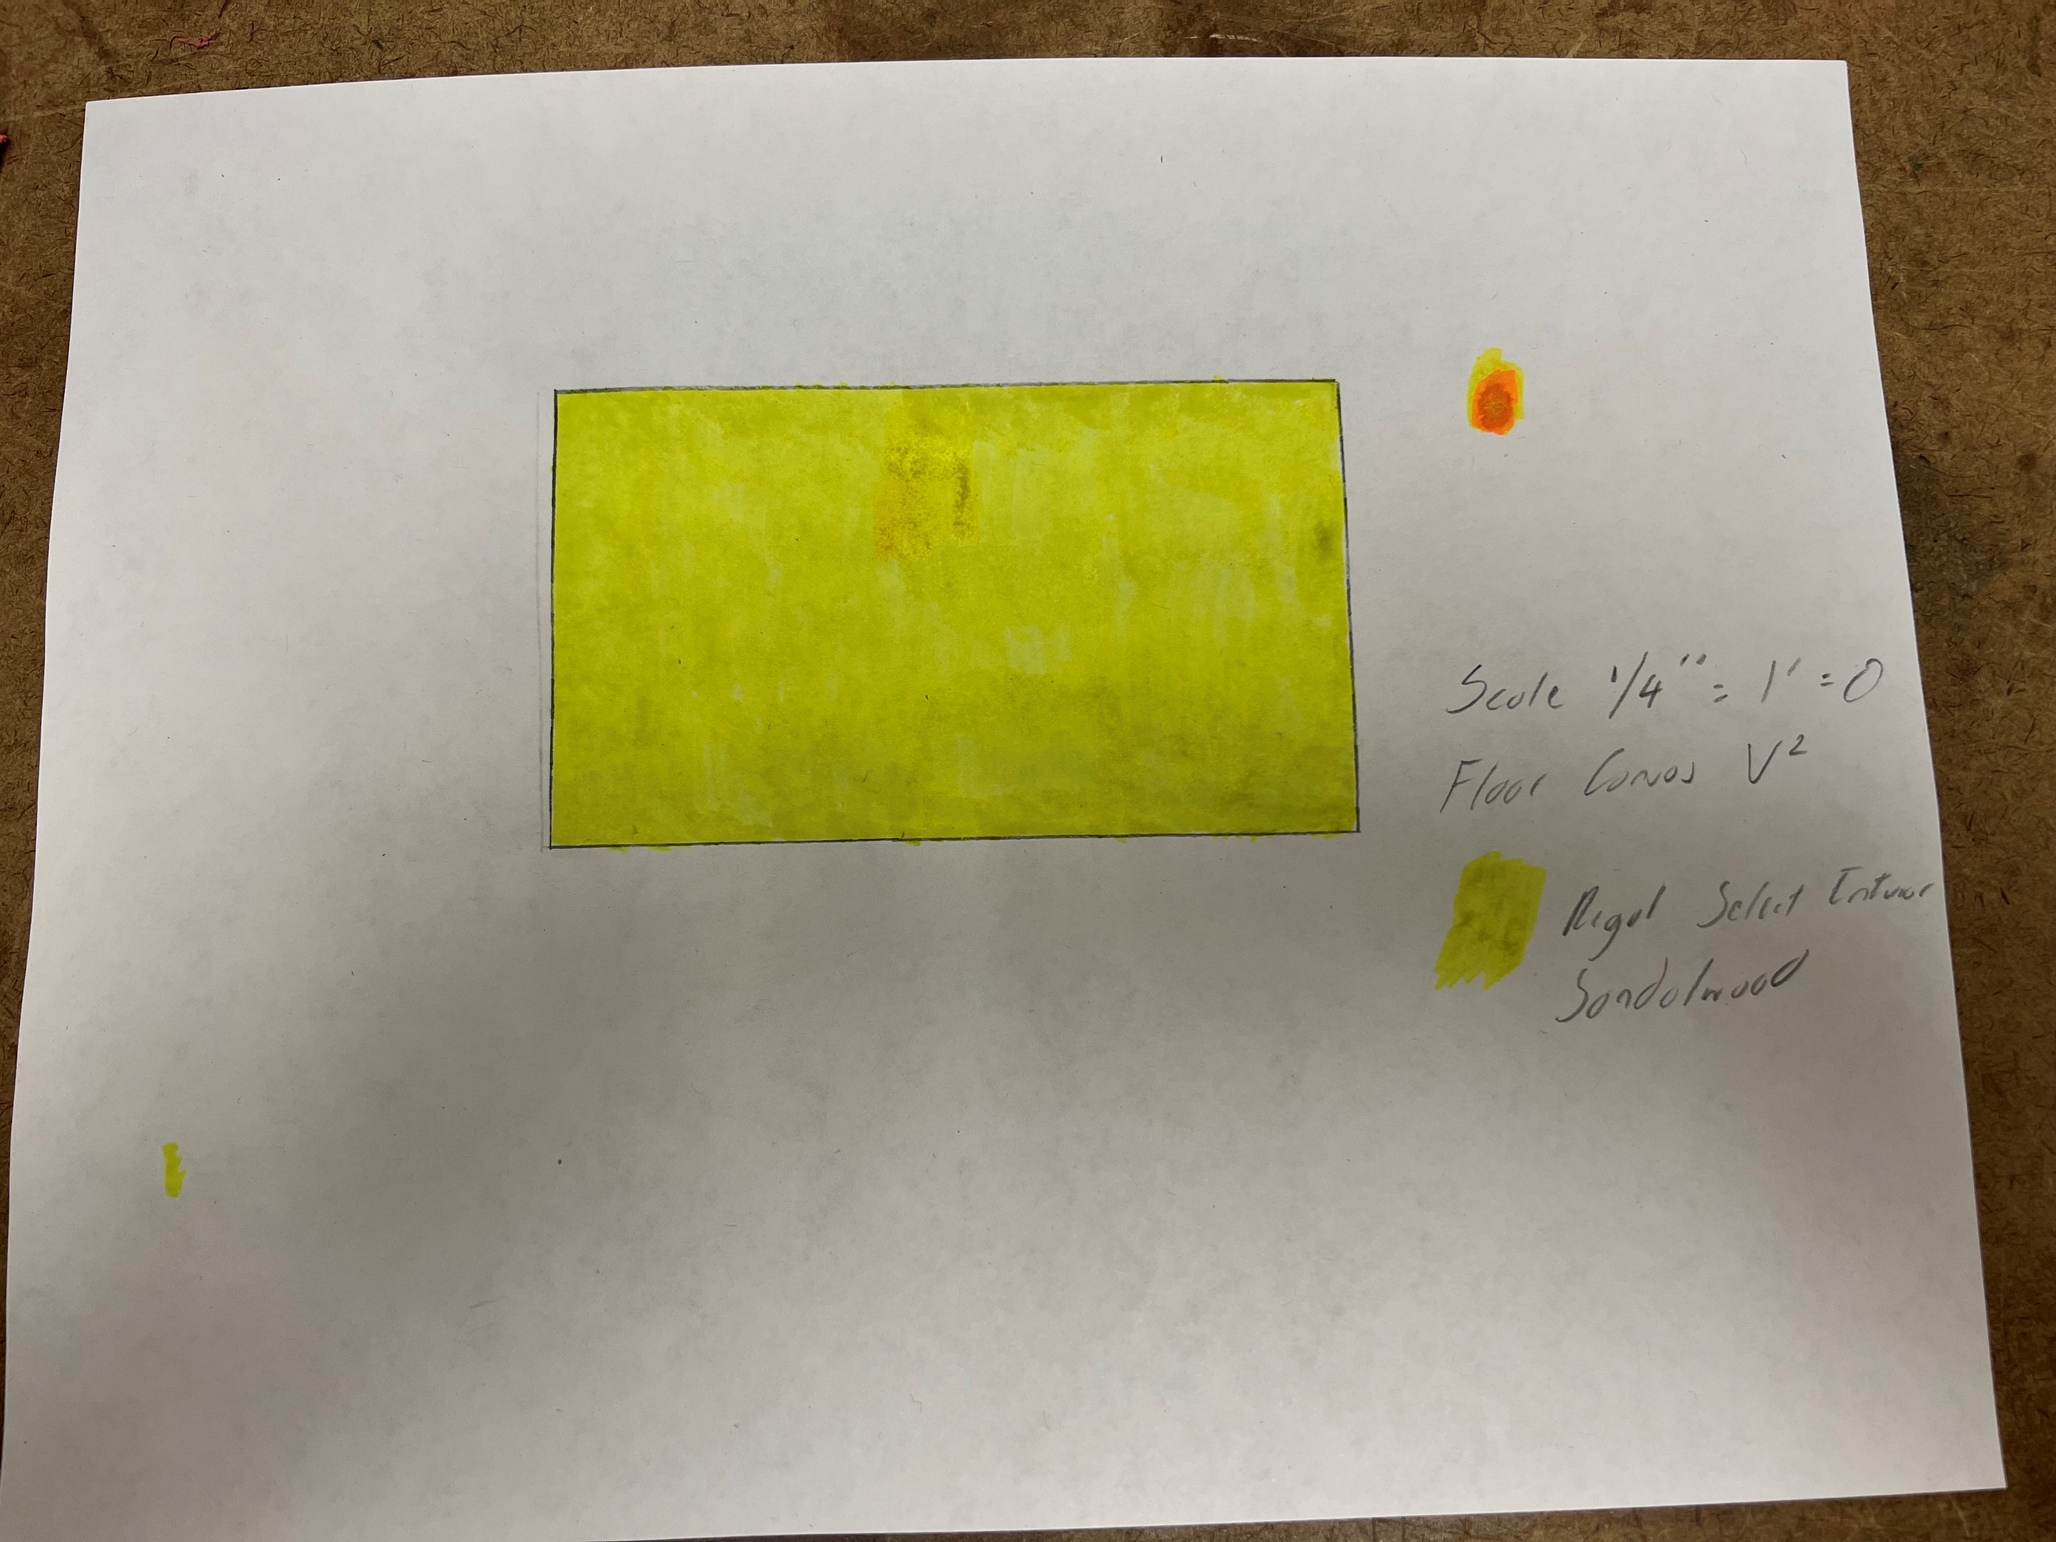
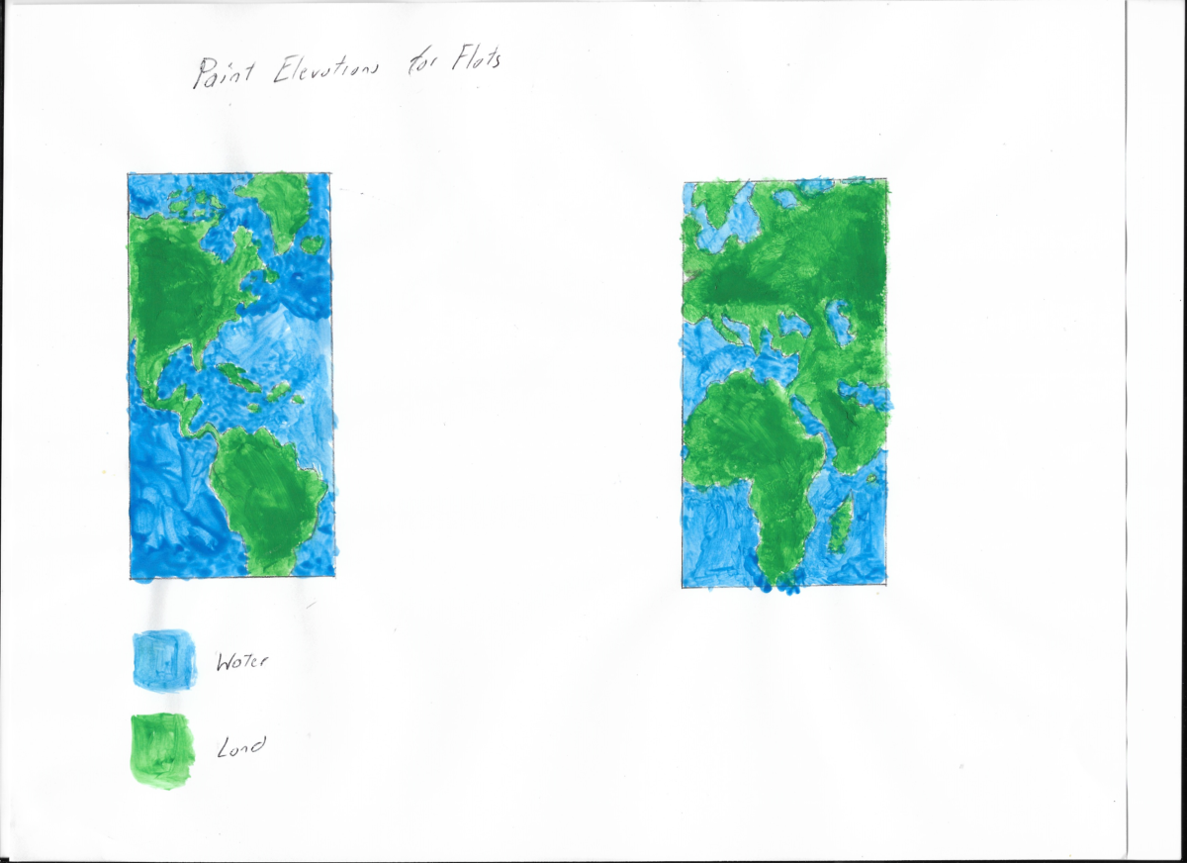
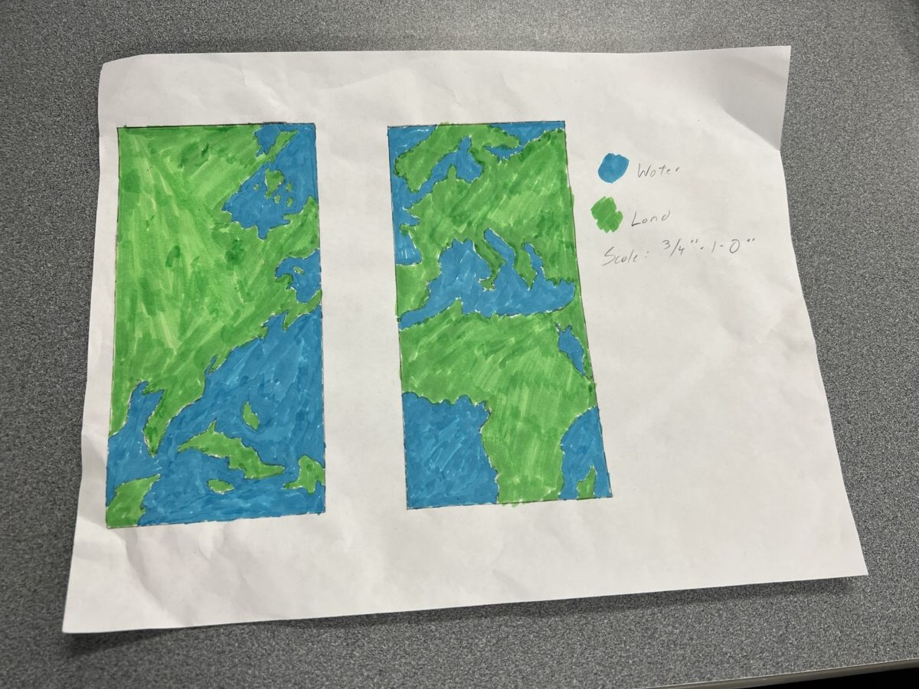
Paint Elevations
Floor Canvas V1
Floor Canvas V2
Flats V1
Flats V2

Slide 9
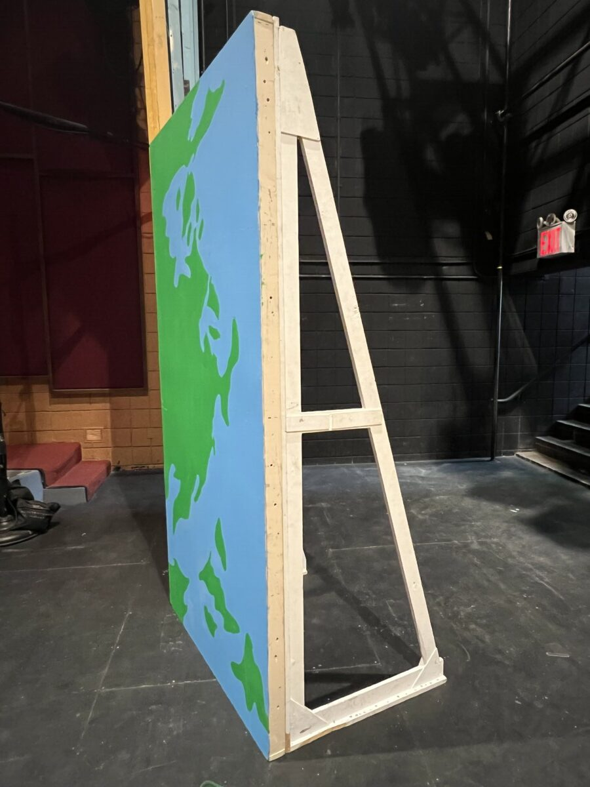
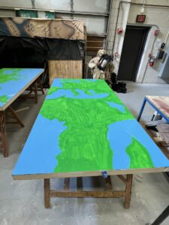
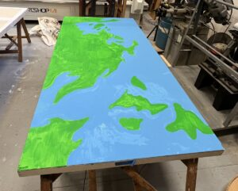
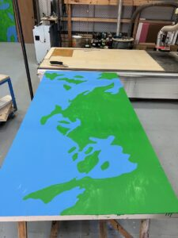
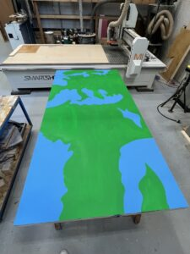
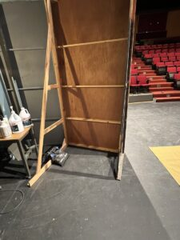
4x8 Flats
For my main scenic elements, I decided to use 2 4x8 Theatrical Flats in stock from V-102.
Before painting, staples should be flushed. Then use a mixture of spackle/water with a trowel. Then scrape it with a sander.
Paint Process: Mix Rosco Flamex PA with Regal Select Interior Paint. 1 Quart = 4 oz Flamex. 1 Gallon = 8 oz.
In terms of design, I decided to choose a map that fits into the theme of the show.
For full color saturation, add on another paint layer.
For the load-in, I used 8’ jacks in house for the flats to stand. Recommend using 1-1/4” Drywall screws
For extra stability, sandbags should be used for added weight.

Slide 10
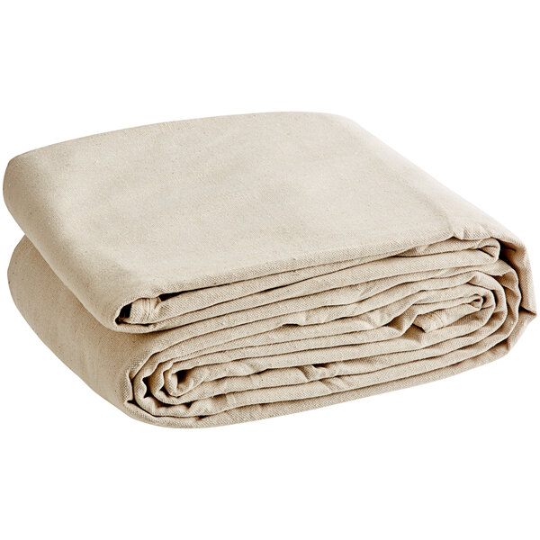
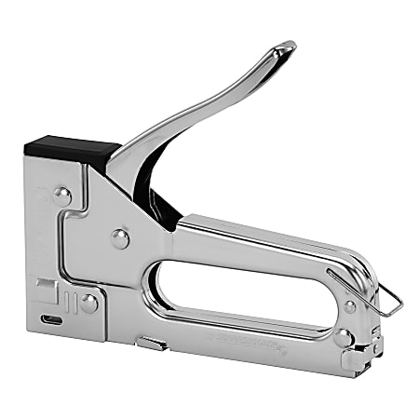
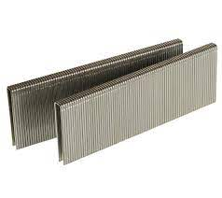
Floor Canvas
For this purpose of the load-in, I decided to use two 6’x9’ Duck Cloth that’s stress free. Stretch cloth is recommended – better wear resistance and breathability for painting.
Stress free Duck Cloth has good water-absorbing functions (Great for Regal Interior Select Paint) but stretch cloth has the better absorption.
If painting floor canvas, use a floor protection material that’s easy to take off after drying.
Paint rollers is highly recommended for better time management (especially with less extra hands).
Paint Process: Mix Rosco Flamex with Regal Select Interior Paint
To attach the floor canvas to the stage floor, use a staple gun with narrow crown staples. A multitool is recommended for removal. Floor tacts are a good alternative.

Slide 11
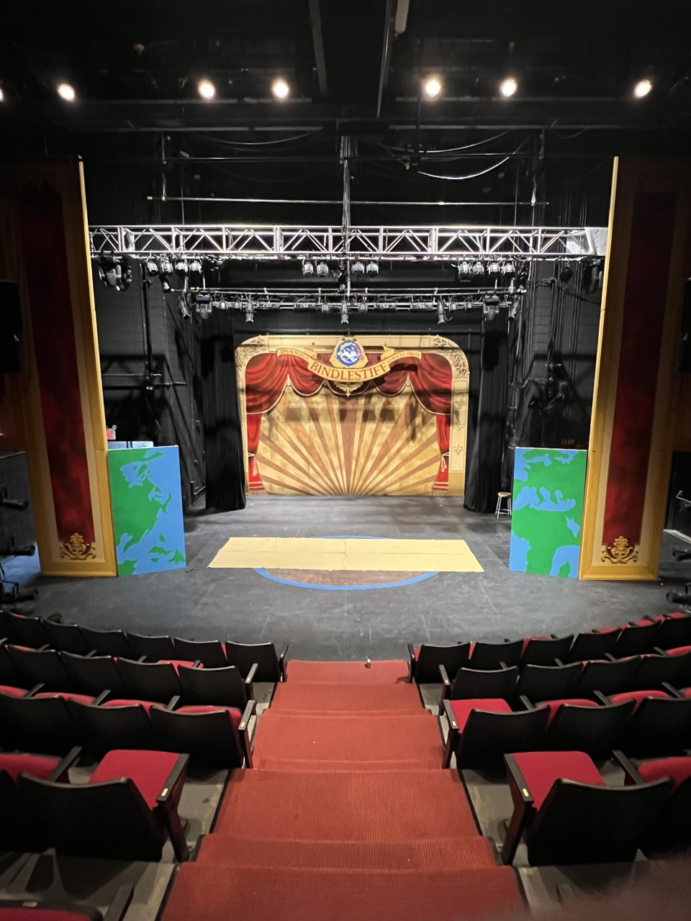
Trial load in/Load out
For the trial-load in, I was dealt with a couple of issues during the process.
Because of the fake proscenium installed for Bindlestiff, installing curtain was impossible.
Material of floor canvas is stress free, causing the floor canvas to not lay completely flat on the theatre as I would like. (Even with stapling both pieces)
The dimensions of the floor canvas is way too small than advertised. (One important tip is to carefully look at the dimensions of the material you’re working with.)
Visually, you can’t work around with the Bindlestiff Scenery being used on stage. (This includes the backdrop and paint surface centerstage)

Slide 12
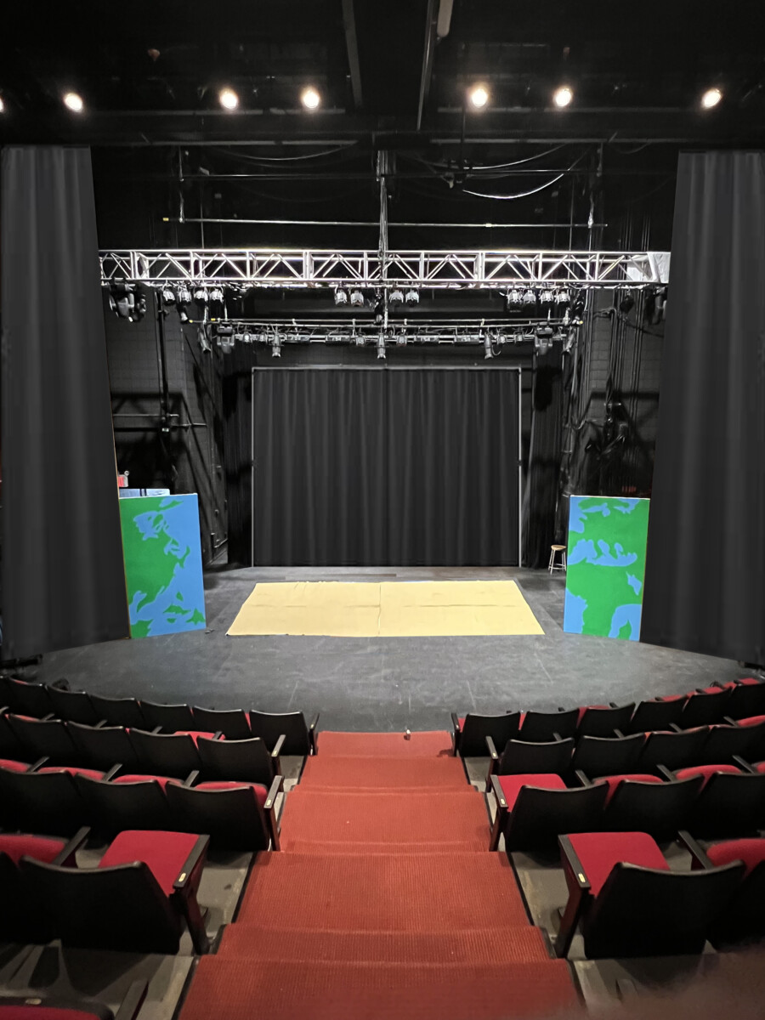
Trial Load In/Load Out
To solve this issue at hand, I decided to use Adobe Photoshop to get rid of the previous elements from Bindlestiff. For the process itself:
Replaced the fake proscenium with large curtains that mask within the flats.
Took out the backdrop upstage and replaced it with a large curtain to fit onto the traveler track.
Cropped out the floor painting and used the stage floor as texture.
Enlarged the floor canvas to the similar dimensions based on the groundplan.

Slide 13
Conclusion
If you’re going to order materials for an upcoming show, don’t place an order directly from the Bursar’s office. Put in a quote directly to the vendors. Delivering straight to the Voorhees Theatre is much easier. Because our money directly came from SGA & Stagecraft, processing the orders from Bursar was guaranteed. Setbacks include,
Longer delivery dates. (Caused me to buy my own floor canvas)
Uncertainties with orders being processed on time.
Spending extra money on materials. (ex: Extra paint, tools)
Change of deadlines
Know what the dimensions of the materials you’re working with before doing anything else. The less mistakes, the better your results will turn out.
Use your time wisely. Using resources in the shop can be beneficial as long it’s approved.
For lab hours, working with crew members is super helpful. Example: Having students from the Stagecraft Club help me paint the flats.

