Slide 1
Do Now: Answer one of the questions in complete sentences in your notebooks.
Why do people use waze or google maps and what are the benefits they gain from using those apps?
How is waze or google maps helpful in your everyday life?
What does waze and google maps have in common?

Slide 2
AIM: hOW CAN WE DRAW AND IDENTIFY THE SYMBOLS IN A SCHEMATIC CIRCUIT?

Slide 3
S.w.b.a.t:
define a schematic diagram
identify basic schematic symbols and their equivalent component
draw and interpret schematic diagrams

Slide 4
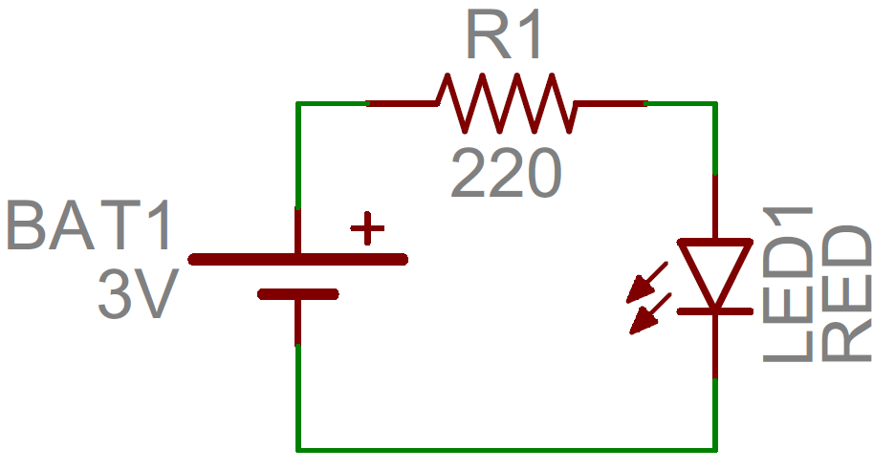
What is a schematic diagram?
A schematic diagram is a technical drawing of a circuit that shows how electronic components are connected to one another in a circuit. Each component has its own unique universal schematic symbol used to identify it in the diagram.

Slide 5
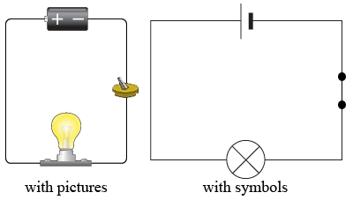
You can think of a Schematic diagrams as a map or blueprint for electronic components.
Just like how maps have satellite and default view, in electronics you can have a pictorial/wiring diagram or a schematic diagram.

Slide 6
What are electronic components?
Electronic components are devices that are connected in a circuit to impact or be affected by electricity.

Slide 7
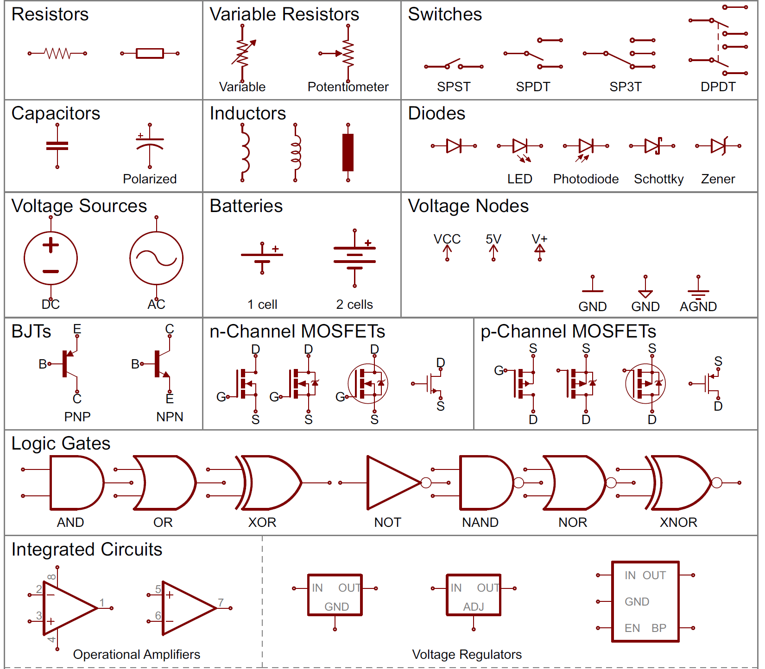
What are schematic symbols?
Each electronic component has an easily drawn, & easily recognizable symbol called a schematic symbol.

Slide 8
Why are schematic diagrams helpful?
Identification: To identify the components used in a circuit.
Troubleshooting: to determine what point in a circuit a problem exists
Guide: As a map to help build or fix a circuit.
Consistency:Schematic diagrams and symbols are universal, so anyone around the world are able to interpret them, even if they don’t speak the same language.

Slide 9
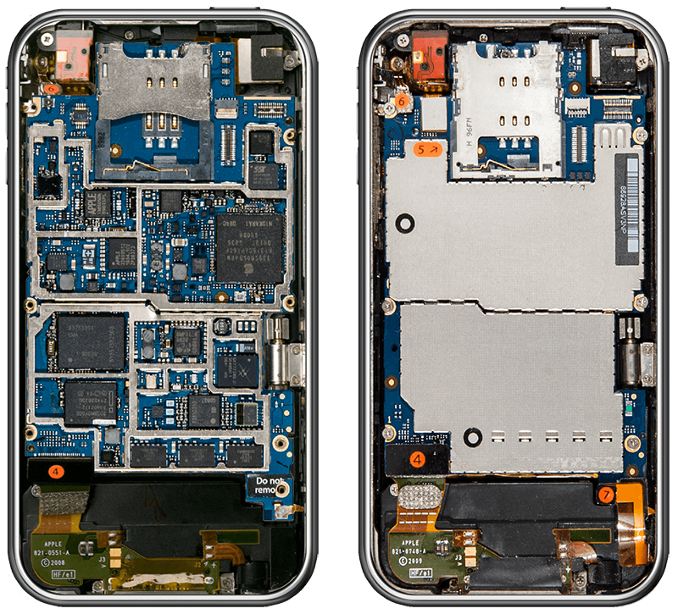
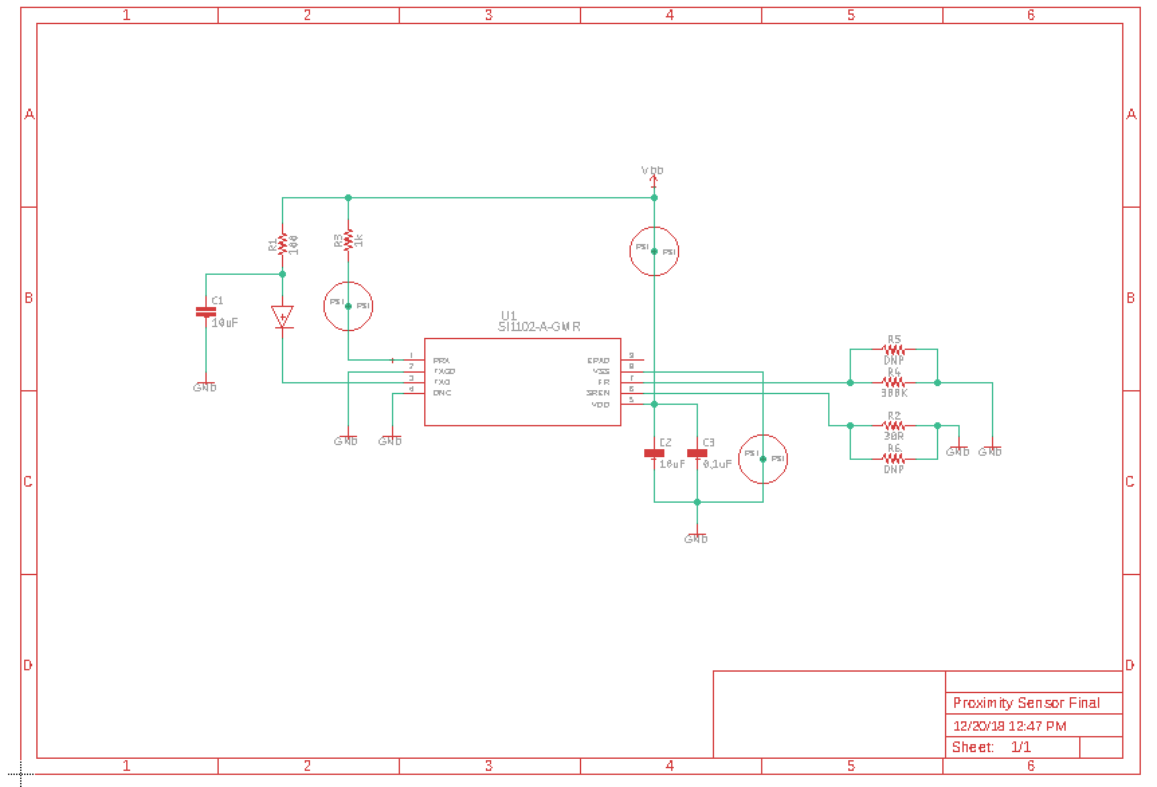
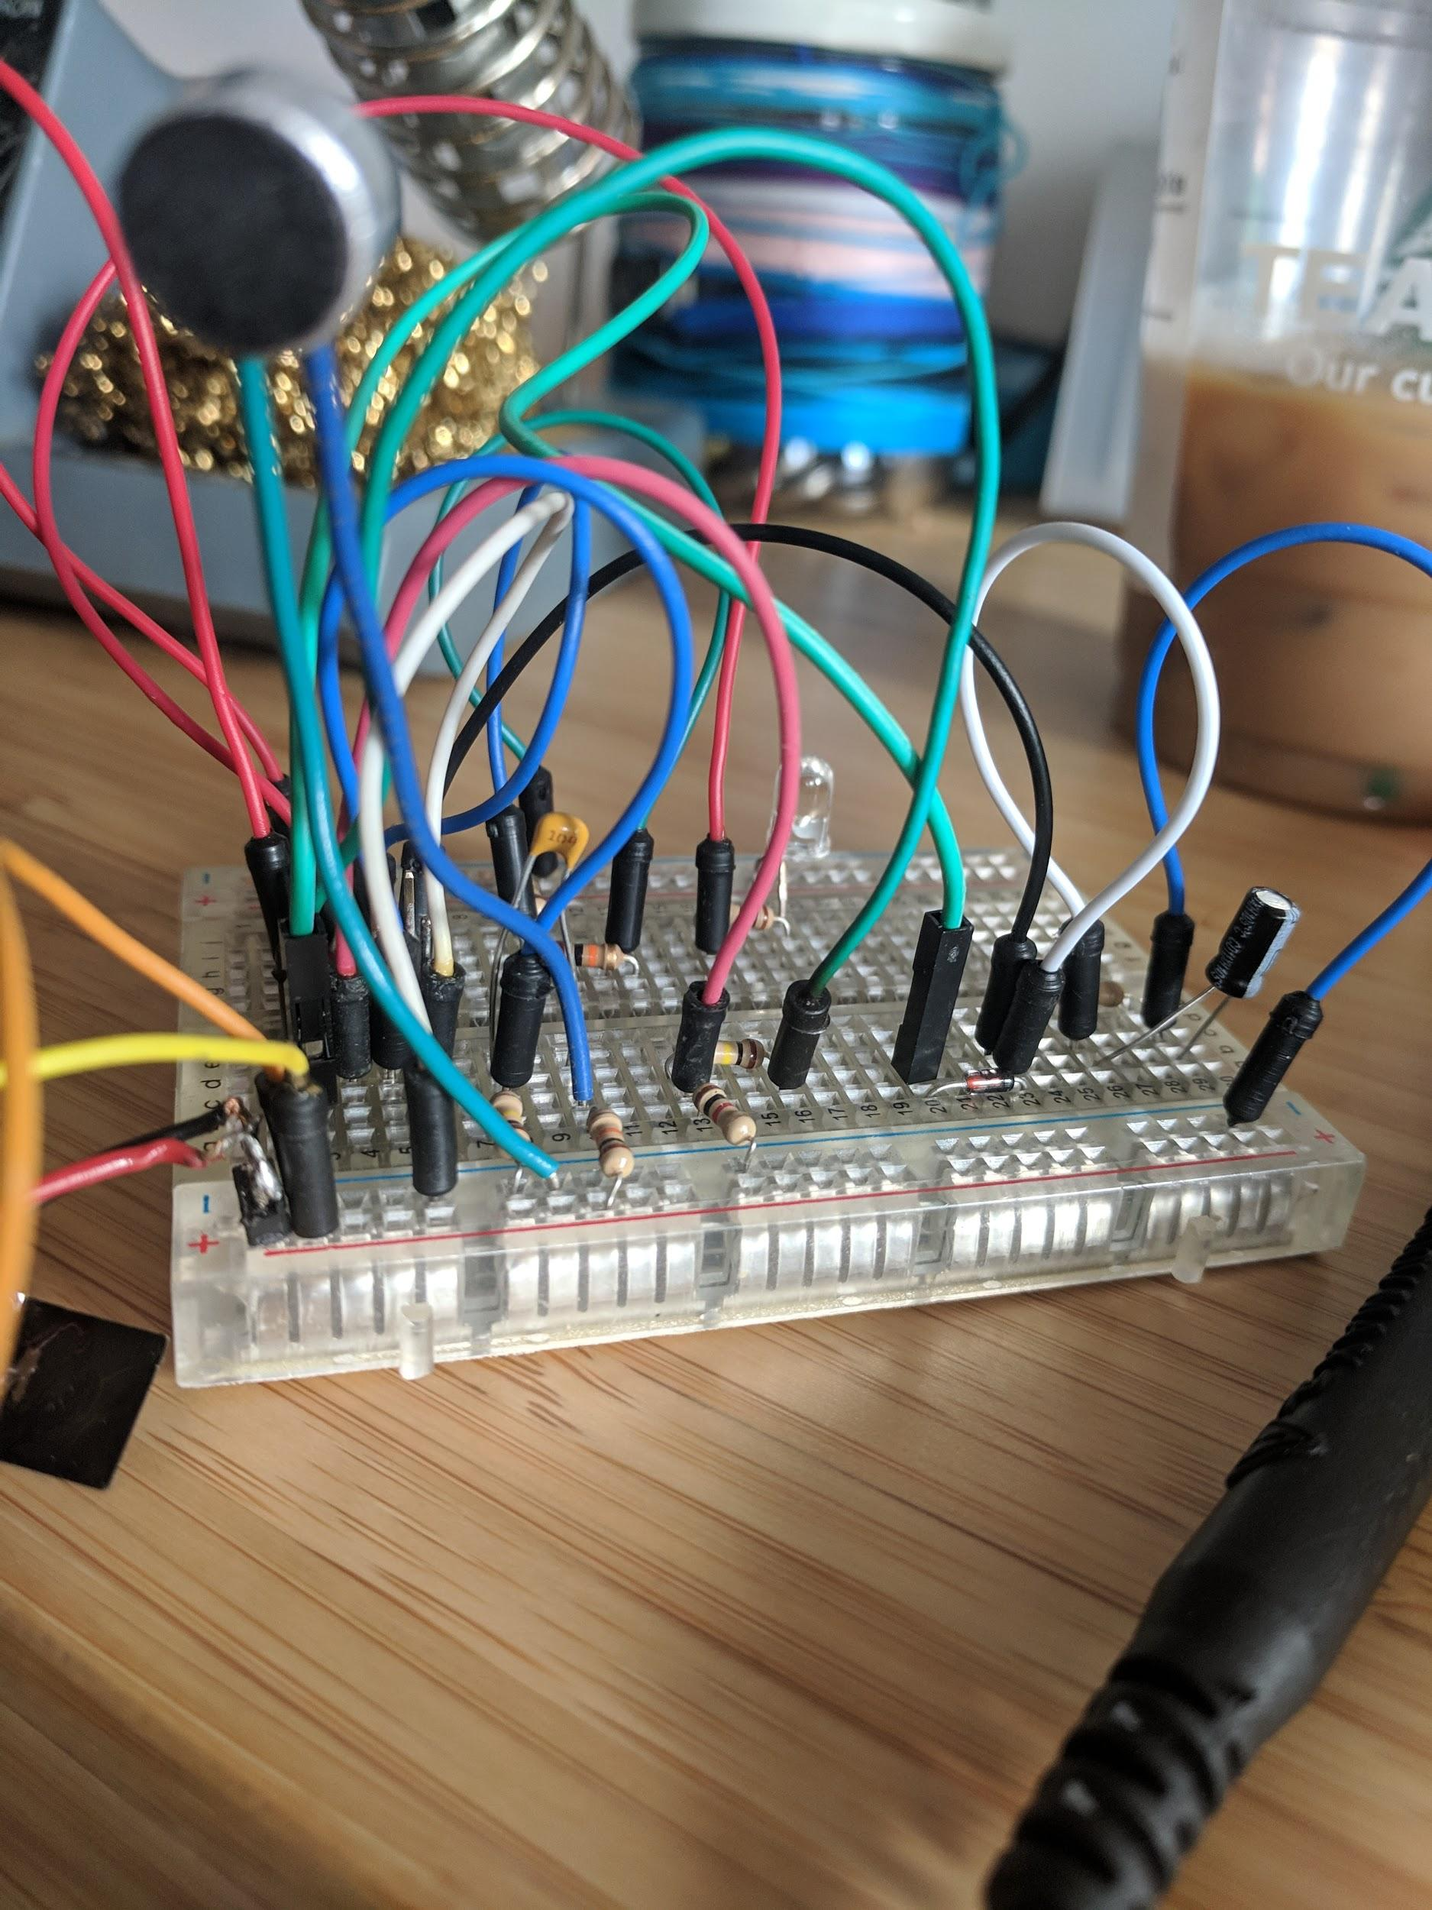
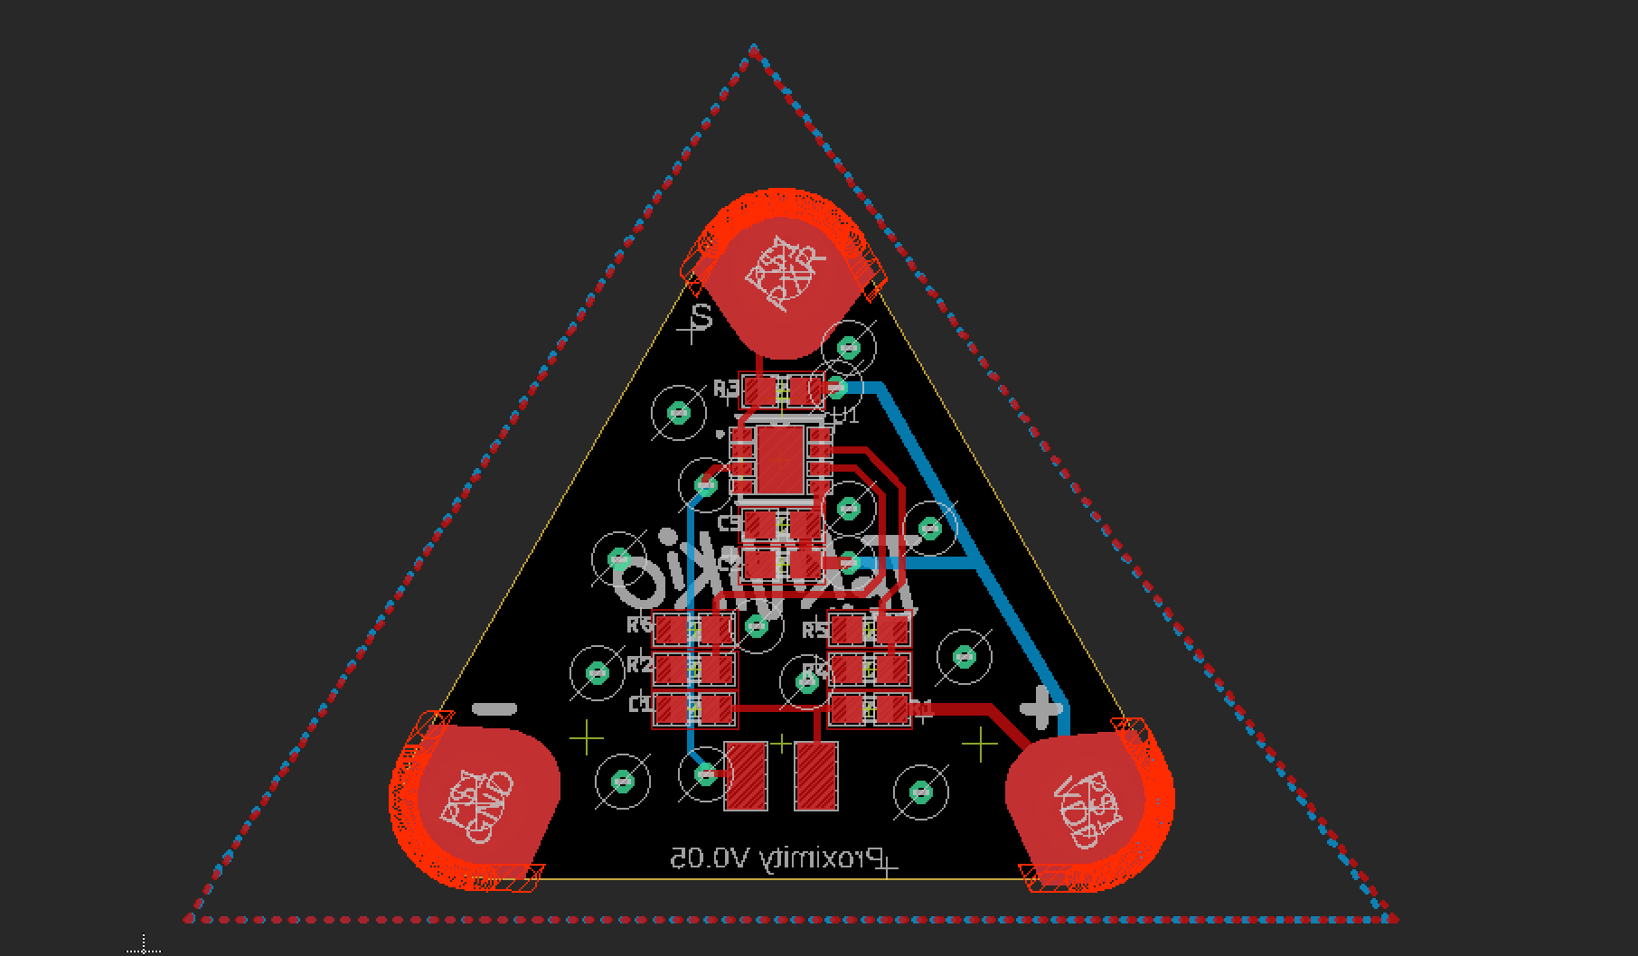
Real World Application

Slide 10
Basic schematic symbols
Battery Lamp Slide Switch

Slide 11
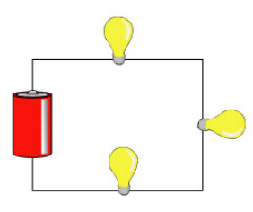
On your own try converting this pictorial into a schematic diagram. Use a ruler when drawing your schematics!

Slide 12
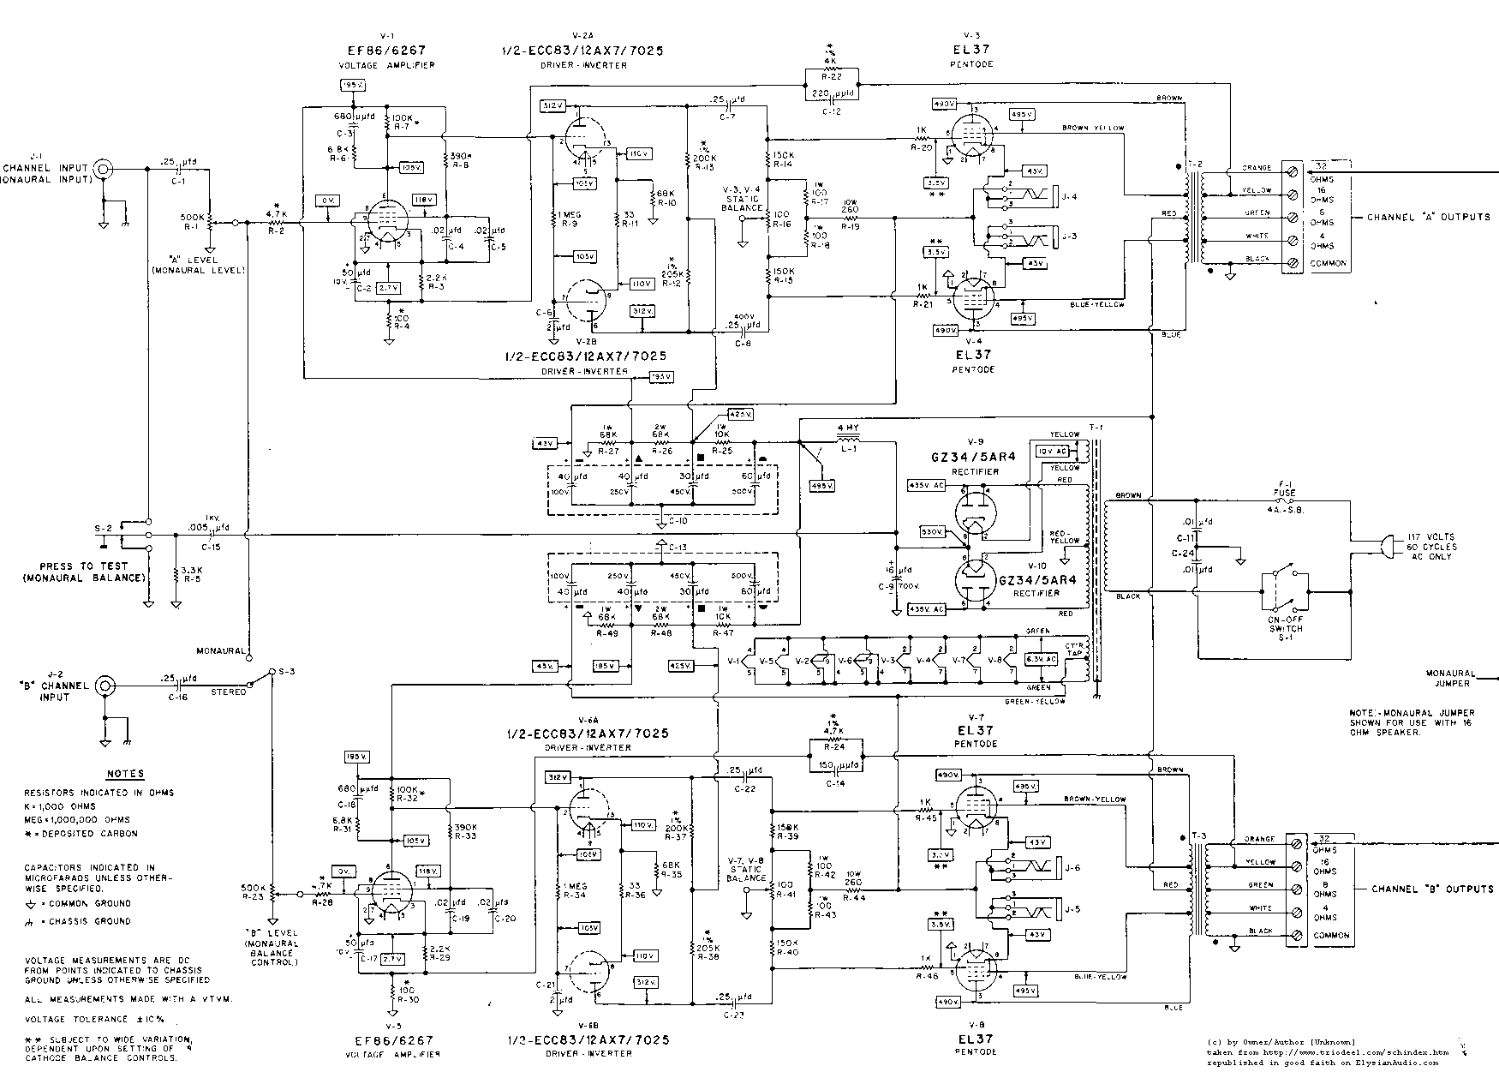
Summary
What is a schematic diagram? Define in your own words.
What are electronic components? Define in your own words.
What are two benefits of using a schematic diagram?

Slide 13
Immediate application
Using the schematic reference sheet, complete the schematic worksheet.
You will need your trainers to complete the schematic worksheet.
If you didn’t finish the schematic worksheet it is homework. (Complete all of the trainer portions first).
When finished with the worksheet, start completing Job #1.

