Slide 1
The unique properties of turmeric in prevention of periodontal disease
Conclusion
Bibliography
Turmeric has been known to posses many beneficial properties, therefore continued research and promotion of this product into the dental practice may prove beneficial and promising to the reduction of gingival inflammation. Turmeric products within dentistry such as in the form of gel, mouthwash, and paste were studied and produced favorable results.
Turmeric supplements are widely available on the market in form of tablets and drops. Hopefully in the near future more products containing turmeric will become FDA and ADA approved, assuring dental professionals that the product is safe to use and effective in the aid of gingival inflammation.
1. Farjana, H. N., Chandrasekaran, S. C., & Gita, B. (2014). Effect of Oral Curcuma Gel in Gingivitis Management - A Pilot Study. Journal Of Clinical And Diagnostic Research. doi:10.7860/jcdr/2014/8784.5235
2.Gu, Y., Lee, H.-M., Napolitano, N., Clemens, M., Zhang, Y., Sorsa, T., … Golub, L. M. (2013). 4-Methoxycarbonyl Curcumin: A Unique Inhibitor of Both Inflammatory Mediators and Periodontal Inflammation. Mediators of Inflammation, 2013, 329740. http://doi.org/10.1155/2013/329740
3. Mali, A. M., Behal, R., & Gilda, S. S. (2012). Comparative evaluation of 0.1% turmeric mouthwash with 0.2% chlorhexidine gluconate in prevention of plaque and gingivitis: A clinical and microbiological study. Journal of Indian Society of Periodontology, 16(3), 386–391. http://doi.org/10.4103/0972-124X.100917
4. Vaughn, A. R., Branum, A., & Sivamani, R. K. (2016). Effects of Turmeric (Curcuma longa) on Skin Health: A Systematic Review of the Clinical Evidence. Phytotherapy Research, 30(8), 1243-1264. doi:10.1002/ptr.5640
Source: https://chihealth.co/4
B.Mashkulli, W.Rodriguez, T.Shchedrina
New York City College of Technology
March 2017
Source: http://healthbubbles.com/gb
Turmeric as a herb, spice, root crop

Slide 2
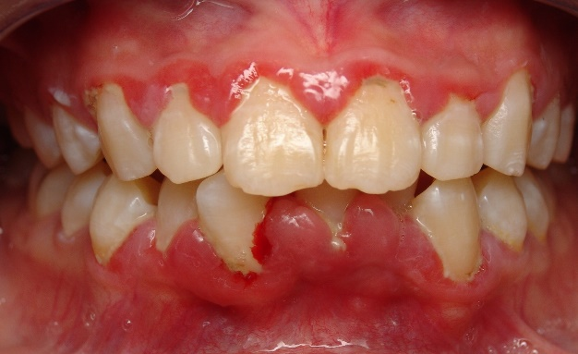
Introduction
Potential Use of Turmeric in dentistry
The turmeric mouthwash proved to be free of the side effects like bitter taste and staining, which occurred with the chlorhexidine mouthwash. Both mouthwashes can be effectively used as an adjunct to mechanical plaque control in prevention of plaque and gingivitis.
Turmeric may have beneficial properties, however it is characterized by poor solubility and low bioactivity, which hinders its medicinal effects. A research study conducted by Stony Brook University on rats, has developed a new turmeric compound- chemically modified Curcumin with increased solubility. The researchers found that the modified Curcumin compound had greater ‘therapeutic activity’ against human enzymes and secretions that cause inflammation. The modified Curcumin compound worked better in this form because it was easier to absorb. The researchers ultimately concluded that the modified Curcumin compound was able to reduce the destructive effects of inflammatory mediators in both local (periodontal disease) and systematic (diabetes) conditions without exhibiting toxicity.
Potentially, more research must be done to apply this modified Curcumin on humans.
Turmeric is a distinctive bright yellow aromatic powder obtained from the rhizome of the ginger family plant. It is used for flavoring and coloring in Asian and Indian cooking and formerly as a fabric dye. Turmeric has also been known to possess many beneficial properties such as anti-inflammatory, anti-oxidant and antimicrobial properties. Turmeric has been used as a medicine for centuries to treat wounds, infections, colds, and liver disease.
Further investigation of turmeric reveals that that it contains a chemical compound called curcumin, which causes the medicinal effects of reducing inflammation. Many research and studies regarding turmeric and its use within dentistry have demonstrated promising benefits.
Recent studies have been done using turmeric as a main ingredient to reduce gingivitis. Studies have received positive feedback with no adverse side effects.
Source: http://keywordsuggest.org/
Inflammation of the gingival tissue
A study published in the Journal of Indian Society of Periodontology provided results that compared the efficacy of using 0.1% turmeric mouthwash versus 0.2% chlorhexidine gluconate mouthwash in the prevention of plaque and gingivitis. The results of the study concluded that both groups revealed significant plaque reduction from the first day, 14th day and to the 21st day. The study was successful in providing results that confirmed both of the mouthwashes have comparable anti-plaque and anti-inflammatory properties.
Source: https://oldwayspt.org
Different forms of turmeric

