Slide 1
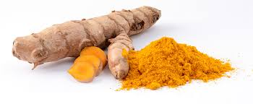
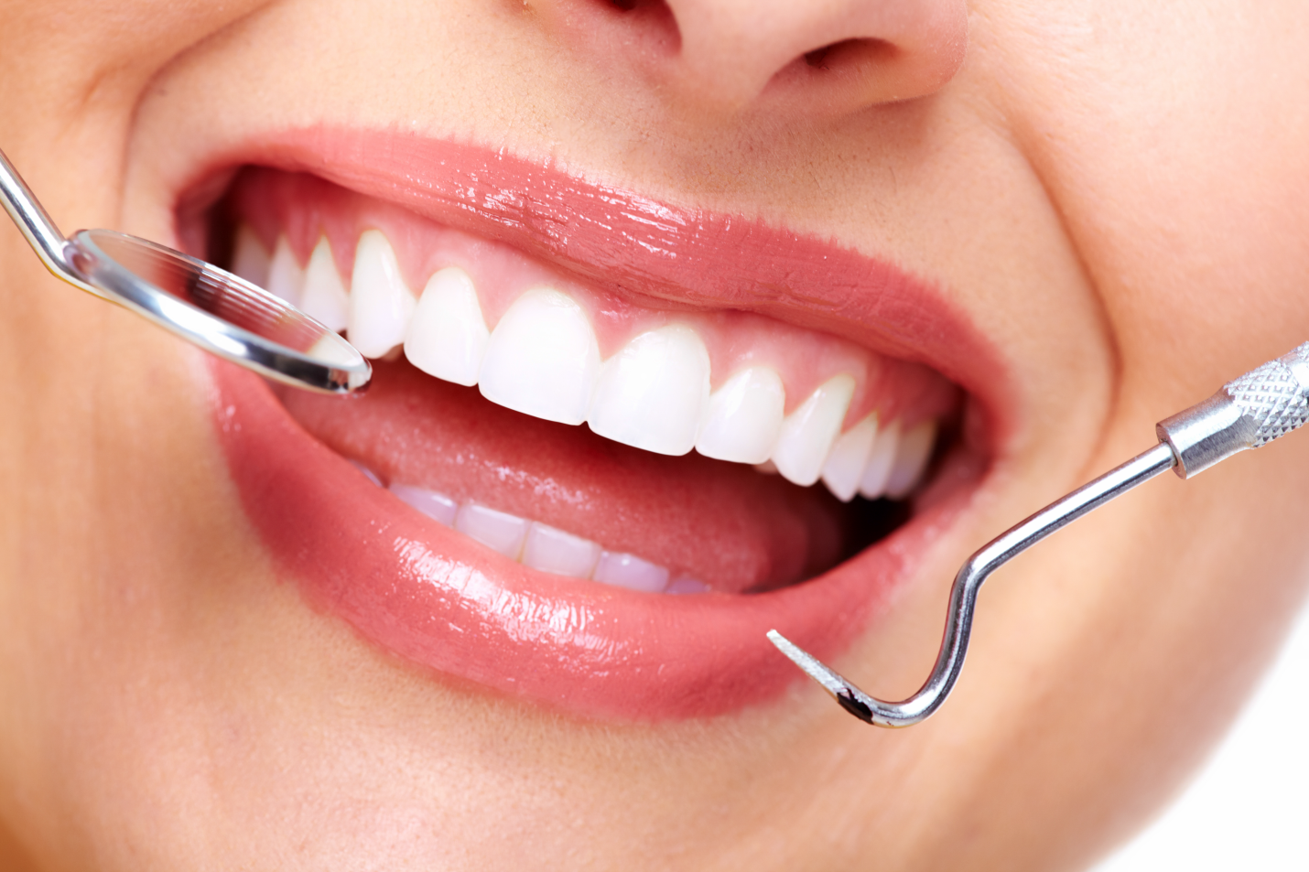
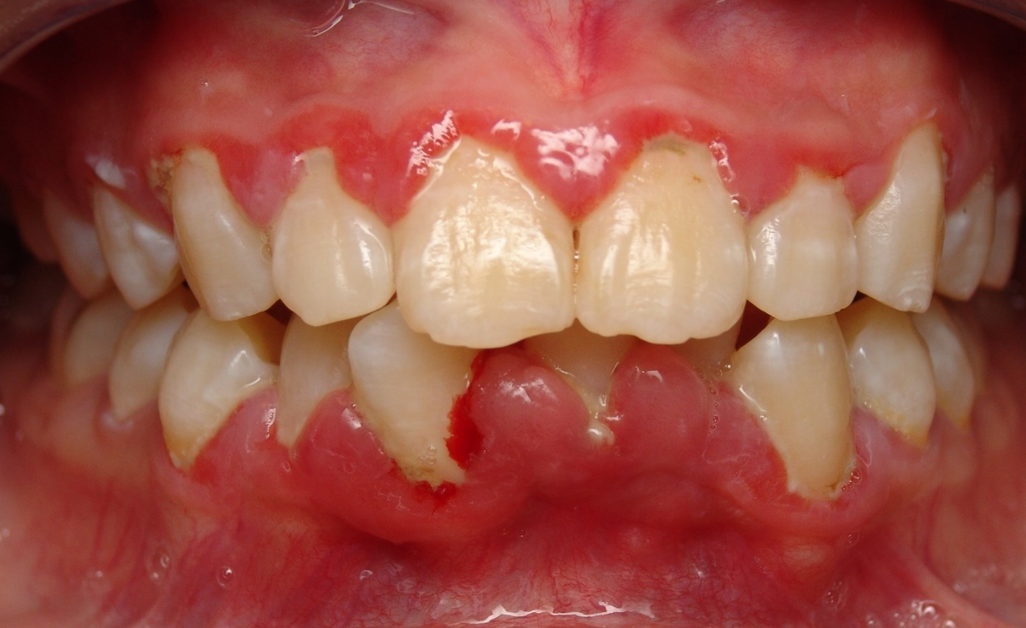
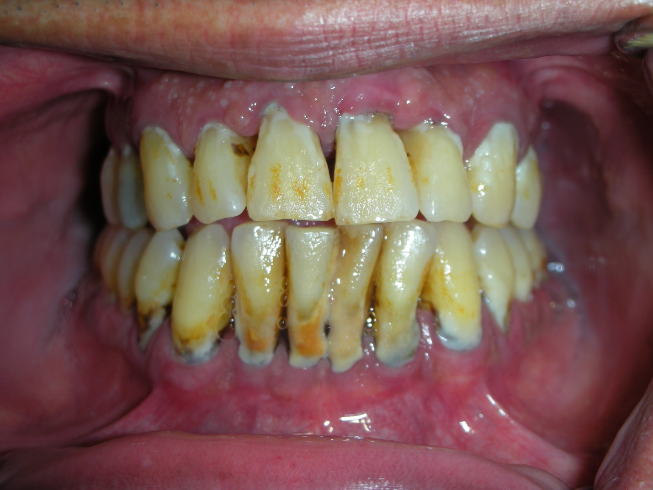
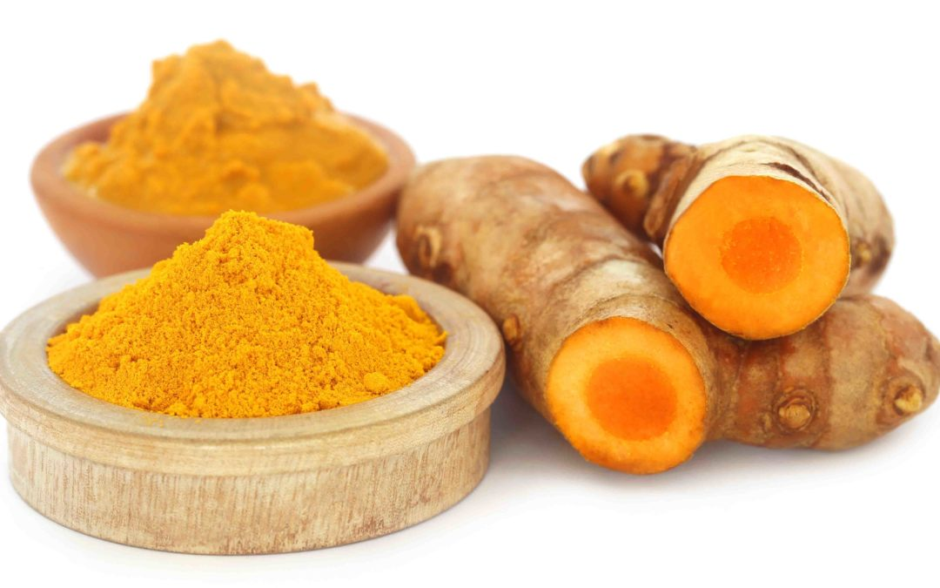
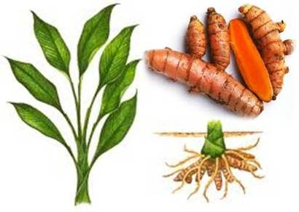
The unique properties of turmeric in the prevention of periodontal disease
B.Mashkulli, W.Rodriguez, T.Shchedrina
New York City College of Technology
March 2017
The fresh rhizome and powder
http://tropical.theferns.info/image.php?id
Introduction
Potential Use of Turmeric in dentistry
Conclusion
Turmeric is a distinctive bright yellow aromatic powder obtained from the rhizome of the ginger family plant. It is used for flavoring and coloring in Asian and Indian cooking and formerly as a fabric dye. It has been used as a medicine for centuries to treat wounds, infections, colds and liver disease. Turmeric has be known to have many beneficial properties such as:
Turmeric contains a component called Curcumin, that has powerful antioxidant effects. It neutralizes free radicals on its own, then stimulates the body’s own antioxidant enzymes.
Curcumin may help reverse many steps in the heart disease process by improving the function of the endothelium, which is the lining of the blood vessels.
Arthritis has been known to cause joint inflammation. To test the efficacy of Curcumin as an anti-inflammatory agent, several studies have been conducted. Results have proven that it does have this property. In a study of patients with rheumatoid arthritis, Curcumin was even more effective than commonly anti-inflammatory drugs. This study demonstrated that Curcumin was effective in reducing joint inflammation.
Curcumin has proven to have comparable effects as some anti-inflammatory drugs. Curcumin actually targets multiple steps in the inflammatory pathway, at the molecular level. It also blocks NF-kB, a molecule that travels into the nuclei of cells and turns on genes related to inflammation. NF-kB is believed to play a major role in many chronic diseases. Curcumin is a bioactive substance that fights inflammation at the molecular level. In several studies, its potency has compared favorably to anti-inflammatory pharmaceutical drugs.
Many research and studies regarding turmeric and its use within dentistry have demonstrated promising benefits. This project was made to investigate anti-inflammatory properties of turmeric.
Recent studies have been conducted using turmeric as a main ingredient to reduce gingivitis. Studies have received positive feedback with no adverse side effects.
A study published in the Journal of Indian Society of Periodontology provided results that compared the efficacy of using 0.1% turmeric mouthwash versus 0.2% chlorhexidine gluconate mouthwash in the prevention of plaque and gingivitis. The results of the study concluded that both groups revealed significant plaque reduction from the first day, 14th day and to the 21st day. The study was successful in providing results that confirmed both of the mouthwashes have comparable anti-plaque and anti-inflammatory properties. The turmeric mouthwash proved to be free of the side effects like bitter taste and staining, which occurred with the chlorhexidine mouthwash. Both mouthwashes can be effectively used as an adjunct to mechanical plaque control in prevention of plaque and gingivitis.
Turmeric has been known to possess many beneficial properties, therefore continued research and promotion of this product into the dental practice may prove beneficial and promising to the reduction of gingival inflammation. Turmeric products within dentistry, such as in the form of gel, mouthwash, and paste were studied and produced favorable results.
Turmeric supplements are widely available on the market in the form of tablets and drops. Hopefully, in the near future more products containing turmeric will become FDA and ADA approved, assuring dental professionals that the product is safe to use and effective in reducing gingival inflammation.
http://www.superlife.com/turmeric/
Healthy Gingiva
https://i0.wp.com/deancosmeticdentistry.com/wp-content/uploads/2016/03/dentist.png
Gingivitis
http://www.pixell.club/severe-gingivitis-before-and-after/
Advanced Periodontitis
http://periocenter.gr/en/periodontics/periodontitis.html/
Bibliography
Agarwal, R., Goel, S. K. and Behari, J. R. (2010), Detoxification and antioxidant effects of curcumin in rats experimentally exposed to mercury. J. Appl. Toxicol., 30: 457–468. doi:10.1002/jat.1517
Aggarwal, B. B., & Harikumar, K. B. (2009). Potential Therapeutic Effects of Curcumin, the Anti-inflammatory Agent, Against Neurodegenerative, Cardiovascular, Pulmonary, Metabolic, Autoimmune and Neoplastic Diseases. The International Journal of Biochemistry & Cell Biology, 41(1), 40–59.
Farjana, H. N., Chandrasekaran, S. C., & Gita, B. (2014). Effect of Oral Curcuma Gel in Gingivitis Management - A Pilot Study. Journal Of Clinical And Diagnostic Research. doi:10.7860/jcdr/2014/8784.5235
Gu, Y., Lee, H.-M., Napolitano, N., Clemens, M., Zhang, Y., Sorsa, T., … Golub, L. M. (2013). 4-Methoxycarbonyl Curcumin: A Unique Inhibitor of Both Inflammatory Mediators and Periodontal Inflammation. Mediators of Inflammation, 2013, 329740. http://doi.org/10.1155/2013/329740
Jurenka, J. S. (2009). Anti-inflammatory Properties of Curcumin, a Major Constituent of Curcuma longa: A Review of Preclinical and Clinical Research. Alternative Medicine Review,14(2), 141-153. Retrieved March 23, 2017, from http://www.altmedrev.com/publications/14/2/141.pdf
Mali, A. M., Behal, R., & Gilda, S. S. (2012). Comparative evaluation of 0.1% turmeric mouthwash with 0.2% chlorhexidine gluconate in prevention of plaque and gingivitis: A clinical and microbiological study. Journal of Indian Society of Periodontology, 16(3),386–391. http://doi.org/10.4103/0972-124X.100917
Snyder, T. C. (n.d.). Gingivitis: Learn About Symptoms and Treatment (M. C., Ed.). Retrieved March 23, 2017, from http://www.emedicinehealth.com/gingivitis/article_em.htm
Vaughn, A. R., Branum, A., & Sivamani, R. K. (2016). Effects of Turmeric (Curcuma longa) on Skin Health: A Systematic Review of the Clinical Evidence. Phytotherapy Research, 30(8), 1243-1264. doi:10.1002/ptr.5640
Gingivitis and Periodontal Disease (Gum Disease). (n.d.). Retrieved March 23, 2017, from http://www.webmd.com/oral-health/guide/gingivitis-periodontal-disease#1
Gingivitis is the mildest form of periodontal disease often caused by inadequate oral hygiene. It causes gingival inflammation, which makes the gums become red, swollen, and bleed easily. There is usually little or no discomfort at this stage. Gingivitis is reversible with professional treatment and good oral hygiene however, if left untreated it can become a more serious infection known as periodontitis. Gingivitis and periodontitis are major causes of tooth loss in adults, according to the American Dental Association. It is necessary to treat gingivitis and arrest inflammation before it leads to irreversible effects such as periodontitis. This is where turmeric can play a role in the treatment of gingival inflammation in conjunction with professional treatment before it progresses to periodontitis.
Turmeric may have beneficial properties, however it is characterized by poor solubility and low bioactivity, which hinders its medicinal effects. A research study conducted by Stony Brook University on rats, has developed a new turmeric compound- chemically modified Curcumin with increased solubility. The researchers found that the modified Curcumin compound had greater ‘therapeutic activity’ against human enzymes and secretions that cause inflammation. The modified Curcumin compound worked better in this form because it was easier to absorb. The researchers ultimately concluded that the modified Curcumin compound was able to reduce the destructive effects of inflammatory mediators in both local (periodontal disease) and systematic (diabetes) conditions without exhibiting toxicity.
Relying on the positive results from this study, it should be assumed that more research and experiments must be done to apply this modified Curcumin potentially to humans.
http://ottawavalleydogwhisperer.blogspot.com/2012/11/turmeric-and-curcumin-good-for-your.html

