Slide 1
Serena Mincey

Slide 2
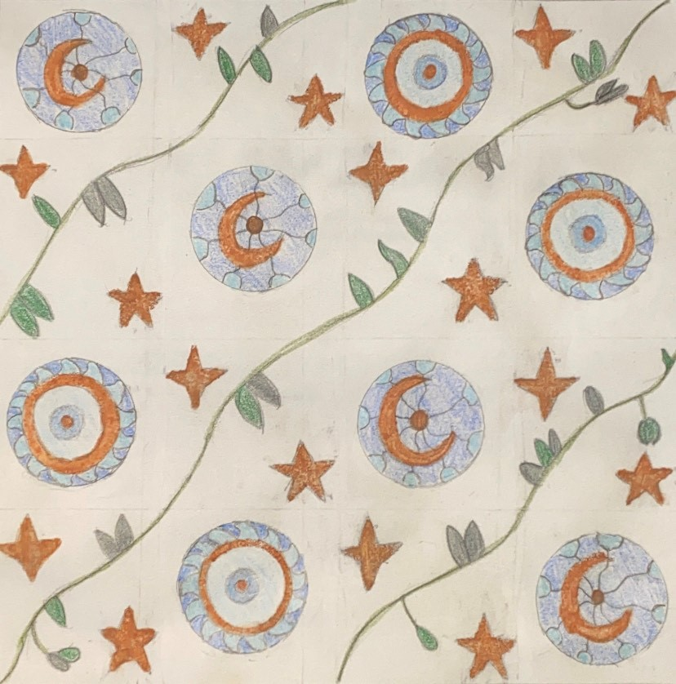
Zodiac by Alphonse Mucha 1896
Zodiac captures the viewers’ attention by having the lady be the main focal point of the piece especially with the jewelry on her head.

Slide 3
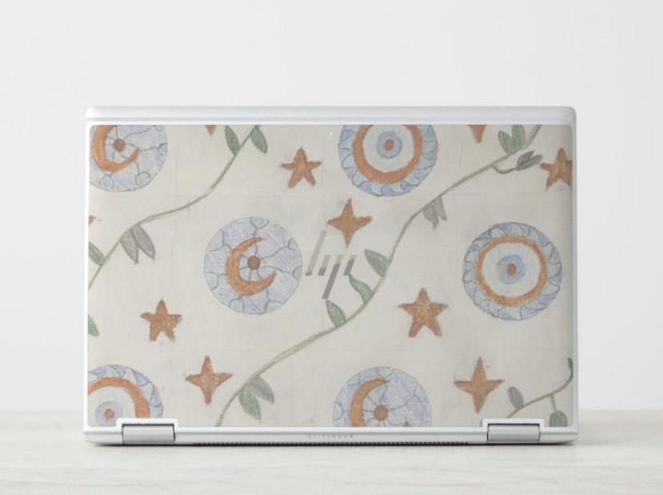

Slide 4
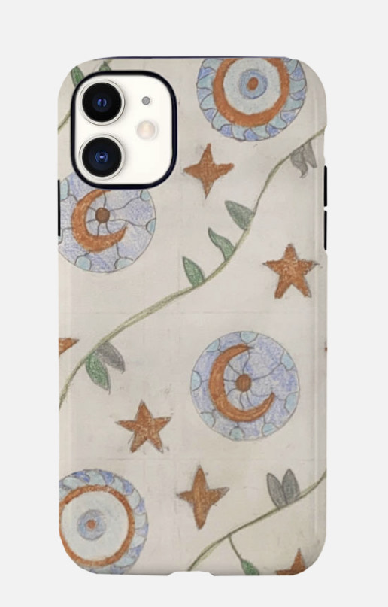

Slide 5
