Slide 1
Color
MMA 100

Slide 2
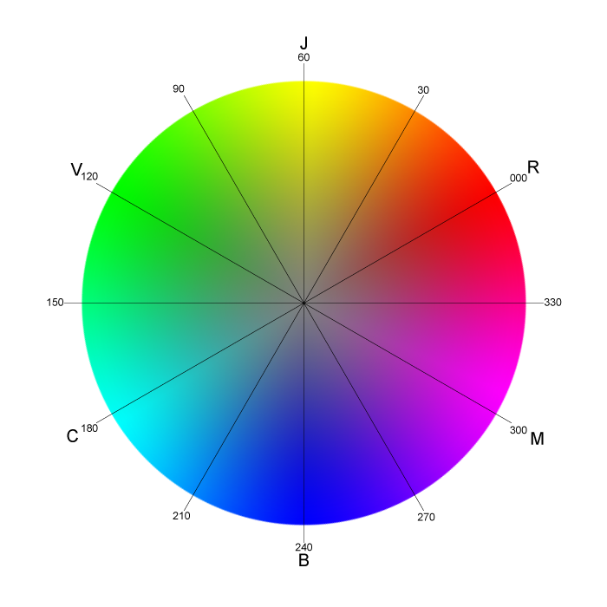
Color wheel
A circle that represents the relationships between colors

Slide 3
Color Models
A color model is a system for organizing colors.
There are many color models. Here are three of the most common that we will discuss and use in this class.
RGB (Red, Green, Blue)
CMYK (Cyan, Magenta, Yellow, Black)
HSB (Hue, Saturation, Brightness

Slide 4
RGB color model
RGB color is an additive model: adding all the colors together at their full % results in white.
Screen based media, (computers, phones) use the RGB color model. It is projected color.
Each color has a possible range of values from 0-255.
For example, RGB (255, 0, 0) represents Red.

Slide 5
CMYK color model
CMYK color is a subtractive color model. If you add all the colors together, you get black.
CMYK color is used for printing, it is based on pigments.
In CMYK color, each color is represented by a percentage.
CMYK(100%, 0, 0, 0) would represent Cyan, for example.

Slide 6
HSB color model
HSB color is composed of 3 values, Hue, Saturation and Brightness.
Hue is the color information. Is the hue red, yellow, blue?
Saturation is how the pure the color is, or how much gray it has in it. A fully desaturated color would be gray, while a fully saturated color would have no gray in it.
Brightness is how dark or light a color is.

Slide 7
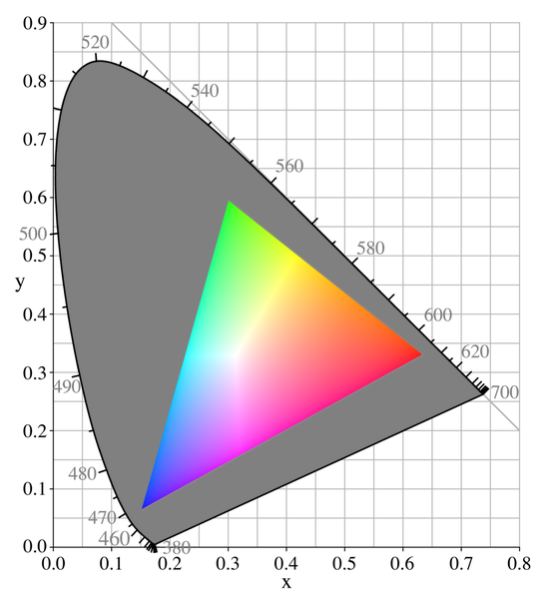
Color gamut
Color gamut refers to the range of colors that can be shown in a color model or in an output device like a monitor.
RGB color, for example, has a wider color gamut than CMYK. This means more colors can be represented in the RGB model than in the CMYK model.
srgb color gamut

Slide 8
Tints
A tint is a variation of a hue that is created by adding white.

Slide 9
Shades
A shade is a variation of a hue created by adding black.

Slide 10
Color schemes
Monochromatic, Analogous, Complementary
Monochromatic color is different shades or tints of the same hue.
Analogous colors are colors that are next to each other on the color wheel.
Complementary colors are opposite each other on the color wheel.

Slide 11
Color schemes
Monochromatic
Analogous
Complementary

Slide 12
Warm and cool colors
Colors have a “temperature”.
Colors that have a blue cast are considered cool, while those with red or yellow may appear warm.

Slide 13
Neutral Colors
Black, white and shades of gray are neutral colors.
They can be warm or cool, combined with slight amounts of other colors.

Slide 14
Value
Value refers to the lightness or darkness of a color.

Slide 15
Choosing a color palette
Consider starting with black and white when you are working on a design.
Add one color at a time.
Identify a dominant, subordinate and accent color.
Use resources like Adobe Color and Color Scheme Designer or find inspiration with blogs like Design Seeds

