Slide 1
Figure/Ground and Repetition
Group 5: Andres, Davis, Serena, Akeela

Slide 2
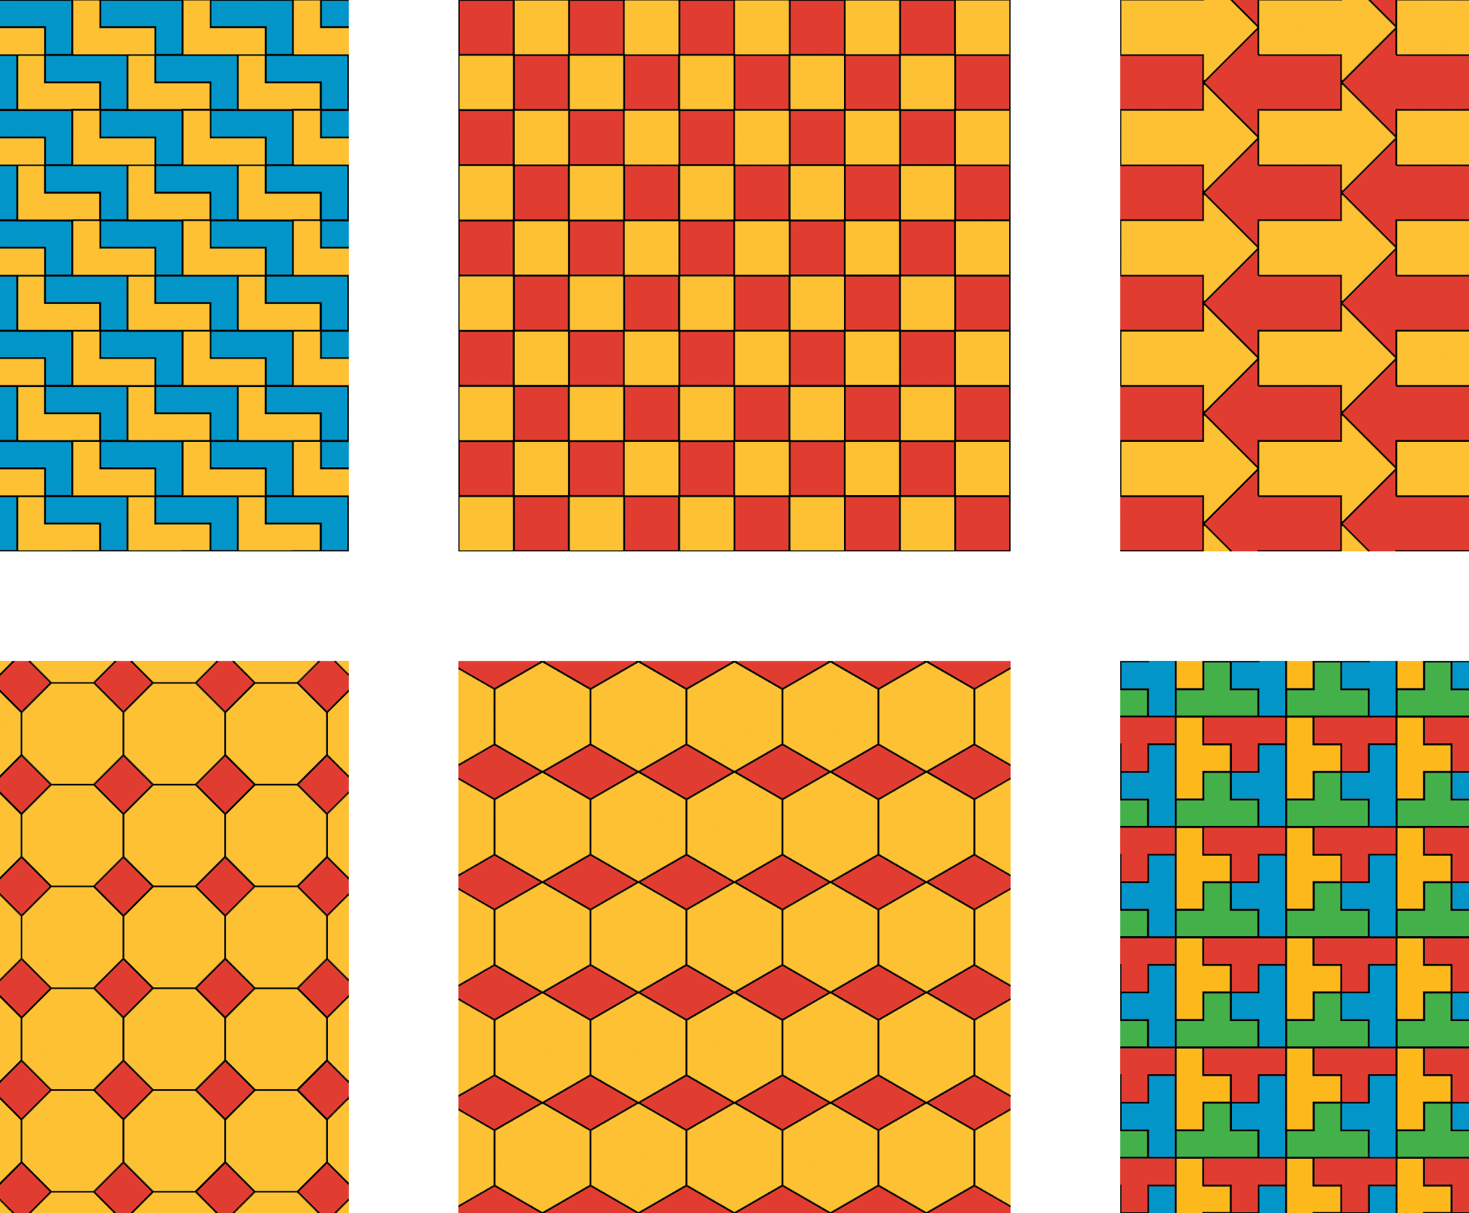
Repetition

Slide 3

Repetition

Slide 4

Repetition

Slide 5

Repetition with Variation

Slide 6

Repetition with Variation

Slide 7

Repetition with Variation

Slide 8

Figure/Ground

Slide 9

Figure/ Ground

Slide 10

Figure/Ground

