Slide 1
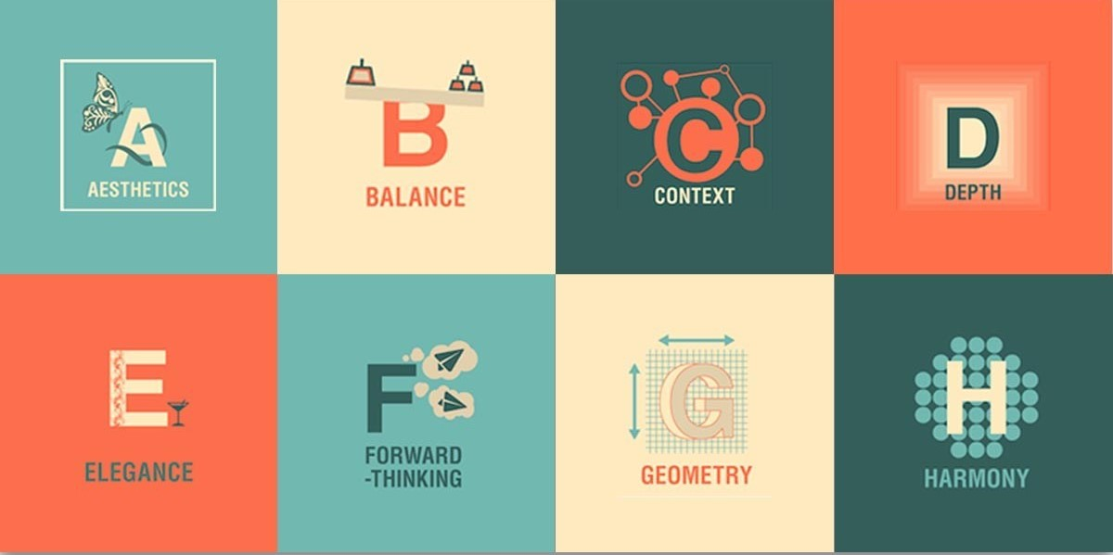
Design Principles
Group 2

Slide 2
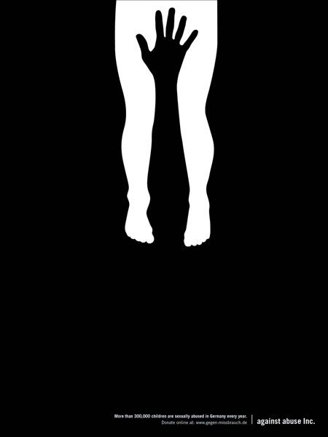
Images of Figure/Ground Relations

Slide 3
Explanation
The first image of figure ground relation(left) is an image of a bird and a polar bear. When i first saw this image i immediately saw the bird before i notice the bear. For me i thought the bird was the figure and the bear was the ground.
The second image of figure ground relation(middle) is an image of a person’s whole hand and an image of a person’s legs. My best guess was the image could be either figure or ground cause I saw both of them at the same time.
The third image of figure ground relation(right) is an image of a butterfly and an image of 2 people doing thumbs up. This image could also be either but for me I saw the butterfly first before i saw the 2 people.

Slide 4
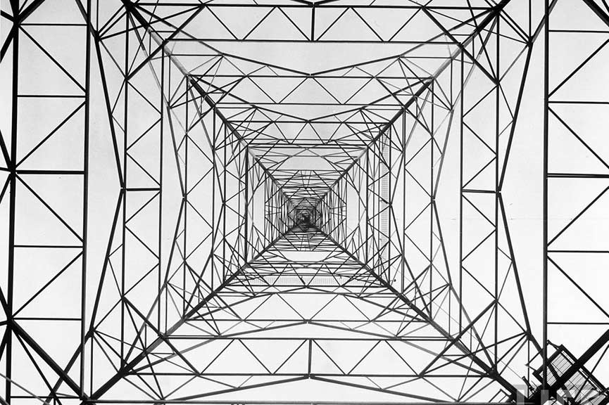
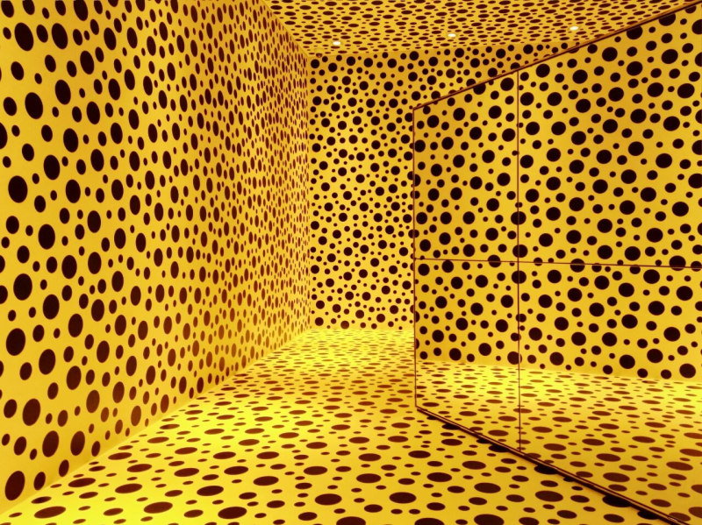
Images of Repetition

Slide 5
Explanation
To begin, the image to the left is portraying repetition where you can see a repeated figure of a man and the word obey repeated horizontally and vertically to create emphasis of the image of a person and the word obey.
Additionally, the middle image is demonstrating repetition with the same designs of triangles forming a rectangle, in which later on the triangles are being repeated to create a rectangular border that zooms in to even reveal a pattern within this example.
Lastly, the last image shows repetition by showing a yellow background and black colored circles being repeated constantly to create the impression of unity between all the sides of the image.

Slide 6
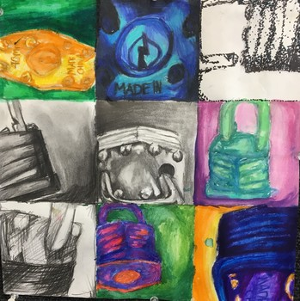
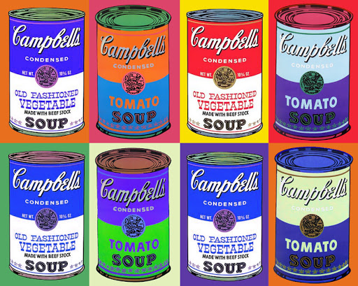
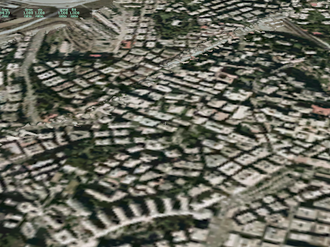
Images of Repetition with Variation

Slide 7
Explanation
The image on the far left consists of multiple padlocks from different angles and color. Although you can barely tell what the item is in some of the more close-up sections, the artist uses variation of color yet repetition of the same item over and over again to give off a separate yet complete view of the item.
The image in the middle consists of multiple cans of Campbell's chicken noodle soup, but with a large variation strictly on the colors of each individual can. Campbells was a prevalent item within pop art in the 50’s and 60’s and this particular image shows off repetition with variation in a simple yet effective way..
The image on the far right is layout of what seems to be a suburb style neighborhood or building based layout in a city. It shows that repetition with variation is even used in things like common architecture. The houses/ buildings are put together in a way that shows order and structure, and in the overall layout, there’s repetition of shapes and the angles in which everything is organized.

Slide 8
Group 2 Names
Alex Veras
Michael Garcia
Yamileth Hernandez- Garcia
Stevette Marrast

