Slide 1
Fusion is a rare developmental anomaly of shape of tooth, characterized by the union of two normally separated tooth germs, seen in both the primary and permanent dentition.

Slide 2
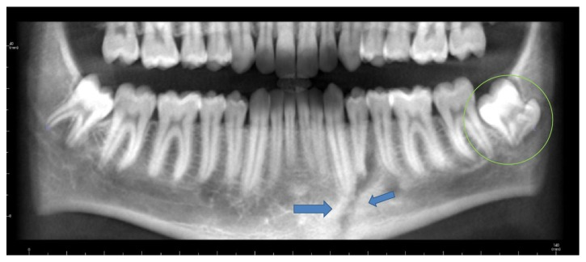
Concrescence is a form of twinning, formed by the confluence of cementum of two teeth at the root level.

Slide 3
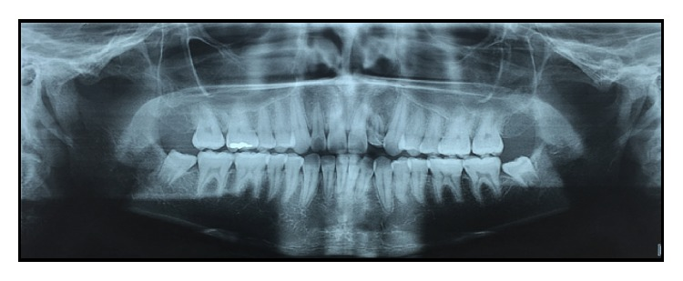
Gemination is an attempt at division of single tooth germ by invagination, resulting in the formation of incomplete teeth. One structure with completely or incompletely separated crowns with single root and root canal.
The tooth count remains normal when the anomalous tooth considered as one.
Seen in both primary and permanent dentitions
Incisors and canines are most commonly effected
Teeth demonstrate a pronounced labial or lingual groove
Gemination in a maxillary lateral incisor with two root canals

Slide 5
References
“Dental Scholar.” YouTube, YouTube, www.youtube.com/channel/UC5PR9WRU8bY08qcdE6SAlfQ.
Mahendra, et al. “Complete Bilateral Gemination of Maxillary Incisors with Separate Root Canals.” Case Reports in Dentistry, Hindawi, 31 Aug. 2014, www.hindawi.com/journals/crid/2014/425343/.
Oshina, Masahito, et al. “Radiological Fusion Criteria of Postoperative Anterior Cervical Discectomy and Fusion: A Systematic Review.” Global Spine Journal, SAGE Publications, Oct. 2018, www.ncbi.nlm.nih.gov/pmc/articles/PMC6232720/.
Romano, et al. “Geminated Maxillary Lateral Incisor with Two Root Canals.” Case Reports in Dentistry, Hindawi, 29 Dec. 2016, www.hindawi.com/journals/crid/2016/3759021/.
Zakir, Ali, et al. “Concrescence: Cone-Beam Computed Tomography Imaging Perspective.” Case Reports in Dentistry, Hindawi, 9 Oct. 2016, www.hindawi.com/journals/crid/2016/8597872/.

