Slide 1
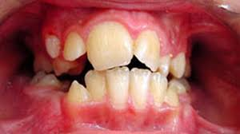
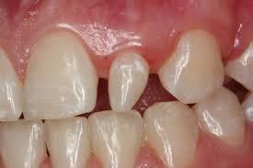
Macro and microdontia
By Tatsiana Maloila

Slide 2
Macrodontia
is a condition where one or more teeth grow at a different rate from the others and exceed the average size and appear to be larger in size.
3 types:
Isolated macrodontia. Only one tooth grows larger than the others.
Extremely rare, but is slightly more common in men than in women.
True generalized macrodontia. All teeth grow larger than normal.
This is usually a symptom of a rare disorder called pituitary gigantism.
Relative generalized macrodontia. This form usually happens when
a patient has an undersized jaw but normal or slightly enlarged teeth.
The teeth appear larger in relation to the small jaw.

Slide 3
Etiology
Certain genetic and environmental causes
Insulin-resistant diabetes
Otodental dysplasia
Pituitary gigantism
Pineal hyperplasia
Unilateral facial hypoplasia

Slide 4
microdontia
is a condition in which one or more teeth appear smaller than normal.
2 types:
Localized form, only a few teeth are involved. Generalized form, all teeth are involved.
The most common teeth affected are the upper lateral incisors and third molars.
Etiology:
An indication of hutchinson teeth, which is a result of congenital syphilis when the baby is in utero.
Pituitary dwarfism or Down's syndrome
Chemotherapeutic and radiation treatment during the tooth development age
Ectodermal dysplasia

Slide 5
treatment
No treatment is required unless chosen by the patient for cosmetic reasons.
Modern dentistry offers many techniques that can help restore teeth and improve smiles. Depending on the severity of microdontia, patients can choose composite bonding, veneers or crowns that can change both the size and shape of the teeth to provide a more “adult” appearance.

Slide 6
Dental team
As a dental hygienist we can inform patients of their condition, provide them with possible treatment information and write a referral if such a treatment desired.
We can also teach tooth brushing techniques and mention the importance of flossing especially if macro or microdonts cause teeth crowding.

