Slide 1
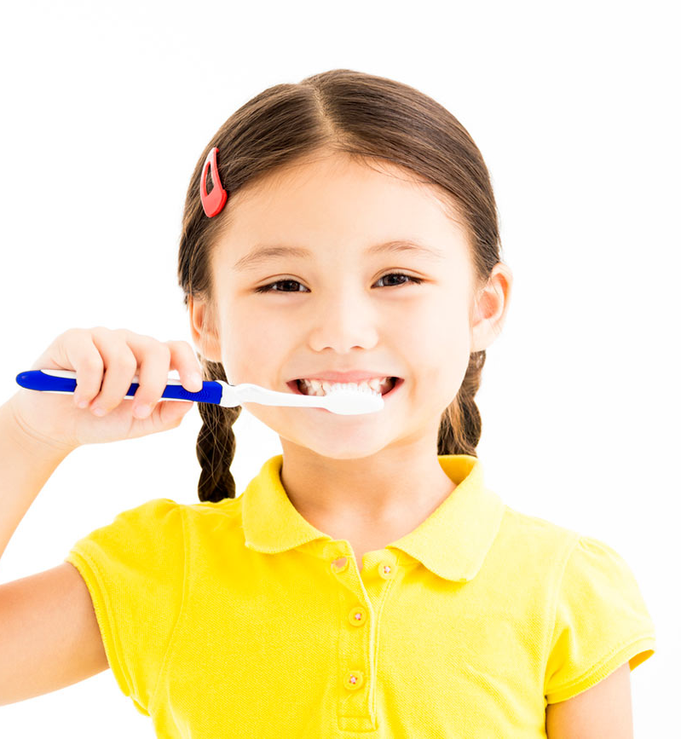
Plaque, Plaque Go Away
Brush Daily, Twice a Day
Presentation by: Minna Harbater, Tatsiana Maloila, Justyna Varela, Mariama Bereteh, Diana Diaz
Notes:
-Target population 8-9 year olds
-Teach kids what plaque is and its effects it can have on our teeth
-Demonstrate for them proper toothbrushing technique to prevent caries

Slide 2
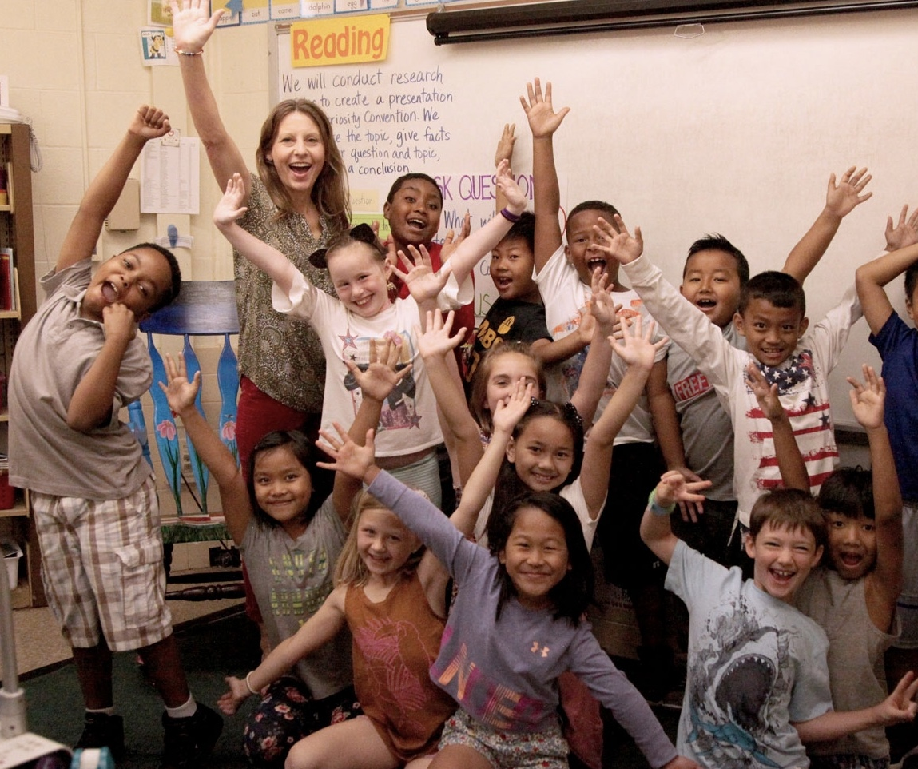
Welcome 3rd Graders!

Slide 3
What is a Hygienist?
Our job is to make your teeth happy, by cleaning them when you come to the dentist
We are here to teach you how you can brush your teeth at home so that you don’t get cavities
Notes:
-Icebreaker: who knows what plaque is? Who knows what a cavity is? Raise your hand if you brush your teeth every day! What is a hygienist?
-Explain to the kids our role and what they will expect when they get a cleaning
-Teach them how to properly brush and take care of their teeth at home so that their teeth will be happy and won't get cavities

Slide 4
Video
https://youtu.be/hDZXSMU2lAk

Slide 5
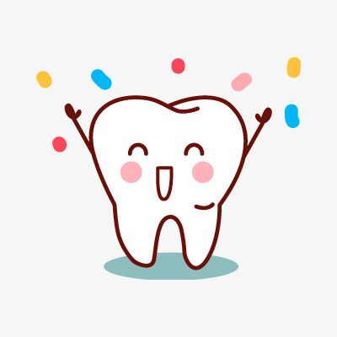
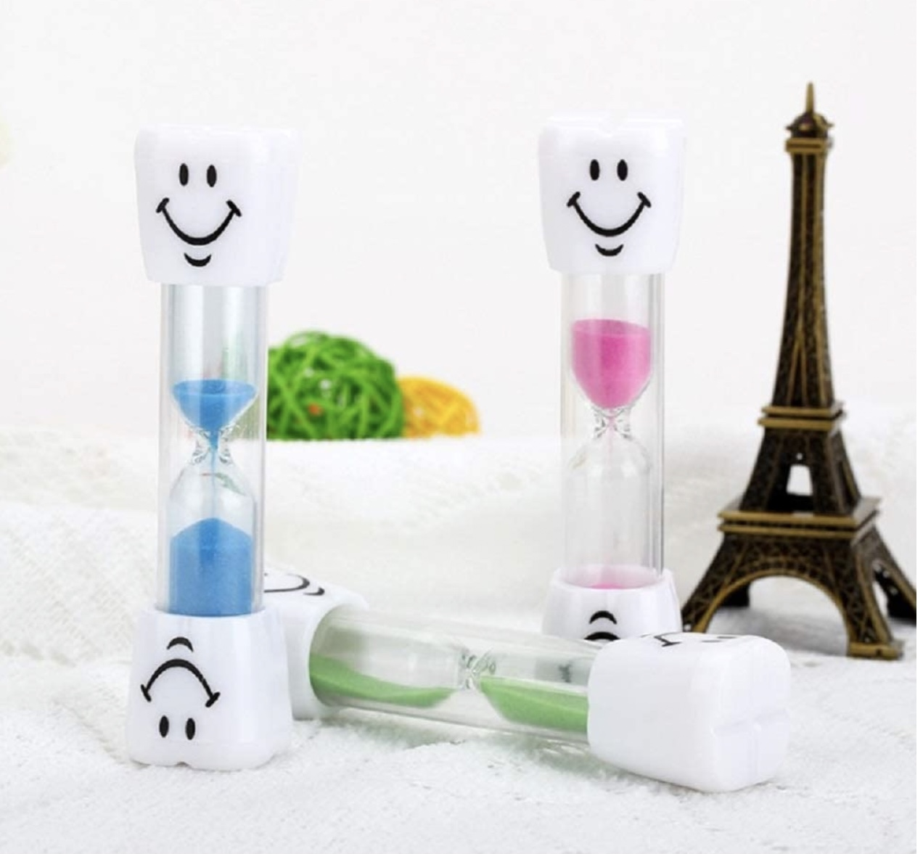
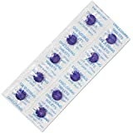
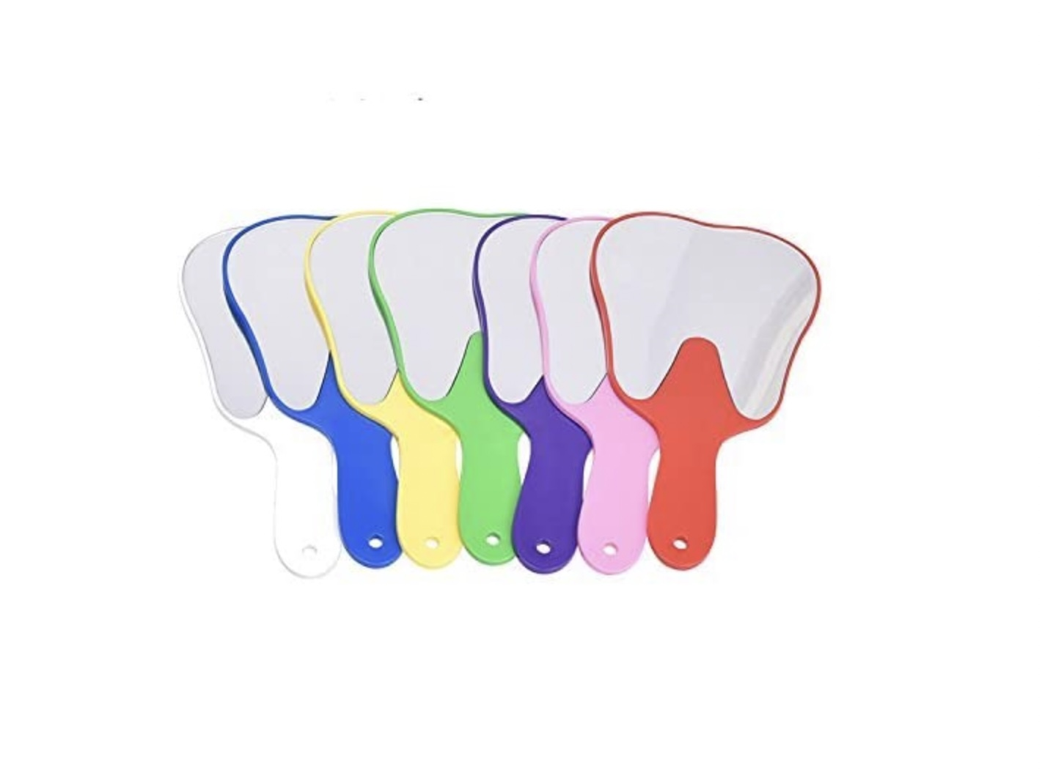
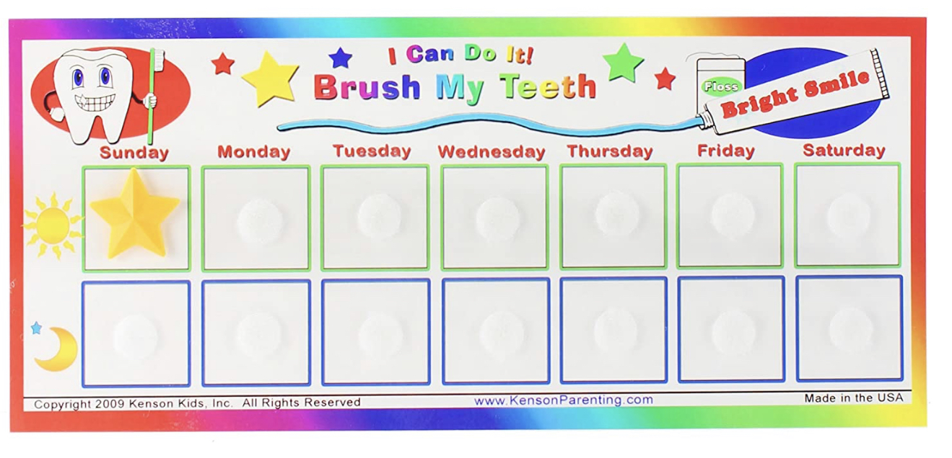
Goodie bags for healthy, happy teeth
Notes:
We tell the kids we brought them some goodies
Describe/ explain what is in each bag. Tell the kids we will use those things for an activity

Slide 6
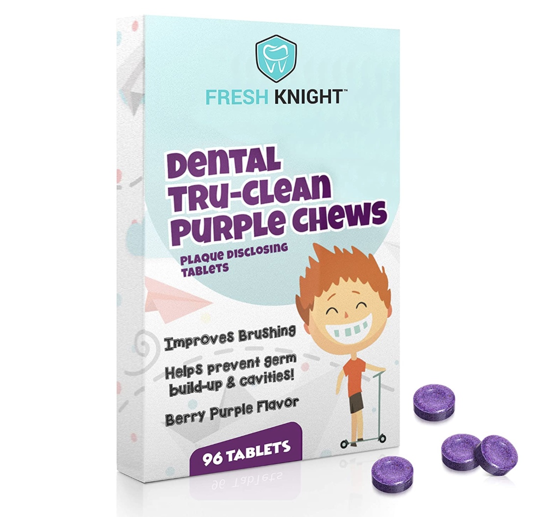
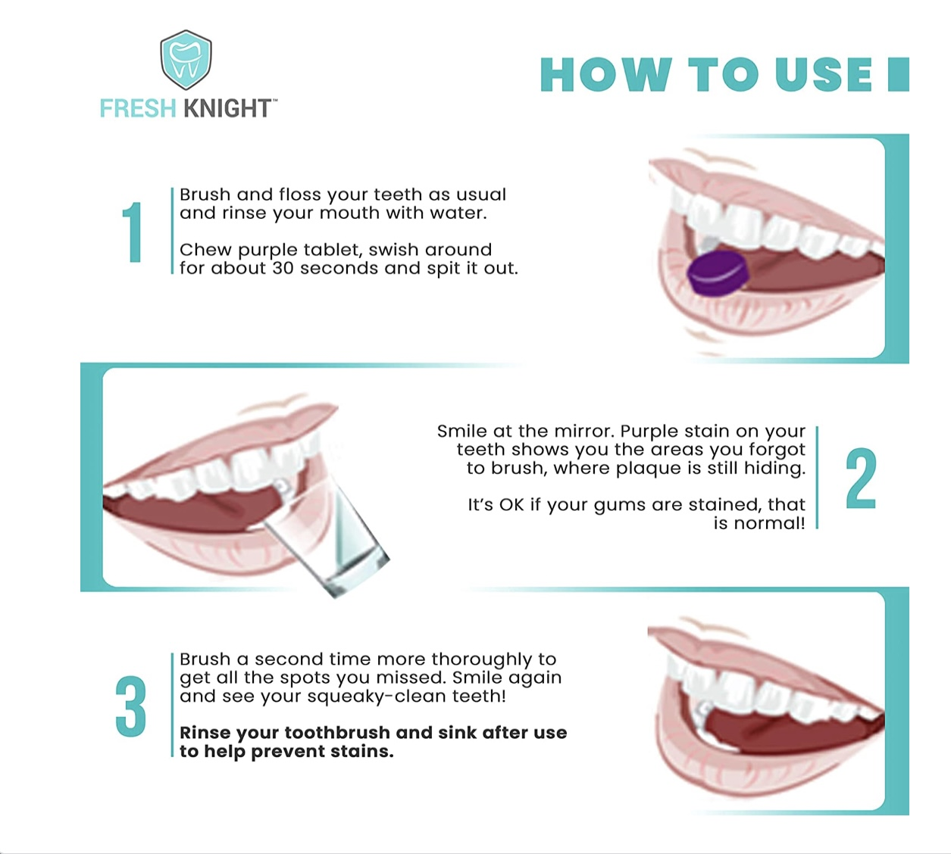
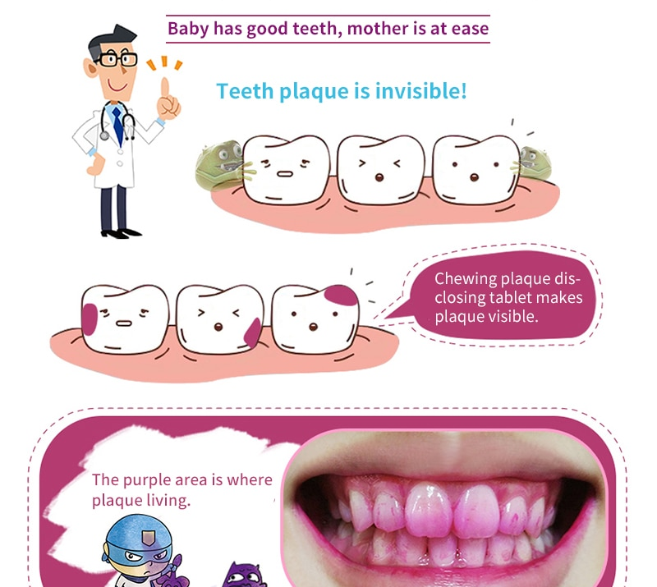
Activity: Disclosing tablets
Notes:
We tell the kids we brought them some goodies
Describe/ explain what is in each bag. Tell the kids we will use those things for an activity

Slide 7
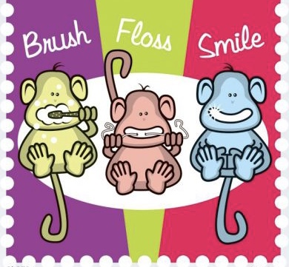
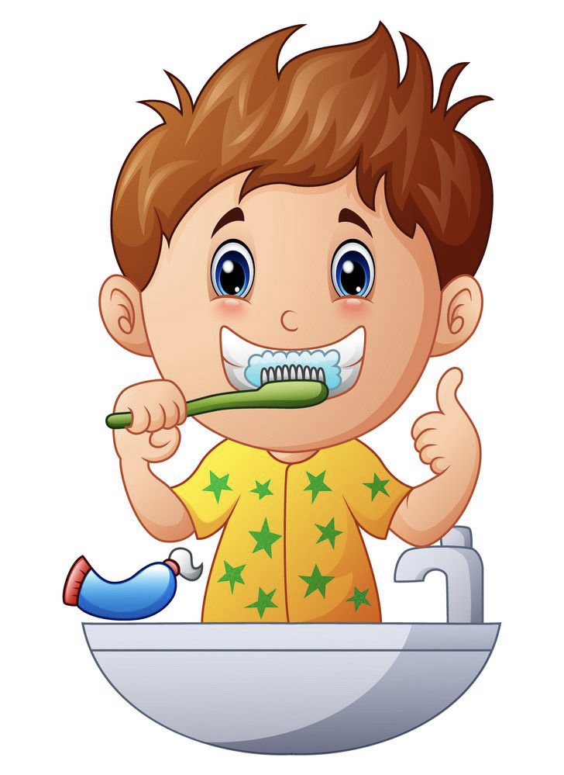
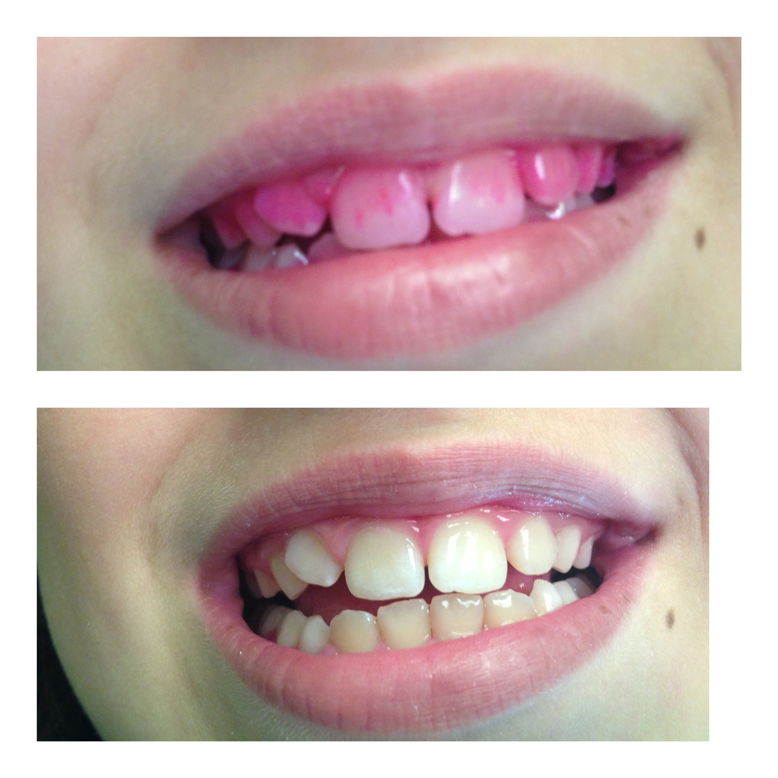
Disclosing tablets

Slide 8
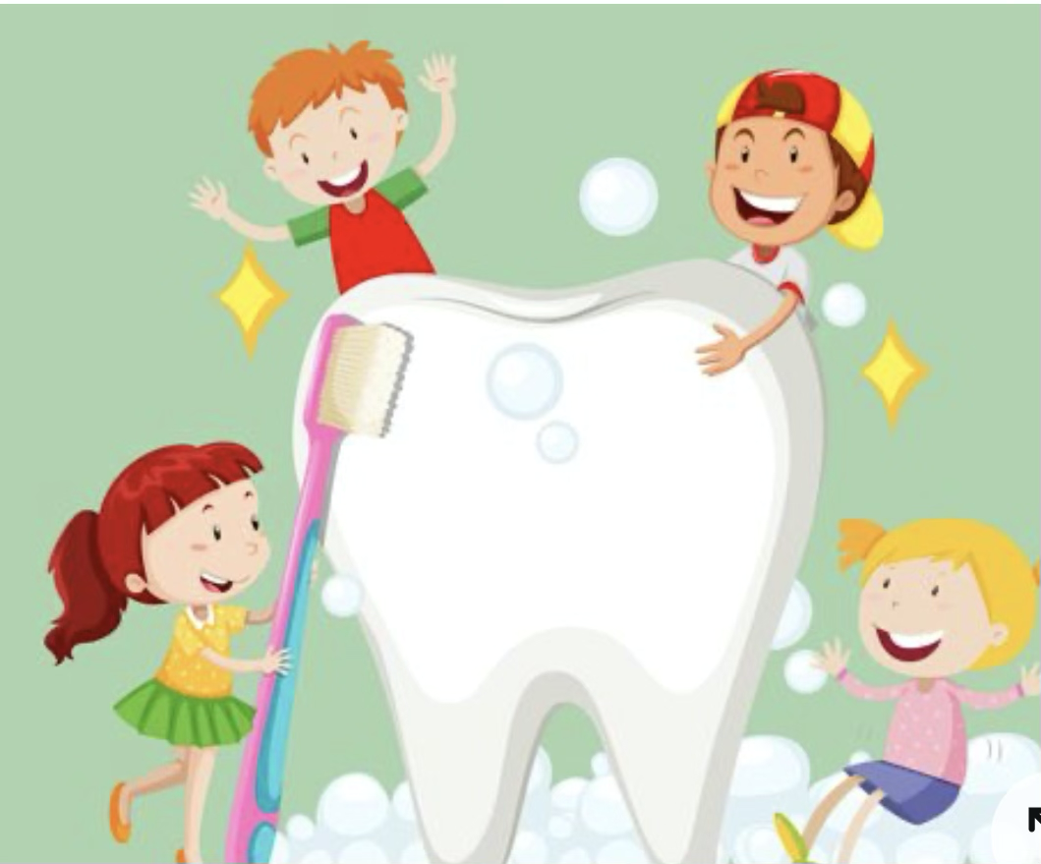
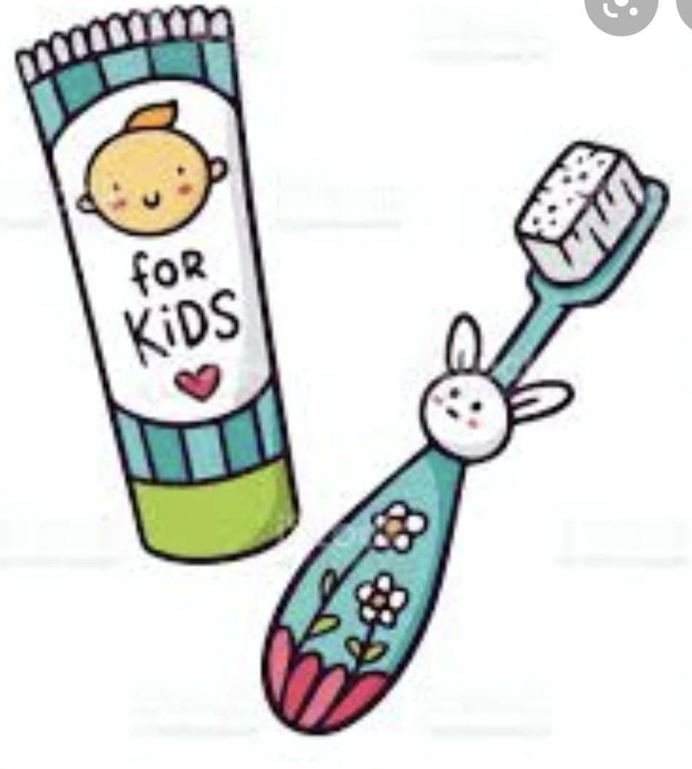
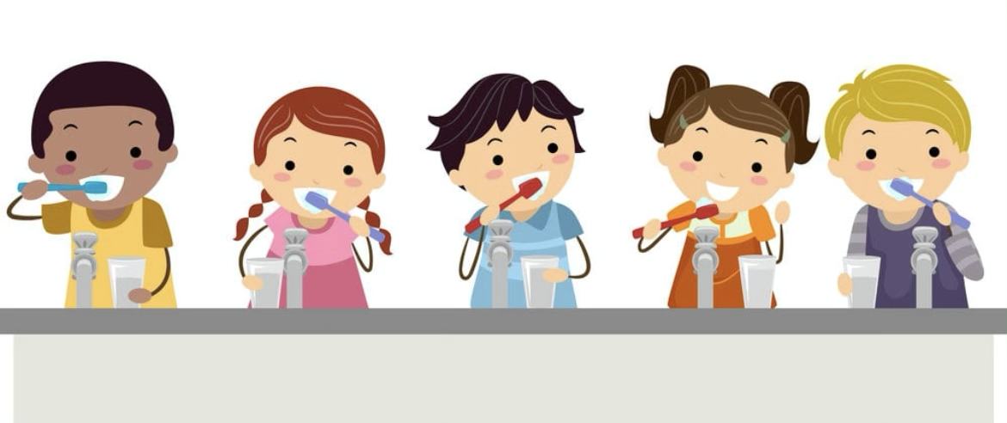

Slide 9
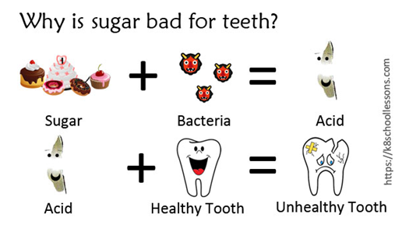
The effects of sugar on teeth

Slide 10
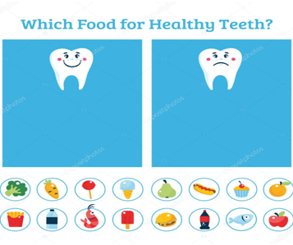
Sad Tooth/Happy Tooth

Slide 11
Questionnaire
1. Which of these is a healthy snack choice and will make your teeth happy? A) Yogurt B) A cupcake C) Doritos
2. How many times a day should you brush your teeth? A) In the morning B) Before bedtime C) In the morning and before bedtime D) When you feel like it
3. What causes cavities and toothache? A) Not brushing your teeth twice a day B) Eating sweets C) Drinking soda C) Skipping dental visits D) All of the above
4. How much toothpaste should you use while brushing? A) The whole tube B) A size of a pea C) As much as you want

Slide 12
Questionnaire
5. How often should you visit the dentist? A) Twice a year. B) When you have a toothache C) When you feel like it
6. Which of these should you drink the most of each day? A) Water B) Your favorite soda C) Orange juice
7. Which of these is an unhealthy snack choice and will make your teeth sad? A) A carrot B) An apple C) A donut

Slide 13
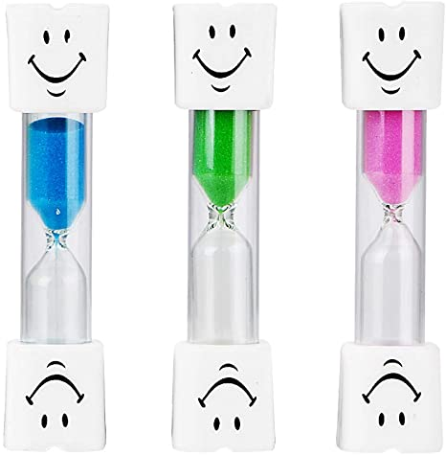
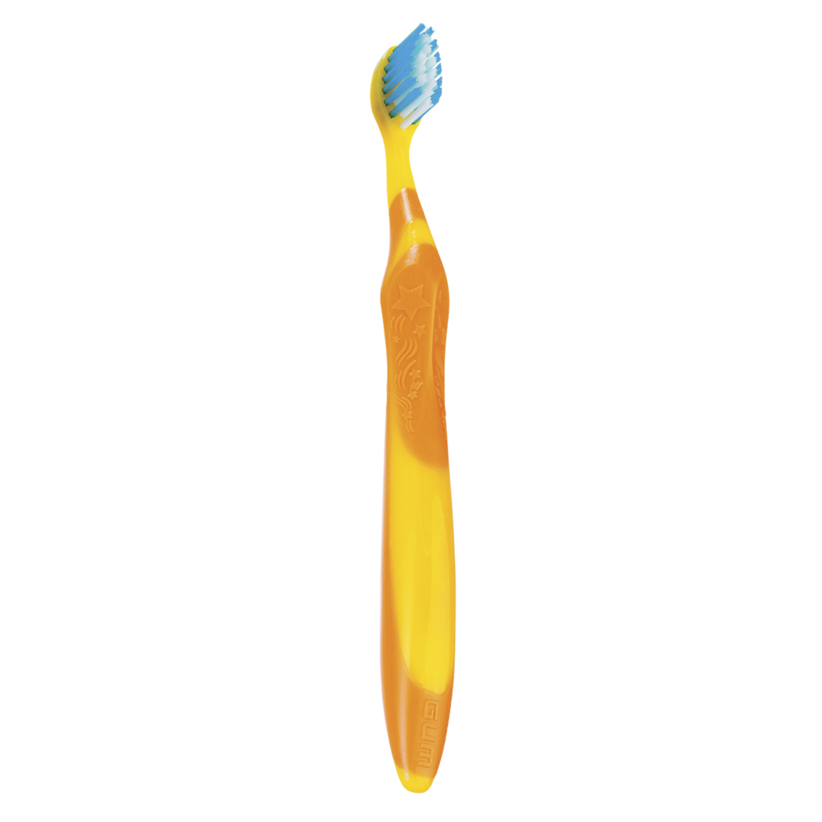
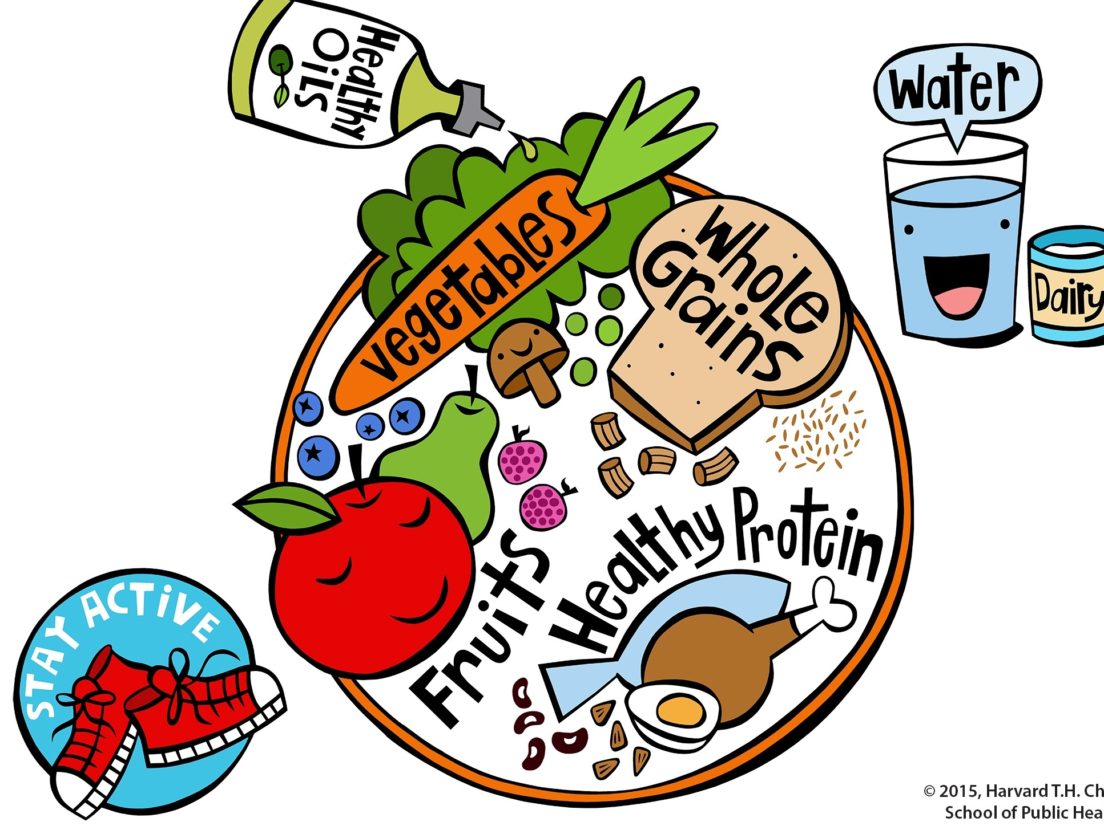
How do we keep our teeth happy?
Brush every day and night!
Use your rainbow sand clocks and tooth mirrors!
Eating less sugar and more fresh foods!

Slide 15
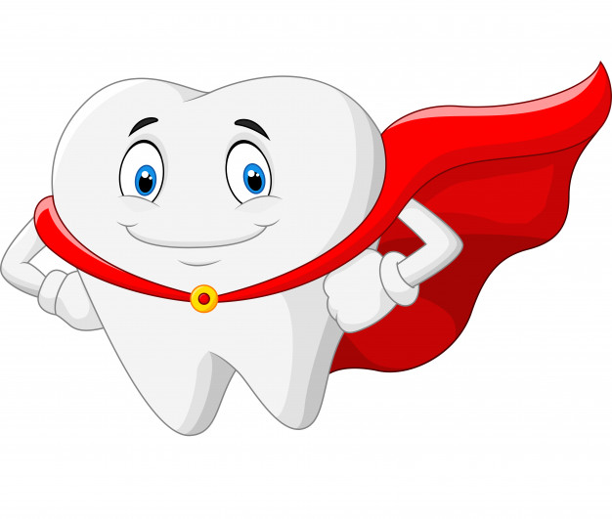
Happy teeth for everyone!
Remember to use your stickers every day after brushing!
Teach your parents what you learned today!
Who is a brushing superstar????

Slide 16
Thank You!!

