Slide 1
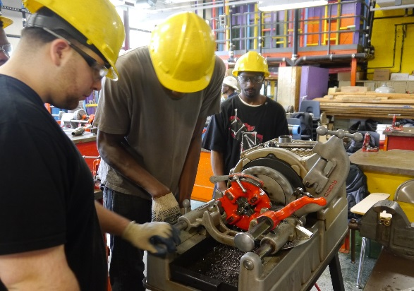
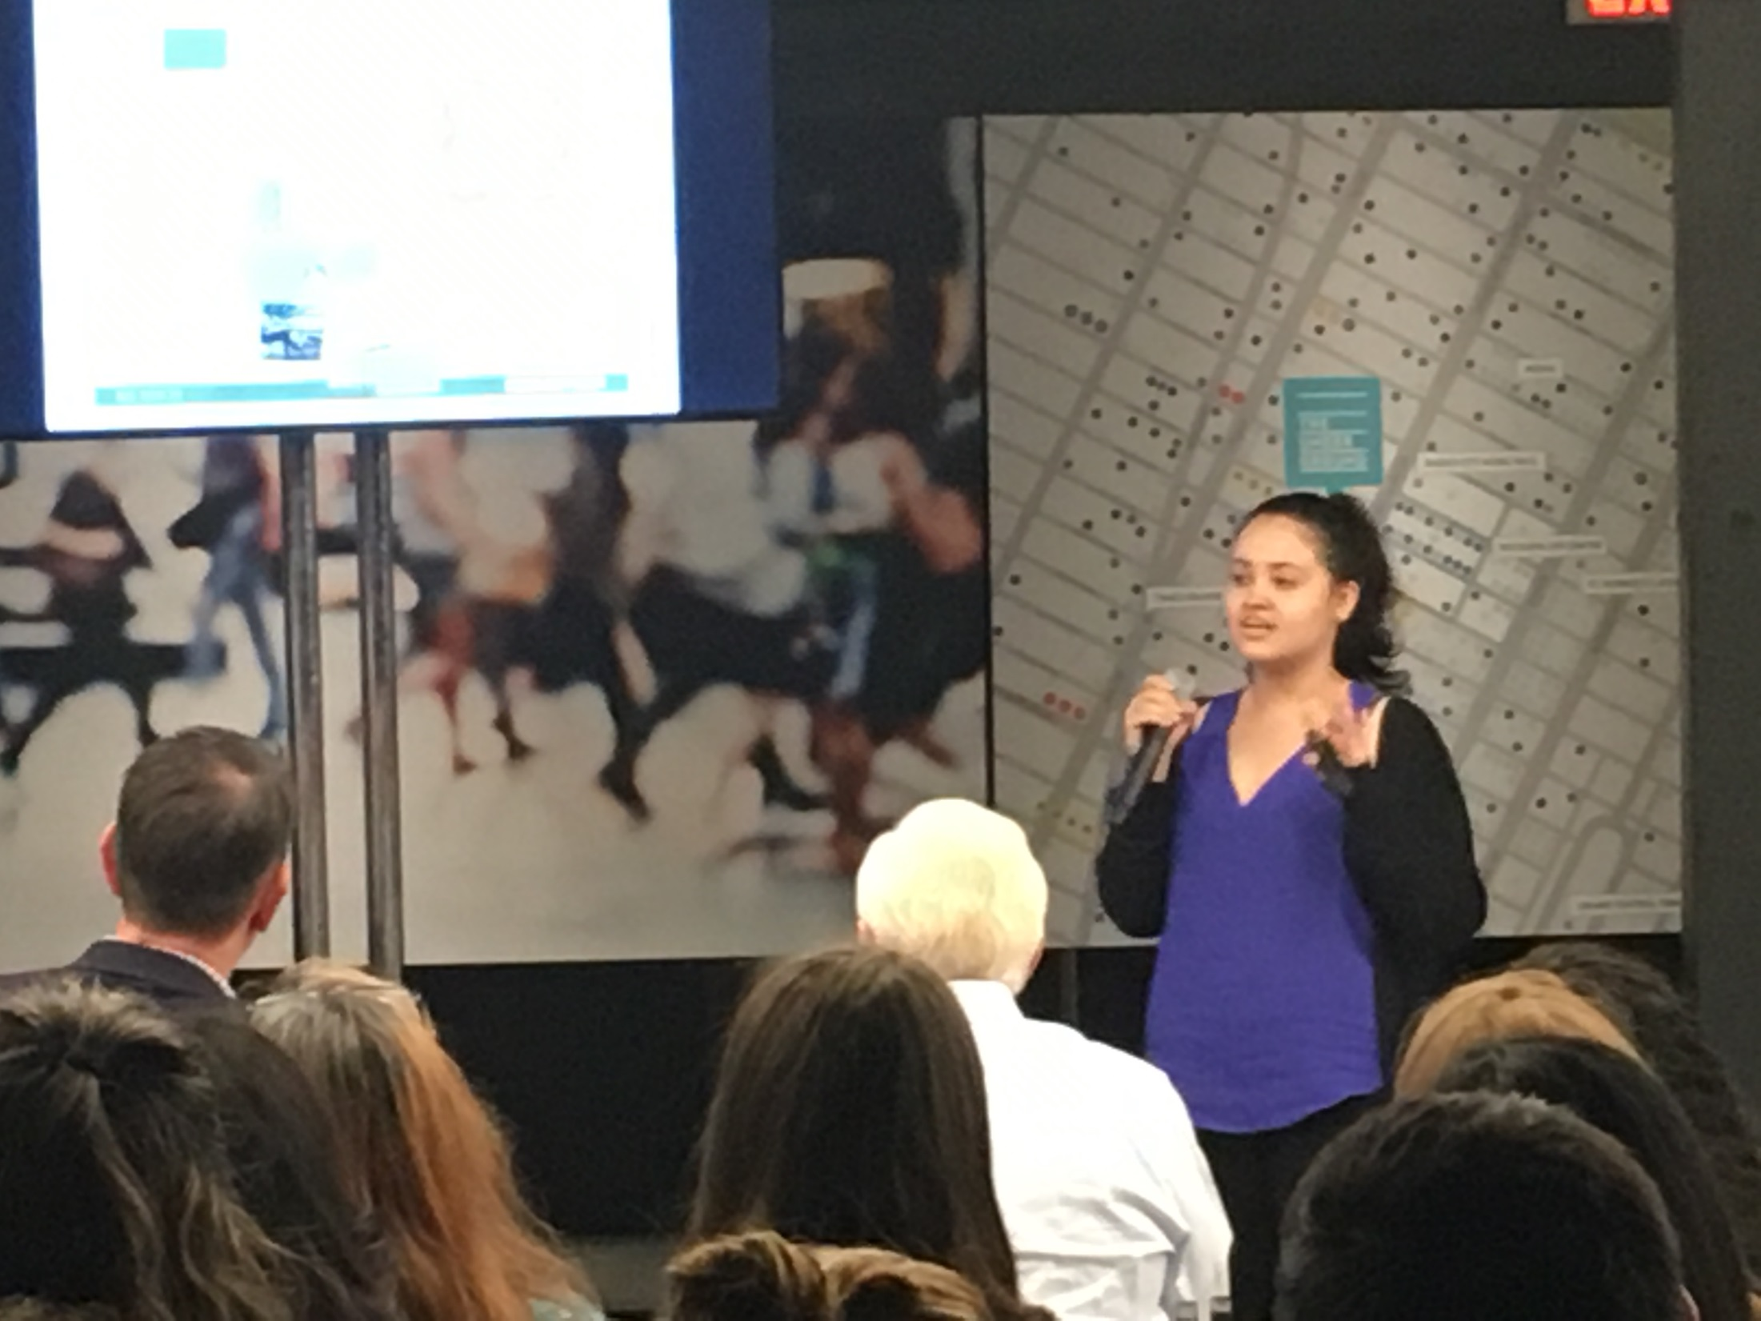
NYC Department of Education Division of Teaching & Learning Office of Postsecondary Readiness
Career and Technical Education
@NYCCTE • www.cte.nyc
Notes:
Presenter introduces themselves and starts out with a question:
How many in the audience held a job as a teenager? How many of feel like if the job was related to learning in school and vice versa, you wouldve stayed more engaged? How many of you want to your students to enroll and graduate college with entry into good paying jobs? CTE is your answer to all of the above- winning strategy for college and career success

Slide 2
Career and Technical Education- History
Insert cte video

Slide 3
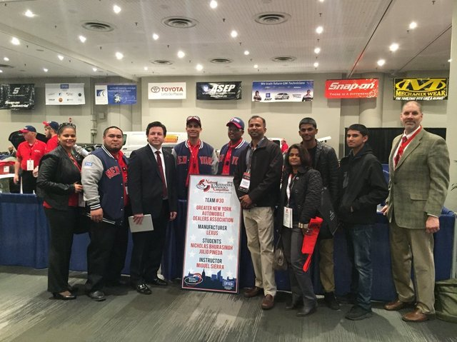
Career and Technical Education- Vision
CTE is a program of study through which students graduate high school with academic and industry-recognized (technical and employability) skills leading to a high quality college and career pathway (in-demand jobs, growing wages) that includes:
Persisting in post-secondary education / training; and
Finding employment based on industry-recognized skills

Slide 4
Almost half of NYC DOE High Schools offer CTE
CTE by the numbers
CTE-designated schools had a 4-year NYC graduation rate of 82 % in 2015-16 ~ 10% higher than citywide graduation rate
4
Notes:
Secret sauce to these successful outcomes= core building blocks to CTE
4

Slide 5
Four Pillars of CTE
HIGH QUALITY ACADEMICS
Support schools in offering CTE programs with Common Core-aligned academically integrated curricula and rigorous pedagogy
WORK-BASED LEARNING
Support school efforts to offer a range of meaningful academic and real world experiences outside classroom
INDUSTRY ENGAGEMENT
Support school efforts to form meaningful connections to industry partners
PROGRAM QUALITY
Support school efforts to offer NYSED program approved high-quality CTE programs
Program sequences are two to three years (Grades 10, 11, and 12)
5
Notes:
5

Slide 6
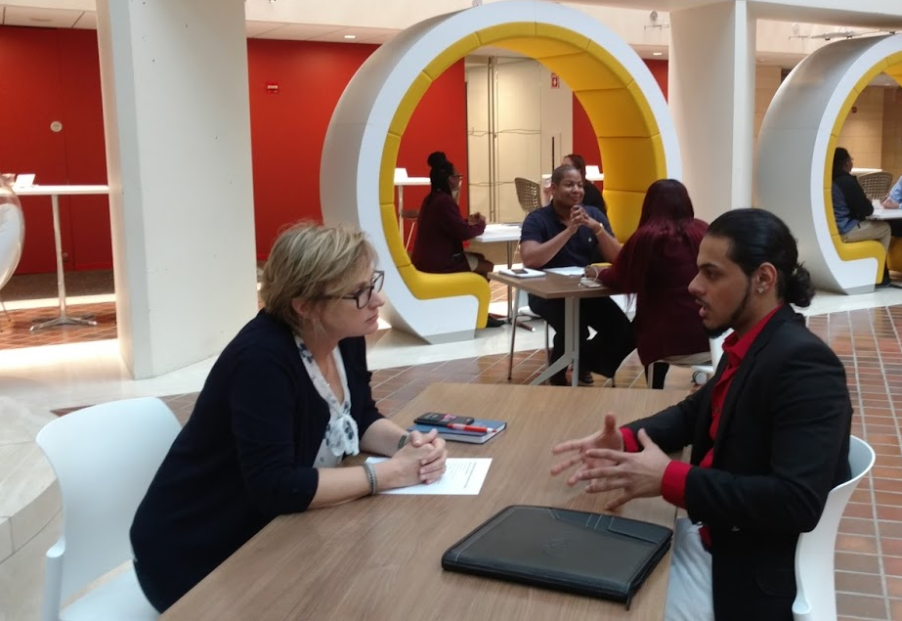
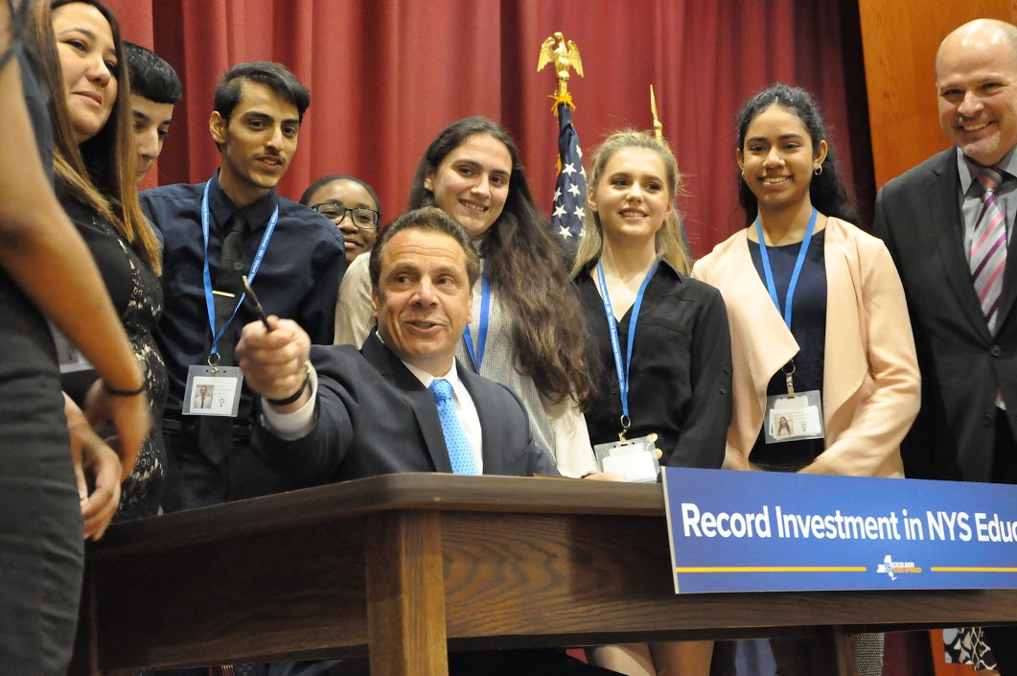
The work-Based Learning in action

Slide 7
Our Programs at a Glance
Program Area | Key Sector Trends | Subtracks | Key credentials presently offered
Healthcare (33 programs) | Healthcare now accounts for 1 in 7 jobs in New York City. | Bio Med Technology Emergency Management Medical Assistant Pharmacy Vision Technology Veterinary Science | Certified Nurse Aid, Certified Medical Administrative Assistant Certified Clinical Medical Assistant Certified Pharm Tech
Culinary, Hospitality and Tourism (19 programs) | This is the fastest growing sector in NYC economy and accounts for one in eight jobs. | Culinary Hospitality and Tourism | NYC Food Handlers Certification Servsafe Food Protection Manager Certification Microsoft Office Specialist
Construction and Sustainability (21 Programs) | Construction is sensitive to the general business cycle, but is likely to be stable over the next few years. | Carpentry Electrical Energy Technology HVAC Plumbing | NCCER-Core Green Professional-Fundamentals of Building Green ETA-Student Electronic Certification OSHA 10 and 30

Slide 8
Our Programs at a Glance
Program Area | Key Sector Trends | Subtracks | Key credentials presently offered
Business and Finance (35 programs) | This sector comprises 12 percent, or 1 in every 8 jobs, in the NYC economy. | Academy of Finance Entrepreneurship Marketing E-Commerce | NOCTI-Basic Accounting Microsoft Office Specialist-Expert
Information Technology (45 programs) | Employment growth in this sector has outpaced the economy as a whole. | Academy of Information Technology CISCO Networking Academy Computer Networking Computer Repair Software Engineering | CompTIA A+ Network + Security + Mobility + CISCO- CCENT, CCNA
Construction and Sustainability (21 Programs) | Construction is sensitive to the general business cycle, but is likely to be stable over the next few years. | Carpentry Electrical Energy Technology HVAC Plumbing | NCCER-Core Green Professional-Fundamentals of Building Green ETA-Student Electronic Certification OSHA 10 and 30

Slide 9
Our Programs at a Glance
Program Area | Key Sector Trends | Subtracks | Key credentials presently offered
Media Technology and Design (37 programs) | All parts of this sector have gained employment growth with the exception of telecommunications. | Film and Video Production Graphic Design Advertising Broadcast Journalism Fashion Design and Merchandising | Adobe Certified Associate Skills USA 3D Visualization and Animation Adobe Premiere Pro NOCTI- Apparel, Textile Production
Engineering Architecture Robotics (24 programs) | Employment growth in this sector from 2001 to 2015 grew faster than NYC as a whole. | Architectural Design Civil Drafting and Civil Engineering, Electromechanical Technology, Engineering, Environmental Engineering and Technology, Logistics and Materials Management, Marine Maintenance, Robotics | Autodesk Certified User AutoCAD Inventor Revit Maya NOCTI-Pre Engineering C-Tech- Copper Based Networking, Fiber Optics Certified Solid Works Associate

Slide 10
How can students and families learn more about CTE?
Attend High School Fairs
Work with middle and high school counselors
Participate in Middle School events
Join us and send counselors to our CTE High School Fair
Schedule a visit to one of our schools and programs
Visit us online at WWW.CTE.NYC

