Slide 1
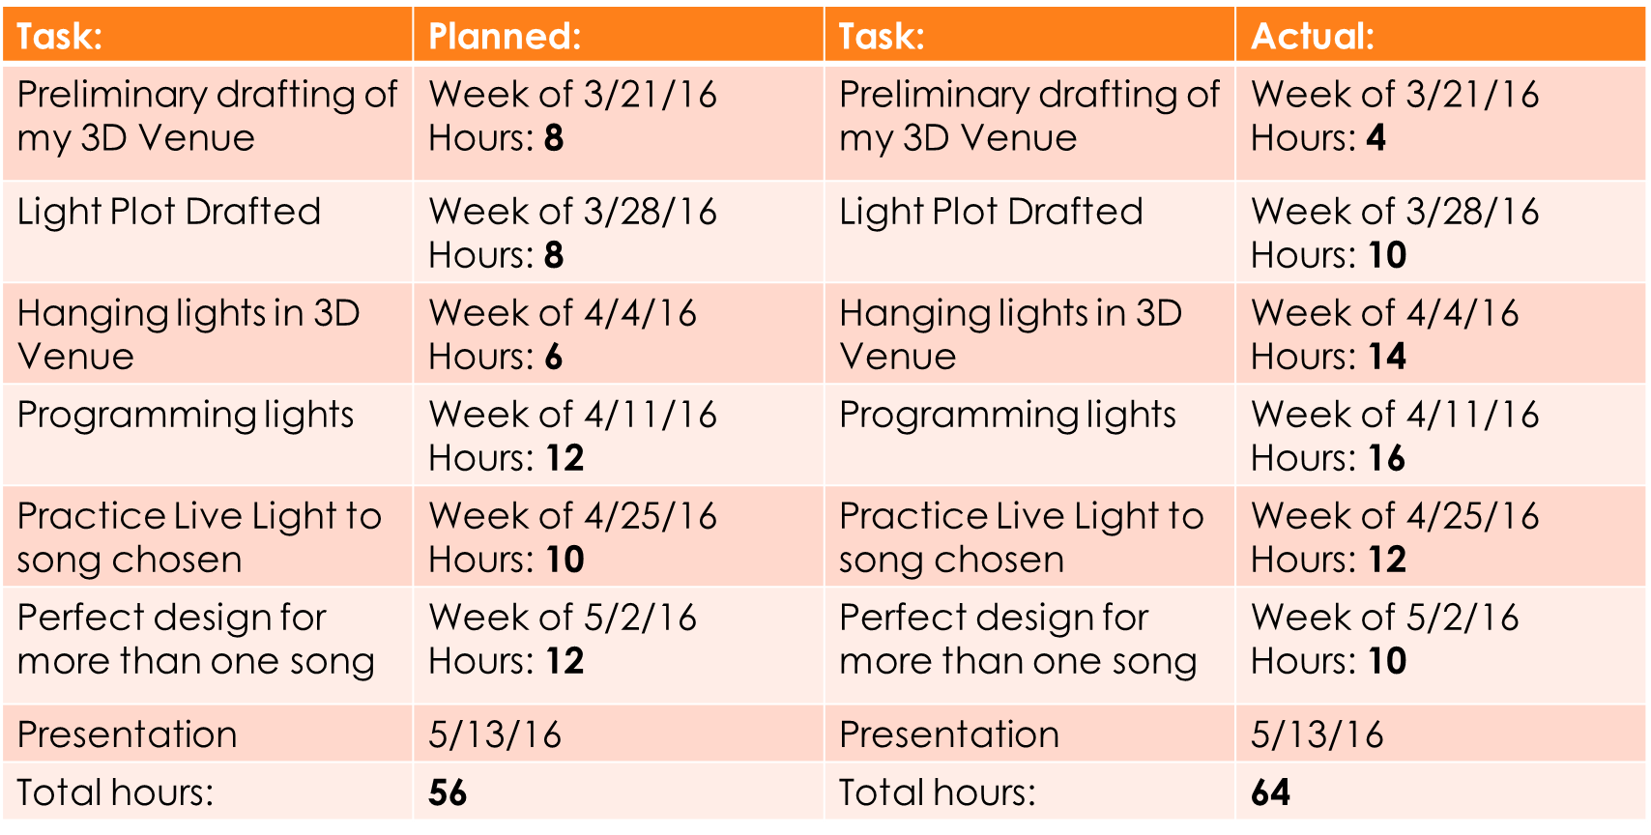
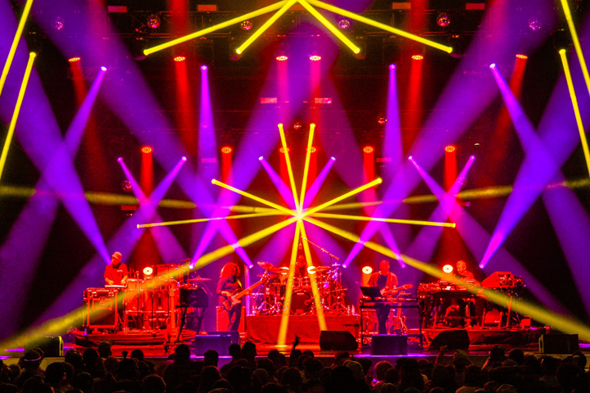
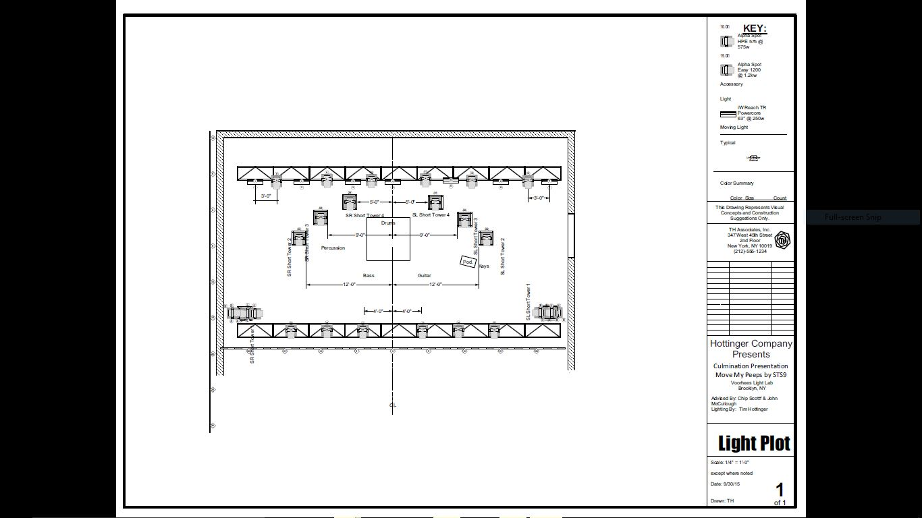
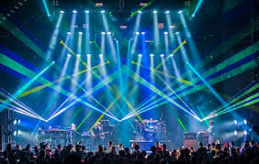
3D Visualization for Improvisational
Lighting Design
Timothy Hottinger New York City College of Technology, Brooklyn, New York 11201
Introduction and Description
During my time at NYCCT I have focused my learning into the Lighting Design and Video Production aspects of theater and studio with what I have learned I have successfully created live stage lighting design plots in my Lighting Design Course. My goal in my career is to become a live music concert Lighting Designer and for my culmination project I feel as though my skills will be put to the test by choosing a venue in GrandMA 3D (3D Visualization) and applying a strategic concert lighting design to the venue I chose to use. By using my skills of Lighting Design to do this I will act as if I were presenting this design to a real client and every aspect of project management would be used in the creation of this lighting design including budgeting, scheduling, and listing deliverables. I am looking at this project as a way for me to fine tune my skills in Lighting Design. The main design of this project is going to be for a band called STS9 (Sound Tribe Sector 9) for their new song “Move My Peeps”. I think this song will give me a lot of creative space to create a cool design.
Research
In my personal experience I have witnessed over 100 shows of Improvisational Lighting Designers light bands I think that is what inspired me to do what I love. This lighting design and show was inspired by the Lighting Design of Saxton Waller (Lighting Designer of STS9) as well as the Lighting Design of Johnny R. Goode III (Lighting Designer of The Disco Biscuits). They match their improvisational skills every show they perform with the musicians skills to created a show similar to what I have done in GrandMA 3D.
Results
GrandMA 3D is a very complex program that really gives the operator a virtual environment to design in, there are a multitude of things that this program can do including running video and lighting at the same time. I only just touched the surface of this expansive technology. GrandMA 3D is not an easy program to master. It takes time and patience to create a lighting design in a 3D venue. Tasks that I thought would take a week actually turned out to take 3 weeks in some cases. With the time and skills that I have I believe I succeeded in my goal to create live concert lighting design that I could potentially pitch to a client.
I would recommend this program to other lighting designers out there because I believe it is a very helpful tool.
Schedule
Conclusion
In conclusion of my project I have learned a lot in the process of creating this design. I have learned to focus more on lighting the band while using simplistic effects. I also have learned how to program things I could not before such as faded position cues. As well as mastering how to create a chase on a professional rig. I think this project showed me what it may be like in the real world when creating a lighting design for a prospective client.
Figure 1.
Figure 2.
Materials and methods
GrandMA3D is a 3D Visualization program that helps designers recreate a space and design in it when one may not have endless lighting resources available. This program helps designers finalize or showcase a design before putting it in a venue a good tool to help designers preview their design to their client. I will learn and master this program by watching tutorials and reading the user guide. I already have some basic knowledge in this program but I hope to master it well enough that I could potentially teach it to anyone.
Project Deliverables
Lighting Plot and Ground Plan of Model
Budget for Design
Live 3D Visualization Projection
3D Model (within program) of Venue
Poster and Openlab Portfolio
Required Resources
The resources I require include my personal computer, City tech school computers, GrandMA 3D, Lightwright 5, Vectorworks and the ability to use the GrandMA 2 Lite console provided by City tech. Most of my resources are available to me except the GrandMA 2 Lite which I can only use under the consent of my technical advisor.
Figure 3. This figure is an example of a Lighting Design look done by Saxton Waller. (STS9)
Literature cited
http://www.malighting.com/en/support-downloads/software.html
Figure 4. This figure is an example of a Lighting Design look done by Johnny R. Goode III (The Disco Biscuits)
Acknowledgments
Charles Scott, Technical Advisor
John McCullough, In class Advisor
Figure 3. This figure shows my Lighting Plot for my Design and also shows the 3D Rendering of the lights on where they were hung onstage.
Figure 5. This figure is an example of a Lighting Design look done by me in GrandMA 3D

