Slide 1
The Cafe
It’s Better Than Starbucks

Slide 2
Caramel Macchiato
Ingredients
How to Make It
6 ounces of brewed coffee
6 ounces of steamed milk
1-2 teaspoons of sugar
3 teaspoons caramel syrup
1⁄2 teaspoon of artificial vanilla flavor
Whipped cream
Caramel syrup
Brew 3 tbsp of coffee. Add vanilla to the coffee grinds before making the coffee, that way it will infuse while brewing. Once done brewing, place milk in a large cup and microwave until hot. In a tall glass, combine the coffee, milk, and caramel syrup and stir well. Add sugar in until desired sweetness is achieved. Top with whipped cream and drizzle caramel.

Slide 3
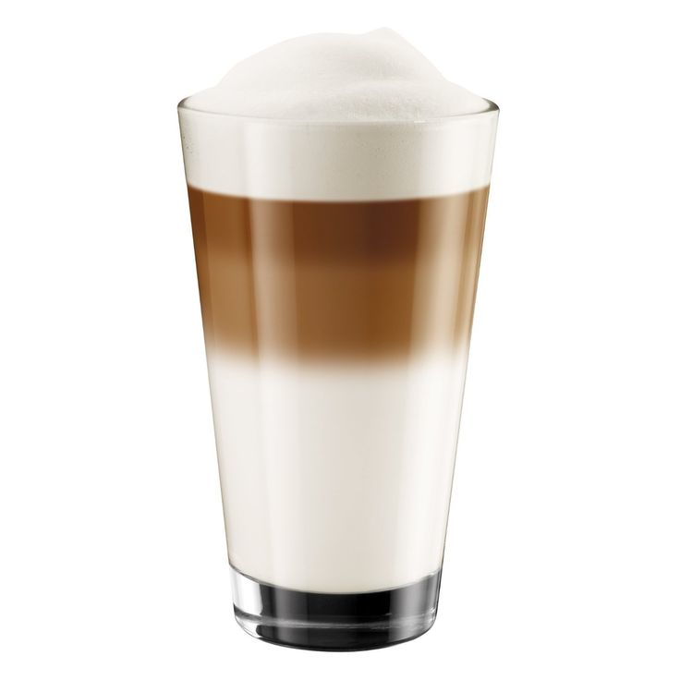

Slide 4
Cinnamon dolce Latte
Ingredients
How to Make It
6 ounces boiling water
1 to 2 teaspoons instant espresso powder 1/2- cup milk (I use skim)
1/4- teaspoon ground cinnamon
1/2- tablespoon light brown sugar
1/2- teaspoon pure vanilla extract
pinch of ground nutmeg
Whipped cream and Ground Cinnamon for garnish
Stir the espresso powder into the hot water and set aside. In a measuring cup combine milk, cinnamon, brown sugar, vanilla and nutmeg; stir until thoroughly combined. Place in Microwave and heat for 1 minute and 30 seconds; until the milk starts to froth up. Remove from Microwave and stir again. Place in Microwave until the milk froth up again. Remove and, while stirring the espresso, slowly pour the milk mixture into the coffee. Top with whipped cream and garnish with cinnamon. And then Serve.

Slide 5
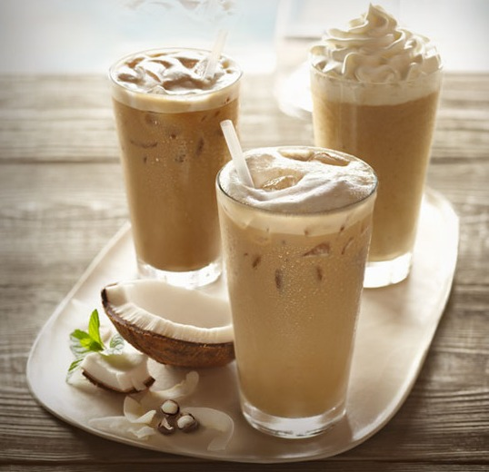

Slide 6
espresso
Ingredients
How to Make It
1/2 cup ground coffee (French or other dark roast)
1-1/2 cups cold water
Lemon twists(optional)
Place ground coffee in the filter of a drip coffeemaker. Add water; brew for 5 minutes. Serve immediately in espresso cups with lemon twists if desired.

Slide 7
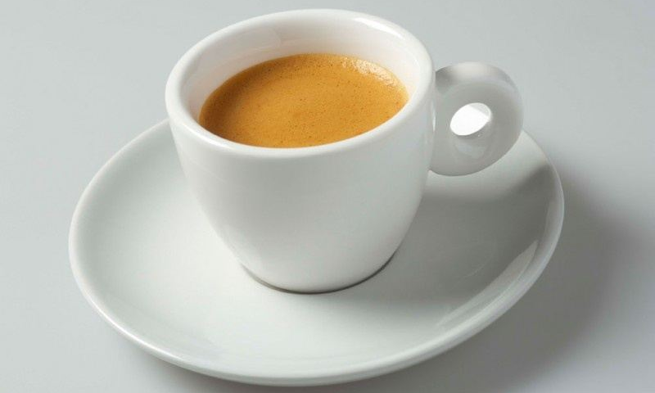

Slide 8
Mocha Frappe
Ingredients
How to Make it
1 cup strong brewed coffee
2 tablespoons sugar
1 tablespoon 2% reduced-fat milk
1 1/4 cups 2% reduced-fat milk
2 tablespoons chocolate syrup
3 tablespoons fat-free frozen whipped topping, thawed
1 teaspoon chocolate shavings
Stir together coffee, sugar, and 1 tablespoon milk in a measuring cup. Pour into ice cube trays, and freeze at least 2 hours or until firm. Process coffee ice cubes, 1 1/4 cups milk, and chocolate syrup in a blender until smooth. Dollop evenly with whipped topping, and sprinkle with chocolate shavings and serve immediately.

Slide 9
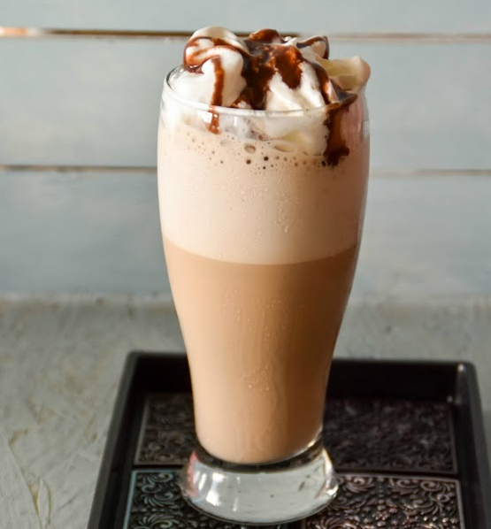

Slide 10
French Vanilla Cappuccino
Ingredients
How to Make It
1 cup of milk.
Brown Sugar
1⁄2 teaspoon vanilla extract
1⁄2 cup fresh hot coffee
Ground Cinnamon
Using a saucepan, add 1 cup of milk and 1/2 tea spoons of vanilla. Heat milk until it starts bubbling. Stir to prevent burning. Remove the milk from heat and stir sugar. Using a hand Frother milk for 60 seconds. Fill a cup with fresh hot coffee. Add the hot milk to almost fill cup. Dust the top of cup with cinnamon.

Slide 11
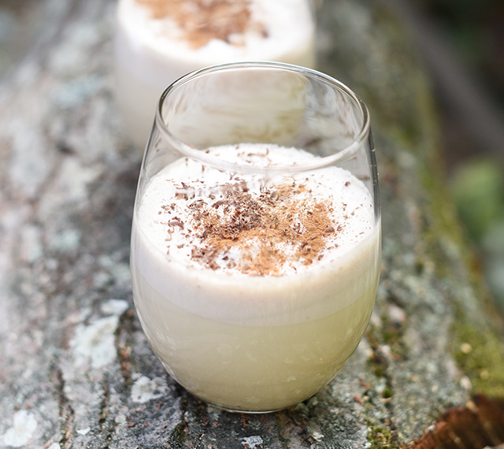

Slide 12
Chai Tea
Ingredients
How to Make It
2-inch piece fresh ginger, cut into thin rounds
2 cinnamon sticks
2 teaspoons black peppercorns
10 whole cloves
6 cardamom pods
6 cups cold water
6 bags of black tea
2 cups whole milk
1/2 cup (packed) golden brown sugar
Combine first 5 ingredients in medium saucepan. Using mallet or back of large spoon, lightly crush or bruise spices. Add 6 cups water; bring to boil over high heat. Reduce heat to medium-low, partially cover pan, and simmer gently 10 minutes. Remove from heat. Add tea bags and steep 5 minutes. Discard tea bags. Add milk and sugar. Bring tea just to simmer over high heat, whisking until sugar dissolves. Strain chai into teapot and serve hot.

Slide 13
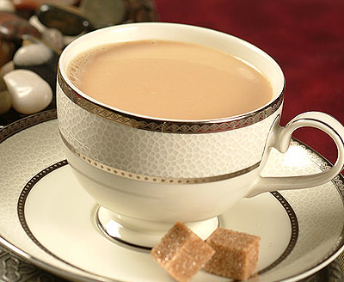

Slide 14
iced Jasmine Green tea
Ingredients
How to Make It
8 teaspoons green tea
4 cups water
1 piece fresh ginger
8 sprigs of fresh mint
2 lemon wedges
1⁄4 cup of sweetener (sugar)
Bring water to a boil. Steep tea for 7 minutes. When substance cools, take out and pour into cup. Chill for 4 hours. Add lemon and fresh mint and/or sugar sweetener.

Slide 15


Slide 16
Tropical Mango Pineapple Smoothie
Ingredients
How To Make It
1 cup vanilla yogurt
1 cup unsweetened pineapple juice
1/2 banana, sliced
1 mango - peeled, seeded, and chopped
1/2 cup nonfat milk
2 tablespoons cream of coconut
In a blender, blend the vanilla yogurt, pineapple juice, banana, mango, milk, and cream of coconut until smooth.

Slide 17
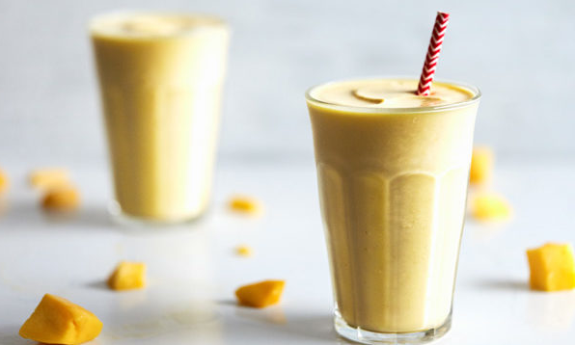

Slide 18
Enjoy!

