Slide 1
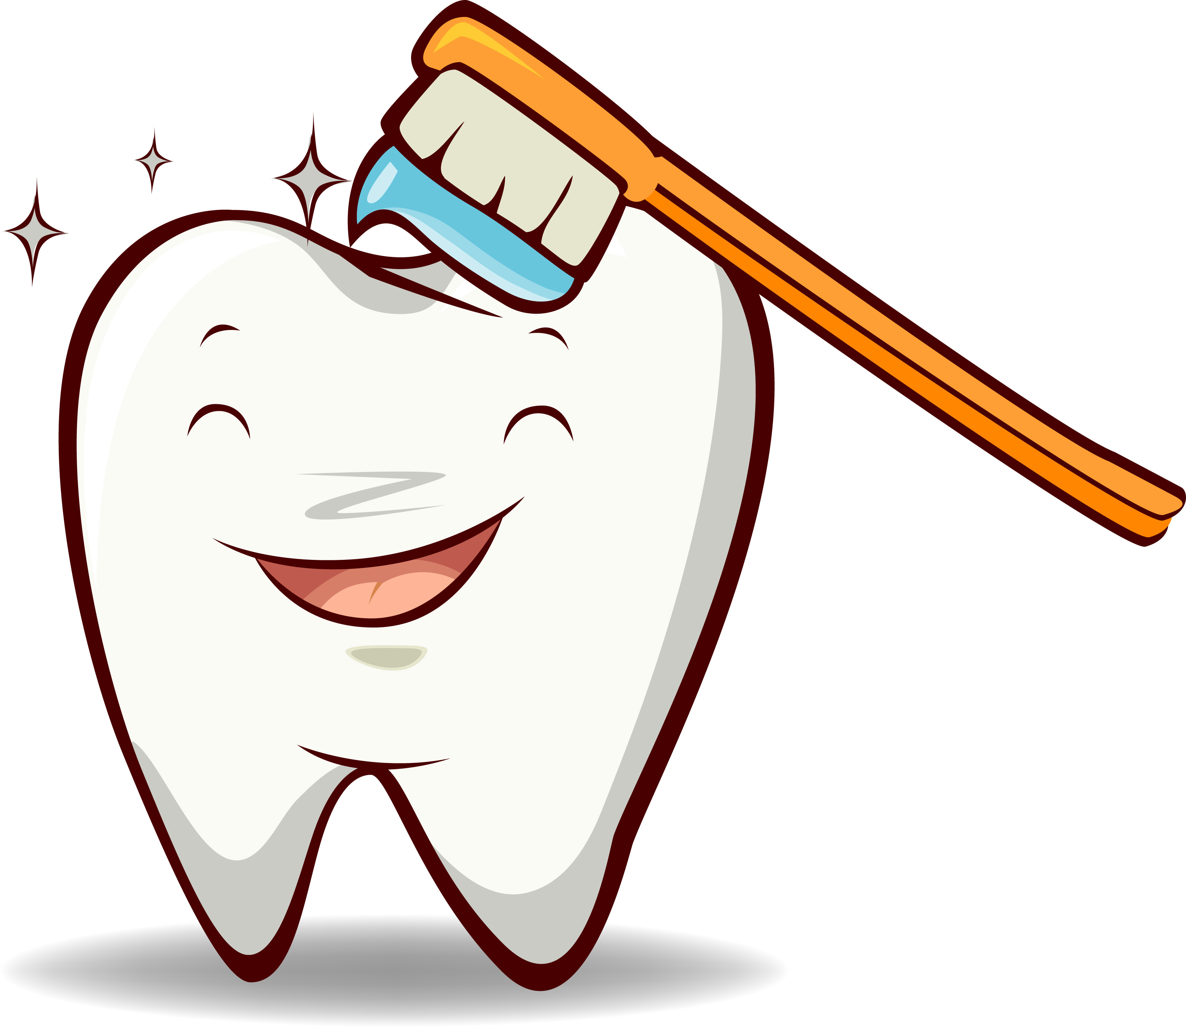
Healthy Smiles
Mirlinda Kaziu, Dafne Papadopoulos, Alaudina Duka, Julia Collins, Tara Gallo

Slide 2
Tiny Teeth Do BIG Jobs
Why do we have teeth?
Talk,
Smile,
Eat,
Sing, &
Chew
Notes:
Who can name something that we do with our teeth? [Discuss children’s suggestions, which may include talking, eating or chewing, smiling, singing.
Have children talk, chew, and smile and frown at each other.] Today we are going to talk about a very important part of our bodies — our teeth. Teeth help us do many things. Our teeth have the important job of helping our lips and tongue make sounds properly. I have another question. Do you think you need your teeth to frown? Let’s test it out. Turn to your neighbor and give a great big smile... Good. Now, give your neighbor a very unhappy frown... H-m-m-m. I guess you don’t need teeth to frown! But since most of you laugh and smile a lot, your teeth are very important!

Slide 3
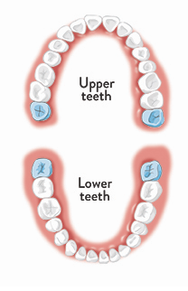
Do You Know How Many Teeth You Have?
Baby Teeth
Adult Teeth
20
32
Notes:
Primary Tooth Development. Here is a picture that shows all the teeth in the top of your mouth and in the bottom. Let’s count them together out loud… Twenty teeth! That’s a lot. By the time children are three or four years old, they have 20 teeth. Will you have these 20 teeth your whole life? [No.] What happens to your teeth when you get to be 5, 6 or 7 years old? [Your teeth start to come out.] Yes, your baby teeth start to come out. Why do you lose your baby teeth? [As children get bigger they need bigger, stronger teeth.] (First grade teachers may want to discuss losing primary teeth and getting permanent teeth in more detail.

Slide 4
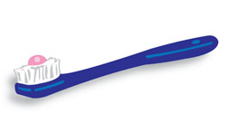
Keeping Teeth Bright And Healthy
What can you do to keep your teeth clean and healthy?
How many of you brush your teeth?
How many times a day should we brush our teeth?
Brush, Floss, Rinse & Eat Healthy
2 times a day

Slide 5
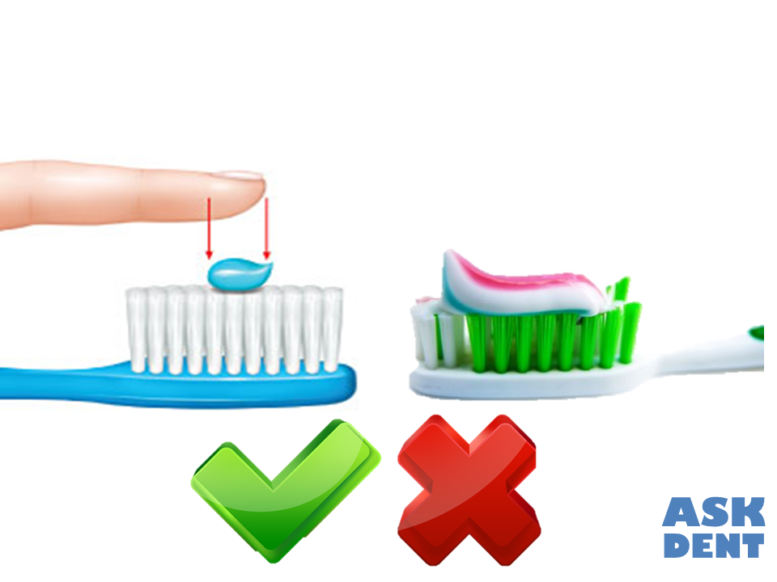
Keeping Teeth Bright And Healthy
Why do we use toothpaste to clean our teeth?
How much toothpaste do we need on our toothbrush?
ALWAYS REMEMBER: toothpaste is for cleaning your teeth, not your stomach. Make sure you always spit out your toothpaste when your done!
It is better than water only, and removes food and germs

Slide 6
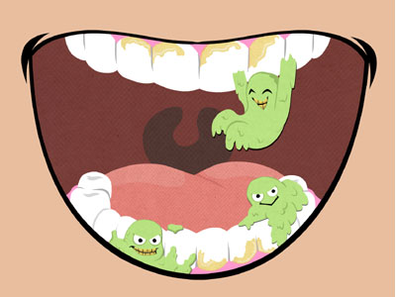
When we brush our teeth, we are brushing away
plaque.
Plaque is a sticky layer of germs that forms on your teeth all the time.
Notes:
What plaque is. When you brush your teeth at night, they feel clean and your mouth tastes good, right? Well, if you don’t brush your teeth before going to bed, how does your mouth feel when you wake up in the morning? [Tastes bad, smells bad, teeth feel sticky.] That is because there is something else that gets on your teeth besides the food you eat. It’s called plaque. Can you say “plaque”? Although you can’t see it, plaque is a sticky film that is forming on your teeth all the time.

Slide 7
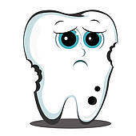
Plaque can cause:
Cavities
The germs in the plaque can hurt your teeth by helping to make a little hole called a cavity.
Plaque and cavities make our teeth weaker.
That is why it is so important to brush all the plaque away.

Slide 8
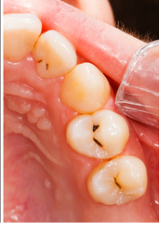
Can You Spot The Cavities?

Slide 9
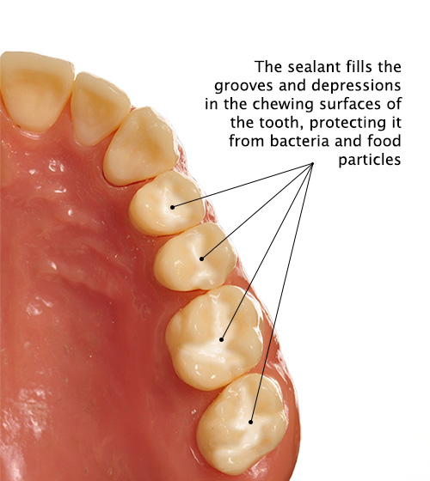
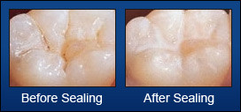
Sealants
Ask Your Dentist About:
Sealants act as a blanket to cover and protect your teeth from plaque sticking to the tiny grooves in your teeth.
They also help to prevent cavities from forming by blocking the germs out.

Slide 10
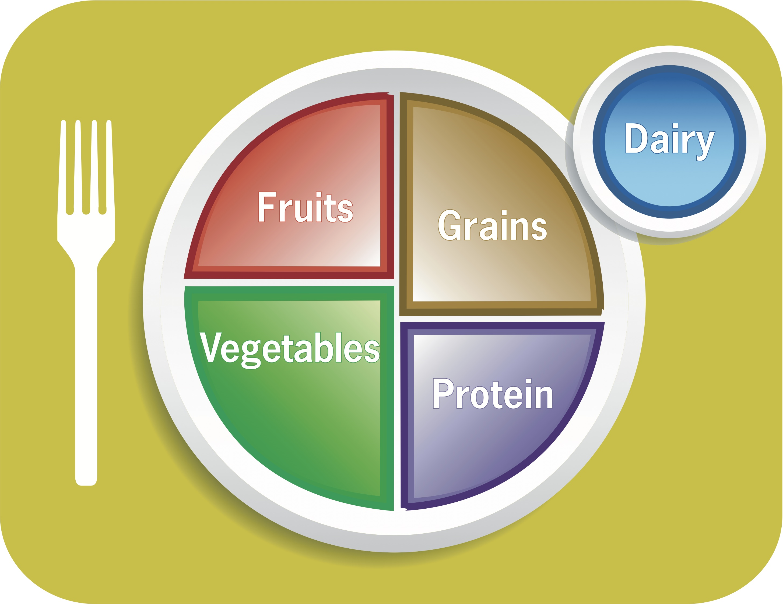
Help Promote A Healthy Smile By Eating Healthy Foods
Eating healthy foods helps keep your teeth and body healthy. Don’t eat or drink too many sweets. If you want sweets, eat or drink them with your meals.

Slide 11
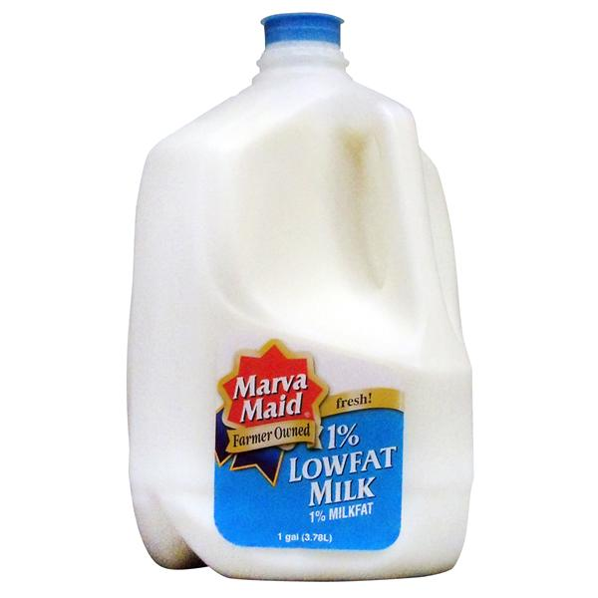
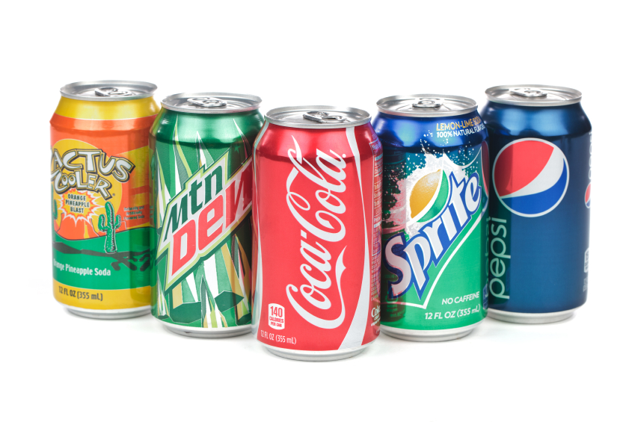
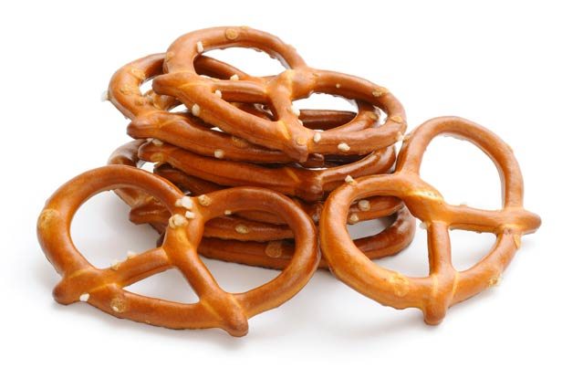
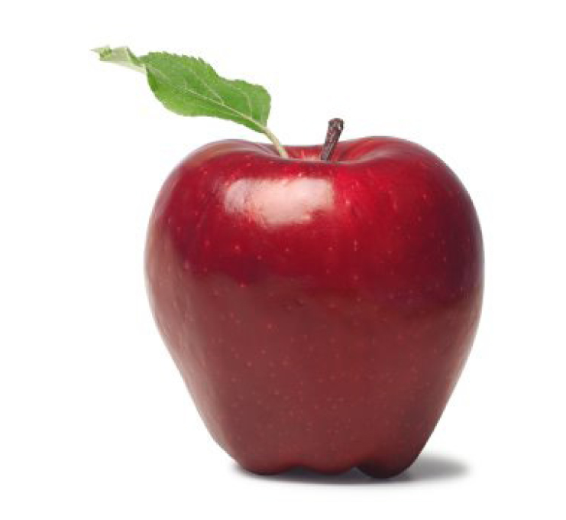
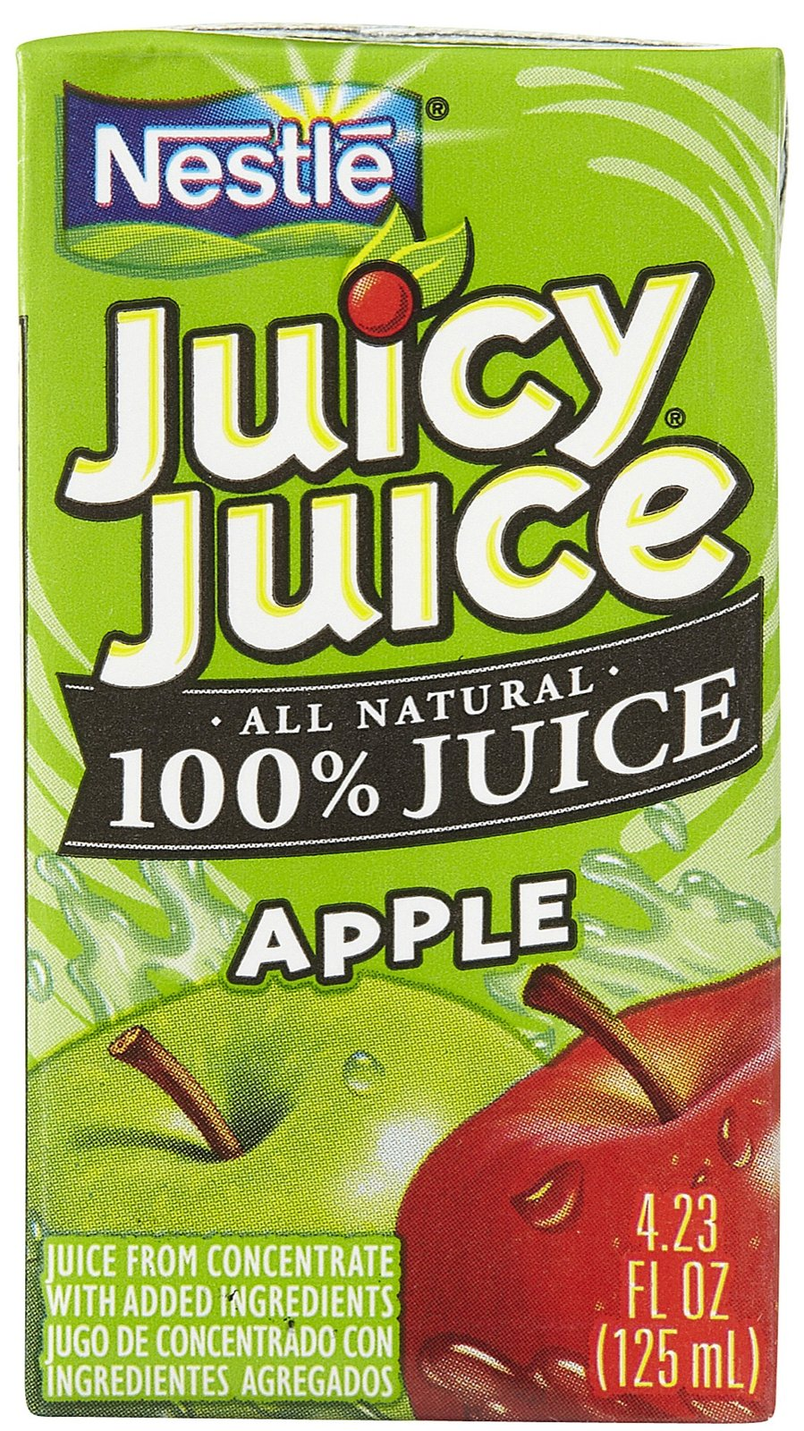
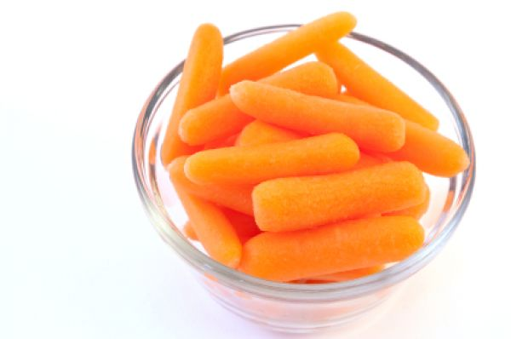
Help Promote A Healthy Smile By Eating Healthy Foods
Can you spot the healthy foods?
Notes:
There is another way we can help keep our teeth clean and healthy. That is by eating and drinking healthy foods. The foods we eat are just as important for keeping our teeth healthy as they are for keeping our bodies healthy. Eating a mix of healthy foods for breakfast, lunch and dinner is the best way to keep your teeth and whole body in good shape. If you are hungry and need a snack, choose foods like fruit, low-fat cheese, low-fat yogurt, or raw vegetables. If you are thirsty, have a glass of water or low-fat milk. Don’t drink too much sugary soda or eat too many sweets. If you have some sweets, try to eat them with your meals.

Slide 12
Cavity Timeline

Slide 13
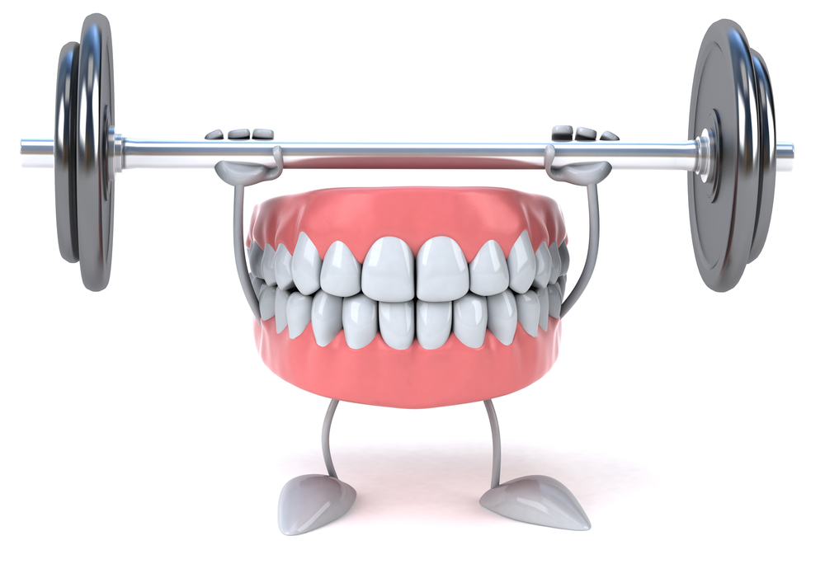
A Visit To The Dentist
How many of you have visited the dentist? Why is it important to visit the dentist?
To make sure your teeth are HEALTHY and STRONG.

Slide 14
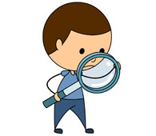
What is your dentist looking for when looking in your mouth?
The dentist looks to count your teeth
Look for cavities,
See if you are brushing properly,
Check if your teeth are growing correctly,
Make sure your whole mouth is healthy.

Slide 15
The Dental Team
What other people might you find at a dentist office?
Dental Hygienist
Helps to clean and polish your teeth.
Dental Assistant
Helps clean up the room and instruments.
Secretary
Greets you at the front desk.

Slide 16
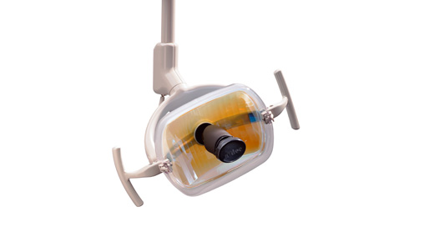
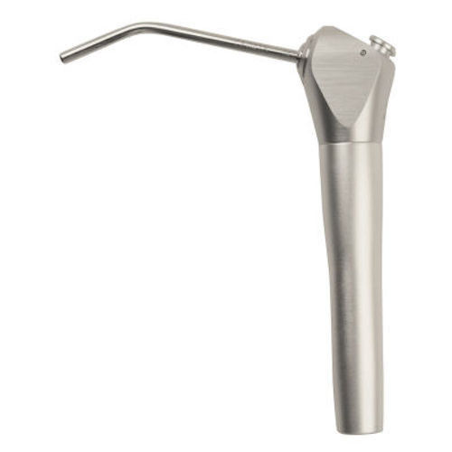
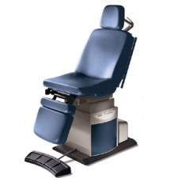
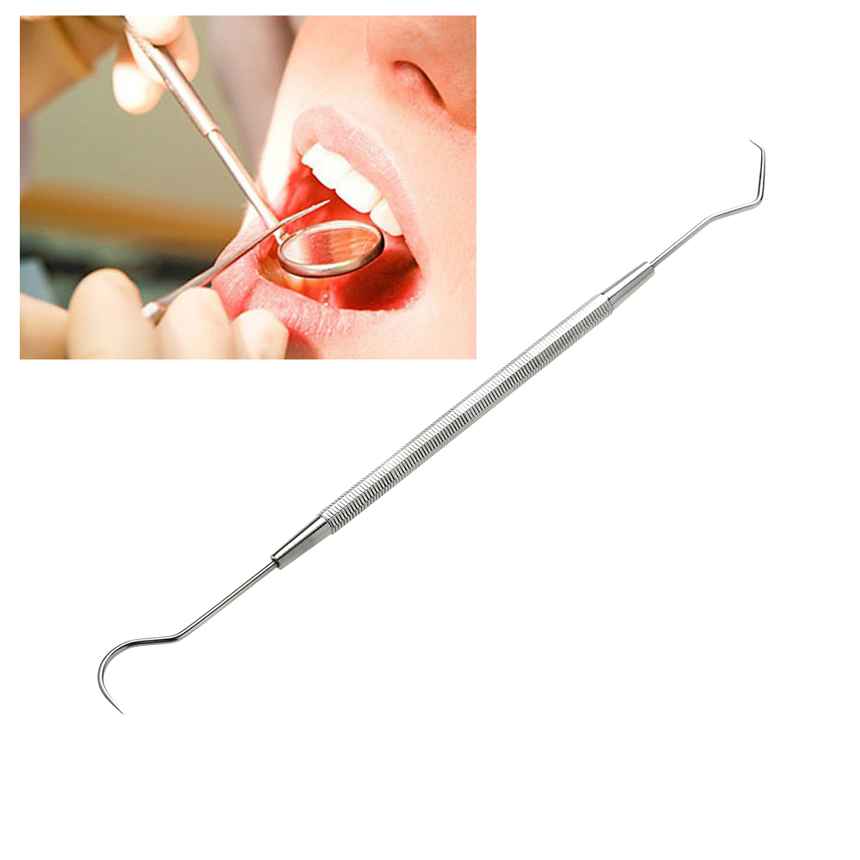
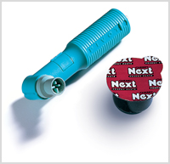
What Interesting Things Do You Find At A Dentist Office?
Notes:
Explain what each thing is used for.

Slide 17
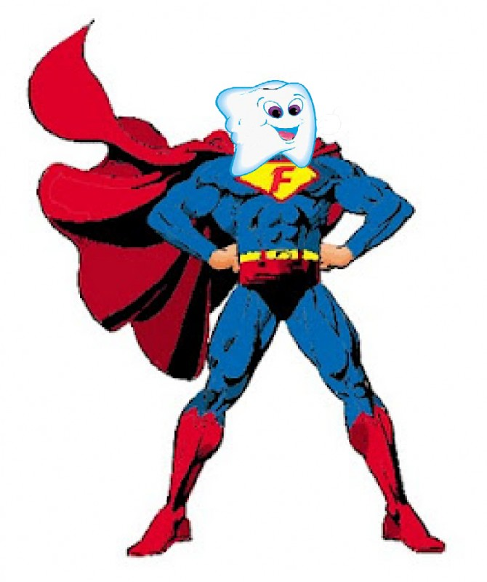
Do Your Dental Job At Home
Remember to brush your teeth with a toothpaste that contains
Fluoride
Fluoride acts like vitamins for your teeth to build them up and make them strong to fight against plaque and germs.

Slide 18
Do Your Dental Job At Home
Make sure you brush the outside, inside and the tops of your teeth!
Don’t Forget to Brush for 2 minutes!
Don’t forget to remove the bad breath germs by brushing your tongue!

