Slide 1
Emergency Precautions
Admins: Andrew, Isamar, and Rafael

Slide 2
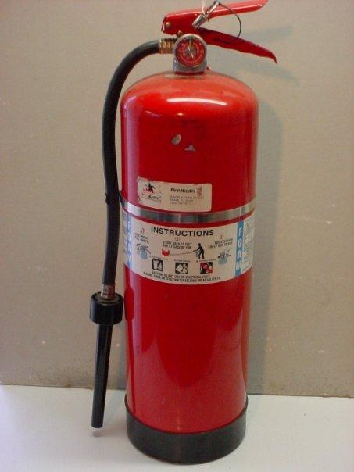
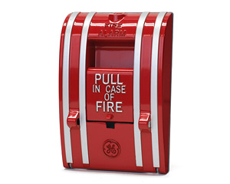
WHAT TO LOOK AT?
Exit
Fire Extinguisher
Fire Alarm
In case of a fire, use the fire extinguisher to prevent the fire from spreading.
Pull the fire alarm to alert other of a fire. This will let people know is time to evacuate.
Use the nearest exit to evacuate the building, exit signs will indicate exiting the building.

Slide 3
What should you do in case of an emergency?
5 Rules
1. Take deep breaths. Your brain can’t function properly without oxygen. Take long, deep breaths, not short ones.
2. Figure out what you need to do, and do it. Make sure you do it right while still being timely. Run in your head each choice you make, and determine the affects of it.
3. Call your local emergency number such as 10111, 112 or 911. After you’ve gone through your choice, call your local emergency number immediately.
4. Follow the instructions of the emergency dispatcher on the phone and don’t hang up.
5. Relax. Wait for the emergency specialists to come. There’s basically nothing you can do after you’ve made your choice and have called the emergency number.

