Slide 1
Drugs To Treat TMD
Presented by, Tenzin Dhasal

Slide 2
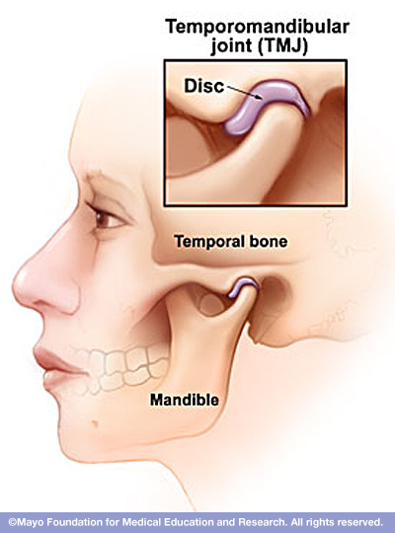
What is TMJ?
Temporomandibular Joint is a hinge located either side of your face that connects your jaw to the temporal bone of your skull
Enables your lower jaw to open and close, move backward and forward, side to side
Talk
Chew
Yawn

Slide 3
What is TMD?
Temporomandibular disorder is a joint, muscle, tendon and ligament disorders of the jaws.
Group of condition that causes pain and dysfunction in the jaw joint and the muscles that control jaw movement.
Pain and inflammation.
Difficulty in opening mouth, clicking, locking of the jaw.

Slide 4
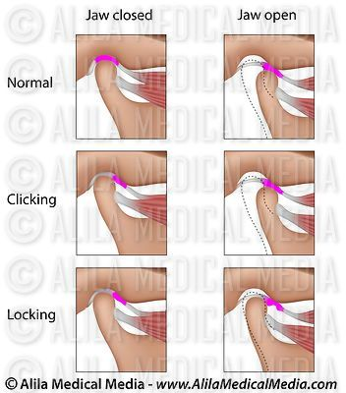

Slide 5
What causes TMD ?
There is no clear or specific cause for the TMD.
Many dentists believe that
Pressure from grinding or clinching the teeth
Dislocation of the soft cushion or disc, dislocation of jaw, or injury to the condyle.
- Osteoarthritis or rheumatic arthritis in the TMJ

Slide 6
Symptom of TMD
Pain and tenderness in the face, jaw joint area, neck and shoulder, around the ear when you chew or open your mouth
Limited ability to open mouth wide
Difficult chewing and uncomfortable biting
Clicking, locking, popping
Ear pain
Headache – 80%
Facial pain – 40%

Slide 7
Symptoms of TMD
Swelling on the side of your face
A tired feeling in the face

Slide 8
Pharmacologic Category
NSAIDs : Reduce pain and anti-inflammatory.
Aspirin
ibuprofin (Advil, Motrin)
diclofenac (Voltaren)
naproxyn (Naprosyn)
Mechanism of action: Inhibition of prostaglandin synthesis by decreasing the activity of the enzyme cyclooxygenase-1 and 2 (COX-1 and 2).
NSAIDs COX-2 inhibitor: celecoxib (Celebrex)
Contraindication: No Alcohol. COX-2 can’t be taken with other traditional NSAIDs.
Adverse effects:
Gastrointestinal. Cardiovascular: edema, heartburn.
CNS: headache, fatigue, dizziness, nervousness.
Celebrex - Reduce the effect of ACE inhibitor drugs.
Reduce the effect of tricyclics antidepressants.

Slide 9
Pharmacologic Category
(2) Muscle Relaxants drugs
cyclobenzaprine (Flexeril)
Methocarbamol (Robaxin)
MOA: Skeletal muscle relaxation by general CNS depression .
Adverse effects:
CNS: drowsiness, dizziness, fatigue, headache.
Gastrointestinal: Xerostomia.

Slide 10
Pharmacologic Category
(3) Anti-anxiety drugs: Benzodiazepines family.
Valium (diazepine)
Xanax (alprazolam)
Ativan (lorazepam)
MOA: Binds to stereospecific benzodiazepine receptors on the presynaptic GABA neuron in CNS. Increase the inhibition effect of GABA on neuronal excitability.
Adverse effects of Benzodiazepines:
CNS depression, sedation drowsiness

Slide 11
Pharmacologic Category
(4) Anti-epileptic drugs
Carbamazepine (Tegretol)
Use: Pain relief of trigeminal or glossopharyngeal neuralgia.
Adverse effects:
CNS: Dizziness(44%), drowsiness(32%), heachache(22%)
Gastrointestinal: Nausea(29%), vomiting(18%), constipation(10%), xerostomia(8%).

Slide 12
Pharmacologic category
(5) Anti-depressant drugs
Tricyclics :
Elavil (amitriptyline)
Use: Management of chronic neuropathic pain in temporomandibular dysfunction (TMD).
MOA: Increases the synaptic concentration of serotonin and norepinephrine in the CNS system by inhibition of their reuptake by presynaptic neuronal membrane pump.

Slide 13
Pharmacologic category
Dental dosage: amitriptyline
Adult: Oral, initial 25mg at bedtime, may increase as tolerated to 100 mg/day.

Slide 14
Home treatment for TMD
Use moist heat or cold packs.
Eat soft food : Mash potato, yogurt, eggs, cooked vegetables, fish soup.
Avoid extreme jaw movement: Gum chewing, loud singing, wide yawning.
Gentle jaw stretching and relaxing exercises.

Slide 15
Traditional treatment
Medications
Stabilization splints or bite guard – Oral appliance, plastic guard that fits over the upper and lower teeth. Keeps distance between teeth to avoid grinding or clenching jaw. Most widely used.
Dental work : crowns, bridges, braces to balance the biting surface of your teeth or to correct a bite problem.

Slide 16
Surgery – Irreversible treatments
Surgical treatments are controversial and often irreversible. It should be avoided where possible.
3 types of surgery
Arthrocentetis – minor procedure, lock jaw case.
Arthroscopy – used anthroscope, remove inflamed tissue or realign the disk or joint.
Open-joint surgery – procedure done if there is a wear down of bony structure of the jaw, have tumor in or around the jaw.

Slide 17
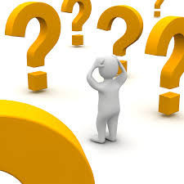
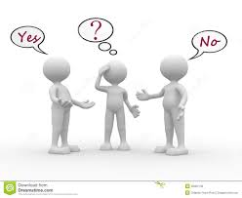
Quiz Time !!

Slide 18
Quiz time !!
Q1. Chewing gum can help relieve jaw pain.
a. True
b. False

Slide 19
Quiz time !!
Q1. Chewing gum can help relieve jaw pain.
a. True
b. False

Slide 20
Quiz time !!
Q2. A sign of TMD may be :
a. Jaw pain
b. Painful clicking or popping
c. Jaw locking
d. All of the above

Slide 21
Quiz time !!
Q2. A sign of TMD may be :
a. Jaw pain
b. Painful clicking or popping
c. Jaw locking
d. All of the above

Slide 22
Quiz time !!
Q3. Grinding and clinching your teeth may cause:
a. TMD and jaw pain
b. Tooth problem
c. Headaches and earaches
d. All of the above

Slide 23
Quiz time !!
Q3. Grinding and clinching your teeth may cause:
a. TMD and jaw pain
b. Tooth problem
c. Headaches and earaches
d. All of the above

Slide 24
Quiz time !!
Q4. Wearing a splint or bite guard round-the-clock may help with pain from TMD
a. True
b. False

Slide 25
Quiz time !!
Q4. Wearing a splint or bite guard round-the-clock may help with pain from TMD
a. True
b. False
Splints are worn 24 hours. Night guards are worn at night. 70% - 90% of people who wear them get some pain relief.

Slide 26
Quiz time !!
Q5. Severe jaw pain may be caused by medication for which medical problem?
a. Cold sores
b. Heartburn
c. Osteoporosis
d. Eczema

Slide 27
Quiz time !!
Q5. Severe jaw pain may be caused by medication for which medical problem?
a. Cold sores
b. Heartburn
c. Osteoporosis
d. Eczema
“osteonecrosis of the jaw”….remember??

Slide 28
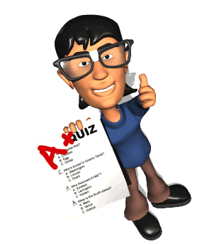
YOU GUYS ARE GENIUS !!!

Slide 29
The End!!!

