Slide 1
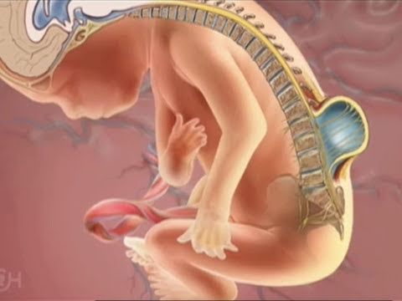
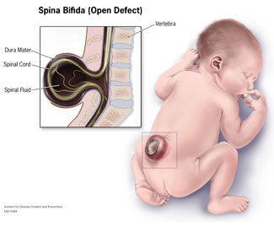
Neural Tube Defect Spina Bifida

Slide 2
What is Neural Tube Defects?
Neural tube defects (NTDs) are serious congenital defects of the central nervous system (CNS), including the spinal cord, skull, and brain, that result from failure of the neural tube to close during the first 30 days of fetal development.
There are three main types of NTDs: anencephaly, encephalocele, and spina bifida.

Slide 3
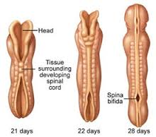
Spina Bifida
Spina bifida, which literally means "cleft spine” or “split spine”, is characterized by the incomplete development of the brain, spinal cord, and/or meninges (the protective covering around the brain and spinal cord). It is the most common neural tube defect in the United States - affecting 1,500 to 2,000 of the more than 4 million babies born each year.

Slide 4
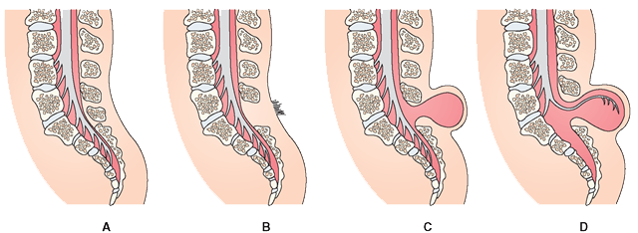
Different types of Spina Bifida
A.Normal
B.Occulta
C.Meningocele
D.Mylelomeningocelle
1. Occulta : Mildest and most common in which one or more vertebrae are malformed.
2. Closed neural tube defects : Consists of a diverse group of spinal defects in which the spinal cord is marked by a malformation of fat, bone, or membranes.
3. Meningocele : Protrusion of spinal fluid and meninges through an abnormal vertebrae opening.
4. Myelomeningocele : is the most severe and occurs when the spinal cord/neural elements are exposed through the opening in the spine, resulting in partial or complete motor paralysis and sensory deficits within the parts of the body below the spinal opening. The paralysis may be so severe that the affected individual is unable to walk and may have urinary and bowel dysfunction.

Slide 5
Causes of Spina Bifida
Unknown, Still a mystery.
Scientists suspect - multifactoral: genetic, nutritional, and environmental factors play a role.
Research studies indicate that insufficient intake of folic acid, a common vitamin B in the mother’s diet is the key factor in causing Spina Bifida and other neural tube defects.
Prescribed prenatal vitamins contain folic acids as well as other vitamins.
Women with pregestational diabetes are at increased risk of giving birth to a child with a NTD.

Slide 6
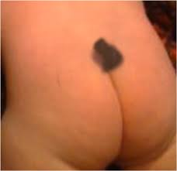
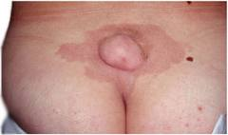
Symptoms of Spina Bifida
Closed neural tube defects are often recognized or identified early in life due to an abnormal tuft or clump of hair or a small dimple or birthmark on the skin at the site of the spinal malformation.
Meningocele and myelomeningocele generally involve a fluid-filled sac -- visible on the back -- protruding from the spinal canal.

Slide 7
Prevention and Treatment
No cure for Spina Bifida. The damaged nerve tissues and tissues cannot be repaired.
Treatment depends on severity of the disorder. Children with the mild form need no treatment, although some may require surgery as they grow.
A child born with spina bifida will have surgery to close the defect and minimize the risk of infection or further trauma within the first few days of life.
Recent studies have shown that by adding folic acid to their diets, women of childbearing age significantly reduce their risk of having a child with a neural tube defect, such as spina bifida.

Slide 8
The Role of Dental Care
Dental professionals need to be knowledgeable about the birth defect special needs so that they can provide adequate, efficient, and effective care to this patient population.
Children with spina bifida are at increased risk of latex allergy ( more than 70% exhibit allergy).
Dental office contains many sources of latex, such as gloves, suction tips, air or water syringes, mixing bowls, blood pressure cuffs, orthodontic rubber bands, and nitrous oxide reservoirs.
-When treating patients with spina bifida in the dental office, a latex-free environment must be maintained.

Slide 9
The Role of Dental Care
Patients at risk of bacteremia (blood infection), may require antibiotic prophylaxis (AP) before dental treatment.
Dental anxiety – antianxiety agent diazepam or lorazepam can be prescribed.
Patient with gastrointestinal and/or tracheostomy tubes should be placed upright in dental chair to maintain the airway.
Dysphagia – minimize the use of water.

