Slide 1
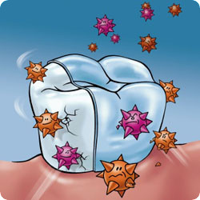
Caries Prevention

Slide 2
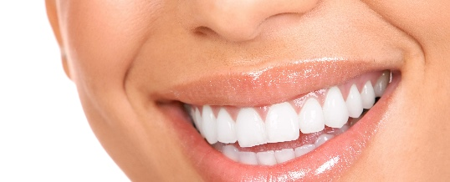
Healthy

Slide 3
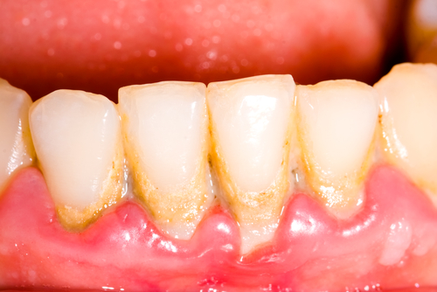
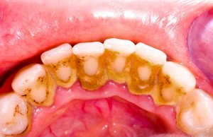
What does plaque look like?

Slide 4
Gingivitis or Gum disease
Irritation
Redness
Inflammation(swelling)

Slide 5
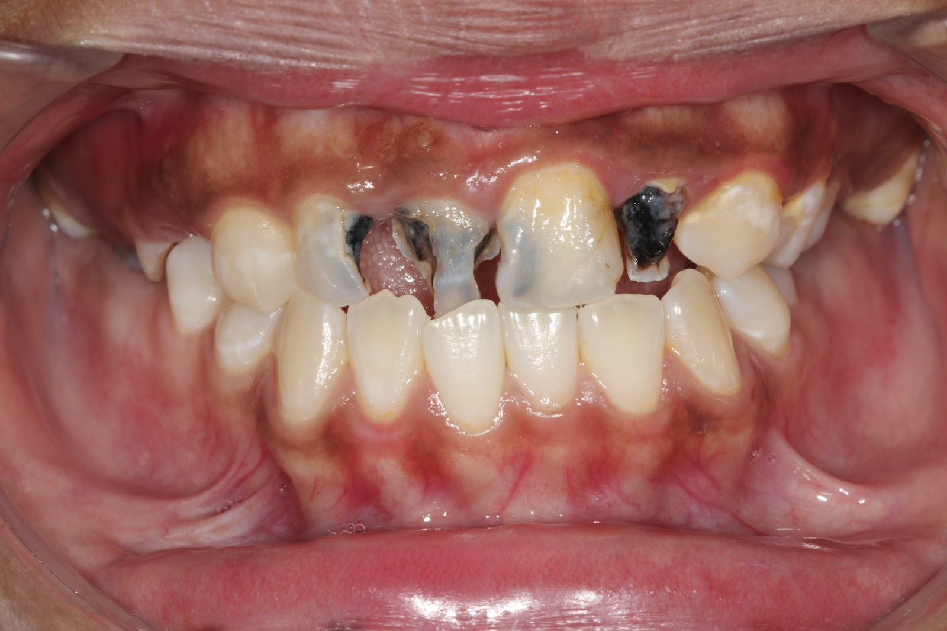
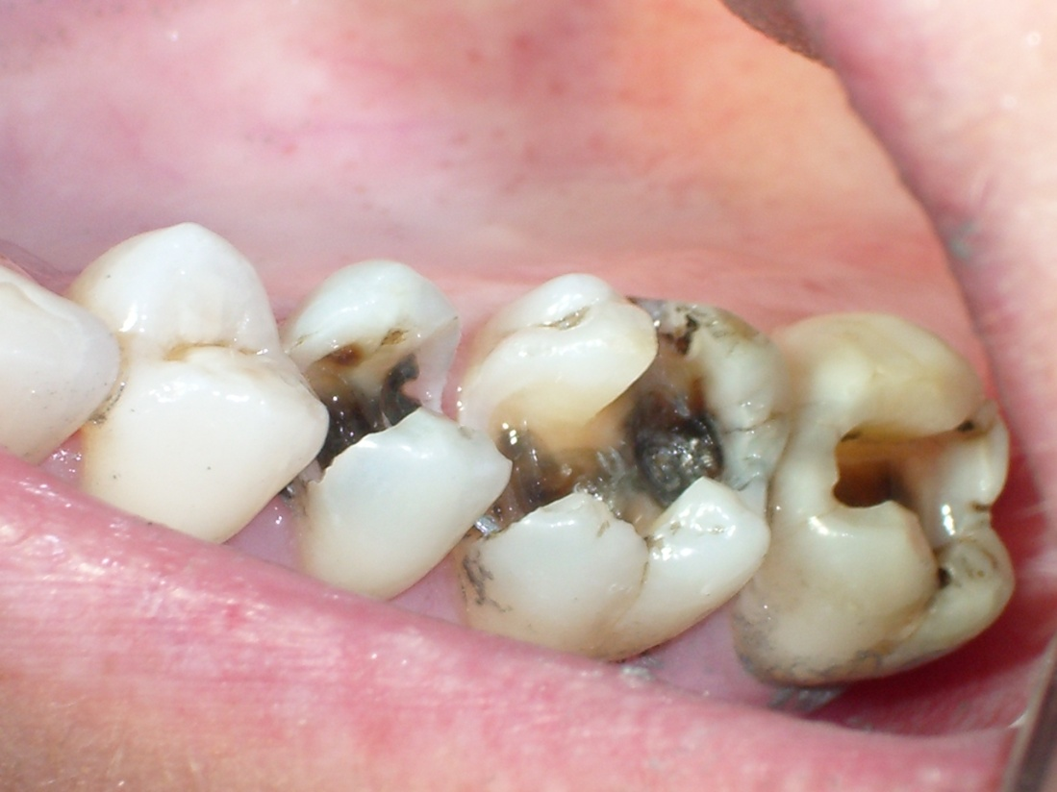
Caries Diseased

Slide 6
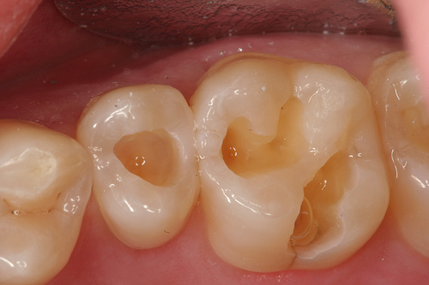
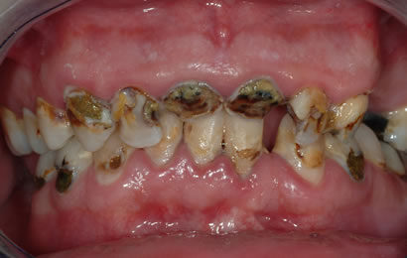
Con’t

Slide 7
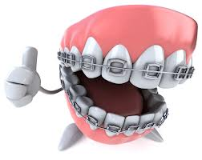

Slide 8
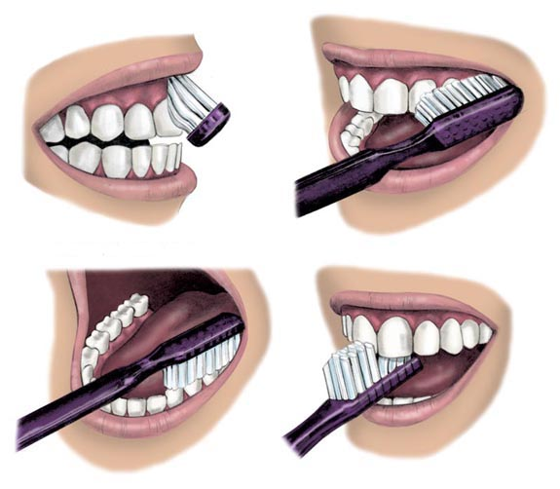
4 Steps to a great smile
Brush

Slide 9
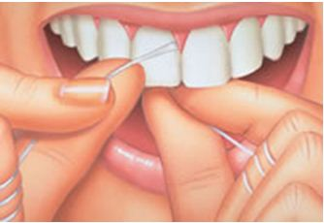
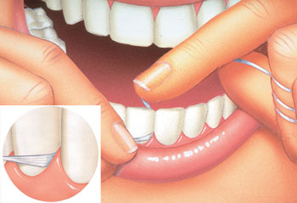
Floss

Slide 10
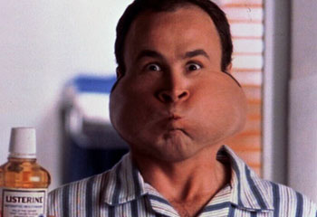
Should we rinse this much??
RINSE

Slide 11
NO……………

Slide 12
Dental Check up!!

Slide 13
What of these foods we don’t have to brush off?

Slide 14
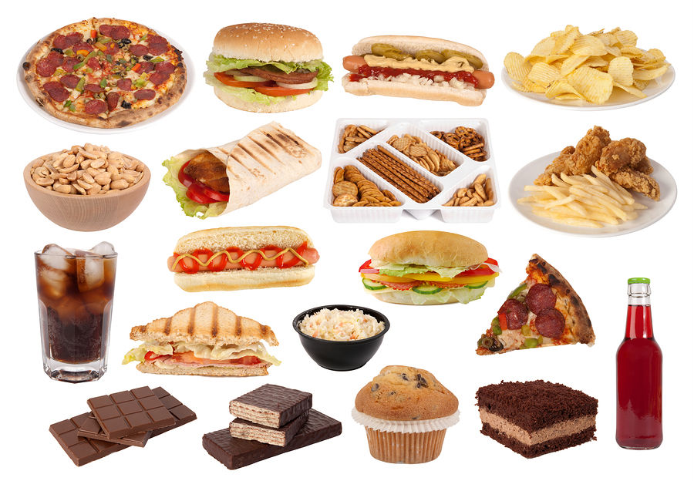
Or……..

Slide 15
All of them!!!

Slide 16
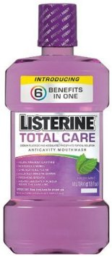
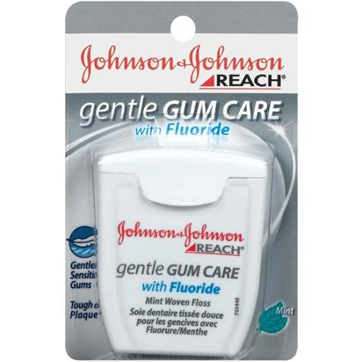
Fluoride

Slide 17
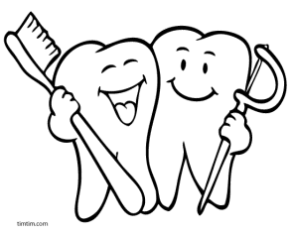
Let’s practice!

Slide 18
Quiz questions
1) Name one food or fruit that is good for your teeth?
- apple, carrot, broccoli, banana etc.
2) Name one food or drink that is bad for your teeth?
- Potato chips, soda, candy, sugar etc.
3) How many times should you brush a day?
Twice.
5) What are the four steps to a great smile?
- Floss, Brush, Rinse, Dental check up.

