Slide 1
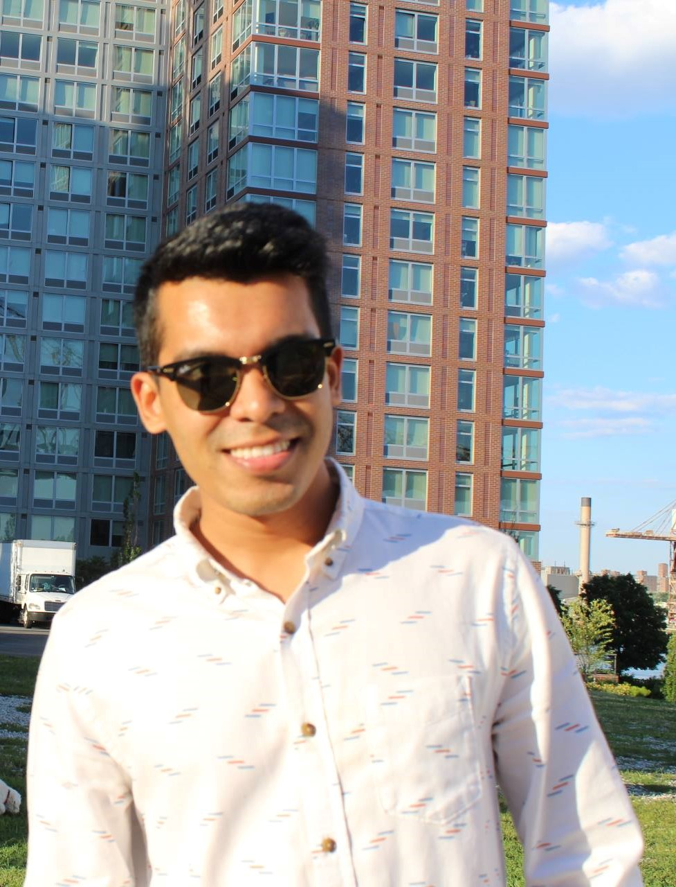
Ahasan Haque
Lives in Jamaica, Queens
Strengths: Focused, Goal Oriented, Perfectionist
Weakness: Easily Distracted
Software Skill: Adobe Illustrator, Revit

