Slide 1
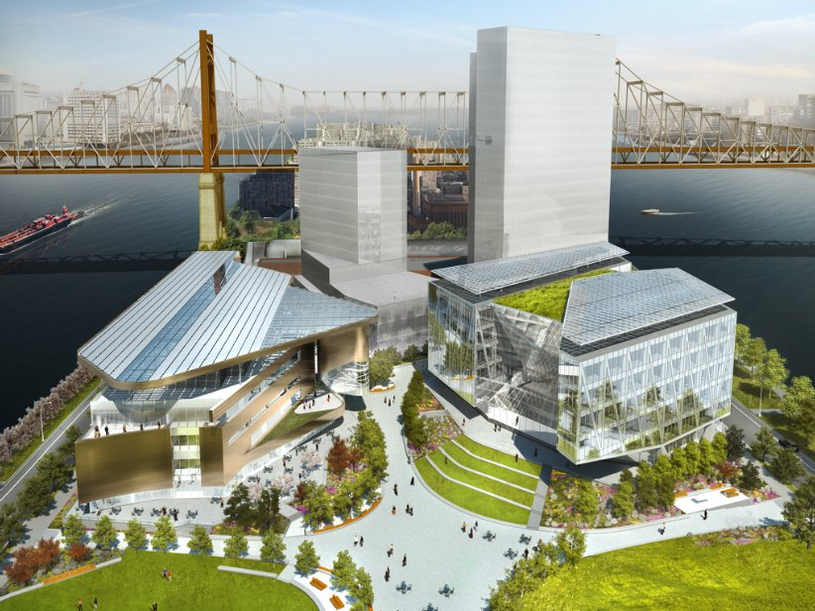
Cornell university

Slide 2
Table of content
About Cornell Tech
Campus Sustainability Planning Overview
Roosevelt Island
Campus Overview
The Bloomberg Center
The Bridge
The House
The open space
Verizon Executive Ed Center
Graduate Roosevelt Island Hotel
Campus Master Plan
Why Roosevelt island?
Cornell tech involvement in Roosevelt island
Future projects

Slide 3
About
Cornell is a private, Ivy League university and the land-grant university for New York state. Cornell Tech is an engineering campus located on Roosevelt Island in Manhattan, New York City. It is anchored by the Jacobs Technion-Cornell Institute, a joint academic venture between Cornell University and the Technion-Israel Institute of Technology. Cornell/Technion promised to create 28,000 jobs, of which 20,000 would be in construction and 8,000 would be those of academics at the campus. also provided for 200 professors and 2,000 students inhabiting some 2,000,000 sqft of campus space.
Location: 2 W Loop Rd, New York, NY 10044
Architect: Skidmore, Owings & Merrill
Landscape design: James Corner
Area: 12 Acres
Opened on September 13, 2017
Initially hosting 30 professors and 300 students

Slide 6
Campus Sustainability planning overview

Slide 7
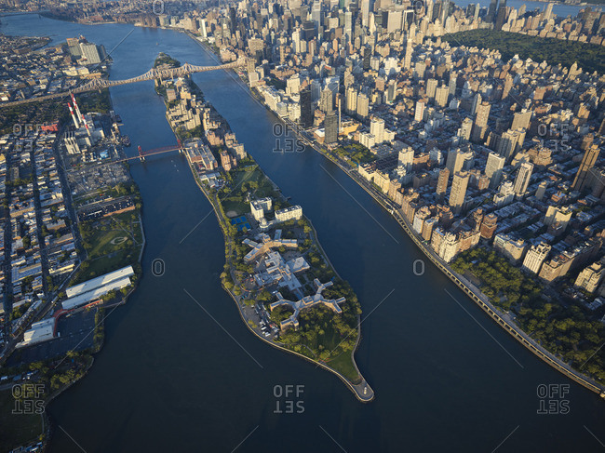
Roosevelt island
Roosevelt Island previously known as Welfare Island (1921-1971) lies between Manhattan Island to its west and the borough of Queens on Long Island to its east, and is part of the borough of Manhattan. Running from the equivalent of East 46th to 85th Streets on Manhattan Island.
About 2 miles long and about 800 ft wide
Total area of 147 acres
Population: About 11,551
White Collar: 3,072
Blue Collar: 946
Total Households: 4,710
Average Household Income: $84,719

Slide 8
The campus overview
Emma and Georgina Bloomberg Center
The Bridge at Cornell Tech
The House at Cornell Tech
Open Space
Verizon Executive Ed Center
Graduate Roosevelt Island Hotel
Campus Master Plan

Slide 9
The Bloomberg Center
Designer: Thom Mayne, Design Director, Morphosis
Named in honor of Emma and Georgina Bloomberg, it is the intellectual nerve center of the campus, bringing together students and faculty to collaborate across disciplines -- but also serving as a venue for chance collisions between academia and the world at large.
The four-story academic building is designed to support the idea that innovation is a collective enterprise. Ample open space encourages collaboration, allowing teams to spread out, actually create things, and put ideas into action. The building is clad in a warm bronze-colored metal and topped by a swooping lily pad-shaped roof. It takes its shape from its triangular site facing the public plaza, the nexus of the campus.

Slide 11
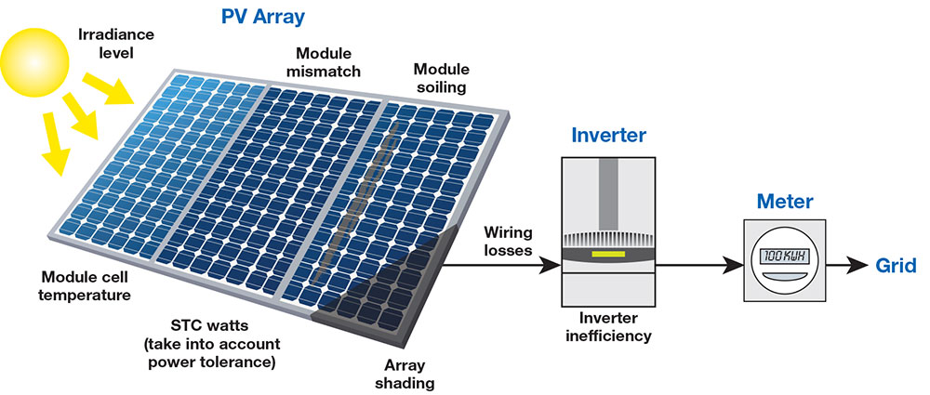
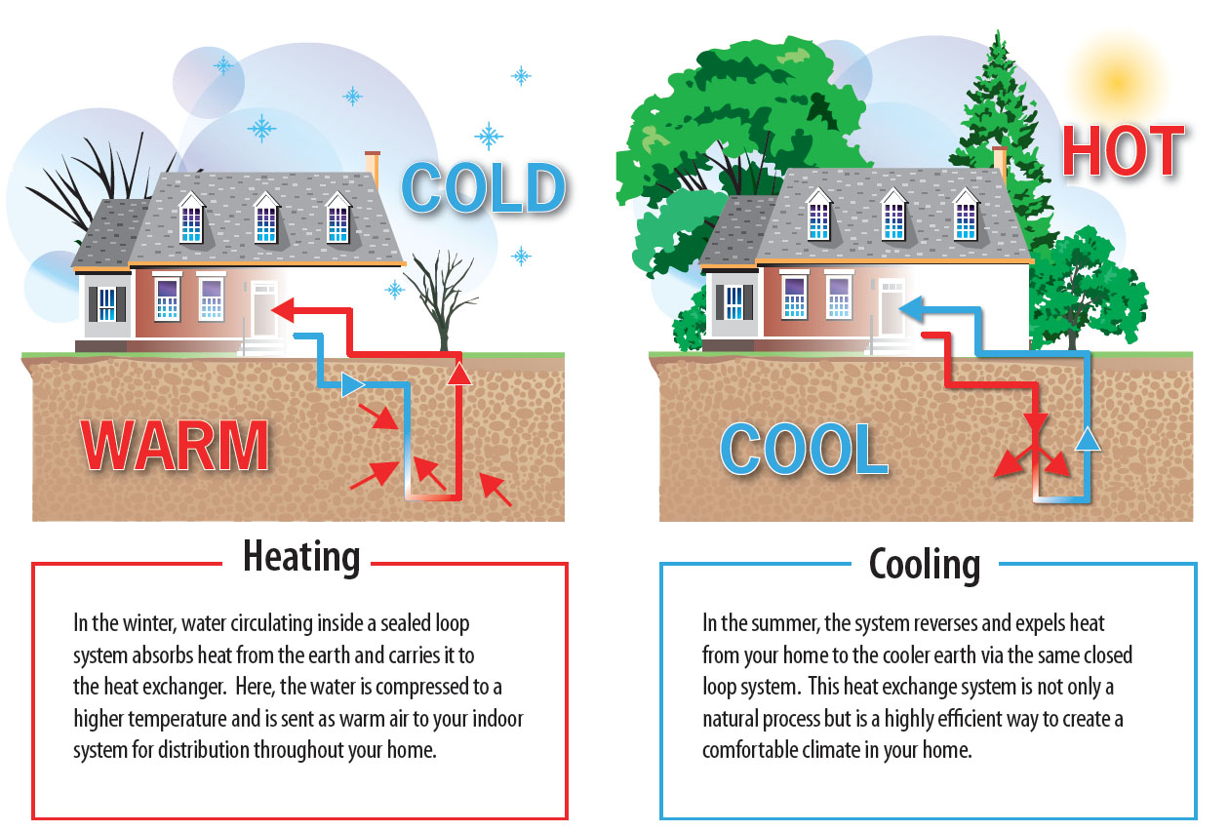
The Bloomberg Center: Sustainability
Pioneering new standards in building performance and targeting LEED Platinum Certification, The Bloomberg Center sets the bar for the rest of the campus. With power entirely generated on campus, it aspires to be among the largest Net-Zero energy buildings in the United States. Its passive energy-efficient design includes a rooftop photovoltaic array system and geothermal heating and cooling systems.
Photovoltaic System
Geothermal Heating & Cooling System
LEED Status- Platinum

Slide 12
LEED PLATINUM CERTIFICATION
LEED Point System
LEED Certification Levels
Innovation and Design- 11 points
Location and Linkages- 10 points
Sustainable Sites- 22 points
Water Efficiency- 15 points
Energy and Atmosphere- 38 points
Materials and Resources- 16 points
Indoor Air Quality- 21 points
Awareness and Education- 3 points
Certified 40 - 49 Points
Silver 50 - 59 Points
Gold 60 - 79 Points
Platinum 80-110 Points

Slide 13
The Bridge at Cornell Tech
Designed by Weiss/Manfredi Architecture
The Bridge reinforces incidental interaction. The Bridge was developed in partnership with Forest City Ratner Companies. Planned around an expansive, central staircase, the building’s openness promotes visual connections between floors, outward into the heart of the campus and surrounding city beyond. The glass façade melds inside and out, allowing those inside to draw inspiration from river-to-river views throughout the interior of the building and from the rooftop terrace.

Slide 14
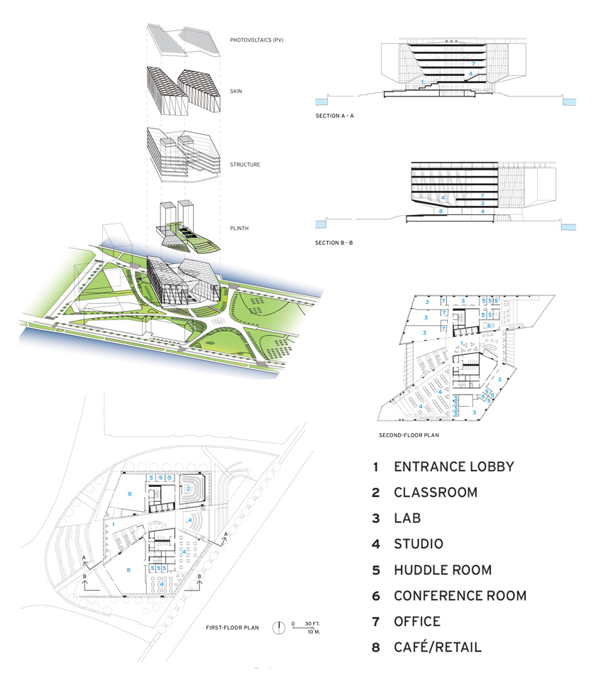

Slide 15
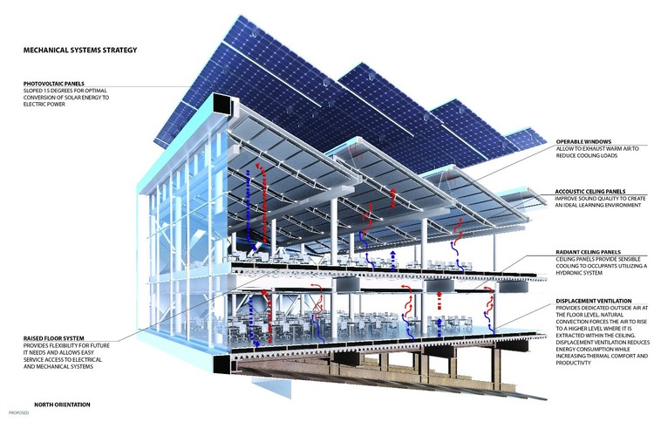
The Bridge: Sustainability
The Bridge is built to LEED Silver sustainability standards. The silhouette of the rooftop photovoltaic canopy unifies the campus’ architectural expression and serves as an iconic symbol of Cornell’s commitment to conserving natural resources. The energy generated from the roof will offset the overall energy consumption of The Bloomberg Center, helping it achieve its low-energy goals. Expansive windows will inspire innovation with incredible views, but also bring daylight deep into the building.
16,500 sq. ft. of rooftop solar panels
Plumbing
High efficiency plumbing fixtures for increased water savings
Storm water system inclusive of bio swales to remove debris
Storm drainage system incorporates both primary and secondary overflow drains to prevent ponding and water buildup
Mechanical
Systems designed to accommodate high density occupancies varying between 84–96 usable sq. ft./person on the office tenant floors
LEED Status- Silver

Slide 16
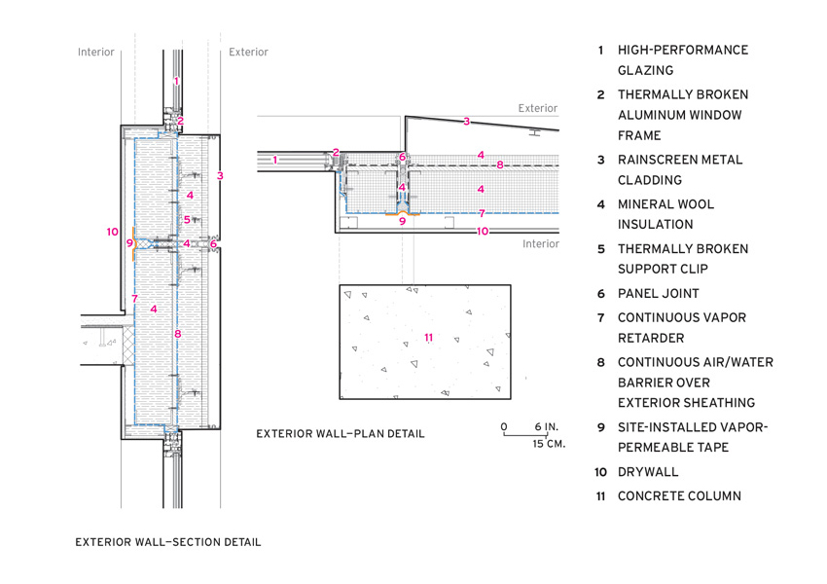
The Bridge: Sustainability
Electrical
600 kW emergency generator for life safety and critical building loads
6 watts/useable sq. ft. demand for light and power
HVAC
Unit load densities for cooling:
Power — 3-1/2 watts/usable sq. ft.
Lighting — 1 watt/usable sq. ft.
Supplement Condenser Water Cooling Capacity — 1-1/2 watts/usable sq. ft.
Flood Protection
Bathtub Foundation Design
Ground Floor located over 10’ above the 100 year flood plane
Switchgear located on the roof level
Base Building tel/data and security head-end equipment at grade
Diverse Points of Entry for Tel/Data

Slide 17
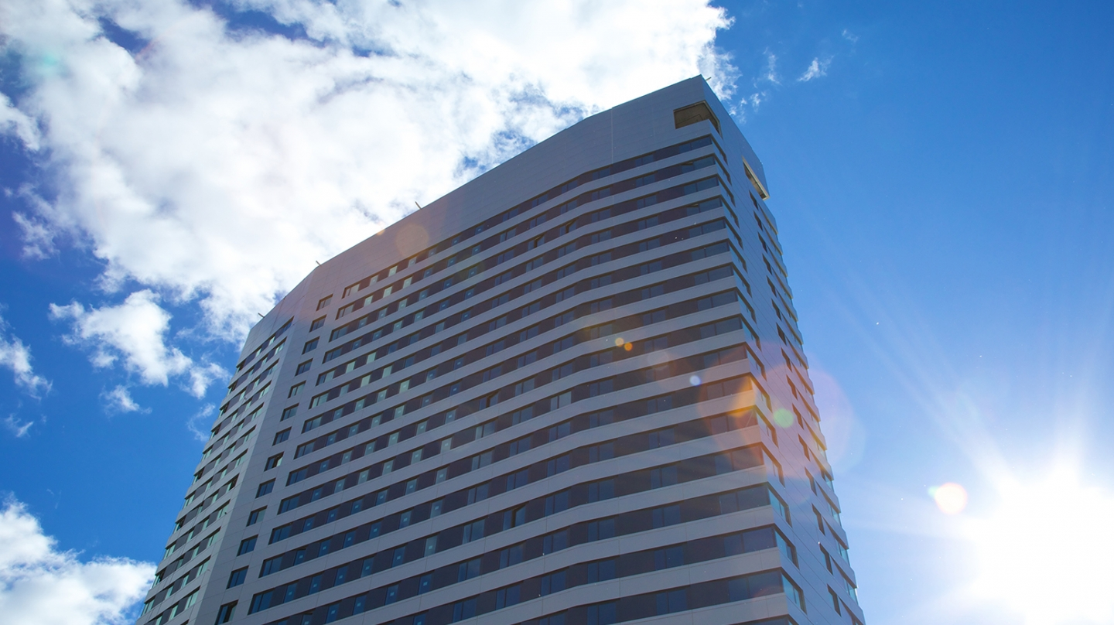
The House
Designer: Gary E. Handel, President, and Blake Middleton, Partner, Handel Architects
The House further serves as a beacon with a metal façade that shimmers in the light, shifting in hue from silver to warm champagne. As elsewhere on campus, The House has a wealth of collaborative space. From the multi-story lobby to the rooftop space, residents have access to many common areas where they can socialize while taking in a stunning view over the East River.

Slide 18
The House: Sustainability
Considered the most rigorous energy efficiency standard in the world, Passive House buildings use 60-70 percent less energy than typical buildings. The façade of The House, constructed of a metal panel system, acts as an insulated blanket wrapping the building. A louver system spans the building to serve as “gills” where the heating and cooling live, allowing the systems to breathe. Compared to conventional construction, it is projected to save 882 tons of CO2 per year equal to planting 5,300 new trees.
Passive design strategy carefully models and balances a comprehensive set of factors including heat emissions from appliances and occupants to keep the building at comfortable and consistent indoor temperatures throughout the heating and cooling seasons. As a result, Passive buildings offer tremendous long-term benefits, including reduced operating costs for its residents, in addition to their energy efficiency.

Slide 19
The House: apartments
Micro
Studio
1BR/1B

Slide 20
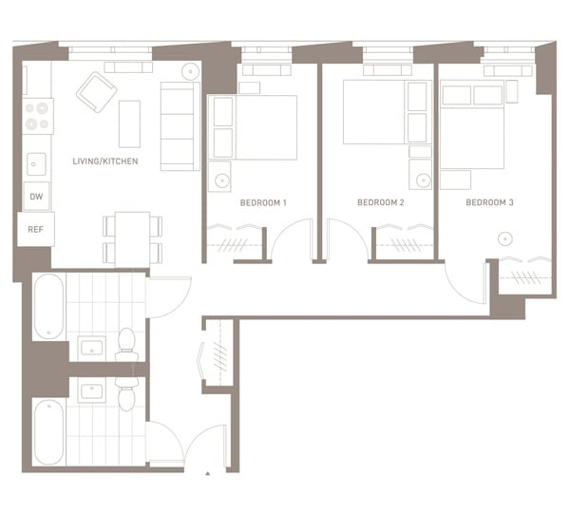
The House: apartments
2BR/1B
2BR/2B
3BR/2B

Slide 21
Open Space
Designer: James Corner, Principal, Field Operations
Anchors the campus, fostering collaboration and innovation while simultaneously inviting the public into the campus. The campus is a river-to-river experience, engaging Roosevelt Island’s esplanade and extraordinary water frontage while maximizing views of Manhattan and Queens. The heart of 3.5 acres of open space is the Campus Plaza, a multi-use central gathering space that can accommodate larger events. Connected to the Plaza is the quarter-mile long Tech Walk, a central spine that features a series of active and social spaces that are linked by pedestrian pathways. Throughout the campus, outdoor and indoor spaces are synergistically connected to allow people to move easily and comfortably in and out during the course of the day. The open space features comprehensive resilient design, including rain harvesting for irrigation, subterranean gravel trenches that hold and slow down storm water; a series of bio-filtration gardens that treat storm water runoff non-mechanically before it enters the river; and a geothermal field that provides energy to The Bloomberg Center.

Slide 23
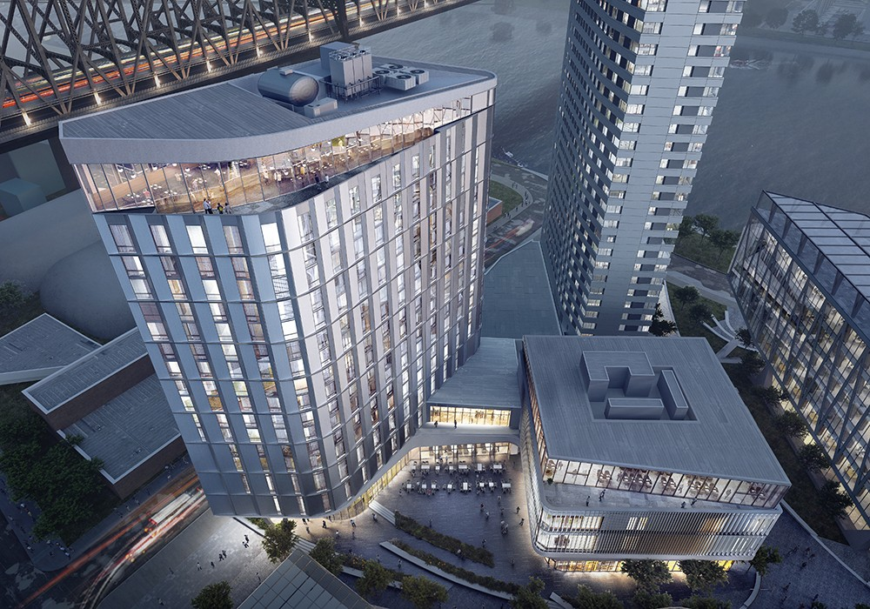
Verizon Executive Ed Center
Designer: Snøhetta
The two buildings, which are connected by a shared hall, occupy the space nearest to Cornell Tech's entrance, closer to the Queensboro Bridge, and is meant to be "the front door for the campus," said Andrew Winters, the school's senior director of capital projects.
The 195-room hotel will be made of metal panels and glass set upon a platform, which opens out to a outdoor plaza for the community. The lodging will primarily serve visitors from out of town attending business and academic conferences, students and professors from around the world, as well as the general public, according to Winter

Slide 25
Graduate Roosevelt Island Hotel
Designed By: Snohetta
The Graduate Roosevelt Island hotel is expected to open in 2019. The boutique Graduate brand has hotels in locations where there's a strong identification with a university, and the Roosevelt Island site will be located at the gateway to the Cornell Tech complex, which is being built by Cornell University. The first phase of Cornell Tech is scheduled to open in September.
The Graduate Roosevelt Island hotel will be a new build with 196 rooms and will offer unobstructed views of the Manhattan skyline. There are no other hotels on the island.
The hotel will include a restaurant, rooftop bar and meeting and event space. The decor will also reference Roosevelt Island history. Over the centuries, the island — once known as Welfare Island — has housed a prison and hospitals. Still standing is a now-abandoned smallpox hospital from the 1850s known as the Renwick Ruin.

Slide 27
Campus Master Plan

Slide 28
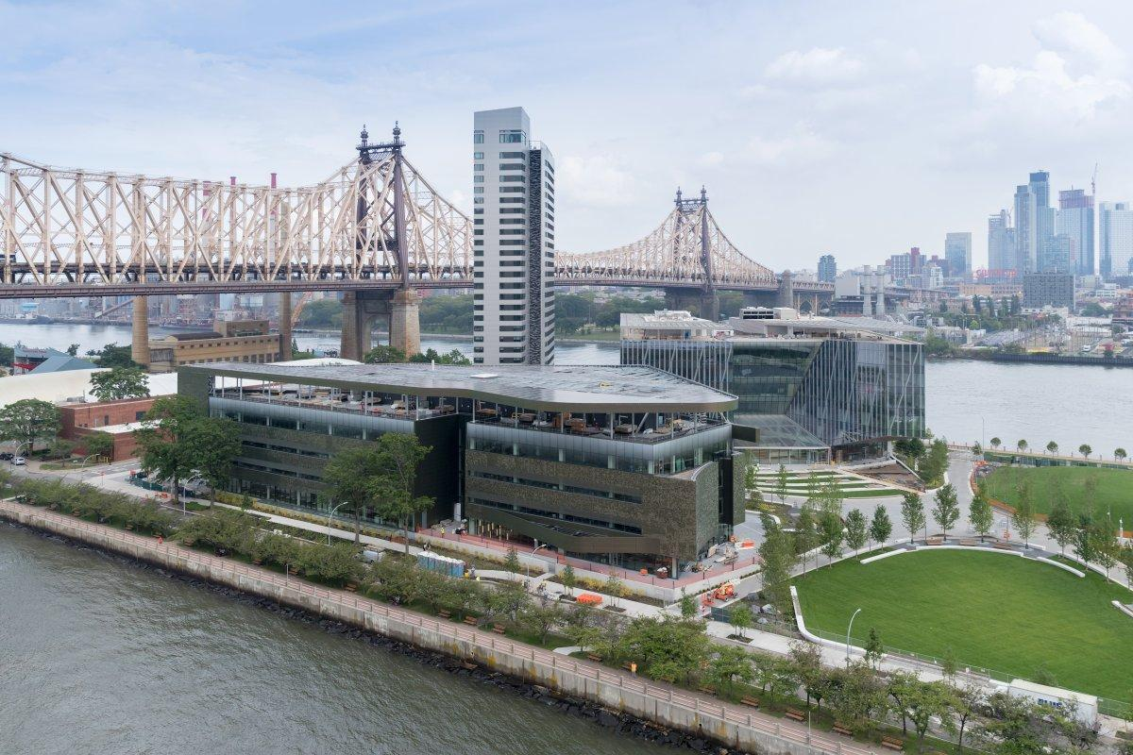
Why Roosevelt island?
Congresswoman Carolyn B. Maloney said, “With its proximity to Manhattan and to industrial space in Western Queens, Roosevelt Island is the perfect setting for an educational institution.
Besides, one of the main goal is to implement more technology in NYC and making this island as the capital of technology. Since Roosevelt Island is in between Manhattan and Queens, the location works perfectly to serve that purpose. That way both boroughs get the effect of the new research and technology.
Also, former mayor M. Bloomberg’s focus is to bring a world renowned university in NY and compete with Universities like MIT, Harvard and make NY more known to the world. Keeping that in mind, Roosevelt Island already have it’s historical reputation and having an university like Cornell Tech will bring it more into light.

Slide 30
Cornell tech involvement in Roosevelt island
Cornell Tech fosters community connection and collaboration
Cornell Tech’s K-12 education
Cornell Tech’s Teacher-in-Residence program
Agriculture and Food Systems
Retirees in Service to the Environment (RISE)
Roosevelt Island Disabled Association Brainstorming Challenges For The Hackathon
Civic Engagement A Safe Bike Ramp
Cornell Univ. Co-Op Extension Nutrition Lesson for Brownies
Community and Economic Vitality
Environment and Natural Resources, Sustainable Energy, and Climate Change
4-H Youth Development and Children, Youth, and Families

Slide 31
Future projects
Verizon Executive Ed Center: To be completed by 2019
Graduate Roosevelt Island Hotel: To be completed and opened by 2019
New York City Applied Sciences Competition
Commitment to Community: Building a More Diverse and Inclusive Tech Talent Pipeline

Slide 32
Works cited
https://tech.cornell.edu/news/cornell-tech-campus-opens-on-roosevelt-island-marking-transformational-mile
https://tech.cornell.edu/campus
https://construction.tech.cornell.edu/project-documents/
http://cce.cornell.edu/programs
http://news.cornell.edu/stories/2017/09/cornell-tech-fosters-community-connection-and-collaboration
https://tech.cornell.edu/news/cornell-tech-campus-opens-on-roosevelt-island-marking-transformational-mile

