Slide 1
EXPLORING DC COMICS, INC.
PRESENTED BY TIMOTHY COLON

Slide 2
COMPANY OVERVIEW
Year started: 1937
Company is subsidiary of Time Warner, private media giant.
Founded by Jack Liebowitz & Harry Donenfeld
Headquarters: 1700 Broadway, New York, NY 10019
Distribution: Diamond Comic Distributors

Slide 3
Company website web address: www.dccomics.com

Slide 4
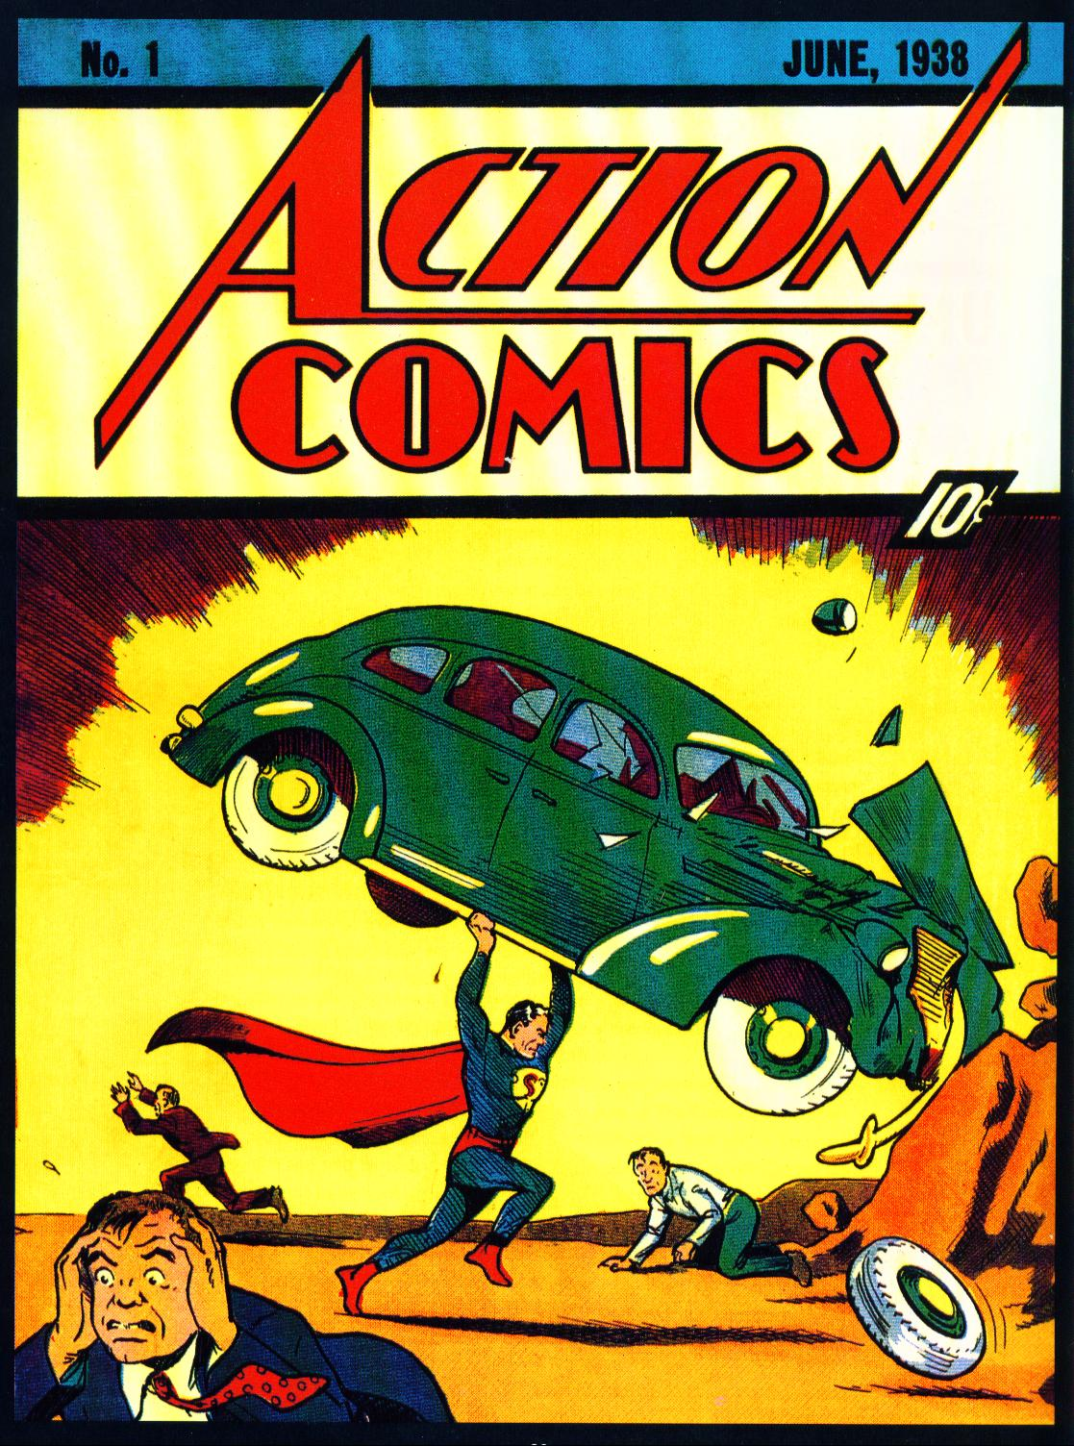
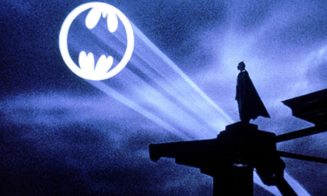
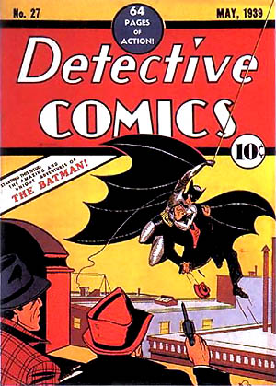
Dc comics timeline through history
1937 – Inaugural Year
March 1937 – Detective Comics #1 (First Publication)
May 1939 – Detective Comics #27 (First Appearance of Batman)
June 1938 – Action Comics #1 (first appearance of Superman)
1944 – All American Comics merge with Detective Comics
1961 – Detective Comics becomes National Periodical Publication
1967 – Merges with Kinney National Services (who purchases Warner Brothers) which becomes Warner Communications (1968)
1978 – DC Comics agrees to huge settlement over the creative rights of Superman with creators.
1989 – Batman the movie debuts in theaters. (becomes one of the highest grossing films in the U.S.)

Slide 5
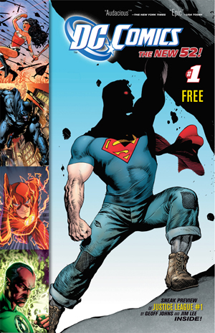
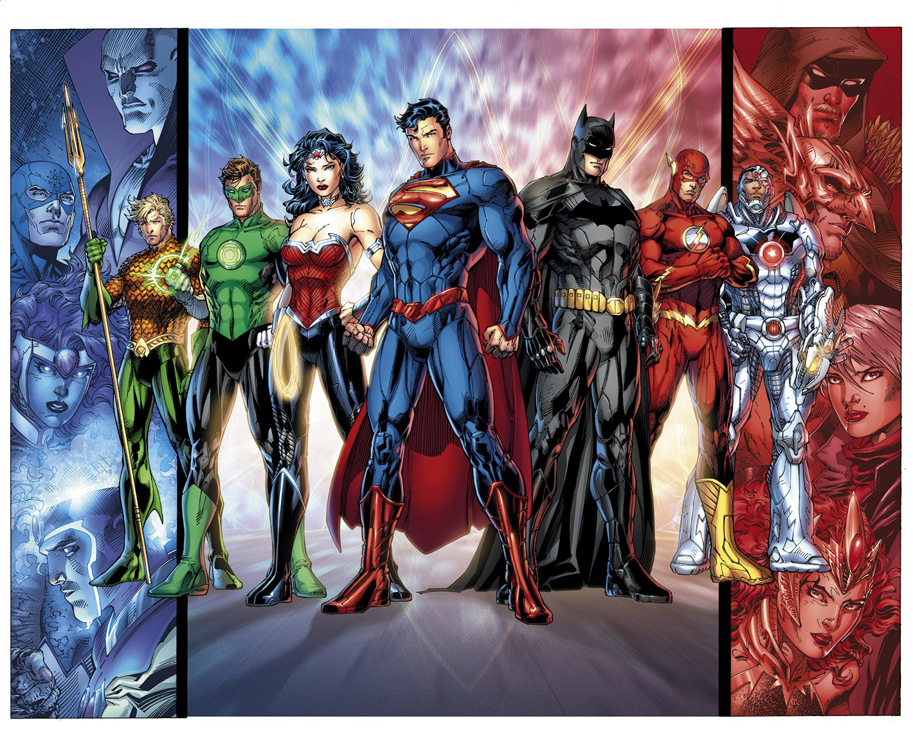
Timeline continuation
1990-1993 – Comic book Industry goes through a BOOM period (Market reaches its highest point – reaches $800 million in 1993)
late 1900 – Industry goes on the decline (main competitor, Marvel, files for bankruptcy protection in 1996)
2000 – only one third of operating comic shops as of 1993 still exist.
2005 – DC Comics & Marvel begin Major annual events (crossover all popular heroes into one story arc: inspired by success of blockbusters produced in Hollywood). An attempt to increase sales (which does).
2007 – Comic Industry hits Bookstores (graphic novels collect complete stories in form of trade paperback & Hardcover)
2009 – Disney buys Marvel Entertainment.
2011 – DC Comics relauches all its title, calling the event “the New 52”.

Slide 6
Key Individuals
Jack Liebowitz
Harry Donenfeld
Jerry Siegel
Joe Shuster
Thomas Ballou Jr.

Slide 7
Key Financials ( Company doesn’t disclose financials -*7)
Market of Comic Industry (as of 2008 - *7)
Marvel Entertainment – 40%
DC Comics – 32%
Independent publishers & anime – 28%

Slide 8
Revenue
In 1993, The Industry raked in $800 Million (*3)
In 2000, The Industry raked in $250 million (*3)
In 2005, Comic book sales began to soar again, raking in $149 million the first half of the year, 6% increase from previous year. (*6)
In 2007, sales in bookstores reached $700 million (*7)
In 2010, revenue began to decline from $270 million to $246 million
In 2013, DC Comics sees Double Digit growth In print

Slide 9
The customer
Initial demographic: 8-12 years old (*2)
Late 80s: demographic becomes average age 24 years old (college educated, household income of $38,000.00 - *1)

Slide 10
The product
Size/ Page Count: 6.625″x10.25″ 32 to 52 pages.
Binding: Saddle-Stitched, two staples
Interior Pages: 40lb to 50lb paper
Cover: various (Norm: 40lb to 80lb gloss paper)
Printing process: Offset printing

Slide 11
Recent news
2011, DC Comics becomes first publisher to release debut prints with digital simultaneously. (*8)
Summer of 2013, DC launches Forever Evil event, print 3D covers for all 52 Titles. (*11)
As of October 2013, DC Comics sees double digit growth in print sales and Triple digit growth in digital revenue (*10)
DC Comics head quarters relocating to Burbank, CA in 2015 (*14)

Slide 12
references
1. Rothenberg, Randall. "THE MEDIA BUSINESS: Advertising; D.C. Comics In New Push To Sell
Space." The New York Times 22 Dec. 1988, nat. ed., sec. D: 20.
2. Deer, Brian. "Comics boom shows its darker side; Publishing; Spectrum." The Sunday Times
(London) 8 Oct. 1989, nat. ed., sec. issue: 8617.
3. Stuever, Hank. "Superheroes' Last Stand; Can Reality Save Them From Their Archenemy, the
Vanishing Reader?." The Washington Post 6 May 2000, nat. ed., sec. STYLE: C01
4. Adiga, Aravind. "Man of Steel no match for teen apathy: Comic books in decline." National Post
(Canada) 18 Oct. 2000, nat. ed., sec. FINANCIAL POST; C01.
5. Nash, Eric P. "Jack Liebowitz, Comics Publisher, Dies at 100." The New York Times 13 Dec.
2000, nat. ed., sec. B: 10.

Slide 13
references
6. Tidwell, Beau. "Comic book publishers take cue from Hollywood." The International Herald
Tribune 29 Nov. 2005, nat. ed., sec. FINANCE: 10.
7. Flamm, Matthew . "Marvel zaps DC in comic battle; Publisher reaches more readers with
bookstore hits." Crain's New York Business 17 Mar. 2008, nat. ed., sec. NEWS: 1.
8. Frean, Alexandra. "Drug Test are not only for athletes - they are for welfare seekers, too."
The Times 23 Nov. 2013. 1 Sep. 2011 <http://thetimes.co.uk>.
9. Steinberg, Brian. "AMERICA'S HOTTEST BRANDS; DC COMICS." Advertising Age
28 Nov. 2011, nat. ed., vol. 82: 48.
10. Johnson, Scott. "DC Comics Seeing Double-Digit Growth In Print & Triple-Digit Growth In
Digital." ComicBook.com. 23 Nov. 2013. ComicBook.com, LLC. 5 Oct. 2013
<http://comicbook.com/blog/2013/10/05/dc-comics-seeing-double-digit-growth-in-print
-triple-digit-growth-in-digital/>.

Slide 14
references
11. Phegley, Kiel. "DC ANNOUNCES ALLOCATION OF VILLAINS MONTH 3D
COVERS."Comicbookresources.com. 23 Nov. 2013. Comicbook Resources. 7 Aug. 2013
<http://www.comicbookresources.com/?page=article&id=47175>
12. Fingers, Twelve. "Self Publishing and Printing Comics – The
Basics."comicbooktutor.wordpress.com. 26 Nov. 2013. 7 Nov. 2009 <http://comicbooktutor.wordpress.com/2009/11/07/self-publishing-and-printing-comics-the-basics/>.
13. "About Diamond." Diamondcomics.com. 23 Nov. 2013. Diamond Comic Distributors, Inc..
<http://www.diamondcomics.com/Home/1/1/3/303?articleID=24292>.
14. Sunu, Steve. "NELSON DISCUSSES DC COMICS' MOVE TO
BURBANK."comicbookresources.com. 23 Nov. 2013. Comic Book Resources. 4 Nov. 2013 <http://www.comicbookresources.com/?page=article&id=48910>.

