Slide 1
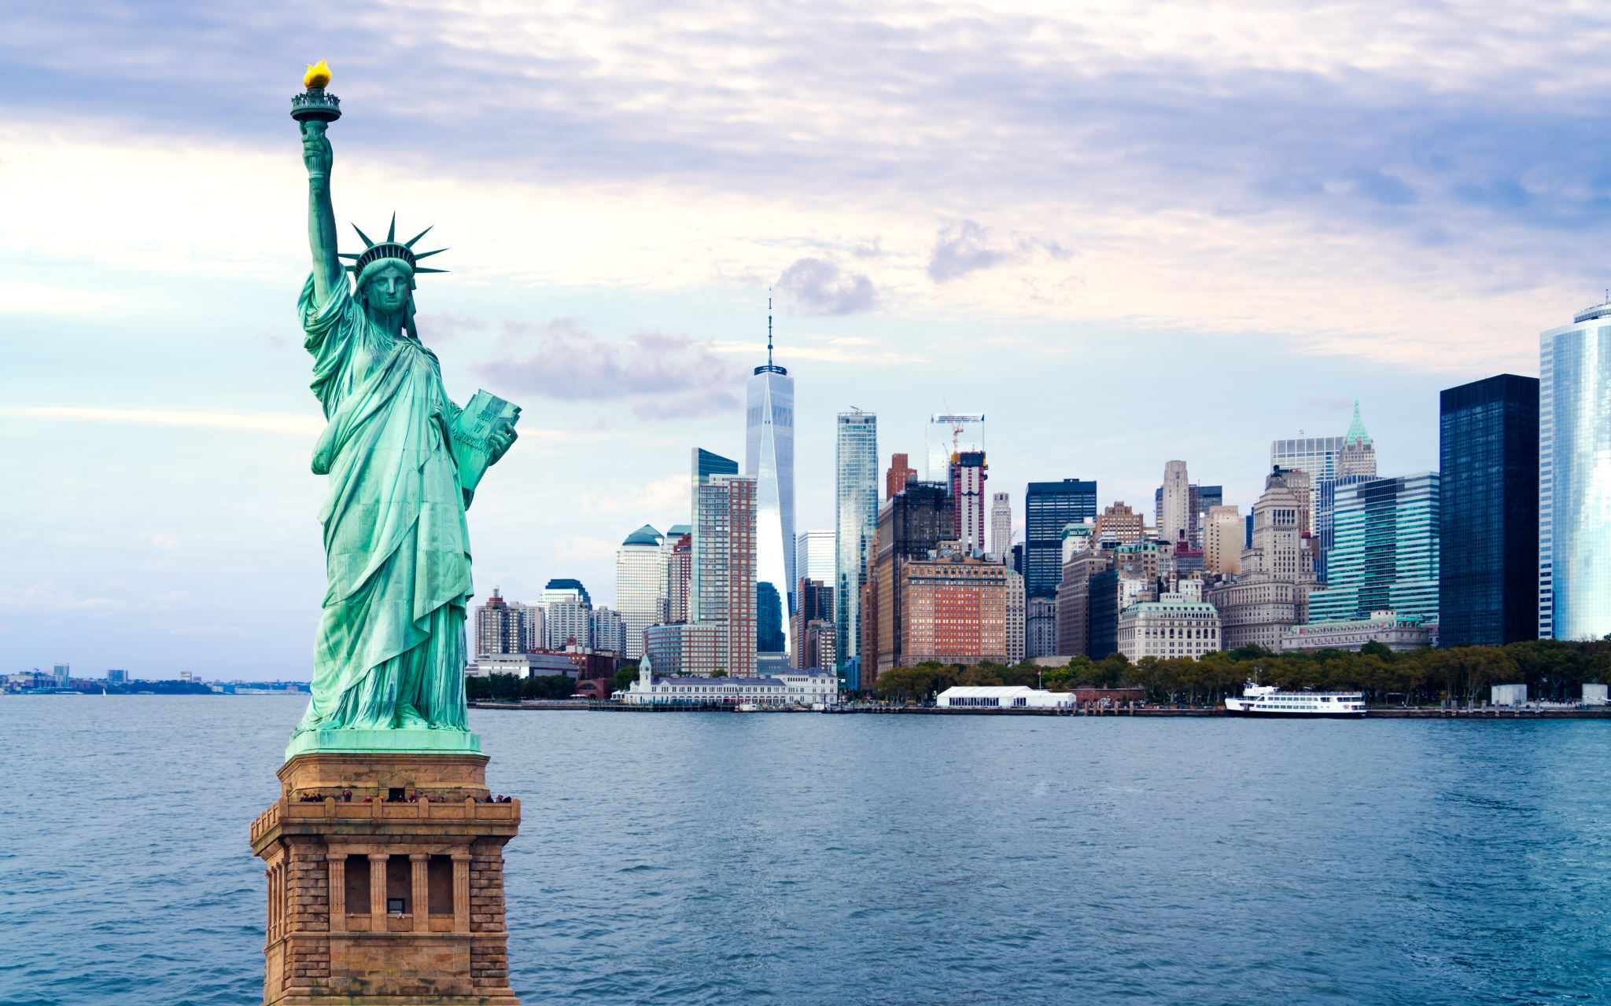
Travel New York Like a Pro
By Taneil Watson

Slide 2
Tourist Attractions
-Depending on the time of the year you could have a chill time on the 843 acres of land called Central Park. It's a great way to destress after being in the hustle and bustle of city life.
- For shopping, eating, tourist attraction and just about anything go to Time Square. Time Square draws over 50 million tourists, so be one of them to be a part of the hype.
- See the present that the U.S got from France by taking a ride on the ferry to see the one and only Statue of Liberty
This Photo by Unknown Author is licensed under CC BY-SA

Slide 3
Public transportation
- When riding public transportation be sure to read the signs because taking the train the wrong way could make u end up in the Bronx when you really need to be in Queens.
- On the train you could see the culture of New York even more, from the stands selling snacks to the people dancing and singing in the trains.
This Photo by Unknown Author is licensed under CC BY-SA

Slide 4
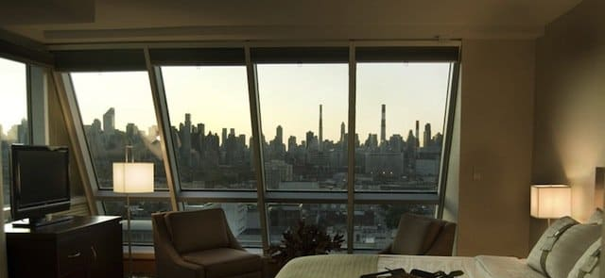
Where To Stay
New York has some of the hotels with the best views, sometimes they are a bit small, but they give a feeling of comfort to them.
-The Hyatt Hotel
-The Holiday Inn
- The Cambria Hotel
Those are just a few hotels with pricing as low as $80.
This Photo by Unknown Author is licensed under CC BY-NC-ND
This Photo by Unknown Author is licensed under CC BY-NC-ND

Slide 5
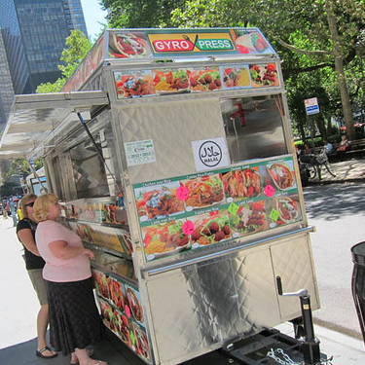
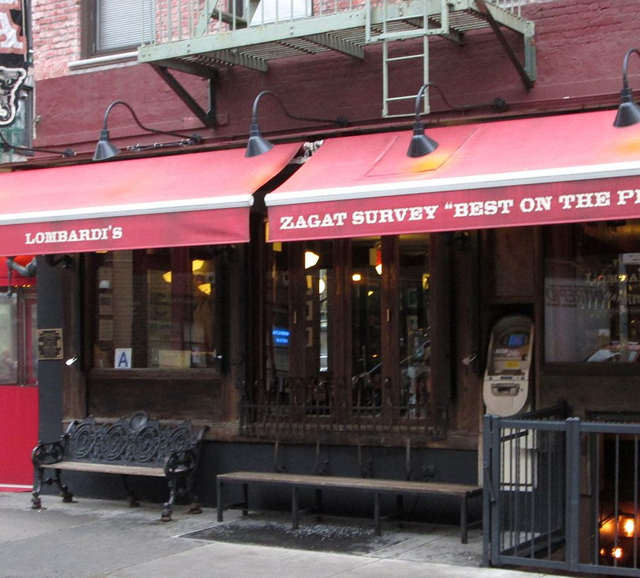
What to eat
There is a variety of foods to eat when coming to New York. To eat like a real New Yorker here are some tips:
-Want to quick breakfast sandwich while on the go, stop at the local deli and order a bacon, egg ,and cheese on a roll. That is one of the more local breakfast that New Yorkers feast on
- Ready for lunch grab a slice of pizza or a hot dog and keep it pushing
-For dinner you could stop at a gyro cart and get some chicken over rice to finish off the day
People who live in New York are used to these meals, so try them out so you could emerge yourself in the experience that much more.
This Photo by Unknown Author is licensed under CC BY-SA
This Photo by Unknown Author is licensed under CC BY-SA
This Photo by Unknown Author is licensed under CC BY

Slide 7
Bibliography
https://www.centralparknyc.org/about
https://www.nycgo.com/videos/bet-you-didnt-know-these-times-square-facts
https://getawaytips.azcentral.com/how-much-does-it-cost-to-go-inside-the-statue-of-liberty-12220788.html
https://www.trivago.com/?themeId=16&iPathId=34812&sem_keyword=best%20hotels%20in%20nyc&sem_creativeid=473974621322&sem_matchtype=e&sem_network=g&sem_device=c&sem_placement=&sem_target=&sem_adposition=&sem_param1=&sem_param2=&sem_campaignid=10554074600&sem_adgroupid=104643931432&sem_targetid=kwd-253200743&sem_location=9003382&cip=1061900355&gclid=CjwKCAiAt9z-BRBCEiwA_bWv-DGW95AUUcA52d1Qds0Alxj4KSLreHfJ6F_JUzIkRVlMlQ45ATJVbBoCc5MQAvD_BwE

