Slide 1
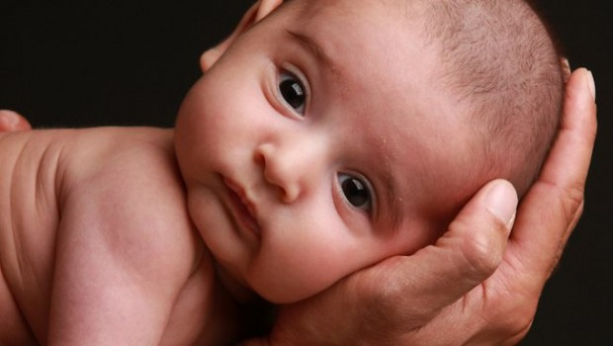
Fetal Alcohol Syndrome
Tatyana Aksaeva
Professor M. Bilello

Slide 2
-Fetal alcohol syndrome is a condition in a child that results from alcohol exposure during pregnancy - It causes the brain damage and growth problems - 40,000 childen are effected each year in the United States

Slide 3
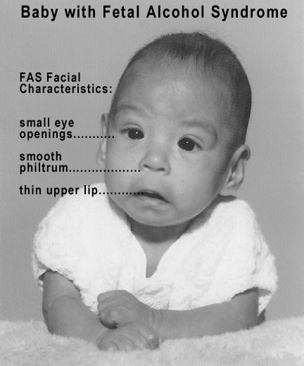

Slide 4
Person with FAS migh have: -small head size - low body weight - learning disabilities (poor memory, difficulty with attention, low IQ) - vision, hearing problems - problems with the heart, kidneys or bones

Slide 5
Dental issues might include: -cleft palate -undeveloped jaw (toothbrushing might be challenging) - weak muscles around the mouth -mouth breathing caused by facial deformities ( can lead to dry mouth) -temporamandibular joint disorder -more sensitivity to different tastes and textures

Slide 6
Alcohol related birth defects last a lifetime -early intervention treatment can improve child's development -medical care and medication -behavior and educational therapy

Slide 7
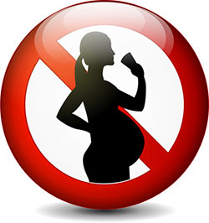
- The amount of alcohol consider to be safe during pregnancy is unknown
- The only way to prevent FAS is to avoid alcohol exposure during pregnancy

