Slide 1
The History of the Nickelodeon Logo
Shaina Williams
COMD 1112

Slide 2
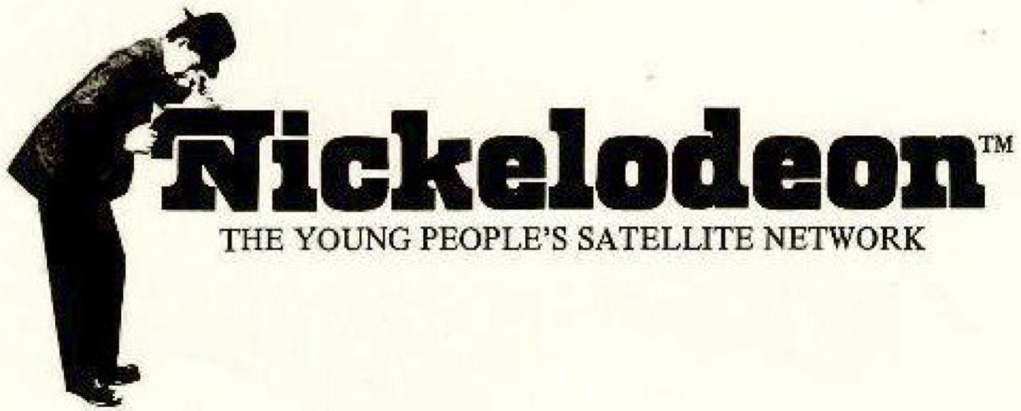
The Very Beginning of Nickelodeon
Nickelodeon was founded on December 1st, 1977 under the name of Pinwheel. It was officially rebranded on April 1st, 1979 by Joseph Iozzi, the creative director/designer of the children’s network’s first logo, as shown below. Iozzi used a serif font designed by Lubalin, Smith, Carnase, Inc.

Slide 3
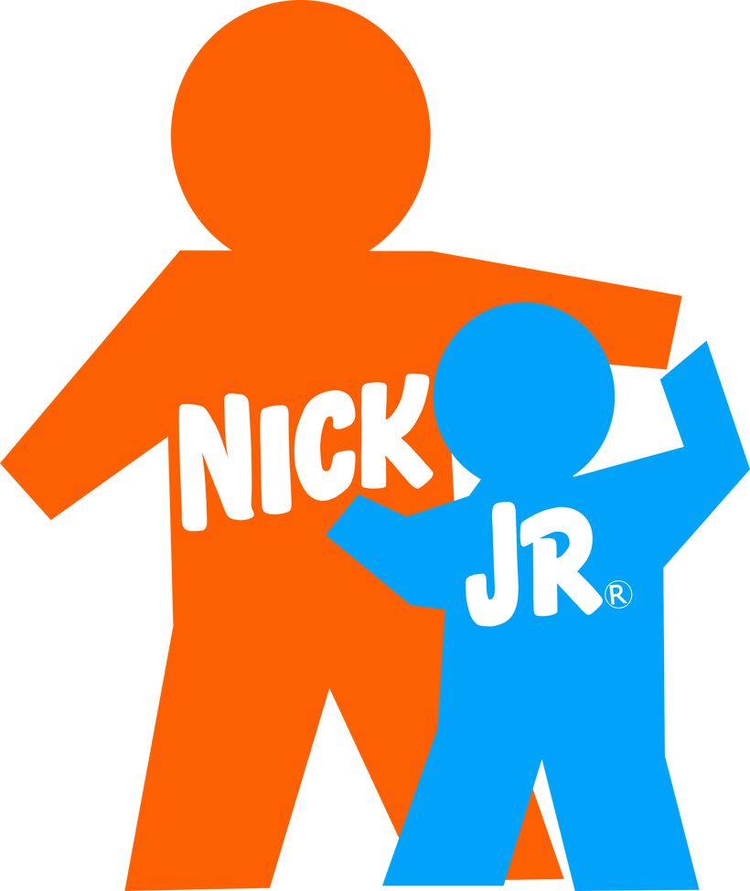
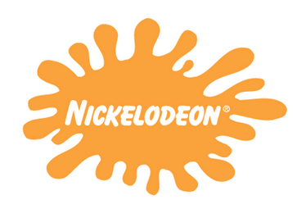
Nickelodeon (1984-2009)
In October of 1984, the logo was redesigned to the more iconic orange splotch with the name of the network written in the middle using the font known as “Balloon.” Its sister networks (formally separate blocks on the channel), Nick Jr (formally Noggin), Nicktoons (formally Nicktoons Network), and TeenNick (formally The N), underwent similar changes, as shown below.

Slide 4
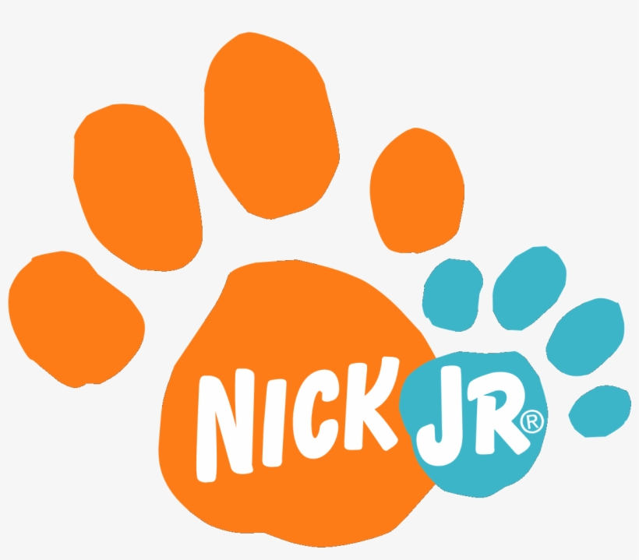
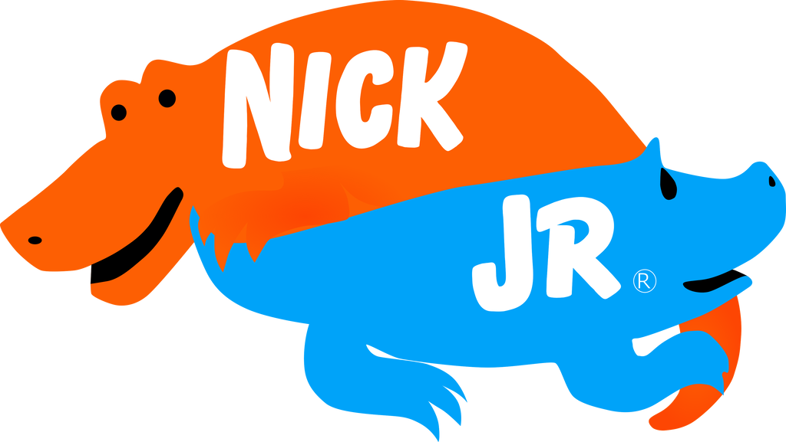
The orange splotch had multiple variations throughout the years, ranging from different forms of the splotch to playful shapes, such as animals and holiday-related items. Nick Jr.’s logo variant often changed depending on the program being shown or the time of the year.

Slide 5
Nickelodeon (2009-Present Day)
In 2009, the network retired and traded in its iconic logo for a more simplistic sans serif font, as shown below. While sleek and more modern, the logo still rocks its iconic orange glow.

Slide 6
Photo Credits
http://classic-nickelodeon-fan-blog.blogspot.com/2014/02/interview-with-joseph-iozzi.html
https://www.deviantart.com/misterguydom15/art/The-Nickelodeon-Logos-1984-2009-656826353
https://www.deviantart.com/idknjbc/art/Nick-Jr-logo-1995-779213339
https://en.wikipedia.org/wiki/Nick_Jr.
http://idsgn.org/posts/nickelodeon-cleans-up/

