Slide 1
GEOSPATIAL ANALYSIS

Slide 3
GIS
Geographic Information System – designed to capture, store, manipulate, analyze, manage, and present all types of geographical data (ie. Spatial data)
It can be 2D or 3D. Web maps are 2D; Web scenes are 3D

Slide 4
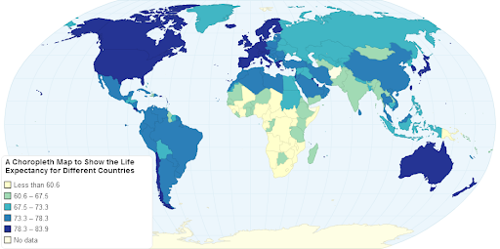
GEOSPATIAL ANALYSIS
Analysis is tied to space/location – and hence map-able, and able to be visualized

Slide 5
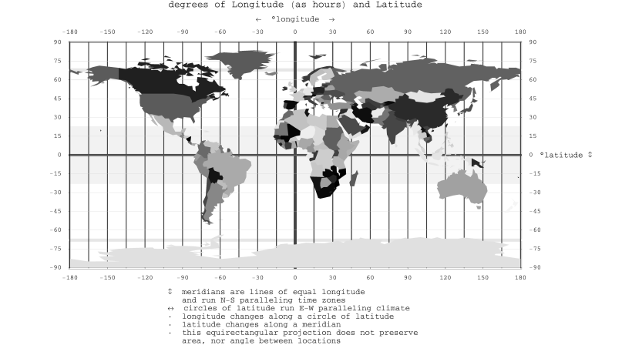
LONGITUDE/LATTITUDE
Longitude – Angular distance of a place East or West from Greenwich, UK
Lattitude – Angular distance of a place North or South from the Equator

Slide 6
SHAPE FILE
Spreadsheet file formatted for use in GIS – contains longitude/latitude information to make data mapable

Slide 7
CSV File
Tabular data file – like a spreadsheet. Contains data information and can be easily imported /exported across programs
The CSV stands for Comma separated values

Slide 8
BASEMAPS
Basemap layers are static tiled layers such as imagery, territorial boundaries, or roads that provide geographic context.

Slide 9
OPERATIONAL LAYERS
Contain features (information shown as points, lines, or polygons) or imagery that can be drawn on top of a base map

Slide 10
ATTRIBUTE TABLE
A spreadsheet that is attached to a GIS map

Slide 11
SYMBOLOGY
The way data features are represented in the GIS map
Elements that can be designed in Symbology include color, transparency, outline color, and outline width

Slide 12
ARCGIS ONLINE
ArcGIS Online is a cloud-based geographic information system (GIS). You can use it to create, use, and share geospatial content throughout your organization, and openly on the web.
Layers are one of the primary ways that you work with geographic data in ArcGIS Online. All web maps and scenes include layers. Each layer references a dataset and specifies how that dataset is portrayed using symbols and text labels. You can open the spreadsheet/table associated with layer typically inside ArcGIS Online.

Slide 13
Creating Layers
1. GIS Online: There is a wealth of content available from ArcGIS Online. If you are a member of an organization, your organization is the first place you might look for map layers. The ArcGIS Living Atlas of the World also provides a library of robust, current, and trustworthy map layers.
2. Local files can be added to create map layers. Common mappable file formats include CSV files and shapefiles. When you create layers from local data, they are hosted by ArcGIS Online.

Slide 14
Data available in NYC Open Data & Living Atlas
Education level for residents over 25 years
Subway stops
Borough Boundaries
Income levels
Zoning/land use
Other basic demographic data (occupants’ age, gender, ethnicity)

Slide 15
Arc Story Maps
“Story Maps - combine your maps with narrative text, images, and multimedia content to create compelling, user-friendly web apps.

Slide 16
Examples from Living Atlas:
https://livingatlas.arcgis.com/en/browse/#d=3&q=current%20year%20acs%20poverty
https://www.arcgis.com/home/item.html?id=b3802d8a309544b791c2304fece864dc (crime)
https://www.arcgis.com/home/webmap/viewer.html?useExisting=1&layers=2718975e52e24286acf8c3882b7ceb18&layerId=2 (popular demographics in the US)
https://www.arcgis.com/home/item.html?id=5f239fd3e72f424f98ef3d5def547eb5 (EPA Air Quality Monitoring)
https://www.arcgis.com/home/item.html?id=a245493a8c5344cbafc60d70170c666d (Population Density)
https://www.arcgis.com/home/item.html?id=4607d50b7f6a41c0b9d33803282a7262 (Education level for 25 yrs and up)
https://www.arcgis.com/home/item.html?id=2064702cb1fe47e5868333f56d4c99d0 (500 cities Project - CDC Health Data)

Slide 17
Assignment
Learn the terms on the preceding pages for a possible quiz next class
One person on the team will complete the Getting Started with ArcGIS Online Tutorial on ESRI Training.com (https://www.esri.com/training/catalog/5d816c0255cf937306d2d3ef/arcgis-online-basics/)
The other person on the team will complete the Getting Started with Mapping and Visualization Tutorial on ESRI Training.com (https://www.esri.com/training/catalog/5c9a7354190cf23eac62a92f/getting-started-with-mapping-and-visualization/)
Save and turn in screen shots of your maps or story. Turn in the completion certificates as well.

Slide 18
RESOURCES
Maps Mania
Air Pollution Maps: https://air.plumelabs.com/en/
Half of Americans Live Here Map: https://observablehq.com/@acz13/density-based-county-counting-to-specified-proportion
1940s NYC and 1980s NYC https://1940s.nyc/map/photo/nynyma_rec0040_1_01012_0038a#17.35/40.755821/-73.987674
NYC Languages Spoken at Home http://www.jillhubley.com/project/nyclanguages/

