Slide 1
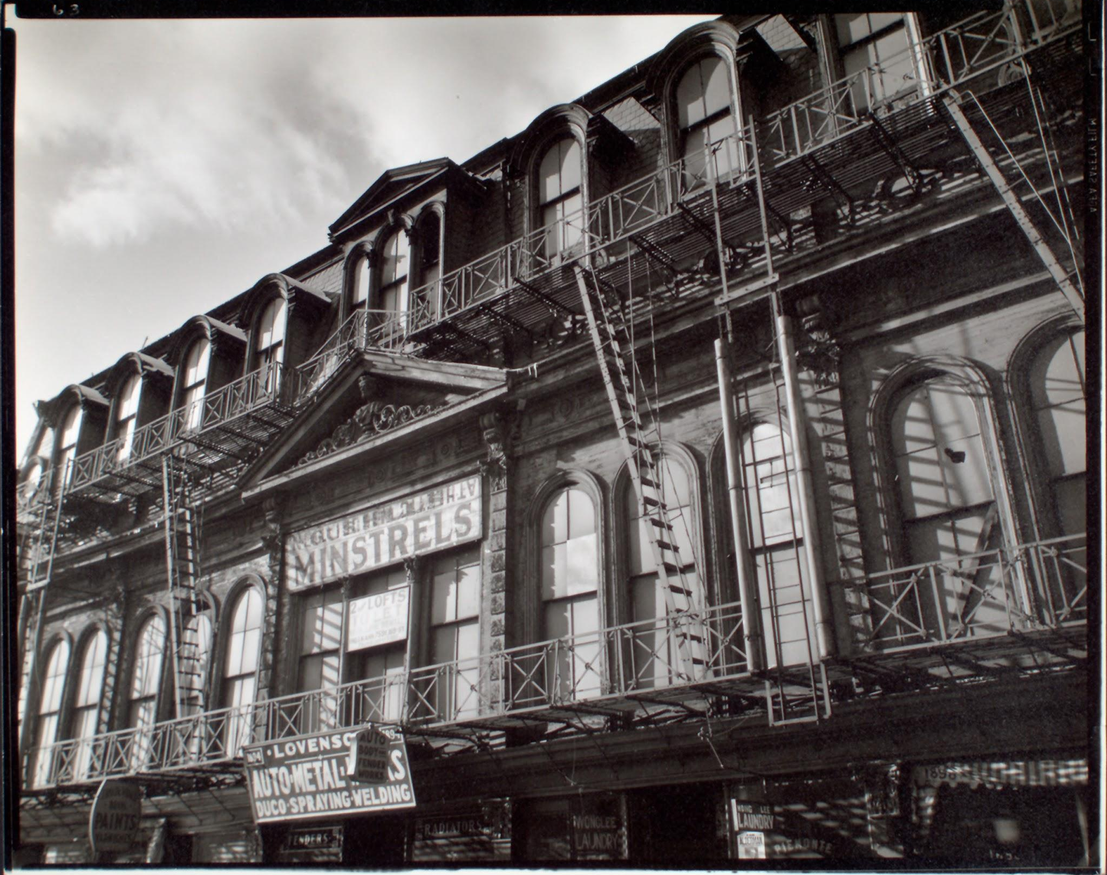
Minstrelsy in the United States
Text
Text
Text
Gus Hills Minstrels, 1890-1898 Park Avenue, Manhattan. The New York Public Library Digital Collections. 1935.
Free use without restriction

Slide 2
Bibliography
Image Credits
Gregory, Kia. “In Harlem, Renaissance Theater Is at the Crossroads of Demolition and Preservation” The New York Times (Dec. 19, 2005). https://www.nytimes.com/2014/12/21/nyregion/in-harlem-renaissance-theater-is-at-the-crossroads-of-demolition-and-preservation.html?searchResultPosition=1. Accessed March 13, 2020
"Gus Hills Minstrels, 1890-1898 Park Avenue, Manhattan." The New York Public Library Digital Collections. 1935. http://digitalcollections.nypl.org/items/510d47d9-4f11-a3d9-e040-e00a18064a99

