Slide 1
Natural Hair versus relaxers
By: Zipporah PORTER & Siera WHITAKER

Slide 2
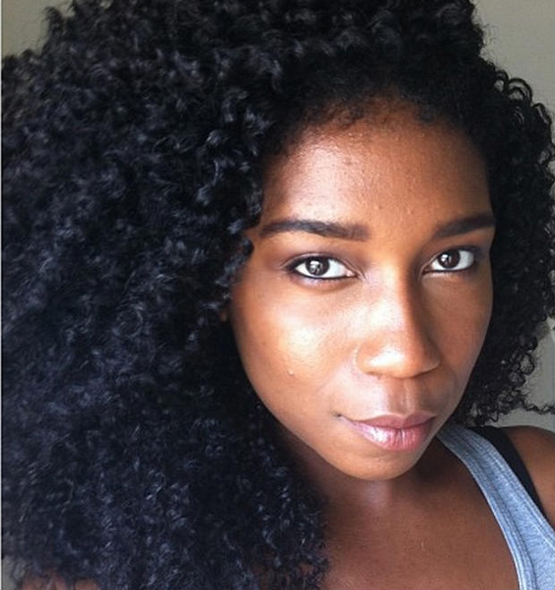
WHAT’S THIS ABOUT?
Good Hair should look like this
She has BAD HAIR!!!
n
So many stigmas about hair…
My hair allows me to accept myself for who I am

Slide 3
Garret A. Morgan
Invented three-position traffic signals, safety hoods, smoke protectors, and first hair relaxer
He made the hair relaxer out of chemicals he used to fix sewing machines in his workshop testing it first on dog fur, and then his own hair
Founded the G.A. Morgan Hair Refining Company in 1913

Slide 4
Madam C.J. Walker (1st woman to become a millionaire)
Philanthropist
Entrepreneur
Inducted into the National Negro Business League in 1912
Became a millionaire
Grew her company internationally
Lived Well

Slide 5
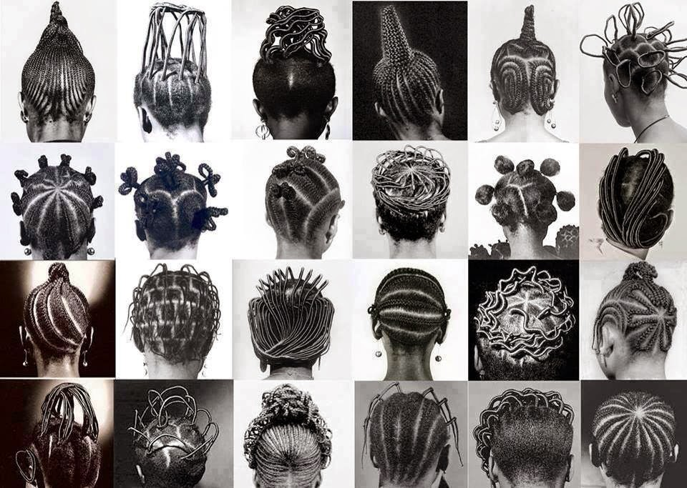
Transition from Braids, Twists, LOCs to Straighter Hair to Fit In and Be Accepted In Western Culture

Slide 6
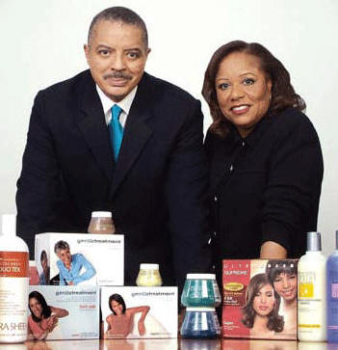
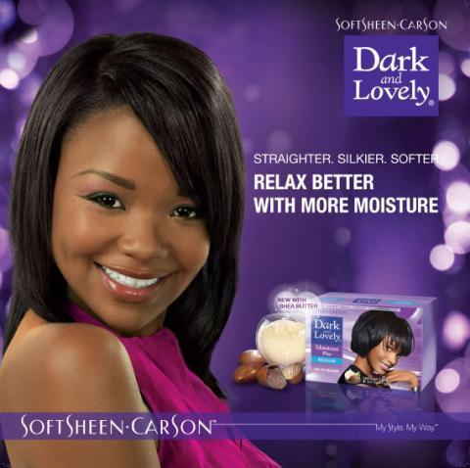
Proline, the manufacturers of Dark and Lovely are the first to commercialize lye relaxers in 1971
The Johnson Products Company Inc. created Gentle Treatment, the first no-lye treatment in 1981

Slide 7
Relaxer Facts
Relaxers range from $4-$10
They are sold by multiple retailers including drug stores like Walgreens and Beauty stores like Ulta making access easy to consumers
Represent 21% of the Black Haircare Market with expenditures of $152 Million out of a $774 Million Industry

Slide 8
Benefits of Relaxing
Make hair more manageable
Allows hair to be straightened and remain straightened for a longer period of time
Allows hair to look more slick

Slide 9
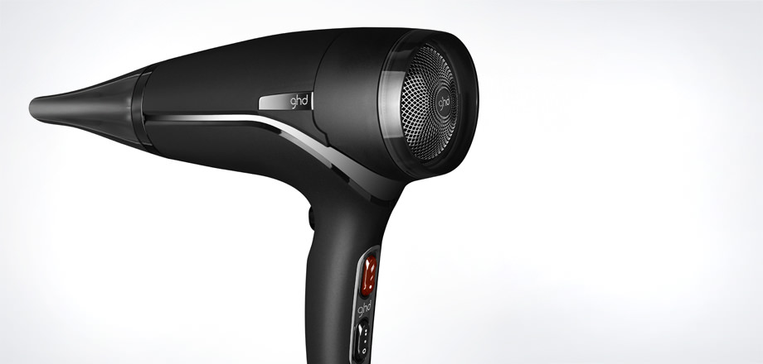
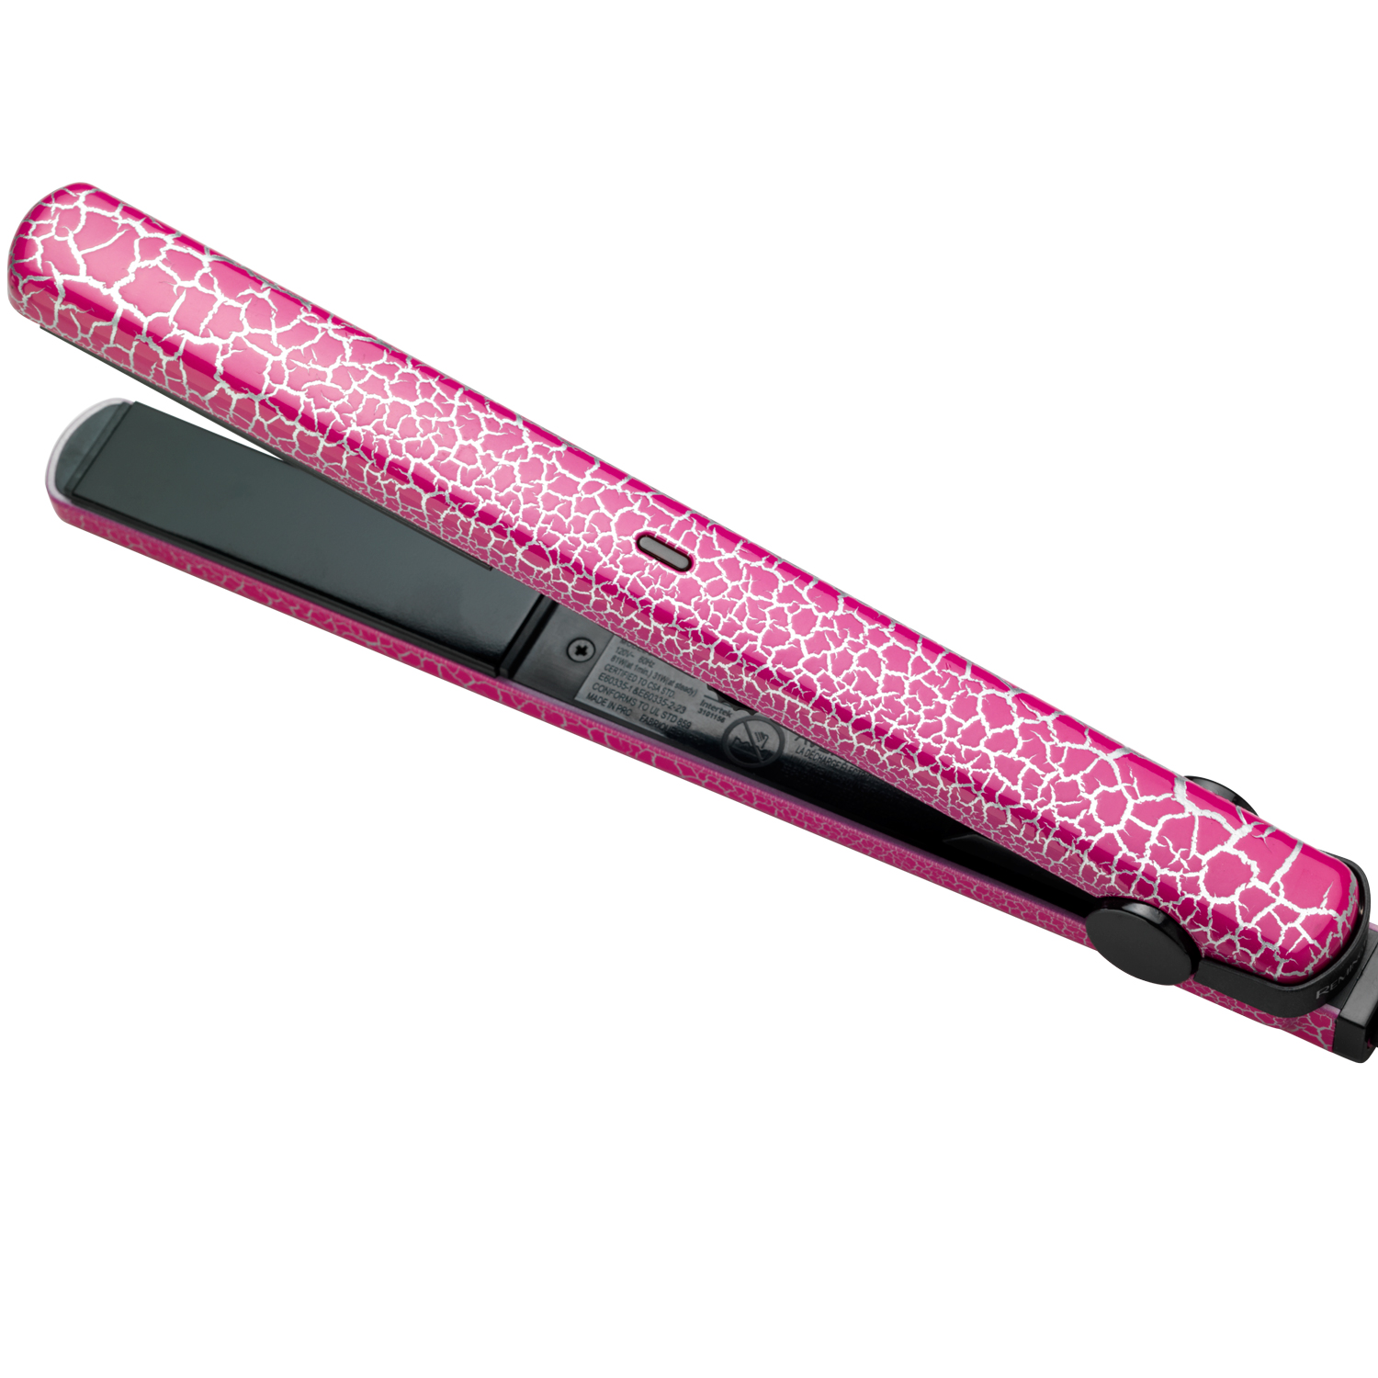
RELAXERS ARE SUBSTITUTES FOR OTHER STRAIGHTENING PRODUCTS
RELAXER
STRAIGHTENING PRODUCTS
But still have to use these anyway

Slide 10
Relaxers Sales Went

Slide 11
Demand Decreases
Civil rights movement
Relaxers become linked to fibroids and early puberty in young girls
Findings that lye relaxers strip the protein from the hair causing thinning and hair breakage
Movies like Spike Lee’s School Daze and Good Hair highlight the stigma of good and bad hair
Public becomes more aware about chemicals
Celebrities and others influence Natural Hair Movement
Relaxer Sales Have Dropped 15% since 2011 and continue to Decline

Slide 12
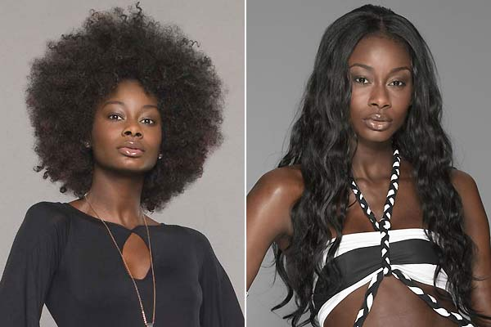
Consumers Preferences
Change

Slide 13
Demand for Natural Hair Products GOES UP
The Black hair market is one of the most, influential and power markets of today.
Market research firm Mintel estimated the size of the 2012 market at $684 million, with a projection of $761 million by 2017
Women of color come in ranges of various shapes and sizes, from many different hair types, making the market do vast and successful.
“Missing from these figures are general market brands, weaves, extensions, wigs, independent beauty supply stores, distributors, e-commerce, styling tools, and appliances.” A rough estimate will run the market to half a trillion which is $500 billion dollars in all. – un-ruly.com
The black hair market was unscathed, meaning that it did not fall during the latest recession, but in fact had a steady rise of 21%

Slide 14
Is it a TREND or is it here to stay?
Dark & Lovely
Sponsorship
Dark & Lovely (Au Naturale)

Slide 15
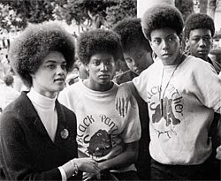
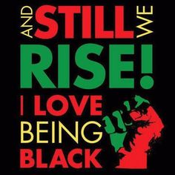
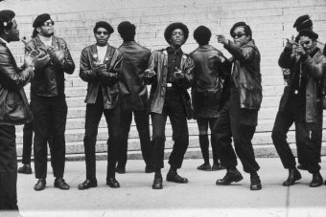
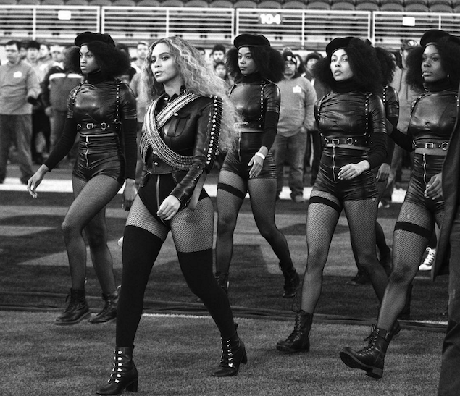
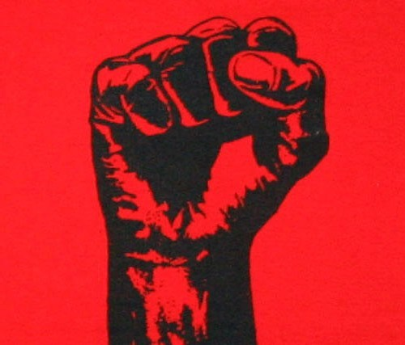
Natural Hair Movement
Gained Traction after slavery
Civil Rights Era
Black Panthers helped to uplift the community and set the safety
Told people they are beautiful as they are.
Women were involved and led next to men
Be proud of your blackness and show it

Slide 16
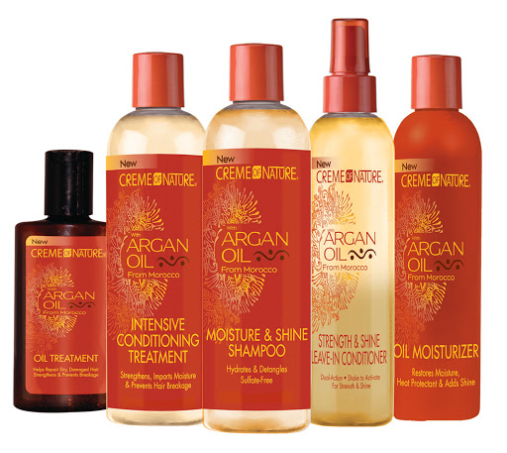
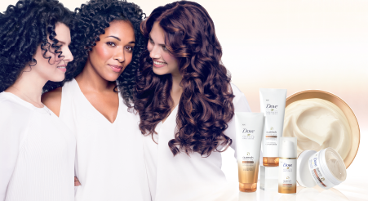
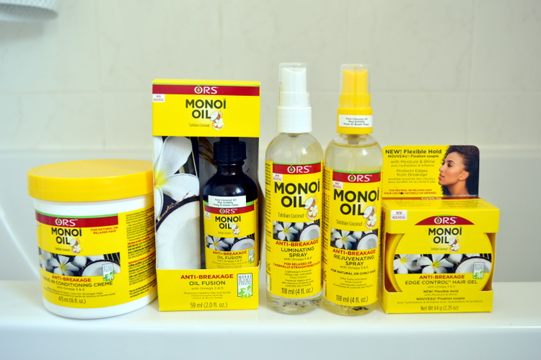
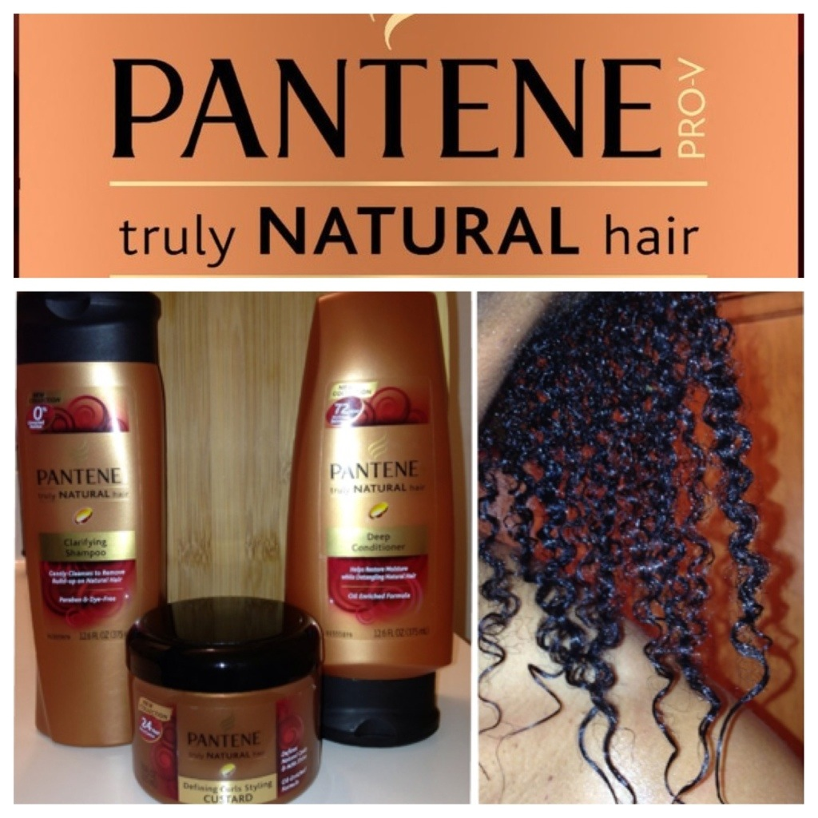
Releasing dedicated lines for black hair.
They highlight ingredients that will attracts customers.
Oils such as argon oil, coconut oil, jojoba oil, avocado oil; etc.
Also market that they take out ingredients bad for black hair such as parabens, silicon, and various types alcohol which dries out the hair.
They keep up with hair care techniques and incorporate it into the products. Driving sales higher and higher.
Bigger companies buy out small companies that cater to black hair and make them bigger. I.E Shea Moisture
Companies Marketing the Natural hair “Movement”

Slide 17
Natural Hair Campaigns
https://www.youtube.com/watch?v=ou7CyPtkpng
https://www.youtube.com/watch?v=F2RVWTGAevE

Slide 18
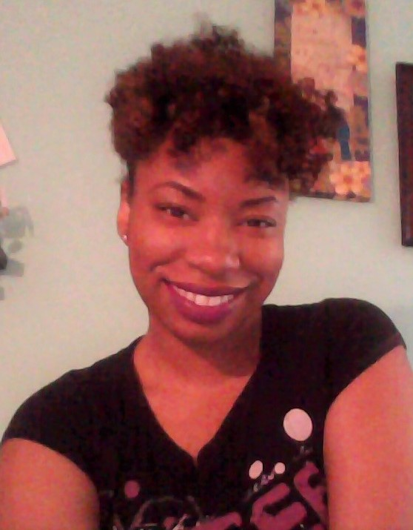
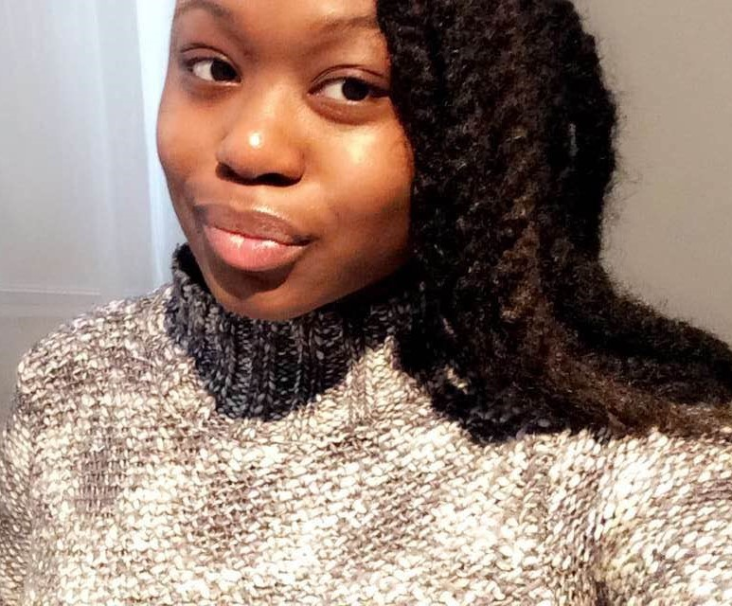
Thanks For Tuning In

