Slide 1
CNC Certification
Lecture 1: Introduction to Industrial Machinery and Tooling

Slide 2
TOPIC 1: IDENTIFY STANDARD GEOMETRIC DIMENSIONING AND TOLERANCE
GEOMETRIC DIMENSIONING AND TOLERANCING (GD&T) is a symbolic language.
It is used to specify the size, shape, form, orientation, and location of features on a part.
Features toleranced with GD&T reflect the actual relationship between mating parts.
Drawings with properly applied geometric tolerancing provide the best opportunity for uniform interpretation and cost-effective assembly.
GD&T was created to insure the proper assembly of mating parts, to improve quality, and to reduce cost.
GD&T is a design tool. Before designers can properly apply geometric tolerancing, they must carefully consider the fit and function of each feature of every part.
GD&T, in effect, serves as a checklist to remind the designers to consider all aspects of each feature.
Properly applied geometric tolerancing insures that every part will assemble every time.
Geometric tolerancing allows the designers to specify the maximum available tolerance and, consequently, design the most economical parts.
GD&T communicates design intent.
This tolerancing scheme identifies all applicable datums, which are reference surfaces, and the features being controlled to these datums.
A properly toleranced drawing is not only a picture that communicates the size and shape of the part, but it also tells a story that explains the tolerance relationships between features.

Slide 3
The USASI Y14.5–1966 (United States of America Standards Institute—predecessor to the American National Standards Institute) document was produced on the basis of earlier standards and industry practices.
The following are revisions to the standard:
ANSI Y14.5–1973 (American National Standards Institute)
ANSI Y14.5M–1982
ASME Y14.5M–1994 (American Society of Mechanical Engineers)
ASME Y14.5M – 2009 (Revision of ASME Y14.5M-1994)

Slide 4
Many designers ask under what circumstances they should use GD&T.
Because GD&T was designed to position size features, the simplest answer is, locate all size features with GD&T controls.
Designers should tolerance parts with GD&T when:
Drawing delineation and interpretation need to be the same
Features are critical to function or interchangeability
It is important to stop scrapping perfectly good parts
It is important to reduce drawing changes
Automated equipment is used
Functional gaging is required
It is important to increase productivity
Companies want across-the-board savings

Slide 5
Some advantages of geometric dimensioning and tolerancing include:
Provides a clear and concise technique for defining a reference coordinate system (datums) on a component or assembly to be used throughout the manufacturing and inspection processes. This system reduces misinterpretations and the need for costly engineering changes and rework that can result from a lack of clarity.
Proper application of geometric dimensioning closely dovetails accepted and logical mechanical design processes and design for manufacturing considerations.
Geometric dimensioning dramatically reduces the need for drawing notes to describe complex geometry requirements on a component or assembly by the use of standard symbols that accurately and quickly define design, manufacturing, and inspection requirements.
GD&T concepts such as MMC (maximum material condition) when applied properly will facilitate and simplify the design of cost saving functional check gages and manufacturing fixtures and jigs.

Slide 6
Definitions
dimension: a numerical value(s) or mathematical expression in appropriate units of measure used to define the form, size, orientation or location, of a part or feature.
dimension, basic: the numerical value defining the theoretically exact size of a feature.
dimension, reference: a dimension, usually without a tolerance, that is used for informational purposes only.
datum: a theoretically exact point, axis, line, plane, or combination thereof derived from the theoretical datum feature simulator.
tolerance: the total amount a specific dimension is permitted to vary. The tolerance is the difference between the maximum and minimum limits.
tolerance, geometric: the general term applied to the category of tolerances used to control size, form, profile, orientation, location, and runout.

Slide 7
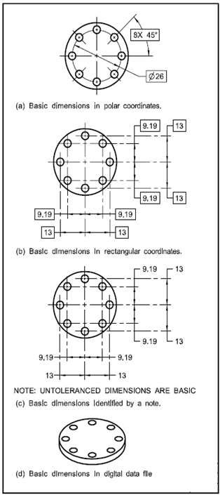
Basic Dimensions:

Slide 8
When you dimension a drawing, it is important to know the intended design of the part and how it will be positioned with other parts in final assembly.
Before an object can be built, complete information about both the size and shape of the object must be available.
The exact shape of an object is communicated through orthographic drawings, which are developed following standard drawing practices.
The process of adding size information to a drawing is known as dimensioning the drawing.
Geometrics is the science of specifying and tolerancing the shapes and locations of features on objects.
Once the shape of a part is defined with orthographic drawings, the size information is added also in the form of dimensions.
Dimensioning a drawing also identifies the tolerance (or accuracy) required for each dimension.
If a part is dimensioned properly, then the intent of the designer is clear to both the person making the part and the inspector checking the part.
A fully defined part has three elements: graphics, dimensions, and words (notes).

Slide 9
Terminology

Slide 10
Dimension line is the thin solid line which shows the extent and direction of a dimension
Arrows are placed at the ends of dimension lines to show the limits of the dimension.
Extension line is the thin solid line perpendicular to a dimension line indicating which feature is associated with the dimension.
Leader line is the thin solid line used to indicate the feature with which a dimension, note, or symbol is associated.
Tolerance is the amount a particular dimension is allowed to vary.
Plus and minus dimensioning is the allowable positive and negative variance from the dimension specified.
Limits of size is the largest acceptable size and the minimum acceptable size of a feature.
The largest acceptable size is expressed as the maximum material condition (MMC)
The smallest acceptable size is expressed as the least material condition (LMC)
Diameter symbol is the symbol which is placed preceding a numerical value indicating that the associated dimension shows the diameter of a circle. The symbol used is the Greek letter phi.
Radius symbol is the symbol which is placed preceding a numerical value indicating that the associated dimension shows the radius of a circle. The radius symbol used is the capital letter R.
Datum is the theoretically exact point used as a reference for tabular dimensioning

Slide 11
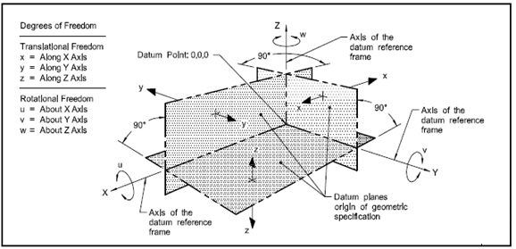
Datum Reference Frame

Slide 12
Units Of Measure
The International System of Units (SI) is featured in this Standard because SI units are expected to supersede United States (U.S.) customary units specified on engineering drawings.
Customary units could equally well have been used without prejudice to the principles established.
Angular Units
Angular dimensions are expressed in both degrees and decimal parts of a degree or in degrees, minutes, and seconds.
These latter dimensions are expressed by the following symbols:
(a) degrees: °
(b) minutes: '
(c) seconds: "
Where degrees are indicated alone, the numerical value shall be followed by the symbol.
Where only minutes or seconds are specified, the number of minutes or seconds shall be preceded by 0° or 0°0', as applicable.
Where decimal degrees less than one are specified, a zero shall precede the decimal value.

Slide 13
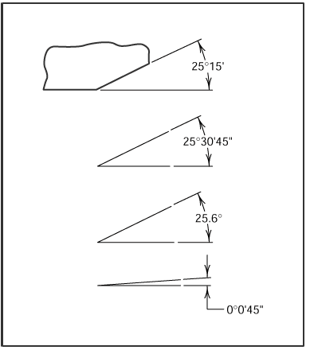
Angular Units

Slide 14
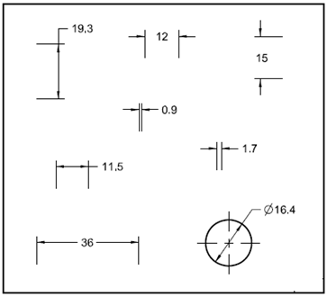
Millimeter Dimensioning
The following shall be observed where specifying millimeter dimensions on drawings:
Where the dimension is less than one millimeter, a zero precedes the decimal point.
Where the dimension is a whole number, neither the decimal point nor a zero is shown.
Where the dimension exceeds a whole number by a decimal fraction of one millimeter, the last digit to the right of the decimal point is not followed by a zero.
Neither commas nor spaces shall be used to separate digits into groups in specifying millimeter dimensions on drawings.

Slide 15
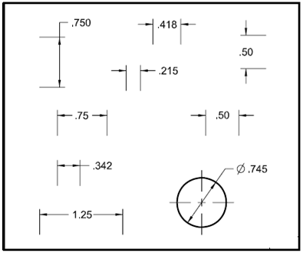
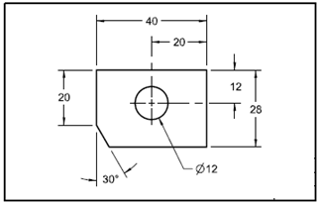
Decimal Inch Dimensioning
The following shall be observed where specifying decimal inch dimensions on drawings:
A zero is not used before the decimal point for values less than 1 in.
A dimension is expressed to the same number of decimal places as its tolerance.
Zeros are added to the right of the decimal point where necessary.
Application Of Dimensions
Dimensions are applied by means of dimension lines, extension lines, chain lines, or a leader from a dimension, note, or specification directed to the appropriate feature.
For further information on dimension lines, extension lines, chain lines, and leaders, see ASME Y14.2.

Slide 16
Basic Concepts of Dimensioning
Dimensions are used to describe the size and location of features on parts for manufacture.
The basic criterion is, "What information is necessary to make the object?“
Dimensions should not be excessive, either through duplication or dimensioning a feature more than one way.
Size dimension might be the overall width of the part or the diameter of a drilled hole. See Fig.
Location dimension might be length from the edge of the object to the center of the drilled hole. See Fig.
Size dimensions
Horizontal
Vertical
Diameter
Radius
Location and Orientation
Horizontal
Vertical
Angle

Slide 17
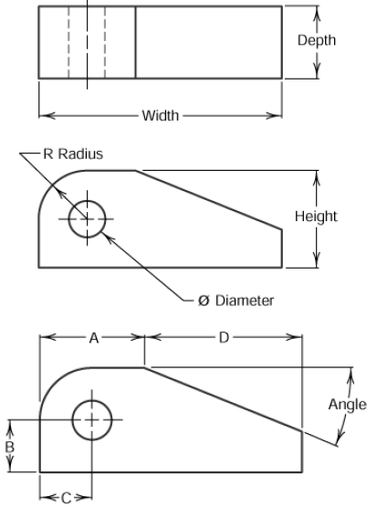
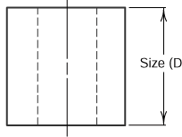
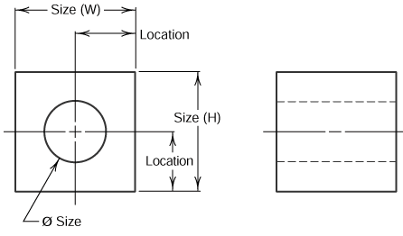
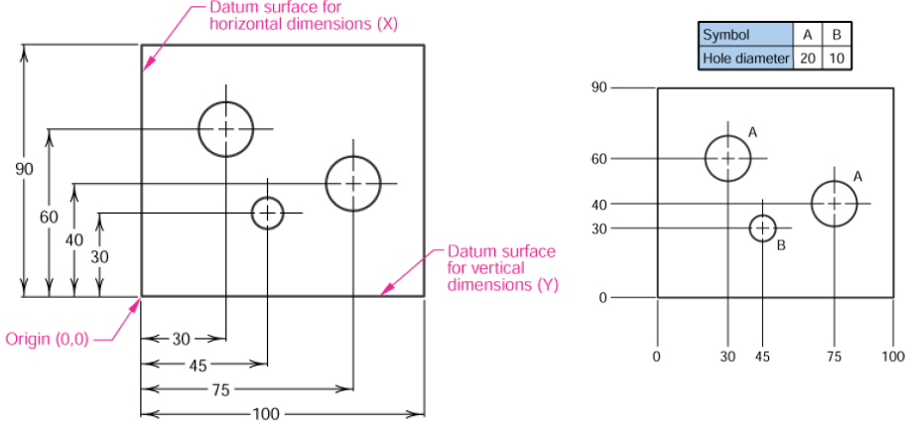
Rectangular coordinate dimensioning, a base line (or datum line) is established for each coordinate direction, and all dimensions specified with respect to these baselines.
This is also known as datum dimensioning, or baseline dimensioning.
All dimensions are calculated as X and Y distances from an origin point, usually placed at the lower left corner of the part. See Fig

Slide 18
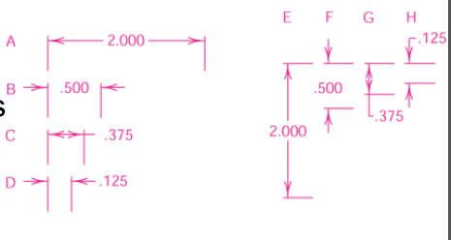
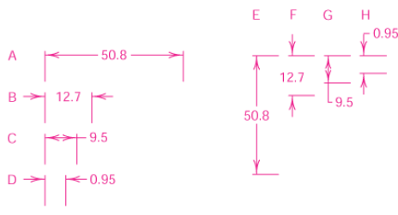
Standard Practices
Placement
Dimension placement depends on the space available between extension lines.
When space permits, dimensions and arrows are placed between the extension lines.
Decimal Dimensioning
Millimeter Dimensioning

Slide 19
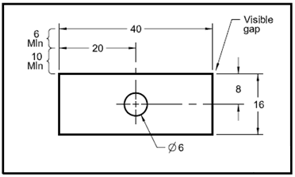
Spacing
Dimension lines are drawn parallel to the direction of measurement.
The space between the first dimension line and the part outline should be not less than 10 mm (3/8 inch); the space between succeeding parallel dimension lines should be not less than 6 mm (1/4 inch). See Fig.
There should be a visible gap between an extension line and the feature to which it refers.
Extension lines should extend about 1mm (1/32 inch) beyond the last dimension line.

Slide 20
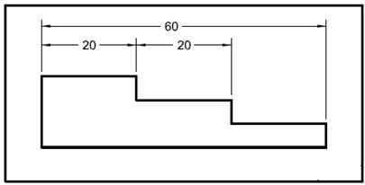
Grouping
Dimensions should be grouped for uniform appearance as shown

Slide 21
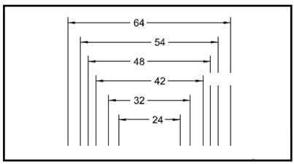
Staggering
Where there are several parallel dimension lines, the numerals should be staggered for easier reading. See Fig.

Slide 22
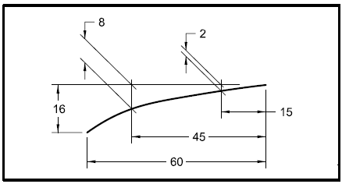
Extension lines
Extension lines are used to indicate the extension of a surface or point to a location preferably outside the part outline.
On 2D orthographic drawings, extension lines start with a short visible gap from the outline of the part and extend beyond the outermost related dimension line. See Fig.
Extension lines are drawn perpendicular to dimension lines.
Where space is limited, extension lines may be drawn at an oblique angle to clearly illustrate where they apply.
Where oblique lines are used, the dimension lines are shown in the direction in which they apply. See Fig.

Slide 23
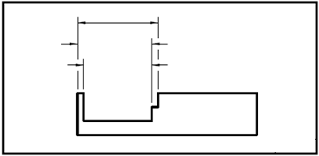
Crossing Extension Lines
Wherever practicable, extension lines should neither cross one another nor cross dimension lines.
To minimize such crossings, the shortest dimension line is shown nearest the outline of the object.
Where extension lines must cross other extension lines, dimension lines, or lines depicting features, they are not broken.
Where extension lines cross arrowheads or dimension lines close to arrowheads, a break in the extension line is permissible. See Fig.

Slide 24
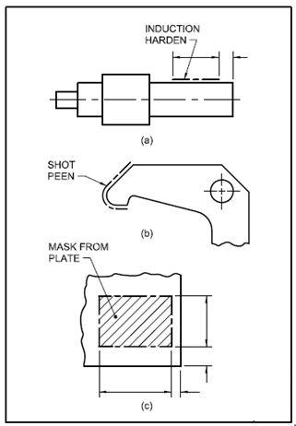
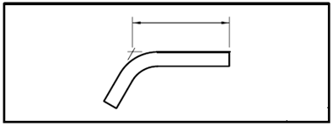
Locating Points or Intersections.
Where a point is located by extension lines only, the extension lines from surfaces should pass through the point or intersection. See Fig
Limited length or areas
Where it is desired to indicate that a limited length or area of a surface is to receive additional treatment or consideration within limits specified on the drawing, the extent of these limits may be indicated by use of a chain line

Slide 25
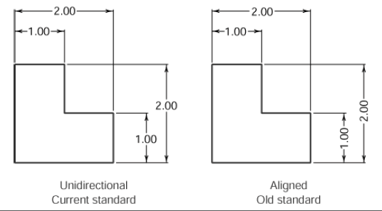
Reading Direction
All dimension and note text must be oriented to be read from the bottom of the drawing (relative to the drawing format).
Placement of all text to be read from the bottom of the drawing is called unidirectional dimensioning.
Aligned dimensions have text placed parallel to the dimension line with vertical dimensions read from the right of the drawing sheet

Slide 26
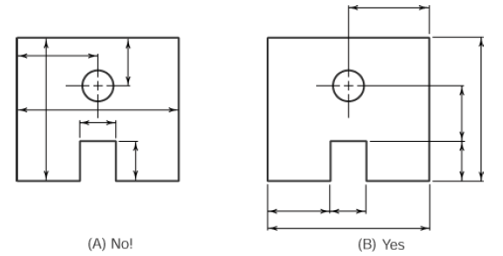
View Dimensioning
Dimensions are to be kept outside of the boundaries of views of objects wherever practical.
Dimensions may be place within the boundaries of objects in cases where extension or leader lines would be too long, or where clarity would be improved.

Slide 27
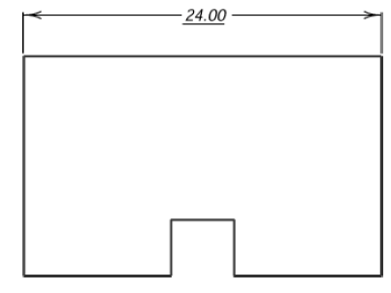
Out-of-Scale Dimensions
If it is necessary to include a dimension which is out of scale, the out of scale dimension text must be underlined

Slide 28
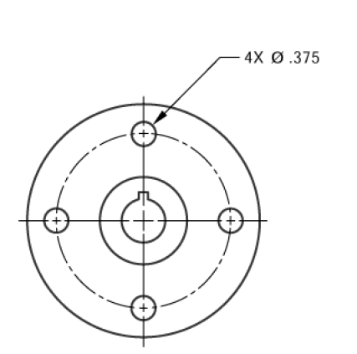
Repetitive Features
The symbol X is used to indicate the number of times a feature is to be repeated. The number of repetitions, followed by the symbol X and a space precedes the dimension text.

Slide 29
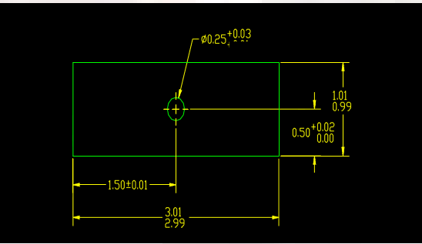
TOLERANCING
This Section establishes practices for expressing tolerances on linear and angular dimensions, applicability of material condition modifiers on geometric tolerance values, and interpretations governing limits and tolerances.
Tolerance is the total amount a dimension may vary and is the difference between the upper (maximum) and lower (minimum) limits.
Tolerances are used to control the amount of variation inherent in all manufactured parts.
In particular, tolerances are assigned to mating parts in an assembly.

Slide 30
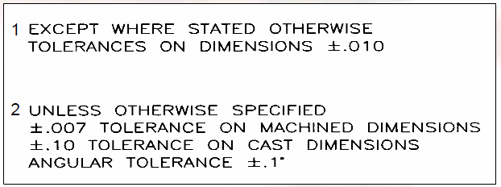
Tolerances Cont.
One of the great advantages of using tolerances is that it allows for interchangeable parts, thus permitting the replacement of individual parts.
Tolerances are used in production drawings to control the manufacturing process more accurately and control the variation between parts
These are specified when all dimension in the drawings have the same tolerance.
These notes are used to reduce the number of dimensions required on a drawing and to promote drawing clarity.

Slide 31
Tolerance Applications
Tolerances may be expressed as follows:
as direct limits or as tolerance values applied directly to a dimension.
as a geometric tolerance.
in a note or table referring to specific dimensions.
as specified in other documents referenced on the drawing for specific features or processes.
in a general tolerance block referring to all dimensions on a drawing for which tolerances are not otherwise specified.

Slide 32
Tolerance Terminology
Limits the maximum and minimum sizes shown by the toleranced dimension.
Allowance is the minimum clearance or maximum interference between parts.
Tolerance is the total variance in a dimension which is the difference between the upper and lower limits. The tolerance of the slot in the Figure below is .004" and the tolerance of the mating part is .002".
Maximum material condition (MMC)is the condition of a part when it contains the most amount of material. The MMC of an external feature such as a shaft is the upper limit. The MMC of an internal feature such as a hole is the lower limit.
Least material condition (LMC) is the condition of a part when it contains the least amount of material possible. The LMC of an external feature is the lower limit of the part. The LMC of an internal feature is the upper limit of the part.

Slide 33
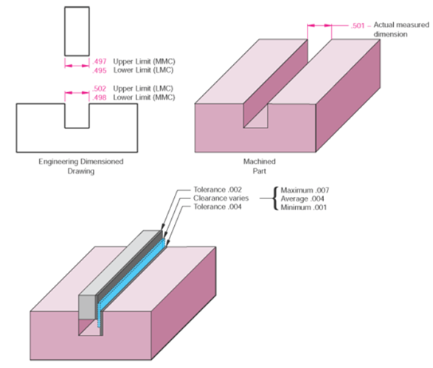

Slide 34
Direct Tolerancing Methods
Limits and directly applied tolerance values are specified as follows. (12.75/12.25 )
Limit Dimensioning. The high limit (maximum value) is placed above the low limit (minimum value). When expressed in a single line, the low limit precedes the high limit and a dash separates the two values. See Fig.
Plus and Minus Tolerancing. The dimension is given first and is followed by a plus and minus expression of tolerance. See Fig.
Unilateral Tolerances - (12.00 + or - xxx)
Bilateral Tolerances - (12.00 +xxx/- xxx)
Geometric Tolerances Directly Applied to Features.

Slide 35
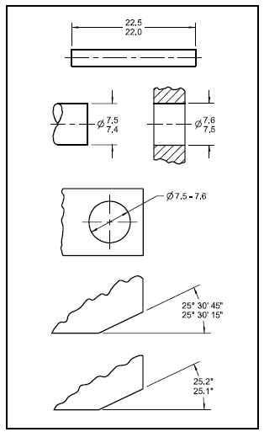
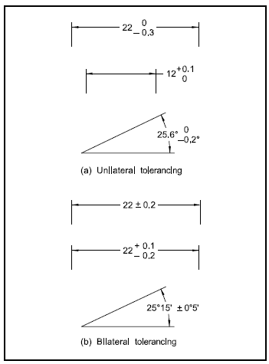
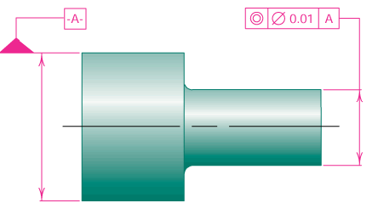
Geometric Tolerancing
Limit Dimensioning
Plus and Minus Tolerancing

Slide 36
Allowance and Clearance
ALLOWANCE
Allowance is defined as an intentional difference between the maximum material limits of mating parts.
Allowance is the minimum clearance (positive allowance), or maximum interference (negative allowance) between mating parts.
The calculation formula for allowance is:
ALLOWANCE = MMC HOLE – MMC SHAFT
CLEARANCE
Clearance is defined as the loosest fit or maximum intended difference between mating parts.
The calculation formula for clearance is:
CLEARANCE = LMC HOLE – LMC SHAFT

Slide 37
Fit
Types of Fit
Clearance fit
The parts are toleranced such that the largest shaft is smaller than the smallest hole
The allowance is positive and greater than zero
Interference fit
The max. clearance is always negative
The parts must always be forced together
Transition fit
The parts are toleranced such that the allowance is negative and the max. clearance is positive
The parts may be loose or forced together

Slide 38
Basic Fits Of Mating Parts
Standard ANSI Fits:
Running and Sliding fits (RC) are intended to provide a running performance with suitable lubrication allowance.
The range is from RC1 to RC9.
Force fits (FN) or Shrink fits constitute a special type of interference fit characterized by maintenance of constant pressure.
The range is from FN1 to FN5.
A force fit is referred to as interference fit or a shrink fit.
The smallest amount of interference is:
MIN INTERFERENCE = LMC SHAFT - LMC HOLE
The greatest amount of interference is:
MAX INTERFERENCE = MMC SHAFT - MMC HOLE
Locational fits are intended to determine only the location of the mating parts.

Slide 39
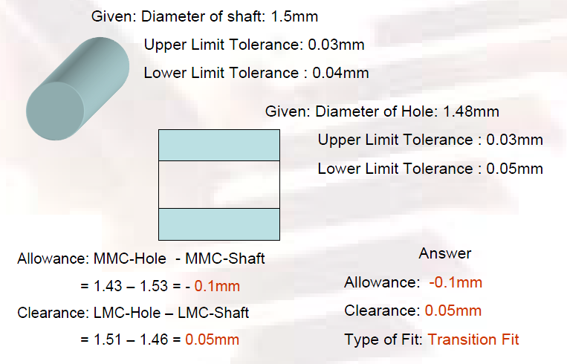

Slide 40
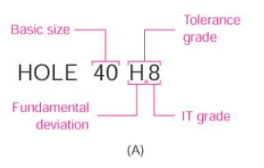
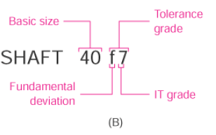
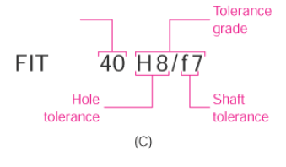
Symbols and Definitions
The symbols are specifying geometric characteristics and other dimensional requirements on engineering drawings.
Symbols shall be of sufficient clarity to meet the legibility and reproducibility requirements of ASME Y14.2M.
Symbols shall be used only as described herein
Example:

Slide 41
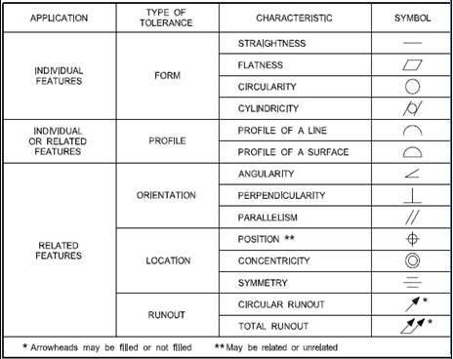
GEOMETRIC DIMENSIONING AND TOLERANCING (GD&T)
Another reason for the increased popularity of GDT is the rise of worldwide standards, such as ISO 9000, which require universally understood and accepted methods of documentation.

Slide 42
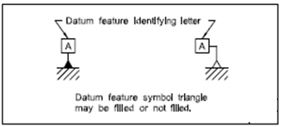
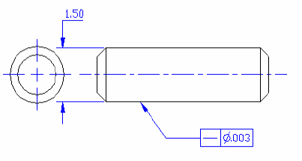
Datum Feature Symbol
Tolerance of Form
Straightness
Straightness Tolerance Zone
Straightness Tolerance

Slide 43
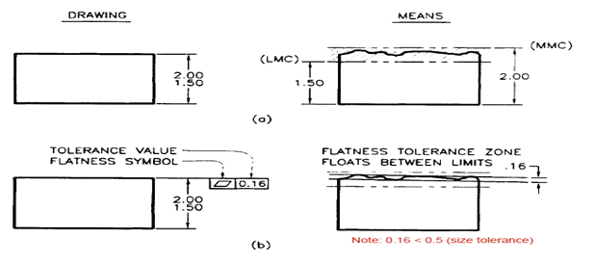
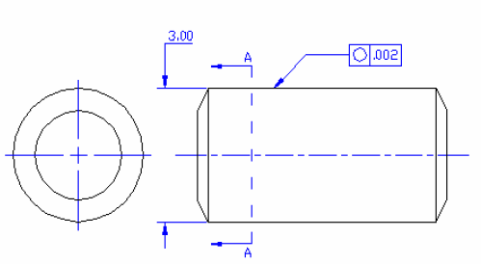
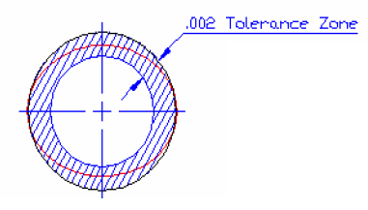
Flatness
Circularity
Circularity Tolerance Zone
Circularity Tolerance

Slide 44
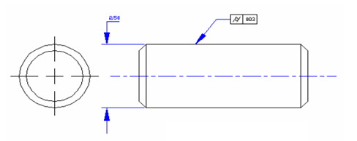
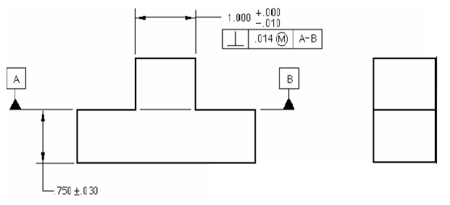
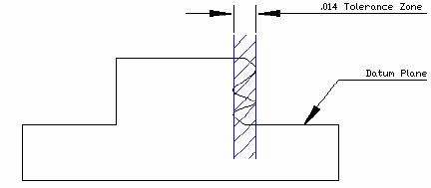
Cylindricity
Cylindricity Tolerance Zone
Cylindricity Tolerance
Tolerance of Orientation
Perpendicularity
Perpendicularity Tolerance Zone
Perpendicularity Tolerance Zone

Slide 45
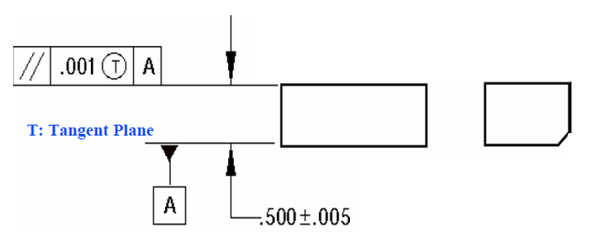
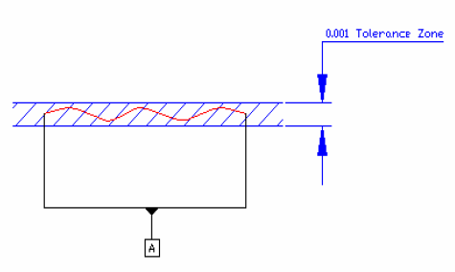
Parallelism
Parallelism Tolerance Zone
Parallelism Tolerance Zone

Slide 46
GEOMETRY DIMESIONING AND TOLERANCE FOR CADD
Some dimensioning and tolerance guidelines for use in conjunction with CADD/CAM:
Geometry tolerancing is necessary to control specific geometric form and location.
Major features of the part should be used to establish the basic coordinate system, but are not necessary defined as datum.
Subcoordinated systems that are related to the major coordinates are used to locate and orient features on a part.
Define part features in relation to three mutually perpendicular reference plans, and along features that are parallel to the motion of CAM equipment.
Establish datum related to the function of the part, and relate datum features in order of precedence as a basis for CAM usage.
Completely and accurately dimension geometric shapes. Regular geometric shapes may be defined by mathematical formulas. A profile feature that is defined with mathematical formulas should not have coordinate dimensions unless required for inspection or reference.
Coordinate or tabular dimensions should be used to identify approximate dimensions on an arbitrary profile.
Use the same type of coordinate dimensioning system on the entire drawing.
Continuity of profile is necessary for CADD. Clearly define contour changes at the change or point of tangency. Define at least four points along an irregular profile.
Circular hole patterns may be defined with polar coordinate dimensioning.
When possible, dimension angles in degrees and decimal parts of degrees.
Base dimensions at the mean of a tolerance because the computer numerical control (CNC) programmer normally splits a tolerance and works to the mean. While this is theoretically desirable, one can not predict where the part will be made. Dimensions should always be based on design requirements.
If it is known that a part will be produced always by CNC methods, then establish dimensions without limits that conform to CNC machine capabilities. Bilateral profile tolerances are also recommended for the same reason.

Slide 47
Summary
GD&T is a symbolic language used to specify the size, shape, form, orientation, and location of features on a part.
GD&T was created to insure the proper assembly of mating parts, to improve quality, and to reduce cost.
GD&T is a design tool.
GD&T communicates design intent.

