Slide 1
MECH 3550 : Simulation & Visualization
Building valid, credible and appropriately detailed simulation models
Notes:
See ME3550Ch2PDF

Slide 2
Key Words and Definitions
Valid: If a simulation model is “valid”, then it can be used to make decisions about the system similar to those that would be made if it were feasible and cost-effective to experiment with the system itself.
Verification: The determination of whether or not the “assumptions document” has been correctly translated into a computer “program” i.e. “debugging”
Accreditation: The official certification (by the project sponsor) that a simulation model is acceptable for a specific purpose.

Slide 3
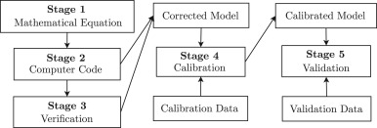
Verification and Validation Process

Slide 4
Level of Detail in Model
Do not have more detail in the model than is necessary to address the issues of interest, making sure the model is credible
Keep the level of detail consistent with the type of data available. The level of detail necessary for a new system will be less than that of what is used to fine-tune an existing system because of the amount of data available.
In almost all simulation studies, the amount of time and money constraints are a big factor in determining the amount of detail.
If the amount of factors is large, then use a “course” simulation model or an analytical model to identify the significant factors.

Slide 5
Verification Techniques
Technique 1: Write and debug the program in sub-programs
Technique 2: Conduct a structured walk-through of the program/subprogram
Technique 3: Run the program using a variety of inputs and decide if the outputs are what were expected.
Technique 4: Write an interactive trace into your program.
Technique 5: Run the model, when possible, under simplifying assumptions for which its true values are known or can be calculated.
Technique 6: In some models it may be helpful to create an animation
Technique 7: Compute the sample mean and variance for each simulation input probability distribution. Compare them with desired values.
Technique 8: Use a commercial simulation package to reduce the amount of programming required.

Slide 6
Validation and Credibility Techniques
Collect High-Quality Information and Data on the System
Interact with the Manager on a regular basis
Maintain a Written Assumptions Document and perform a Structured Walk-Through.
Validate components of the model by using other verification techniques.
Validate the output from the Overall Simulation Model.
Animation

Slide 7
Collecting High-Quality Info and Data on System
Conversations with the Subject-Matter Experts
Observations of the System
Existing Theory
Relevant Results from Similar Simulation Studies
Experience and Intuition of the Modelers

Slide 8
Benefits of Interacting with the Manager Throughout Process
When a simulation study is initiated, the problem being solved becomes clearer
The Manager’s interest and involvement in the study are maintained
The Manager’s knowledge of the system contributes to the validity of the model
The model is more credible since the Manager understands and accepts the model’s assumptions

Slide 9
A Written Assumptions Document Should Include The Following
An overview section that discusses overall project goals, the specific issues to be addressed by the simulation study, model inputs, and the performance measures for evaluation.
A process-flow or system-layout diagram, if appropriate.
Detailed descriptions of each subsystem in bullet format and how these sub-systems interact
What simplifying assumptions were made and why.
Limitations of the simulation model
Summaries of a data set (sample mean, histogram)
Sources of important or controversial information.

Slide 10
Components of the Model that may need Validation
The value of a parameter
The choice of a distribution
The entity moving through the simulated system
The level of detail for a subsystem
What data are the most crucial to collect

Slide 11
How to Validate the Output
Comparison with an Existing System Using
01
Tables with sample mean and variance
Spider-web plot
Dot plot
Comparison with Expert Opinions Using Similar plots
02
Comparison with another type of Model for the same system and for a similar purpose.
03

Slide 12
Management’s Role
Formulating
Formulating problem objectives
Directing
Directing personnel to provide information and data to the simulation modeler and to attend the structured walk-through
Interacting
Interacting with the simulation modeler on a regular basis
Using
Using the simulation results as an aid in the decision-making process

Slide 13
Statistical Procedures for Comparing Real-World Observations and Simulation Output Data
Inspection approach
Confidence-Interval Approach Based on Independent Data
Time-Series Approaches

Slide 14
Inspection Approach
Historical system input data
Actual system
System output
data
Historical system input data
Simulation model
Model output
data
Compare

Slide 15
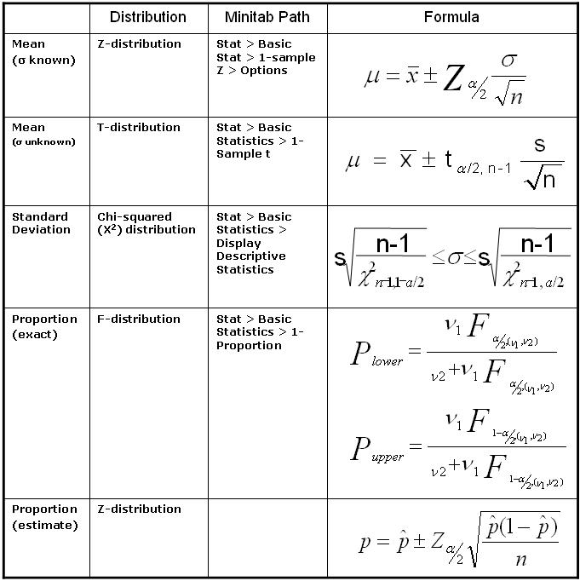
Confidence-Interval Approach

Slide 16
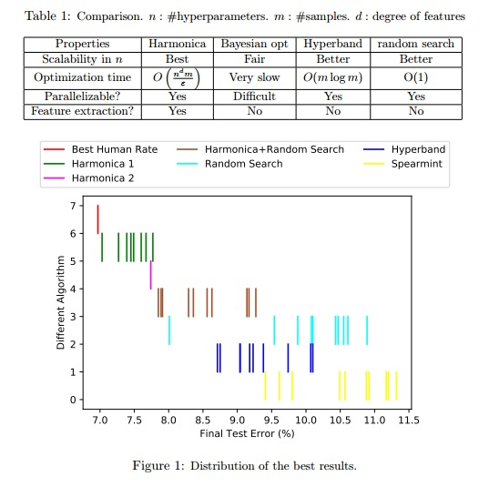
Time-Series Approaches
Linear Regression
Non-linear Regression
Genetic Algorithms
Ex: Spectral Analysis

Slide 17
Simulink Model Example
https://www.mathworks.com/help/physmod/simscape/examples/house-heating-system.html

