Slide 1
(Hands-On) Introduction to SolidWorks Costing 2014
Blake Reeves
SolidWorks Product Definition
Craig Therrien
SolidWorks Product Management

Slide 2
Who are you?
What is your primary job/role?
Manufacturing Engineer / CAM / Estimator
Product / Tooling Designer
Manager / CAD Admin
What best describes your company?
Manufacture only
Design in-house, Manufacture outside
Design & Manufacture in-house

Slide 3
Objectives
Introduction to Costing and the new features added in 2014
Learn the fundamentals of the Costing interface
Sheet Metal
Machining
Template Tips & Tricks
2014 New features:
Advanced Machining
Costing Options Dialog
Simple Volumetric Costing
Notes:
Sheet metal: Costing Options – Cost as machined plate
Machining: Turning Volume features
Template: Filters & Export/Update
Advanced machining: multi-body enhancements (castings)
Options Dialog & Simple Cost/Comparative

Slide 4
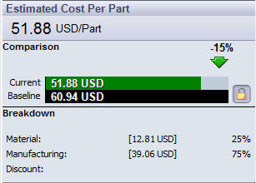
What is SolidWorks Costing?
Automatic manufacturing cost estimates
Sheet Metal and Machined Part Costing
Costs update with every part change
Customizable manufacturing templates
Works with any 3D CAD model
Included in SolidWorks Professional and Premium

Slide 5
Reasons to Use SolidWorks Costing
Designers want to…
Make better design decisions based on cost
Get cost estimates faster
Understand what design changes will help reduce costs during the design phase
Manufacturers want…
Fast, repeatable, accurate quotes
Quoting based on their specific manufacturing processes and labor and material costs
Managers & Executives want to…
Consistently hit product cost targets
Maintain healthy and predictable profit margins
Eliminate the need to re-design products in order to reduce cost
Improve communication between manufacturing and design to reduce product costs earlier

Slide 6
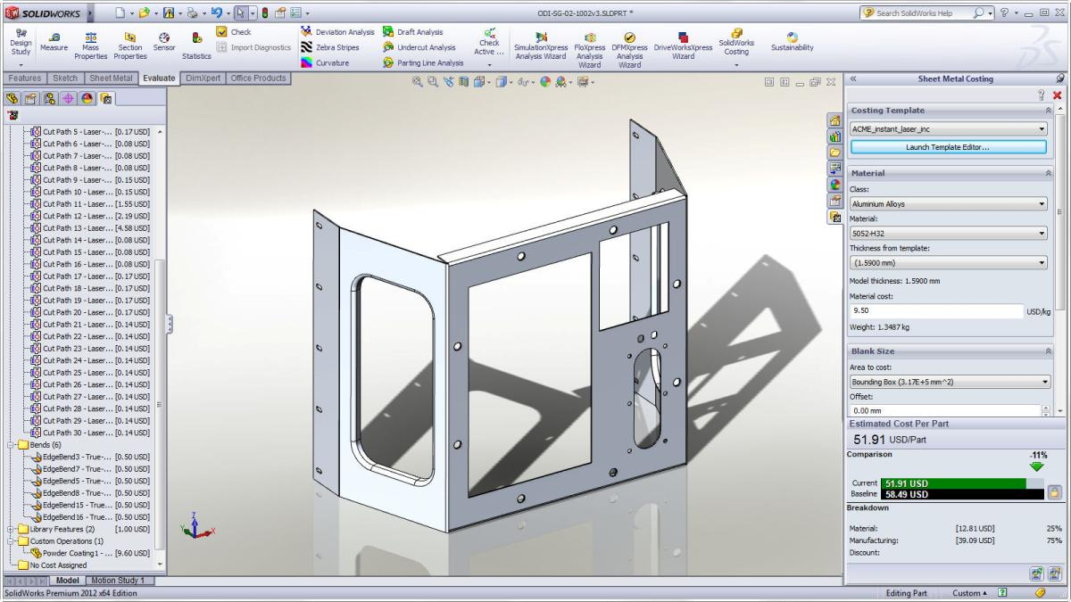
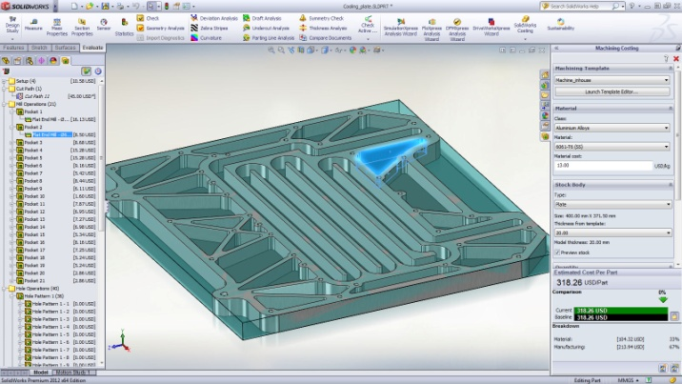
What can SolidWorks Costing do?
Sheet Metal
Laser Cutting
Bends/Hems
Forming Tools
Machining
Milling
Drilling
Turning
Multi-Body
Sheet Metal
Machining
Mixed

Slide 7
How Does SolidWorks Costing Work?
MFG Cost Templates
+
MFG Process Recognition (MPR)
+
Cost Estimation Equations
=
SOLIDWORKS
COSTING

Slide 8
Quick Demo
Make sure to have open
SWW2014_PPT_Costing_Guide.pptx
And align to one side of your screen

Slide 9
Summary
Costing can be used by designers, manufacturers, or basic customers to estimate the cost of a wide variety of prismatic machining operations, sheet metal fabrication operations, and multi-body parts consisting of both
Customizing templates is the primary way for you to get the most accurate estimates based off of your own processes
In the templates, use filters to make filling out data faster, and use the Export/Update feature to make keeping material costs up-to-date easier
User Custom Operations for things like inspection, deburring, painting and other similar post-processing operations
If you just want a quick simple estimate, use volume features to give you a more general cost-per-volume estimate with minimal usage of the templates

