Slide 1
MECH 3550 : Simulation & Visualization
Output Data Analysis
Notes:
See ME3550Ch2PDF

Slide 2
Need for Output Data Analysis
In many “simulation studies” a great amount of time and money is spent on model development and “programming”
Not enough effort is put into analyzing the output data appropriately in order to verify the model is accurate enough.
Without this form of verification, there is a significant probability of making inaccurate assumptions that the system is correct.

Slide 3
Introduction
Each simulation run is a sample point
Attempts to increase the sample size by increasing run length may fail because of autocorrelation
Initial conditions affect the output

Slide 4
Level of Detail in Model
-Model Input Variables are Random Variables
-The Model Transforms Input into Output
-Output Data are Random Variables
-Replications of a model run can be obtained by repeating the run using different random number streams

Slide 5
Measures of Performance
Means
Proportions
Quantiles

Slide 6
Point Estimation (Discrete Time Data)

Slide 7
Point Estimation (Continuous Time Data)

Slide 8
Interval Estimation(Discrete-time Data)

Slide 9
Interval Estimation (cont’d)

Slide 10
Interval Estimation cont’d

Slide 11
Interval Estimation cont’d

Slide 12
Interval Estimation cont’d

Slide 13
Interval Estimation cont’d

Slide 14
Types of Simulations
Terminating (Transient) Simulations
Runs until a terminating event takes place
Uses well specified initial conditions
Non-terminating (Steady-state) Simulations
Runs continually or over a very long time
Results must be independent of initial data
Termination?

Slide 15
Terminating Systems
There is a “natural” event E that specifies the length of each run (replication).
The event E often occurs at a time point that has one of the following properties:
The system is “cleaned out”
Beyond which no useful information is obtained
Specified by management

Slide 16
Terminating Simulation Examples
A retail/commercial establishment (e.g. a bank) closes each evening. If the establishment is open from 9 A.M. to 5 P.M, the objective of a simulation might be to estimate some measure of the quality of customer service over the period beginning at 9A.M. and ending when the last customer who entered before the doors closed at 5 P.M.
In this case, E = 8 hours of simulated time
Initial Conditions for the simulation should be representative of those for the bank at 9 A.M.

Slide 17
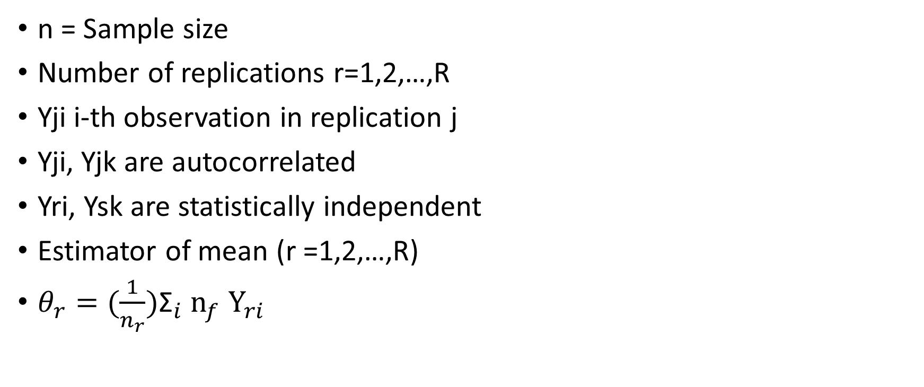
Method of Independent Replications
n = Sample size
Number of replications r=1,2,…,R
Yji i-th observation in replication j
Yji, Yjk are autocorrelated
Yri, Ysk are statistically independent
Estimator of mean (r =1,2,…,R)
$θ_{r}=(\frac{1}{n_{r}}){\text{Σ}}_{i}$ ${\text{n}}_{f}$ ${\text{Y}}_{ri}$

Slide 18
Methods of Independent Replications Cont.

Slide 19
Estimator and Interval

Slide 20
Confidence Intervals w/Specified Precision

Slide 21
Replication Method

Slide 22
Replication Method cont’d

Slide 23
Replication Method Cont’d

Slide 24
Using Batches

Slide 25
Batch Size Selection Guidelines

Slide 26
HW
Lab is to create a Data Output Analysis Graph that has 5 input values output results, an average output value, and a Standard Deviation.
https://www.mathworks.com/company/newsletters/articles/visualizing-simulation-data-with-simulink.html?ovp_custom1_%24%7Bovpid%7D-%24%7Bcmsid%7D_rr

