Slide 1
Control Systems
Prof Swanson MECH 3550

Slide 2
Control System Definition
A control system manages, commands, directs, or regulates the behavior of other devices or systems using control loops. It can range from a single home heating controller using a thermostat controlling a domestic boiler to large Industrial control systems which are used for controlling processes or machines.
For continuously modulated control, a feedback controller is used to automatically control a process or operation. The control system compares the value or status of the process variable (PV) being controlled with the desired value or setpoint (SP), and applies the difference as a control signal to bring the process variable output of the plant to the same value as the setpoint.
For sequential and combinational logic, software logic, such as in a programmable logic controller, is used.

Slide 3
Basic Feedback Terminology
Transfer Function: A function which changes the output given a specified input
PID Controller (Proportional-Integral-Derivative Controller): Calculates an error value e(t) as the difference between a desired value and the actual value.
Control Damping: A way of achieving the desired values through feedback control
Notes:
Assignment is to create a basic control system and plot the results

Slide 4
Basic Feedback Loop
Input A
Control System
A+B
Feedback
Output B

Slide 5
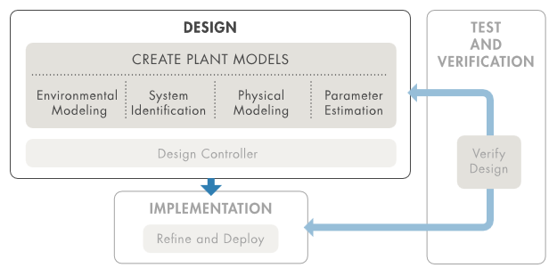
Creating Plant Models

Slide 6
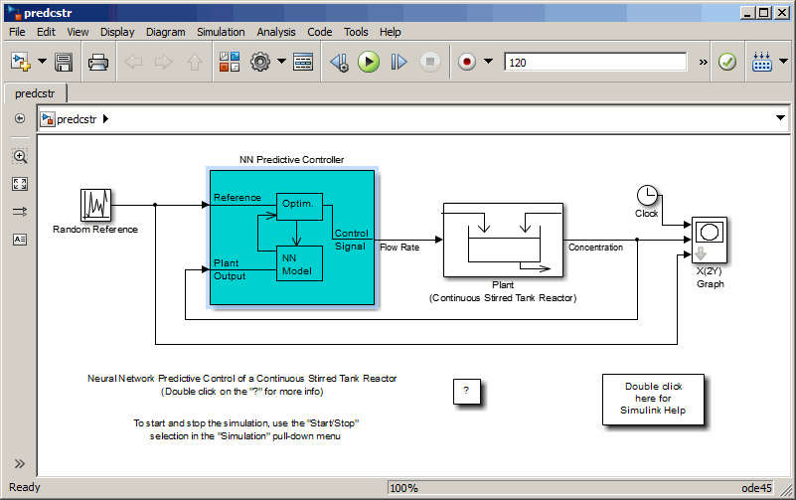
Creating Plant Models on Simulink

Slide 7
Assessing the Feedback Loop
SISO = Single Input Single Output

Slide 8
Creating a Control System Using Simulink
Decide what kind of system you want to create.
Inspect the block menu. (Help Menu>Simulink>Blocks)
Find the Blocks you want to use based on what kind of system you want to create.
Drag the blocks into the workspace.

